Slide 1
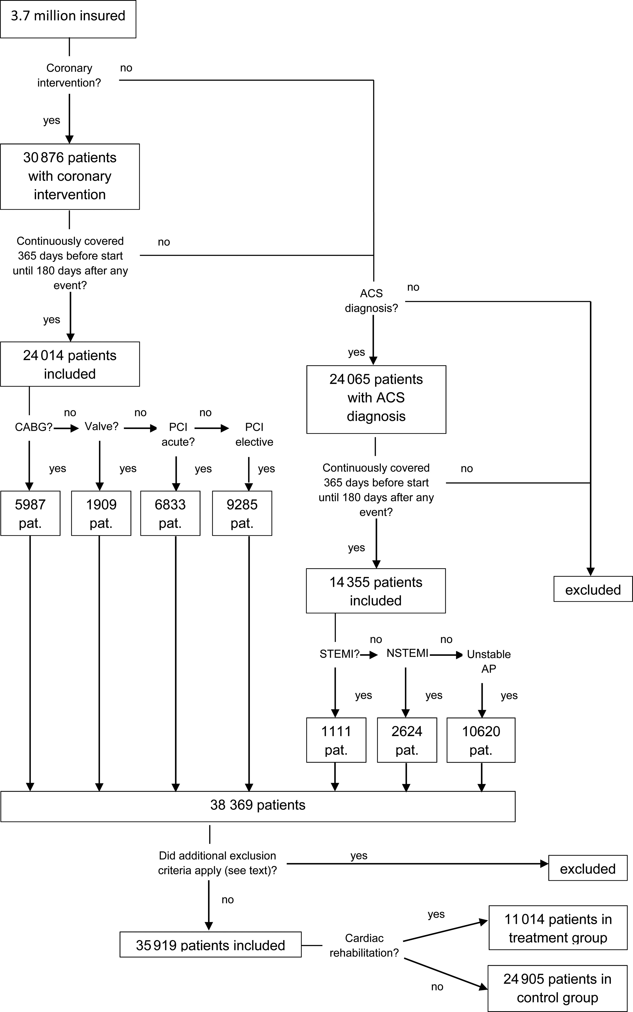
Figure 1 Flow of participants through study.
Notes:
Figure 1 Flow of participants through study.
Unless provided in the caption above, the following copyright applies to the content of this slide: Published on behalf of the European Society of Cardiology. All rights reserved. © The Author 2015. For permissions please email: journals.permissions@oup.com.

Slide 2
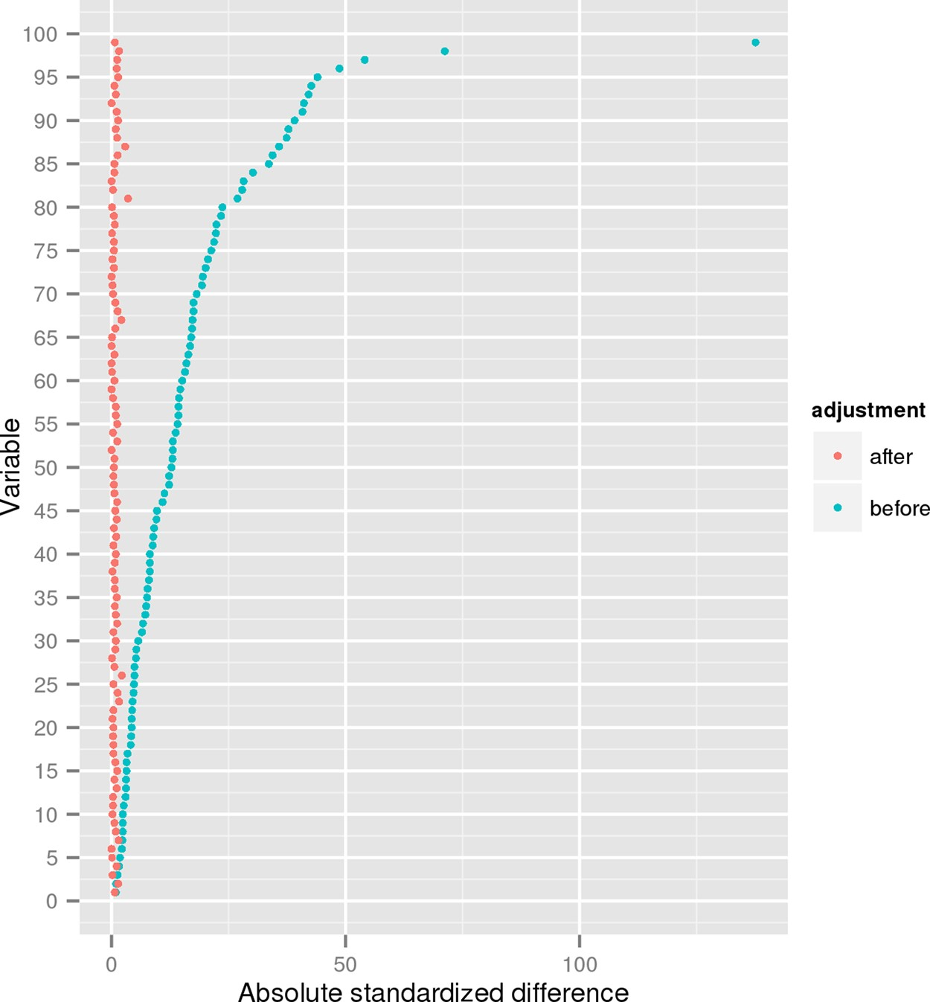
Figure 2 Absolute standardized differences (%) for all 99 variables, before and after propensity score weighting.
Notes:
Figure 2 Absolute standardized differences (%) for all 99 variables, before and after propensity score weighting.
Unless provided in the caption above, the following copyright applies to the content of this slide: Published on behalf of the European Society of Cardiology. All rights reserved. © The Author 2015. For permissions please email: journals.permissions@oup.com.

Slide 3
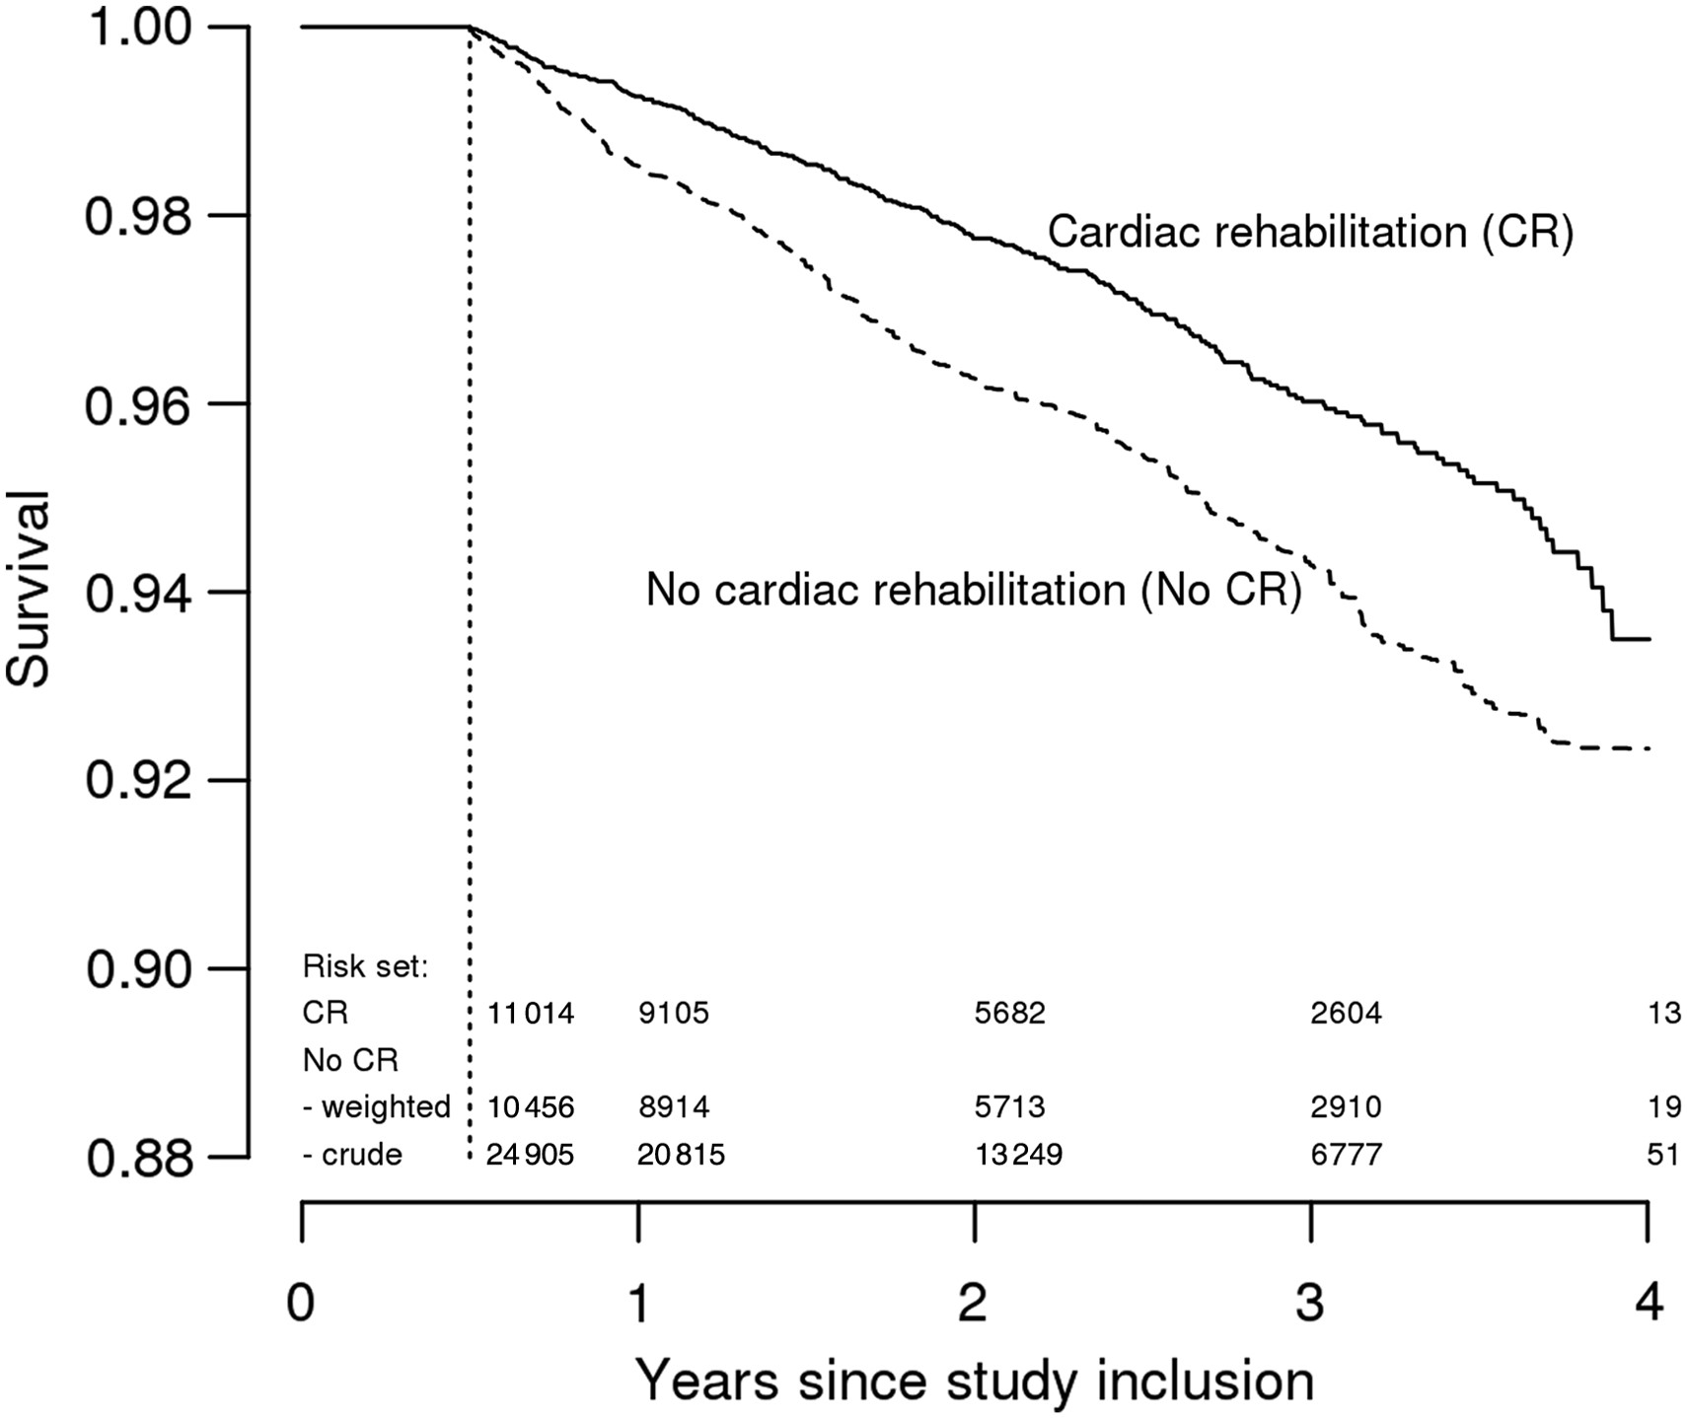
Figure 3 Kaplan–Meier survival curves for patients receiving CR (solid line) and patients not receiving CR (dotted ...
Notes:
Figure 3 Kaplan–Meier survival curves for patients receiving CR (solid line) and patients not receiving CR (dotted line), after propensity score weighting to adjust for age, gender, clinical cardiac diagnosis, and intervention, prescribed medication, co-morbidities, total healthcare expenditure, and other confounding factors derived from the data.
Unless provided in the caption above, the following copyright applies to the content of this slide: Published on behalf of the European Society of Cardiology. All rights reserved. © The Author 2015. For permissions please email: journals.permissions@oup.com.

