Slide 1
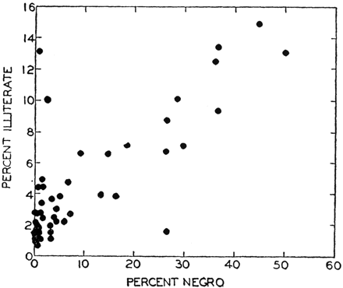
Figure 2.
Notes:
Figure 2.
Unless provided in the caption above, the following copyright applies to the content of this slide: Published by Oxford University Press on behalf of the International Epidemiological Association © The Author 2009; all rights reserved.

Slide 2
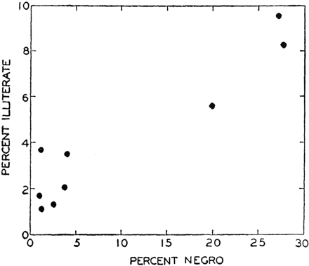
Figure 1.
Notes:
Figure 1.
Unless provided in the caption above, the following copyright applies to the content of this slide: Published by Oxford University Press on behalf of the International Epidemiological Association © The Author 2009; all rights reserved.

Slide 3
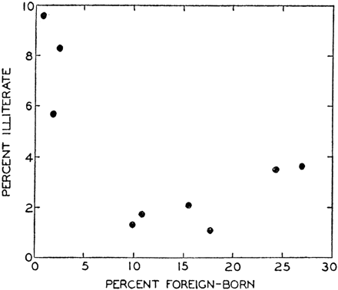
Figure 3.
Notes:
Figure 3.
Unless provided in the caption above, the following copyright applies to the content of this slide: Published by Oxford University Press on behalf of the International Epidemiological Association © The Author 2009; all rights reserved.

