Slide 1
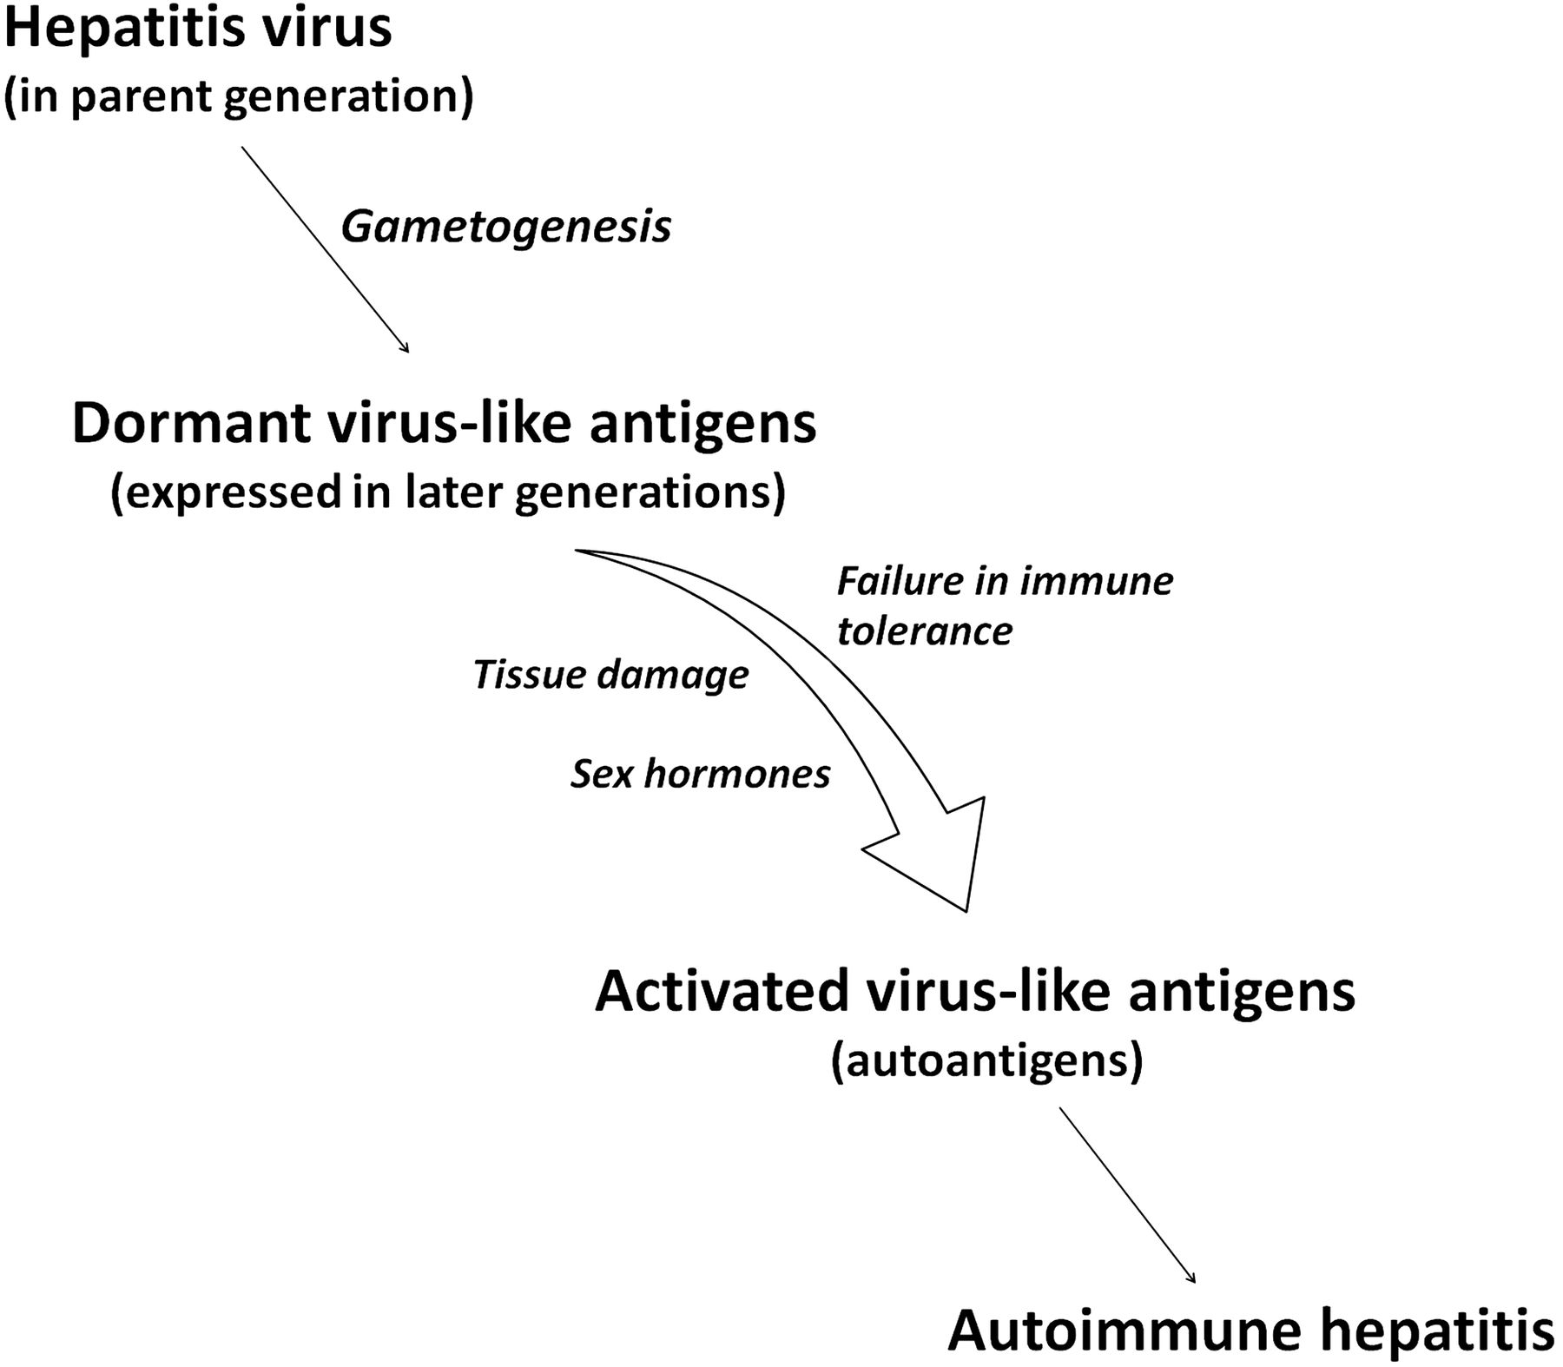
Figure 1. A schema showing the proposed linkage between ancestral viral hepatitis and autoimmune hepatitis.
Notes:
Figure 1. A schema showing the proposed linkage between ancestral viral hepatitis and autoimmune hepatitis.
Unless provided in the caption above, the following copyright applies to the content of this slide: © 2012 American Institute of Biological Sciences

