Slide 1
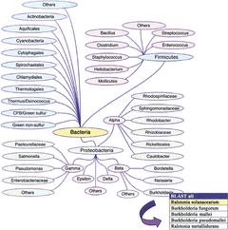
1 Genomic BLAST with graphic tree of Eubacteria taxonomy groups. This graphic tool is available at the NCBI ...
Notes:
1 Genomic BLAST with graphic tree of Eubacteria taxonomy groups. This graphic tool is available at the NCBI site (http://www.ncbi.nlm.nih.gov/cgi-bin/Entrez/genom_tree_cgi). Virtual databases are created by combining organism-specific databases of a desired lineage, for which nucleotide and/or protein data are available. Clicking over phylum/order brings a pop-up box which reveals all the organisms within this lineage group. Complete or unfinished genomes are color-coded. The selection ‘BLAST all’ will include the virtual database of all organisms within this lineage. The upper panel contains the BLAST variables.
Unless provided in the caption above, the following copyright applies to the content of this slide: © 2002 Federation of European Microbiological Societies

Slide 2
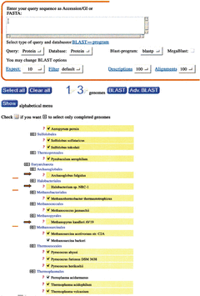
2 Genomic BLAST with alphabetical list of Archaea. This graphic tool is available at the NCBI site ...
Notes:
2 Genomic BLAST with alphabetical list of Archaea. This graphic tool is available at the NCBI site (http://www.ncbi.nlm.nih.gov/cgi-bin/Entrez/genom_table_cgi). Virtual databases are created by combining a variety of organism-specific databases. A more advanced selection system is available by using the ‘plus’ and ‘minus’ signs to perform inclusion/exclusion operations. The ‘+’ Archaea sign has been selected (blue arrow) and three order lineages have been further ‘deselected’ by clicking on the ‘−’ sign (red arrows). A virtual protein database has been constructed and is composed of 13 organism-specific databases (number displayed on the top panel). The bottom ‘show’ brings a pop-up box, which contains an alphabetical list of all organisms. The selected organisms are displayed in red font.
Unless provided in the caption above, the following copyright applies to the content of this slide: © 2002 Federation of European Microbiological Societies

Slide 3
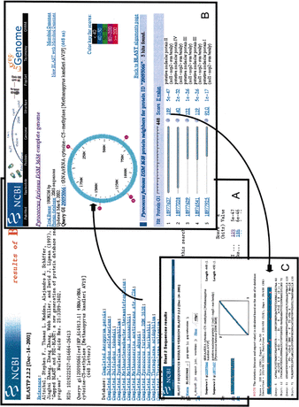
3 BLAST output using Genomic BLAST. The upper left panel displays the list of complete genomes for which ...
Notes:
3 BLAST output using Genomic BLAST. The upper left panel displays the list of complete genomes for which significant matches have been found. Clicking over an individual genome opens a window which contains the graphical representation of the genome, with the location of the best hits in colorful numbered circles. Selected and ordered top hits are found listed below the chromosome. Clicking over the score opens a window that shows the query/match alignment. Clicking over the protein GI will bring the corresponding GenBank record.
Unless provided in the caption above, the following copyright applies to the content of this slide: © 2002 Federation of European Microbiological Societies

