Slide 1
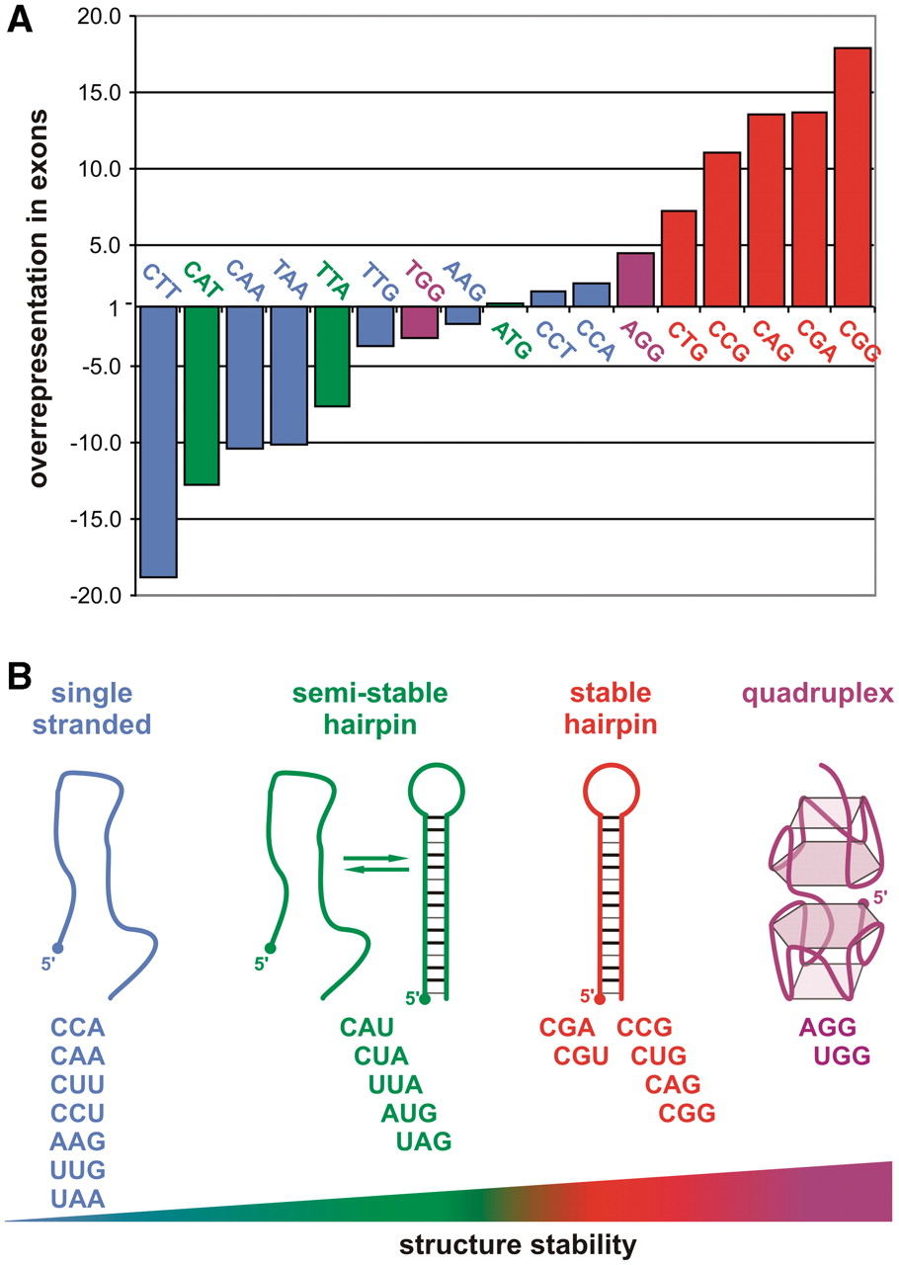
Figure 1. The occurrence of various triplet repeats in the human transcriptome and their RNA structures. (A) ...
Notes:
Figure 1. The occurrence of various triplet repeats in the human transcriptome and their RNA structures. (A) Representation of TNRs composed of at least six repeat units in RefSeq mRNA sequences compared with the whole human genome sequence (17 out of 20 triplets are shown due to lack of CGT, CTA, TAG repeats in exons). Bar colors correspond to the four classes of RNA structure as shown in (B); (B) 20 different triplet repeat RNAs belong to four structural classes. On the diagram, they are ordered from left to right according to the increasing thermodynamic stability of their secondary structure: seven TNRs are single stranded even at low temperature (4°C), five AU-rich repeats form semi-stable hairpins in physiological conditions, the next six GC-rich TNRs form stable hairpin structures and two TNRs form the most stable quadruplexes.
Unless provided in the caption above, the following copyright applies to the content of this slide: © The Author(s) 2011. Published by Oxford University Press.This is an Open Access article distributed under the terms of the Creative Commons Attribution Non-Commercial License (http://creativecommons.org/licenses/by-nc/3.0), which permits unrestricted non-commercial use, distribution, and reproduction in any medium, provided the original work is properly cited.

Slide 2
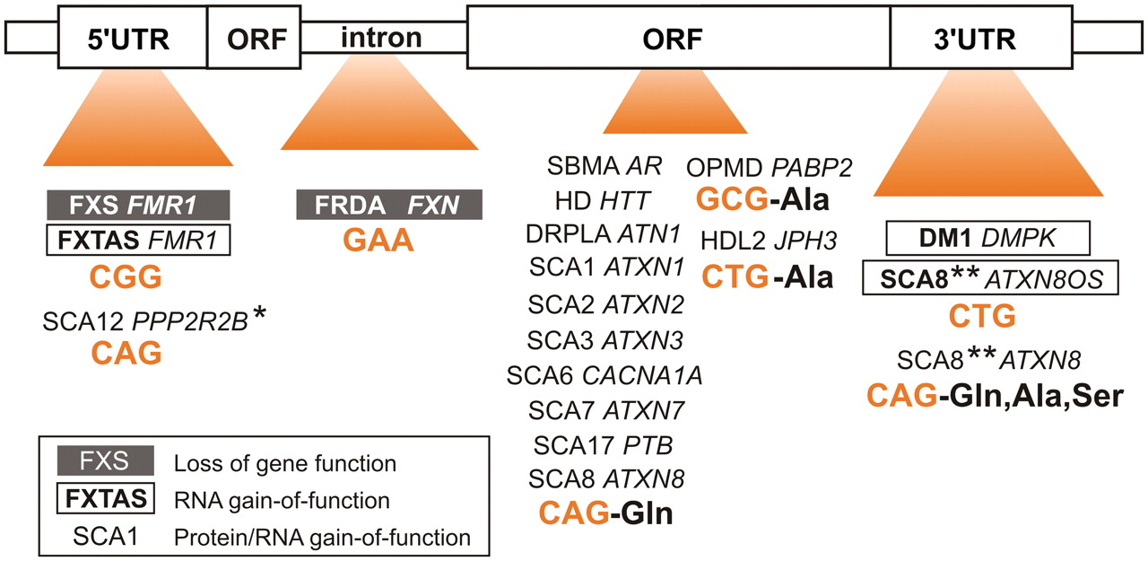
Figure 2. Expanded triplet repeats are located in different parts of transcripts. Depending on the location of ...
Notes:
Figure 2. Expanded triplet repeats are located in different parts of transcripts. Depending on the location of expandable repeats, neurological disease pathomechanisms can be divided into three groups. Repeats located in 5′-UTR, 3′-UTR or in introns cause diseases mainly via either loss of gene function or RNA gain-of-function, whereas repeats present in open reading frames trigger degeneration via gain-of-protein function in conjunction with RNA gain-of-function [in the figure legend, disease symbols (e.g. FXS), names of affected genes (e.g. FMR1), expanded repeat types and amino acids encoded are indicated]. In SCA12 CAG expansion in 5′-UTR also results in the elevated expression of the ppp2r2b protein (denoted by asterisk); In SCA8 bidirectional transcription also results in toxic proteins (denoted by double asterisks).
Unless provided in the caption above, the following copyright applies to the content of this slide: © The Author(s) 2011. Published by Oxford University Press.This is an Open Access article distributed under the terms of the Creative Commons Attribution Non-Commercial License (http://creativecommons.org/licenses/by-nc/3.0), which permits unrestricted non-commercial use, distribution, and reproduction in any medium, provided the original work is properly cited.

Slide 3
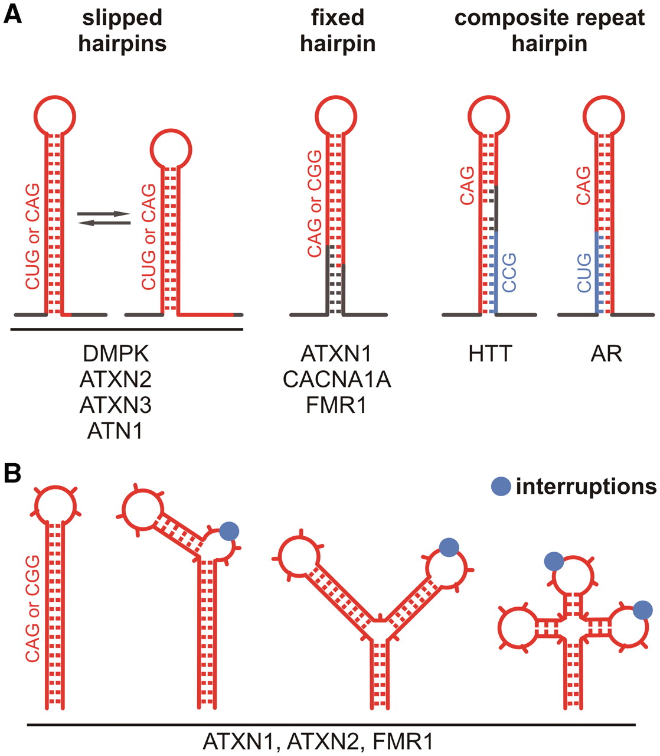
Figure 3. Influence of sequences flanking TNRs and repeat interruptions on structures formed by TNRs in different TRED ...
Notes:
Figure 3. Influence of sequences flanking TNRs and repeat interruptions on structures formed by TNRs in different TRED transcripts. (A) In some transcripts, the repeats themselves (red line) form autonomous hairpin structures that show slippage tendencies (two left panels). In several other transcripts, sequences flanking the repeat (dark gray line) influence the stability of the structure leading to the fixation of a single conformation (middle panel). In HTT and AR transcripts, two consecutive repeat sequences (red and blue lines) together with flanking sequences form a single composite hairpin structure (two right panels); (B) Sequences interrupting the triplet repeat region in the ATXN1, ATXN2 and FMR1 transcripts strongly influence structure formation. The interruptions can either break hairpin regularity or induce the formation of branched structures in which interruptions are predominantly present in terminal and internal hairpin loops.
Unless provided in the caption above, the following copyright applies to the content of this slide: © The Author(s) 2011. Published by Oxford University Press.This is an Open Access article distributed under the terms of the Creative Commons Attribution Non-Commercial License (http://creativecommons.org/licenses/by-nc/3.0), which permits unrestricted non-commercial use, distribution, and reproduction in any medium, provided the original work is properly cited.

Slide 4
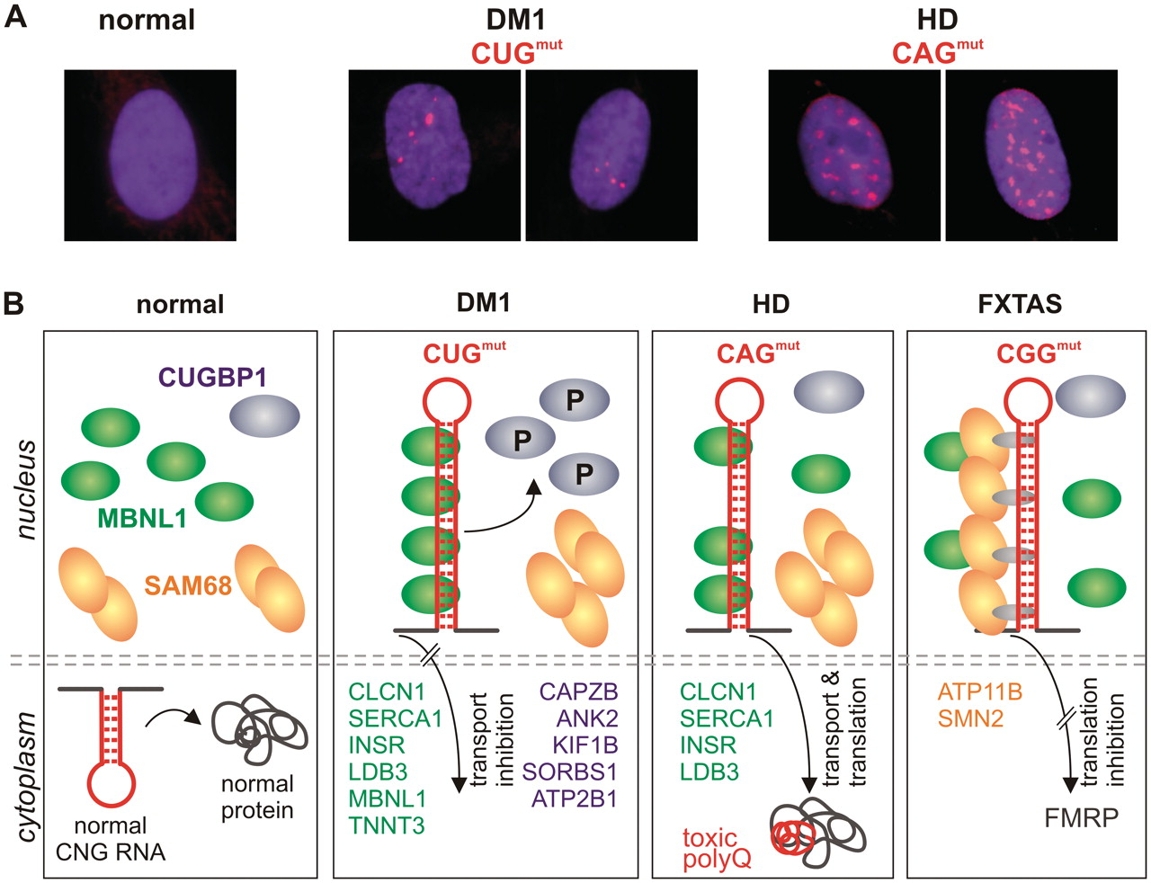
Figure 4. Dominant effects of toxic RNA repeats in different TREDs. (A) Mutant CUG and CAG repeat RNAs form nuclear ...
Notes:
Figure 4. Dominant effects of toxic RNA repeats in different TREDs. (A) Mutant CUG and CAG repeat RNAs form nuclear foci (red) in DM1 and HD human fibroblasts. RNA FISH was performed using fluorescently labelled repeat probes: CAG in DM1 cells and CTG in HD cells, normal cells were treated with either probe; (B) In normal cells, transcripts with short CNG repeats are exported from the nucleus and translated into functional proteins (first panel). Thus, the availability of nuclear splicing factors CUGBP1 (blue), MBNL1 (green) and SAM68 (orange) is not compromised. In DM1 cells (second panel), the CUGmut transcript is retained in the nucleus, where it sequesters MBNL1 and causes the abnormal phosphorylation of CUGBP1, upregulating its nuclear levels. As a result, the incorrect splicing of several MBNL1- and CUGBP1-dependent transcripts occurs (examples of misspliced transcripts are specified as green and blue, respectively). In HD cells (third panel), expanded CAG repeat RNA partially sequesters MBNL1, but does not change the level of CUGBP1, which results in splicing abnormalities affecting some MBNL1-dependent transcripts. The CAGmut transcript is effectively translated into toxic polyQ protein (polyQ tract is indicated by a red line). In FXTAS cells (fourth panel), the CGGmut transcript colocalizes in the nucleus with SAM68 and MBNL1, but this colocalization does not occur via direct RNA–protein interaction. The consequence of this interaction is the aberrant splicing of only SAM68-dependent transcripts (orange). Moreover, FMR1 mRNA containing long CGG repeats in its 5′-UTR is poorly translated.
Unless provided in the caption above, the following copyright applies to the content of this slide: © The Author(s) 2011. Published by Oxford University Press.This is an Open Access article distributed under the terms of the Creative Commons Attribution Non-Commercial License (http://creativecommons.org/licenses/by-nc/3.0), which permits unrestricted non-commercial use, distribution, and reproduction in any medium, provided the original work is properly cited.

Slide 5
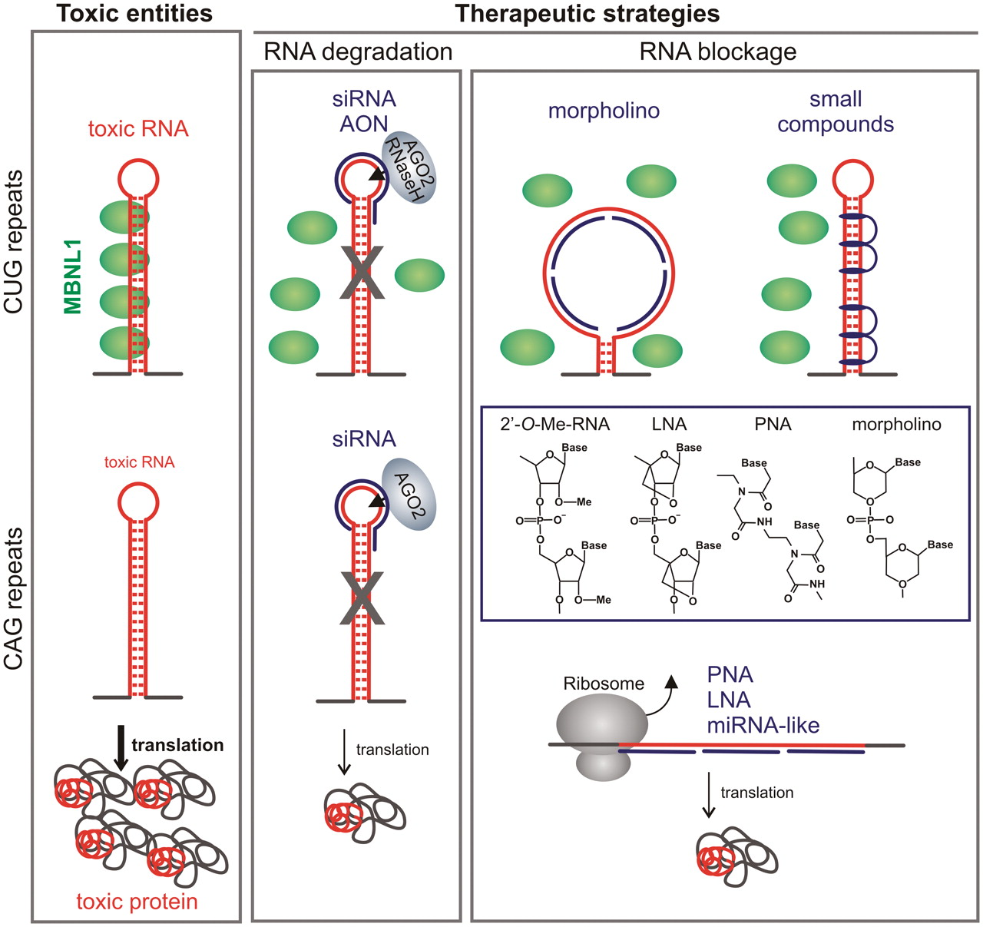
Figure 5. Therapeutic strategies aimed at targeting expanded triplet repeats in TRED transcripts. The left panel shows ...
Notes:
Figure 5. Therapeutic strategies aimed at targeting expanded triplet repeats in TRED transcripts. The left panel shows the main pathogenic agent in diseases caused by expanded CUG or CAG repeats, which is either toxic RNA structure or toxic polyQ protein (both marked red). The middle and right panels show the application of therapeutic AON, RNAi reagents and small compounds (indicated by a blue line) that specifically bind to CUG or CAG repeat hairpins. Antisense reagents (AON) or siRNA called ‘cutters’ induce RNA degradation via RNaseH or AGO2 (middle panel), whereas ‘blockers’ (PNA, LNA, morpholino and miRNA-like duplexes) bind to repeat RNA alone or within protein complexes and inhibit either pathogenic RNA/protein interaction or translation of toxic polyQ proteins (right panel). See text for more details.
Unless provided in the caption above, the following copyright applies to the content of this slide: © The Author(s) 2011. Published by Oxford University Press.This is an Open Access article distributed under the terms of the Creative Commons Attribution Non-Commercial License (http://creativecommons.org/licenses/by-nc/3.0), which permits unrestricted non-commercial use, distribution, and reproduction in any medium, provided the original work is properly cited.

