Slide 1
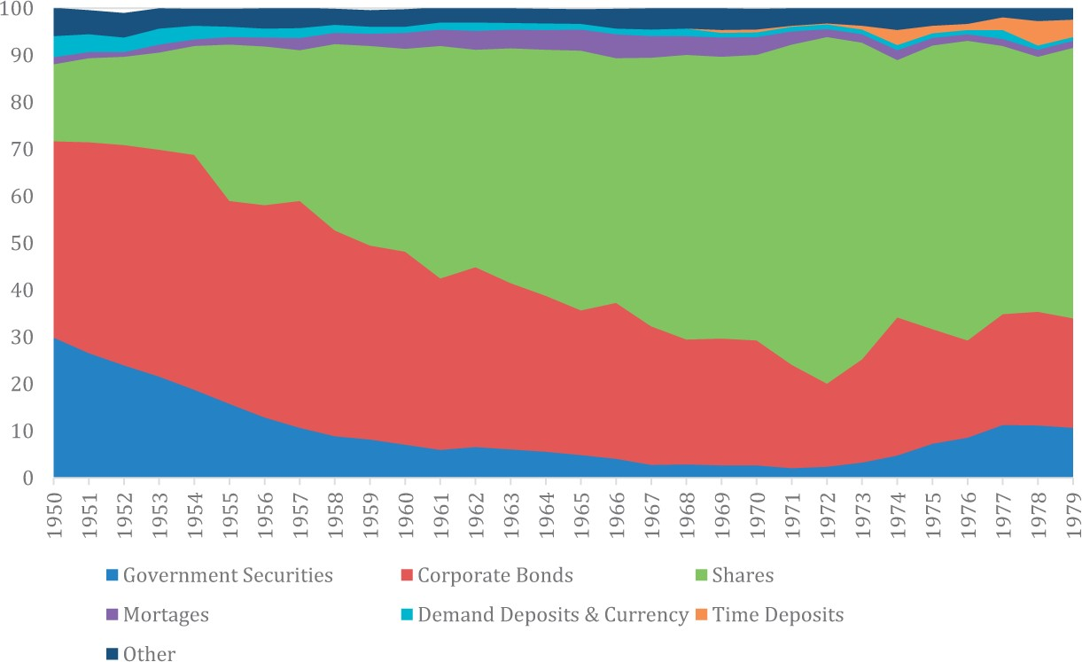
Figure 1 Asset distribution of non-insured private pension funds in the USA, 1950–1979. (United States Department of ...
Notes:
Figure 1 Asset distribution of non-insured private pension funds in the USA, 1950–1979. (United States Department of Labor, 2015) Source: Authors’ calculations from Barth and Cordes (1981).
Unless provided in the caption above, the following copyright applies to the content of this slide: © The Author 2016. Published by Oxford University Press and the Society for the Advancement of Socio-Economics. All rights reserved. For Permissions, please email: journals.permissions@oup.com

Slide 2
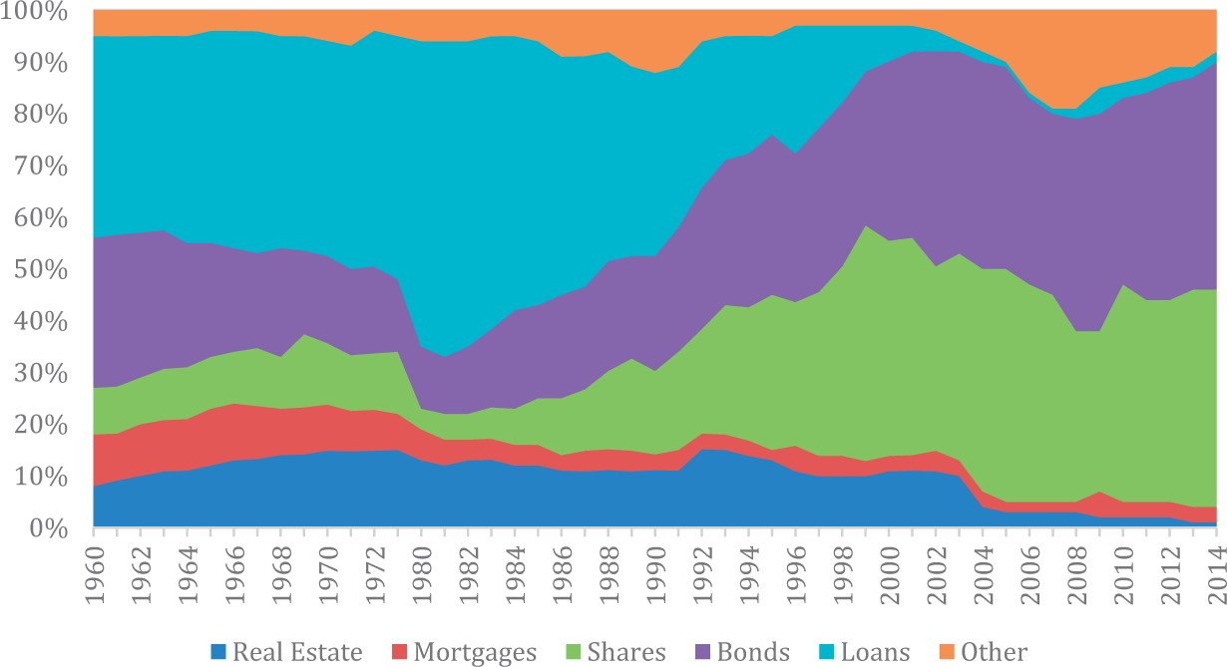
Figure 2 Asset distribution of dutch pension funds, 1960–2014. Sources: Pensioen- en Verzekeringskamer, Financiële ...
Notes:
Figure 2 Asset distribution of dutch pension funds, 1960–2014. Sources: Pensioen- en Verzekeringskamer, Financiële Gegevens Pensioenfondsen (Apeldoorn, multiple years); CBS, ‘CBS Statline’, online database, for years 2003–2014.
Unless provided in the caption above, the following copyright applies to the content of this slide: © The Author 2016. Published by Oxford University Press and the Society for the Advancement of Socio-Economics. All rights reserved. For Permissions, please email: journals.permissions@oup.com

Slide 3
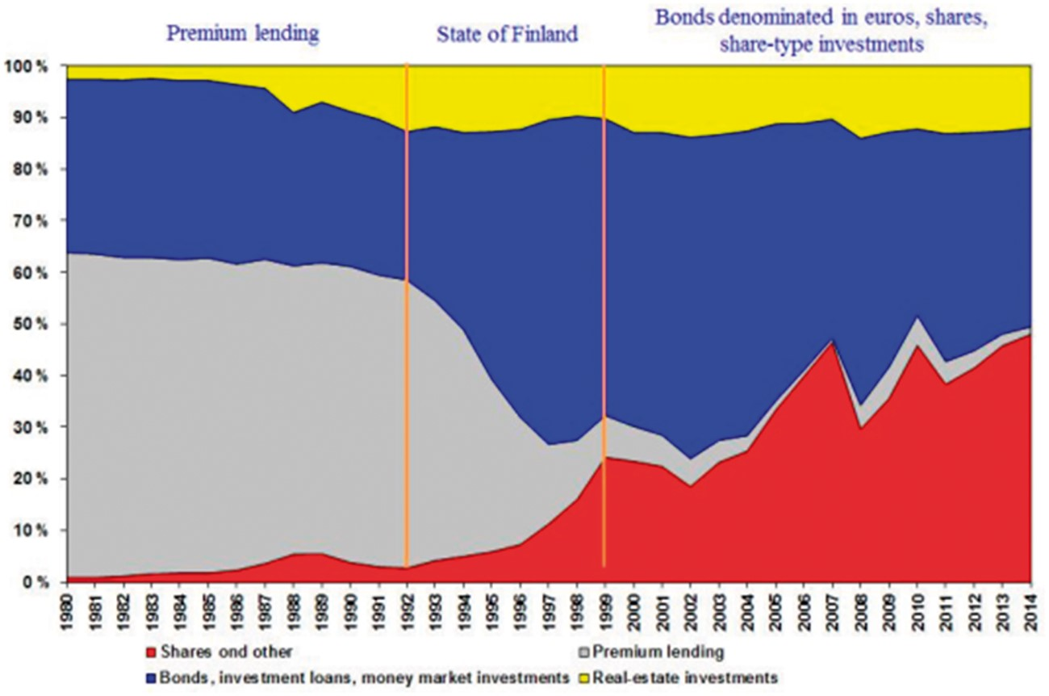
Figure 3 Asset distribution of Finnish PICs, 1980–2014. Notes: Assets are in book value for the years 1980–1996 and in ...
Notes:
Figure 3 Asset distribution of Finnish PICs, 1980–2014. Notes: Assets are in book value for the years 1980–1996 and in market value from year 1999 onwards. Assets in the transition period of 1997–1998 are in estimated market values. Source: The Finnish Pension Alliance (2015).
Unless provided in the caption above, the following copyright applies to the content of this slide: © The Author 2016. Published by Oxford University Press and the Society for the Advancement of Socio-Economics. All rights reserved. For Permissions, please email: journals.permissions@oup.com

