Slide 1
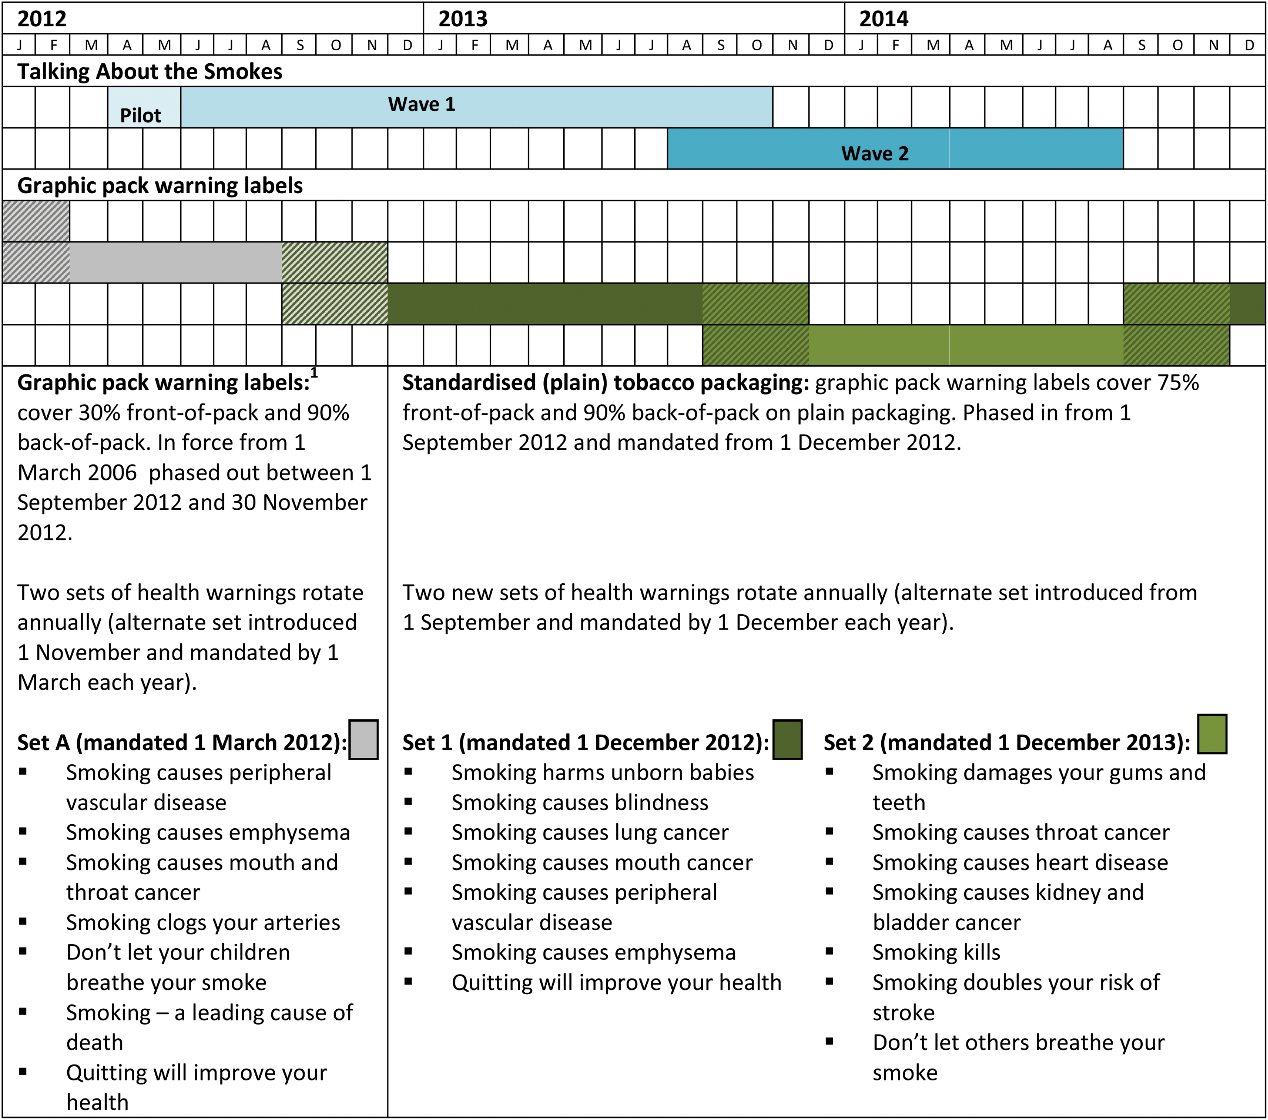
Figure 1. Timing of Talking About the Smokes survey waves compared with graphic health warning labels and the ...
Notes:
Figure 1. Timing of Talking About the Smokes survey waves compared with graphic health warning labels and the introduction of standardized (plain) packaging in Australia.
Unless provided in the caption above, the following copyright applies to the content of this slide: © The Author 2017. Published by Oxford University Press on behalf of the Society for Research on Nicotine and Tobacco. All rights reserved. For permissions, please e-mail: journals.permissions@oup.com.

