Slide 1
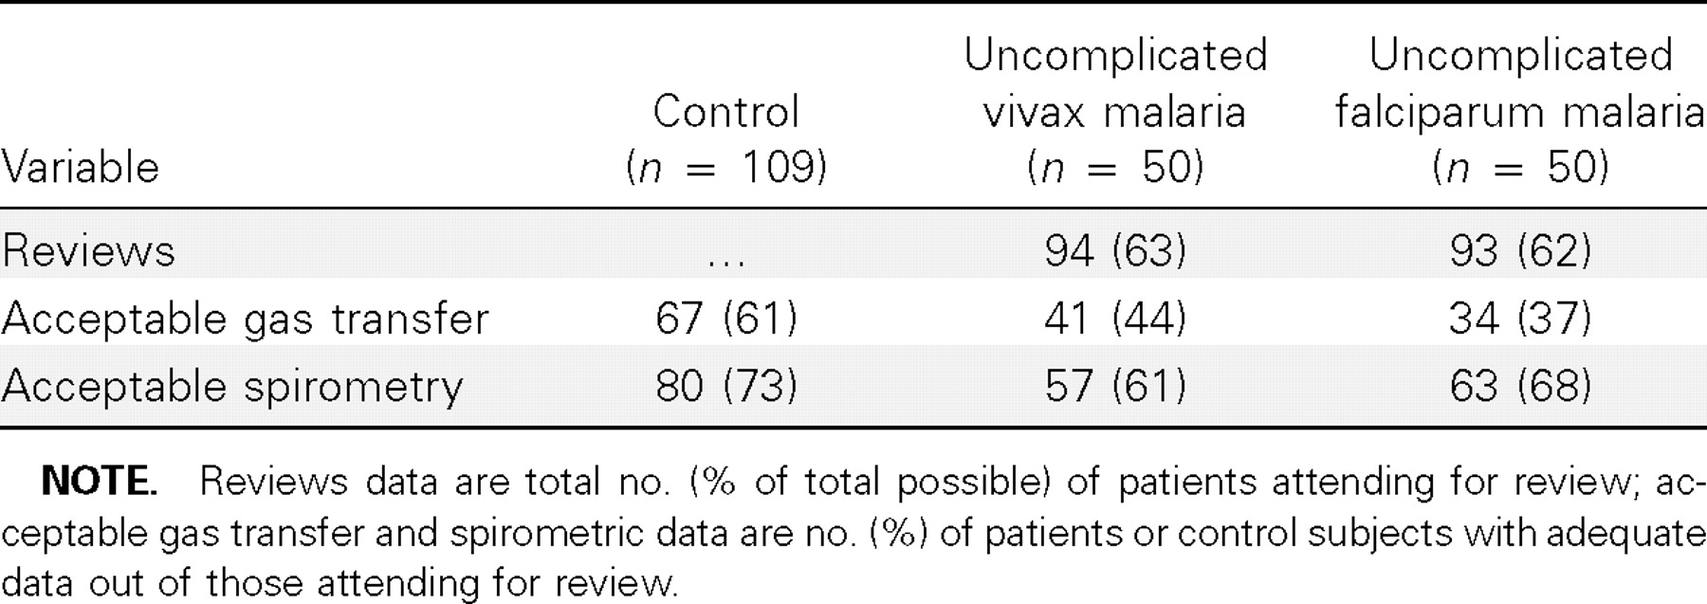
Table 1 Proportion of subjects who attended follow-up as per protocol and who had adequate spirometric and gas ...
Notes:
Table 1 Proportion of subjects who attended follow-up as per protocol and who had adequate spirometric and gas transfer results suitable for analysis.
Unless provided in the caption above, the following copyright applies to the content of this slide: © 2007 by the Infectious Diseases Society of America

Slide 2
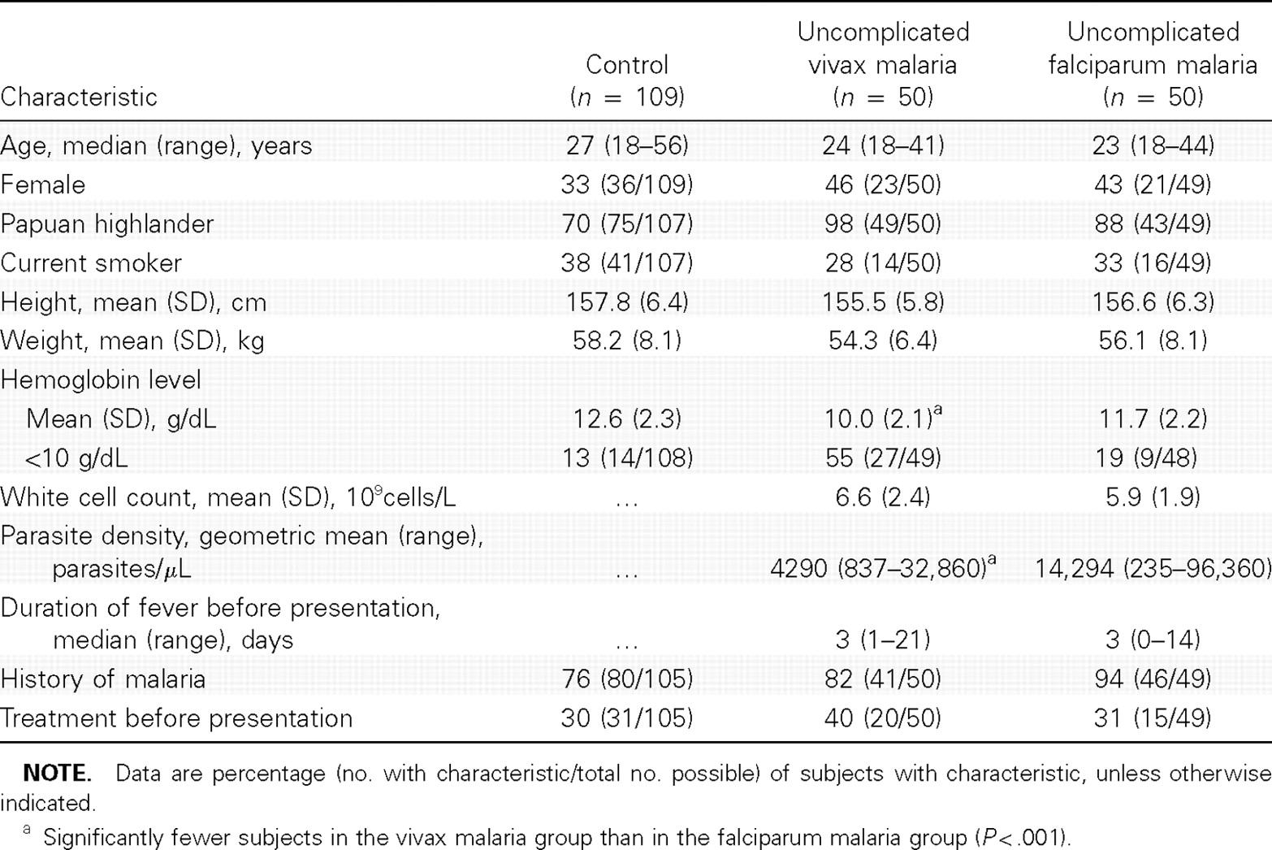
Table 2 Demographic and clinical characteristics at presentation of subjects who had cough data or at least 1 ...
Notes:
Table 2 Demographic and clinical characteristics at presentation of subjects who had cough data or at least 1 acceptable respiratory function test.
Unless provided in the caption above, the following copyright applies to the content of this slide: © 2007 by the Infectious Diseases Society of America

Slide 3
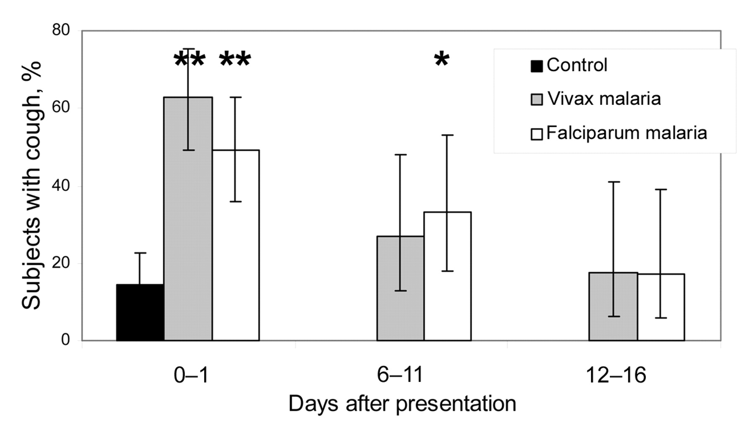
Figure 1 Proportions of patients with uncomplicated vivax and falciparum malaria with cough, over time, compared with ...
Notes:
Figure 1 Proportions of patients with uncomplicated vivax and falciparum malaria with cough, over time, compared with that of control subjects. The whiskers denote 95% confidence intervals. *P<.05, χ2 test; **P<.01, χ2 test.
Unless provided in the caption above, the following copyright applies to the content of this slide: © 2007 by the Infectious Diseases Society of America

Slide 4
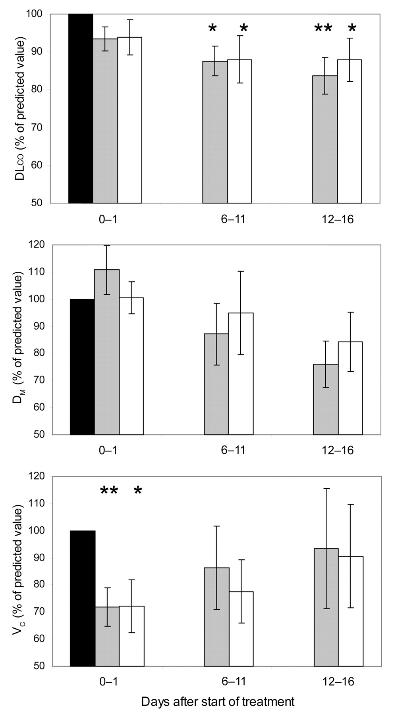
Figure 2 Gas transfer (DL_{CO}) measures over time for patients with uncomplicated vivax and falciparum ...
Notes:
Figure 2 Gas transfer (DLCO) measures over time for patients with uncomplicated vivax and falciparum malaria. Data are mean percentages of predicted values and SE values. Black bars represent the control subjects, gray bars represent patients with uncomplicated vivax malaria, and white bars indicate patients with uncomplicated falciparum malaria. Comparison with controls: *P<.05; **P<.01. Linear regression coefficient for the decrease in the alveolar-capillary membranous component of DLCO (DM) in Plasmodium vivax: −1.0% of predicted value/day; P=.02, r2=.10. The decrease in DM function in P. falciparum was not statistically significant. VC, pulmonary capillary vascular component of DLCO.
Unless provided in the caption above, the following copyright applies to the content of this slide: © 2007 by the Infectious Diseases Society of America

