Slide 1
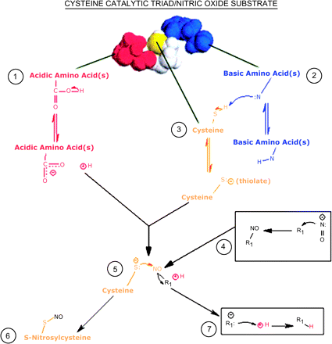
FIG. 1 A color-coded three-dimensional image of a theoretical catalytic triad is shown. The acidic amino acid ...
Notes:
FIG. 1 A color-coded three-dimensional image of a theoretical catalytic triad is shown. The acidic amino acid residue is represented in red, the cysteine residue is presented in yellow, and the basic amino acid is presented in blue. The possible spatiotemporal chemical interactions among these triad components are illustrated schematically. (1) The acidic amino acid residue (red), which can be glutamic and/or aspartic acid(s), will undergo deprotonation to yield a proton (H+) and a carboxylate (COO−). (2) The basic amino acid residues (blue) can be lysine(s), histidine(s), and/or arginine(s). The, respective, nucleophilic side-chain nitrogens of these basic residues can deprotonate the sulfhydryl group of a neighboring cysteine (yellow). As the thiol group is deprotonated, the leaving hydrogen gives up electron density to the sulfur atom, which yields (3) the cysteine thiolate. (4) Before NO− can adduct the thiolate, it must undergo a reaction with an electron pair acceptor (R1) such as GSH. This interaction imparts electrophilic character to NO. (5) The nucleophilic thiolate can then attack the electrophilic nitrogen of the R1-bound NO to yield (6) S-nitrosylcysteine. As a consequence of thiolate adduction, the nitrogen atom of NO gives up electron density to the electron acceptor (R1), which now has nucleophilic character. The H+ from the acidic amino acid residue (1) is an electrophile and is, therefore, susceptible to attack by the nucleophilic R1. (7) Subsequent nucleophilic attack allows R1 to become a better leaving group, which facilitates S-nitrosylation.
Unless provided in the caption above, the following copyright applies to the content of this slide: © The Author 2006. Published by Oxford University Press on behalf of the Society of Toxicology. All rights reserved. For Permissions, please email: journals.permissions@oxfordjournals.org

Slide 2
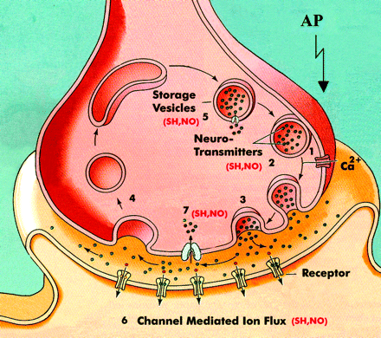
FIG. 2 Sequence of pre- and postsynaptic events involved in neurotransmission at a chemical synapse. An action ...
Notes:
FIG. 2 Sequence of pre- and postsynaptic events involved in neurotransmission at a chemical synapse. An action potential (AP) invades the nerve terminal and the resulting depolarization of the membrane causes opening of voltage-gated Ca2+ channels. The resulting influx of Ca2+ through these channels (1) causes fusion of neurotransmitter-filled synaptic vesicles with the presynaptic membrane (2). Membrane-vesicle fusion promotes the formation of a transmembrane pore through which transmitter is released into the synapse (3). Following exocytosis, the process of endocytosis retrieves the vesicular membrane and an empty synaptic vesicle is regenerated (4). The vesicle is filled with neurotransmitter through the coupled actions of a vesicular transporter (e.g., VMAT) and a vesicular–adenosine triphosphate synthase (5). Once the transmitter has been released into the synaptic cleft, it can bind to specific receptors on the postsynaptic membrane and thereby influence channel-mediated ion flux (6). Neurotransmitter actions are terminated by postsynaptic metabolism and by presynaptic reuptake by a specific membrane transporter (e.g., DAT). The SH,NO in parentheses indicates processes that have been experimentally identified as sites of regulation by NO or thiol reagents such as NEM.
Unless provided in the caption above, the following copyright applies to the content of this slide: © The Author 2006. Published by Oxford University Press on behalf of the Society of Toxicology. All rights reserved. For Permissions, please email: journals.permissions@oxfordjournals.org

Slide 3
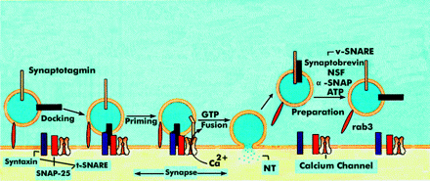
FIG. 3 Essential elements of the SNARE hypothesis are presented. According to this hypothesis, the selective docking ...
Notes:
FIG. 3 Essential elements of the SNARE hypothesis are presented. According to this hypothesis, the selective docking of a synaptic vesicle with its presynaptic membrane target is mediated by the formation of a complex (the SNARE complex) between v-SNARE and cognate t-SNAREs. Once formed the SNARE complex leads to vesicle-membrane fusion and pore-mediated release of vesicular contents. As presented in Fig. 3, the synaptic vesicle protein rab3 (a low molecular weight guanosine triphosphatase [GTPase]) permits reversible vesicle attachment to a membrane target within the presynaptic active zone. This allows formation of a SNARE core complex composed of VAMP/synaptobrevin (v-SNARE) and the two t-SNAREs, syntaxin and SNAP-25. This is an irreversible step that brings the vesicle into the docked position. Before the contents of the docked vesicle can be released a priming reaction is necessary. Although the precise mechanism is unknown, priming appears to involve the recruitment of synaptotagmin to the SNARE complex. During nerve terminal depolarization, the entry of Ca2+ through voltage-gated channels triggers the completion of membrane-vesicle fusion. This step requires GTP and results in the formation of a pore through which neurotransmitter escapes. Following release of transmitter, the actions of NSF and α-SNAP dissociate the SNARE core complex into its individual components, i.e., VAMP/synaptobrevin, syntaxin and SNAP-25. This step requires adenosine triphosphate hydrolysis by NSF and prepares the synaptic vesicle for the next cycle of exocytosis.
Unless provided in the caption above, the following copyright applies to the content of this slide: © The Author 2006. Published by Oxford University Press on behalf of the Society of Toxicology. All rights reserved. For Permissions, please email: journals.permissions@oxfordjournals.org

