Slide 1
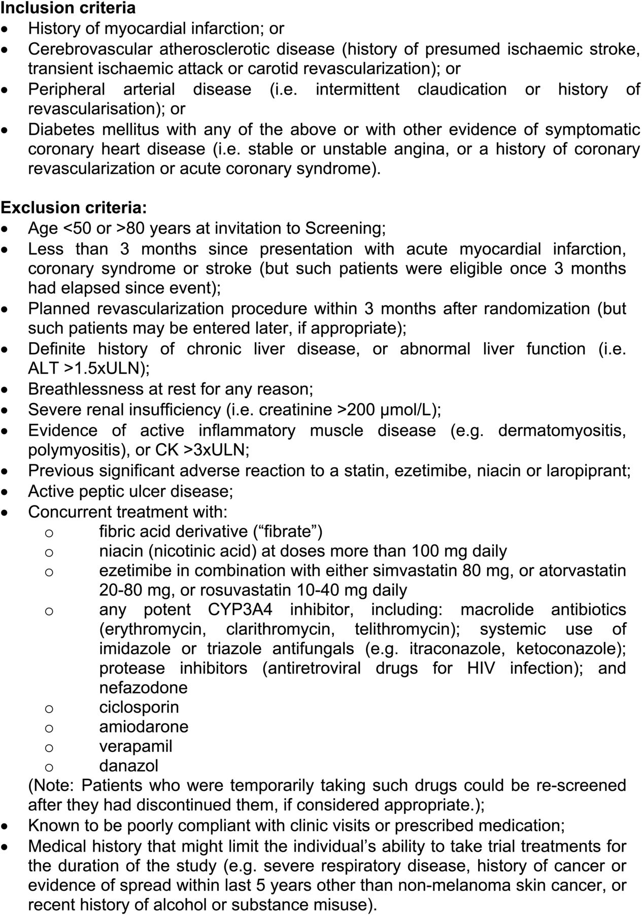
Figure 1 Inclusion and exclusion criteria.
Notes:
Figure 1 Inclusion and exclusion criteria.
Unless provided in the caption above, the following copyright applies to the content of this slide: © The Author 2013. Published by Oxford University Press on behalf of European Society of CardiologyThis is an Open Access article distributed under the terms of the Creative Commons Attribution License (http://creativecommons.org/licenses/by-nc/3.0/), which permits non-commercial reuse, distribution, and reproduction in any medium, provided that the original authorship is properly and fully attributed; the Journal, Learned Society and Oxford University Press are attributed as the original place of publication with correct citation details given; if an article is subsequently reproduced or disseminated not in its entirety but only in part or as a derivative work this must be clearly indicated. For commercial re-use, please contact journals.permissions@oup.com.

Slide 2
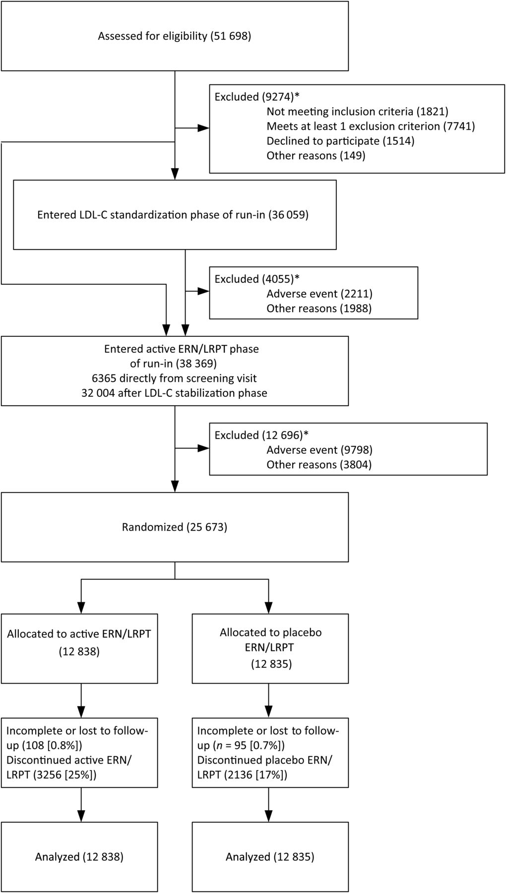
Figure 2 Trial profile: Flow of participants through the trial. Participants receiving simvastatin 40 mg (with total ...
Notes:
Figure 2 Trial profile: Flow of participants through the trial. Participants receiving simvastatin 40 mg (with total cholesterol <3.5 mmol/L) or ezetimibe/simvastatin 10/40 mg prior to screening entered the active ER niacin/laropiprant phase of the run-in immediately after the screening visit. *Participants may have more than one reason for being excluded.
Unless provided in the caption above, the following copyright applies to the content of this slide: © The Author 2013. Published by Oxford University Press on behalf of European Society of CardiologyThis is an Open Access article distributed under the terms of the Creative Commons Attribution License (http://creativecommons.org/licenses/by-nc/3.0/), which permits non-commercial reuse, distribution, and reproduction in any medium, provided that the original authorship is properly and fully attributed; the Journal, Learned Society and Oxford University Press are attributed as the original place of publication with correct citation details given; if an article is subsequently reproduced or disseminated not in its entirety but only in part or as a derivative work this must be clearly indicated. For commercial re-use, please contact journals.permissions@oup.com.

