Slide 1
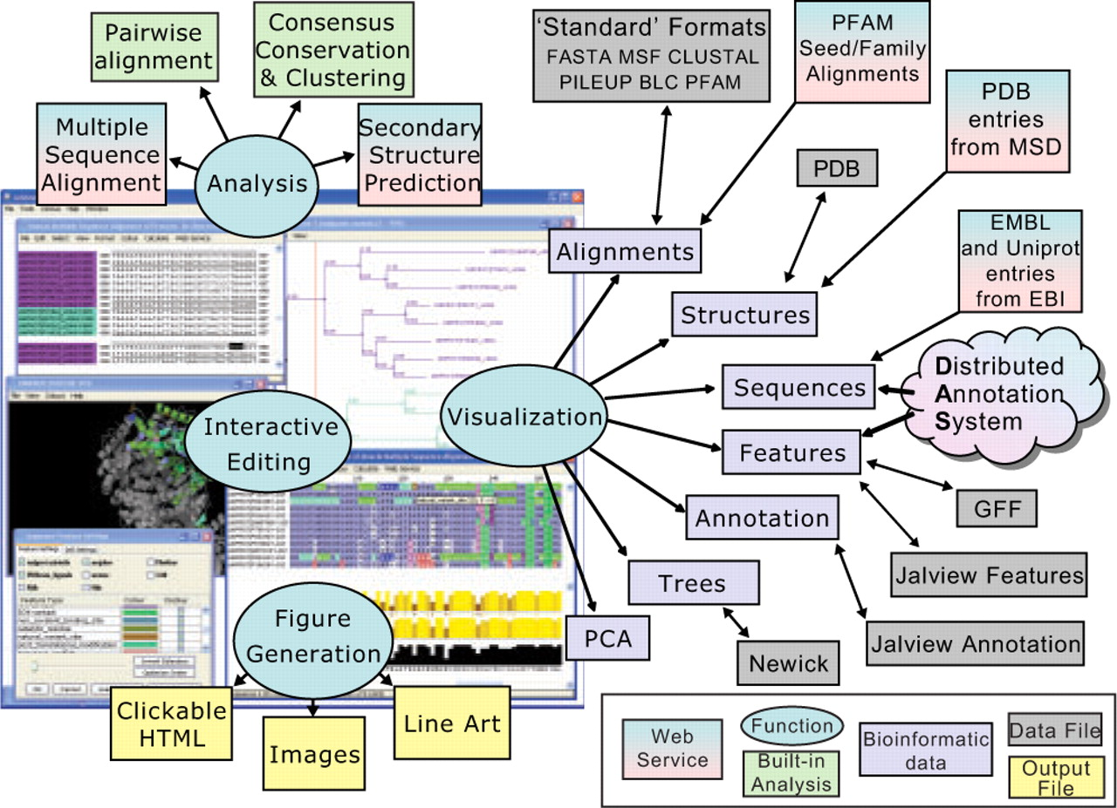
Fig. 1. Capabilities of the Jalview 2 desktop application. Ovals depict major capabilities: visualization, ...
Notes:
Fig. 1. Capabilities of the Jalview 2 desktop application. Ovals depict major capabilities: visualization, interactive editing, analysis and WYSIWYG figure generation. Arrows connect bioinformatics data handled by JV2 with flat-file or web-service data sources. Analysis includes built-in alignment conservation and tree building algorithms, and web services for MSA and secondary structure prediction methods. The screenshot of the application shows two sets of sequences for proteins in the lactate dehydrogenase family. One contains an alignment of protein sequences retrieved from the Uniprot database, the other their coding sequences retrieved from the EMBL database. Interactive highlighting shows the region corresponding to the amino acid or codon position near the mouse pointer in both the alignment windows and the Jmol structure display of a PDB record associated with one protein.
Unless provided in the caption above, the following copyright applies to the content of this slide: © 2009 The Author(s)This is an Open Access article distributed under the terms of the Creative Commons Attribution Non-Commercial License (http://creativecommons.org/licenses/by-nc/2.0/uk/) which permits unrestricted non-commercial use, distribution, and reproduction in any medium, provided the original work is properly cited.

