Slide 1
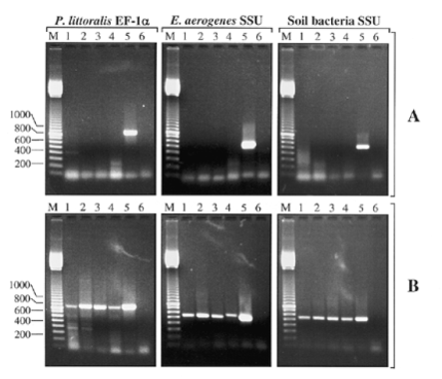
Figure 1 Effect of polysaccharide ( P.littoralis and E.aerogenes ) or humic acids (soil bacteria) contamination on ...
Notes:
Figure 1 Effect of polysaccharide ( P.littoralis and E.aerogenes ) or humic acids (soil bacteria) contamination on PCR amplifications from different genomic DNA extractions. ( A ) Amplifications from DNAs extracted by a conventional method (lane 1), GeneClean (lane 2), CTAB treatment (lane 3), Wizard Genomic DNA Purification System (lane 4) and LMP agarose procedure (lane 5). Lane 6 shows a negative control without DNA. ( B ) Amplifications from the same DNAs after their inclusion in LMP agarose blocks and extensive washing with TE. The size marker is a 100 bp ladder (lane M); sizes are indicated in bp.
Unless provided in the caption above, the following copyright applies to the content of this slide: © 1998 Oxford University Press

