Slide 1
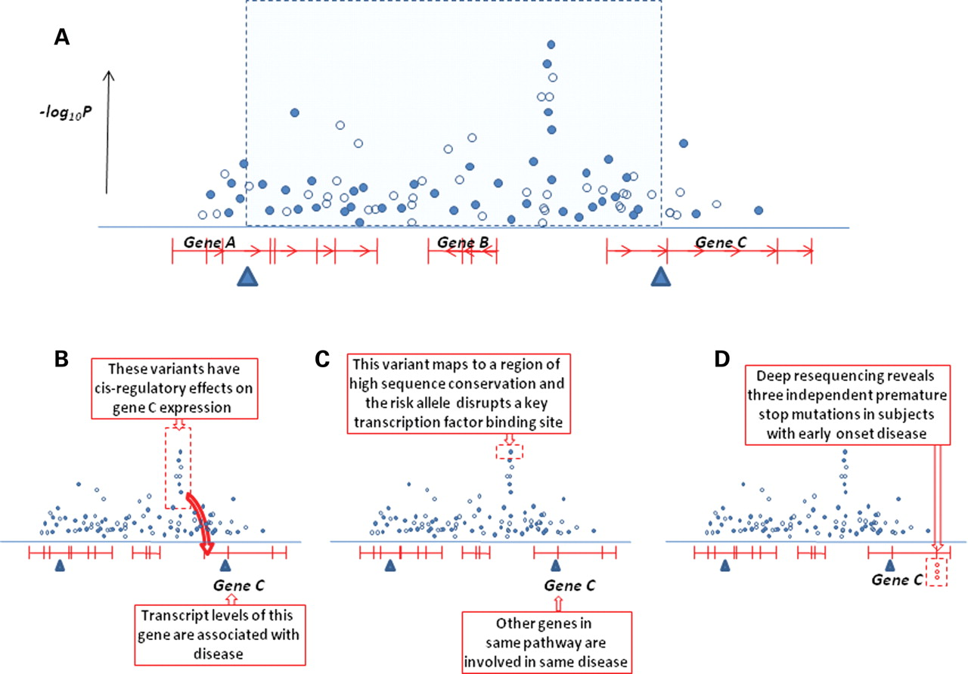
Figure 3. Strategies for using functional data to support causal variant and causal gene identification. The ...
Notes:
Figure 3. Strategies for using functional data to support causal variant and causal gene identification. The figure illustrates ways in which fine-mapping efforts can be supported by clues from functional data: ( A ) consider a locus at which GWA analysis (complemented by replication data—not shown) has revealed a highly significant association mapping between the coding regions of genes B and C. Directly typed SNPs are shown in the filled symbols, imputed SNPs in open symbols. Flanking recombination hotspots (blue triangles) define an interval within which the variant causal for that signal is most likely to reside. This interval contains the entire coding sequence of gene B, and portions of genes A and C. For the purposes of this cartoon, the causal variant turns out to be the typed SNP with the strongest association, and it exerts its effect on disease through altering expression of gene C; ( B ) clues to the identity of the causal gene are derived by expression QTL studies in a tissue relevant to disease: not only is the expression of gene C associated with the same cluster of variants which shows the disease association; but there are also directionally-consistent associations between gene C transcript levels and disease state; ( C ) clues to the identity of the causal gene are derived from analysis of genome annotations: not only does gene C code for a member of a pathway previously implicated in the disease, but the associated variants are predicted to have strong functional credibility; ( D ) clues to the identity of the causal gene are derived from deep exon resequencing of genes A–C: three independent premature stop-codon mutations in gene C (predicted to lead to generation of a truncated protein product with dominant-negative effects) are found in subjects with severe, early-onset forms of the disease of interest.
Unless provided in the caption above, the following copyright applies to the content of this slide: © The Author 2008. Published by Oxford University Press. All rights reserved. For Permissions, please email: journals.permissions@oxfordjournals.org

Slide 2
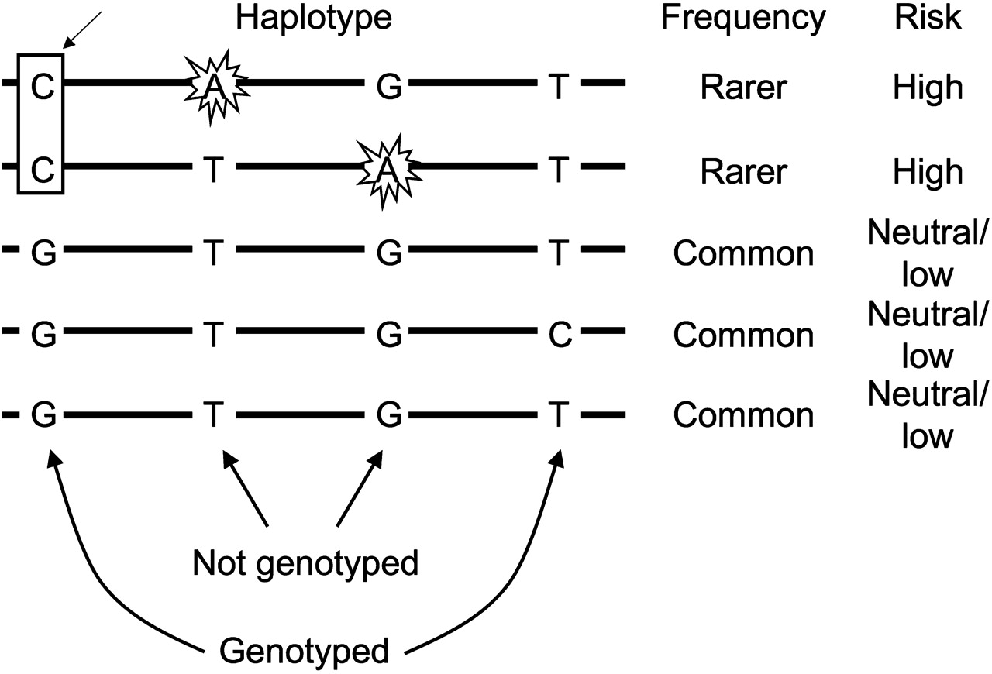
Figure 2. A common SNP may be strongly associated because it tags multiple rarer causal variants. In this hypothetical ...
Notes:
Figure 2. A common SNP may be strongly associated because it tags multiple rarer causal variants. In this hypothetical example, the C allele of the genotyped SNP on the left (indicated by the box) is strongly associated with disease risk because it tags a combination of two rarer causal variants which are themselves only weakly correlated with the associated SNP. Sequencing in affected individuals carrying high-risk haplotypes might be required to uncover the actual causal variants, which in this example have not been genotyped.
Unless provided in the caption above, the following copyright applies to the content of this slide: © The Author 2008. Published by Oxford University Press. All rights reserved. For Permissions, please email: journals.permissions@oxfordjournals.org

Slide 3
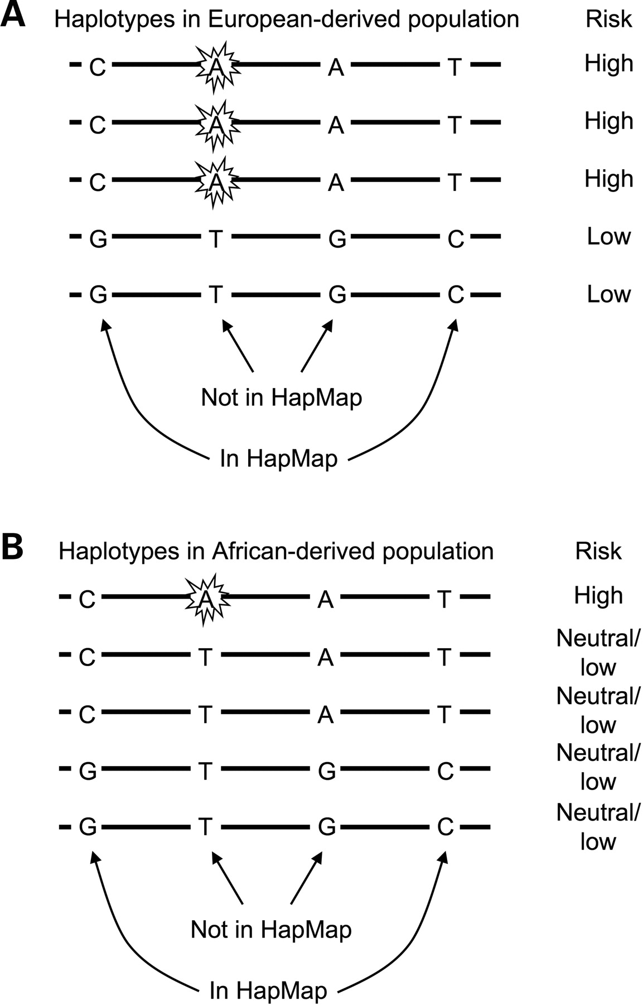
Figure 1. Different LD patterns can yield different patterns of association. Hypothetical haplotypes in an associated ...
Notes:
Figure 1. Different LD patterns can yield different patterns of association. Hypothetical haplotypes in an associated region and their effects on disease risk are shown for a European-derived population ( A ) and an African-derived population ( B ). In European-derived populations, several SNPs show equivalent signals of association, including the causal SNP (marked by jagged lines). Two of these are in HapMap, and have been tested via genotyping or imputation, permitting the effect of the causal SNP (which is not in HapMap) to be detected indirectly. In African-derived populations, the causal SNP is rarer and is no longer strongly correlated with the surrounding SNPs in HapMap, so the surrounding SNPs will not show strong association. Thus, a fine-mapping approach based only on HapMap SNPs but without additional resequencing may fail to detect a signal in the African-derived population.
Unless provided in the caption above, the following copyright applies to the content of this slide: © The Author 2008. Published by Oxford University Press. All rights reserved. For Permissions, please email: journals.permissions@oxfordjournals.org

