Slide 1
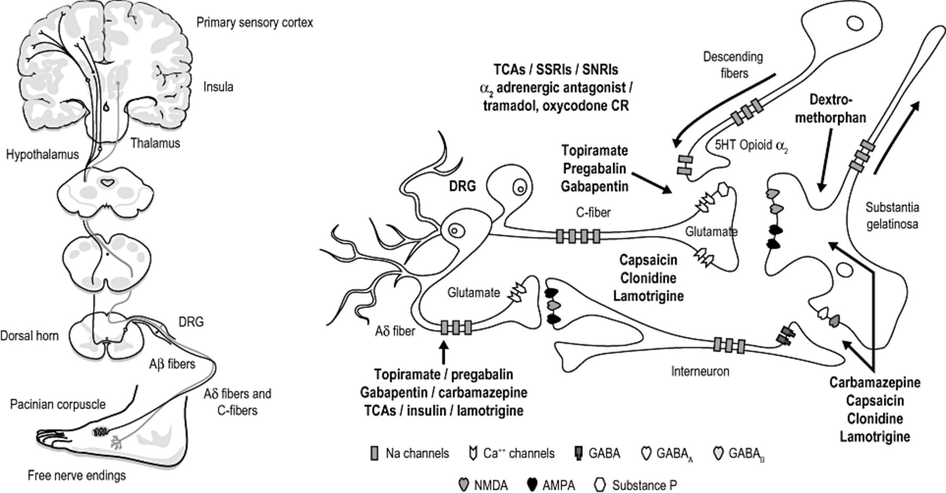
Figure 1 The neural loop and site of action of various analgesics. AMPA = ...
Notes:
Figure 1 The neural loop and site of action of various analgesics. AMPA = alpha-amino-3-hydroxy-5-methylisoxazole-4-propionate; CR = controlled release; DRG = dorsal root ganglion; GABA = γ-aminobutyric acid; NMDA = N-methyl-D-aspartate; SNRI = serotonin-norepinephrine reuptake inhibitor; SSRI = selective serotonin reuptake inhibitor; TCA = tricyclic antidepressant.
Unless provided in the caption above, the following copyright applies to the content of this slide: © American Academy of Pain Medicine

