Slide 1
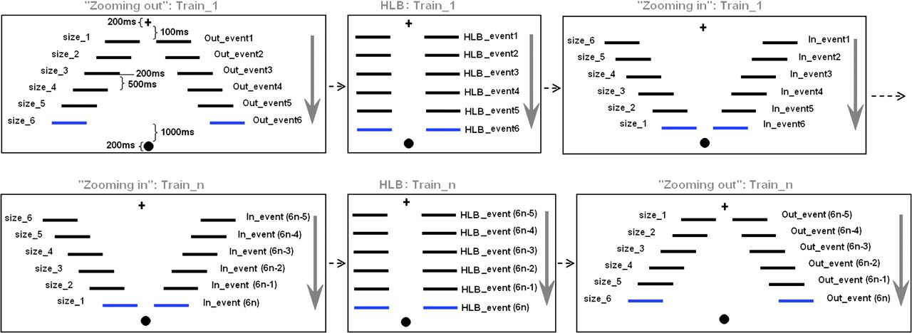
Figure 1. Example of visual stimuli and experimental sequence. The horizontal gap between the 2 lines kept increasing ...
Notes:
Figure 1. Example of visual stimuli and experimental sequence. The horizontal gap between the 2 lines kept increasing in zooming out stimulus trains, decreasing in zooming in stimulus trains, and was constant in HLB stimulus trains. Instead of modeling the whole stimulus train, the 6 pairs of lines within the stimulus train were modeled as separate events for zooming in, zooming out, and HLB conditions. Additionally, in order to regress out the distance confounds from visual inputs between zooming in and zooming out, the size of the horizontal gap which separated each line pair was included as covariates for zooming in and zooming out events.
Unless provided in the caption above, the following copyright applies to the content of this slide: © The Author 2008. Published by Oxford University Press. All rights reserved. For permissions, please e-mail: journals.permissions@oxfordjournals.org

Slide 2
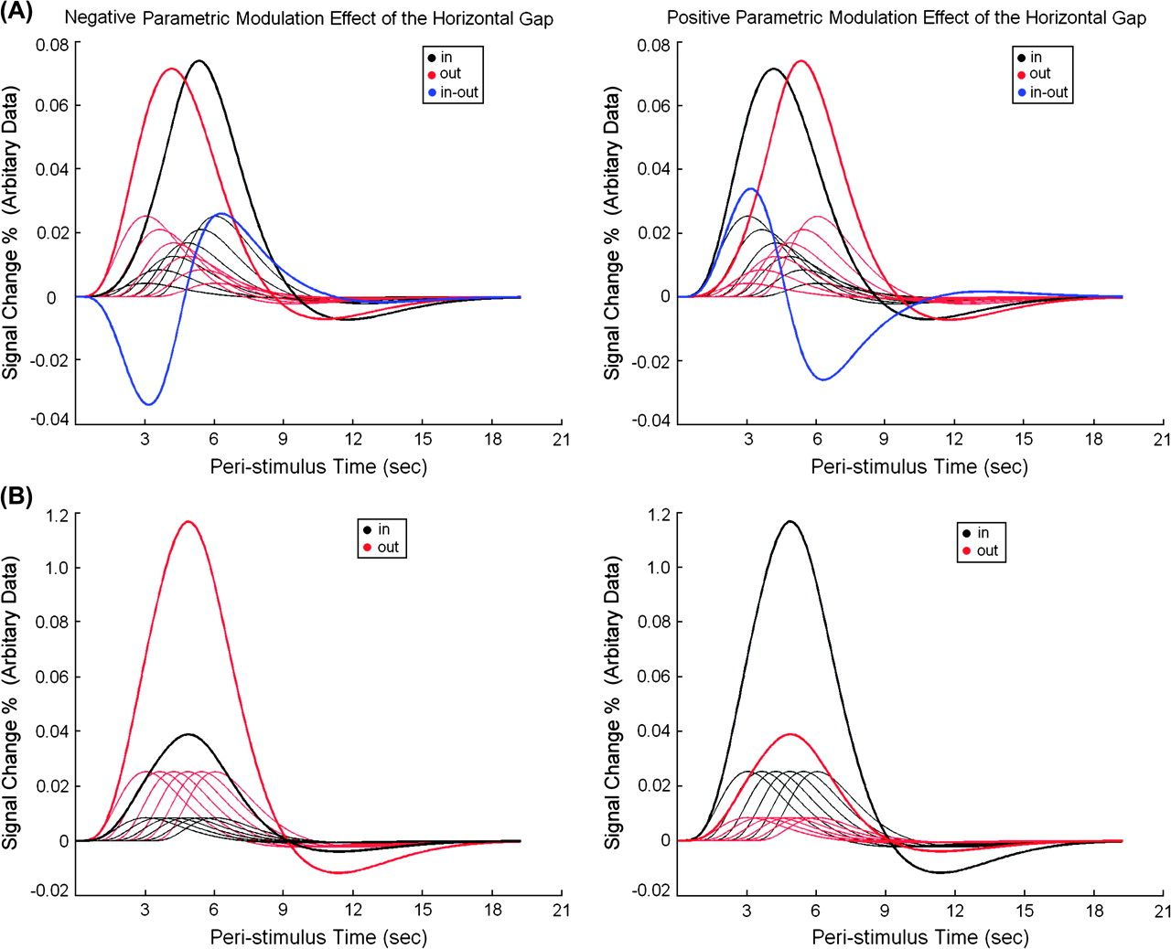
Figure 2. (A) Predictions about neural activity in brain regions that are involved in distance-specific effects. Left: ...
Notes:
Figure 2. (A) Predictions about neural activity in brain regions that are involved in distance-specific effects. Left: For brain regions that are involved in the negative parametric modulation effect of the horizontal gap, neural activity evoked by the 6 pairs of lines will gradually decrease with the increasing size of the horizontal gap (zooming out, thin red curves) and increase with the decreasing size of the horizontal gap (zooming in, thin black curves). Thus, the summed BOLD response will show an earlier peak during zooming out (the thick red curve) but a later peak during zooming in (the thick black curve). The contrast between the evoked BOLD responses of zooming in and zooming out within these regions will yield a response pattern with an earlier negative peak and a later positive peak (the thick blue curve). Right: Similarly, for brain regions that are involved in the positive parametric modulation effects, the summed BOLD responses will show an earlier peak during zooming in (black curves) but a later peak during zooming out (red curves). The contrast between the evoked BOLD responses of zooming in and zooming out in these regions will give an earlier positive response peak and a later negative response peak (the blue curve). (B) Predictions about neural activity in brain regions that are specifically involved in the zooming processes. Left: For brain regions that are specifically involved in the zooming out process, relative to the zooming in process, neural activity will be kept at a consistently higher level across the 6 line pairs during zooming out (thin red curves) than during zooming in (thin black curves). Thus, the summed BOLD response will show only a significant height difference, but not temporal differences, between zooming out (the thick red curve) and zooming in (the thick black curve). Right: Similar predictions apply for neural activity in the brain regions that are differentially involved in the zooming in process.
Unless provided in the caption above, the following copyright applies to the content of this slide: © The Author 2008. Published by Oxford University Press. All rights reserved. For permissions, please e-mail: journals.permissions@oxfordjournals.org

Slide 3
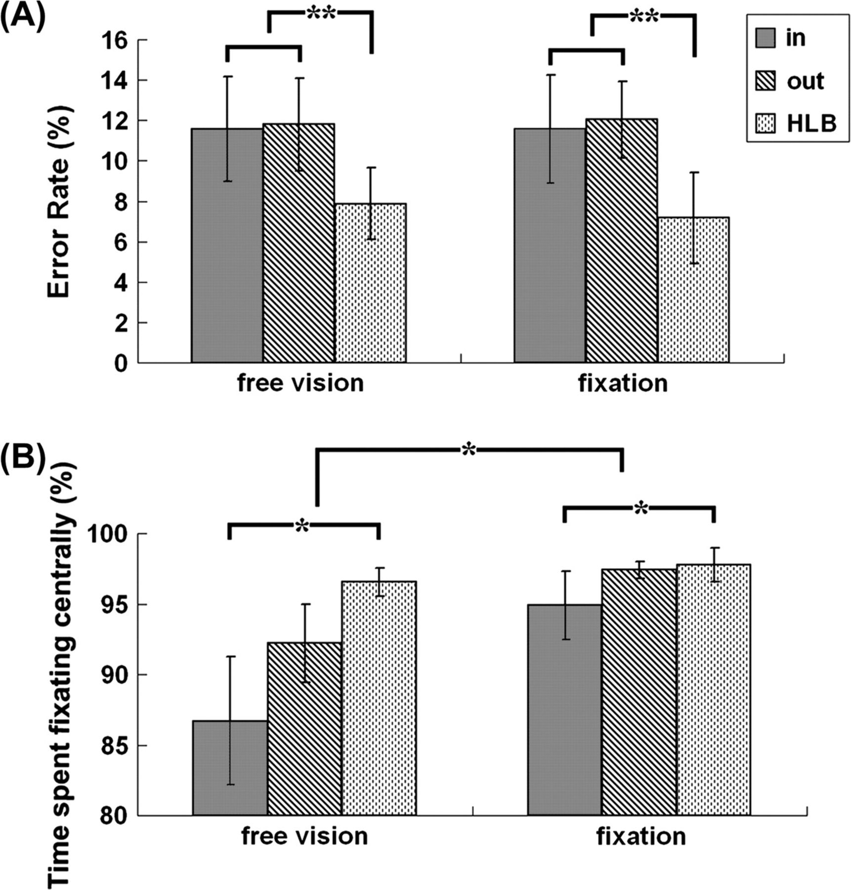
Figure 3. Behavioral and eye-tracking data. (A) Error rates with standard errors in the 6 experimental conditions. (B) ...
Notes:
Figure 3. Behavioral and eye-tracking data. (A) Error rates with standard errors in the 6 experimental conditions. (B) Eye-tracking data: percentage of time during each stimulus train that subjects looked at the spatial region within 1.5° of the central fixation was shown as a function of the 6 experimental conditions. (*P < 0.01 and **P < 0.005).
Unless provided in the caption above, the following copyright applies to the content of this slide: © The Author 2008. Published by Oxford University Press. All rights reserved. For permissions, please e-mail: journals.permissions@oxfordjournals.org

Slide 4
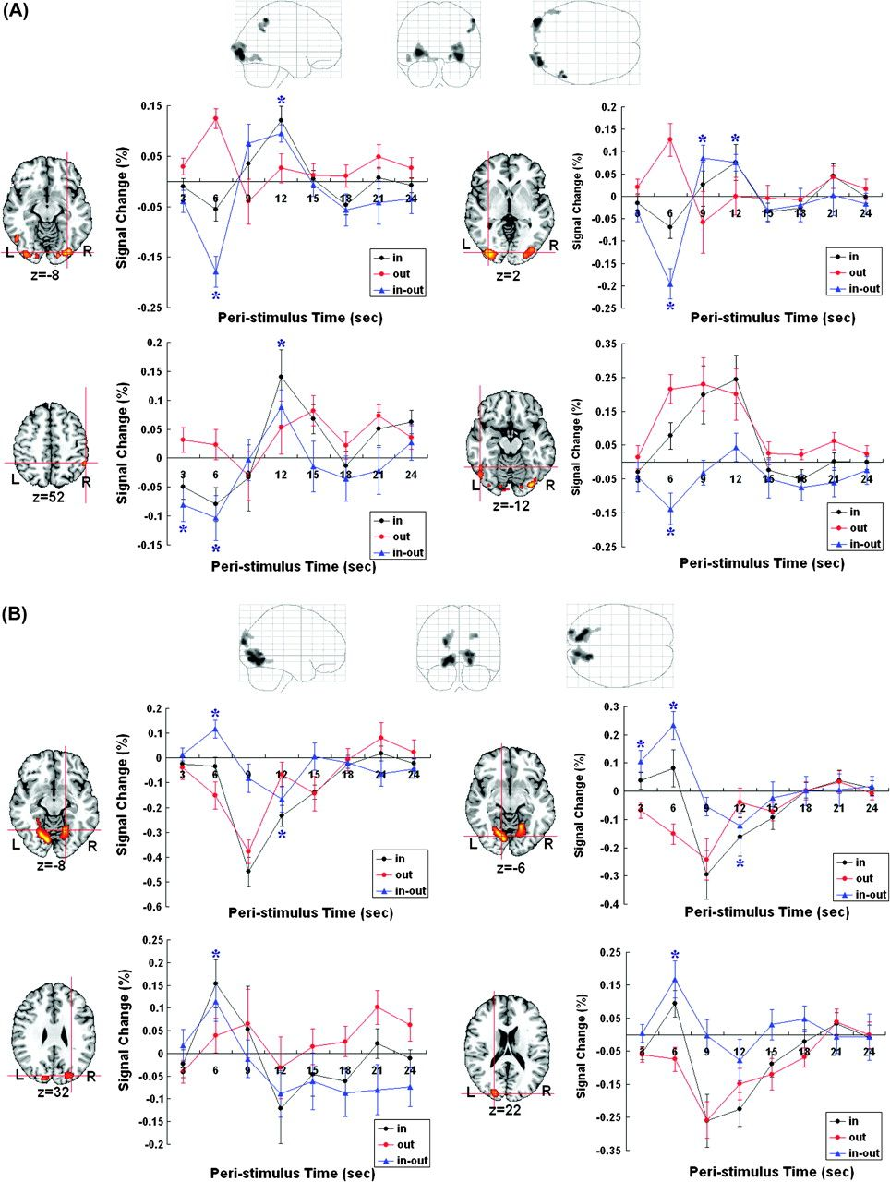
Figure 4. The horizontal gap/distance-specific effects. (A) Bilateral LO-1, left inferior temporal gyrus, and right ...
Notes:
Figure 4. The horizontal gap/distance-specific effects. (A) Bilateral LO-1, left inferior temporal gyrus, and right inferior parietal cortex were significantly activated by the negative parametric modulation effects of the horizontal gap. The plots of the BOLD responses in the 4 regions showed an earlier peak response (3 or 6 s after the start) during zooming out but a later peak response (9 or 12 s after the start) during zooming in. The contrast between the time courses of zooming in and zooming out within the 4 regions accordingly showed an earlier negative peak and a later positive peak (blue curve). These results matched our predictions in Figure 2A. (B) Bilateral hV3v and bilateral hV3d were significantly activated by the positive parametric modulation effect of the horizontal gap. Neural activity in the 4 regions showed earlier peaks (3 or 6 s after the start) during zooming in but later peaks (12 s after the start) during zooming out. The contrast between the time courses of zooming in and zooming out within the 4 regions yielded response curves with earlier positive peaks and later negative peaks. These results matched out predictions illustrated in Figure 2B. The time points denoted with a blue asterisk indicate significant differences between the BOLD responses during zooming in and zooming out, all P < 0.05.
Unless provided in the caption above, the following copyright applies to the content of this slide: © The Author 2008. Published by Oxford University Press. All rights reserved. For permissions, please e-mail: journals.permissions@oxfordjournals.org

Slide 5
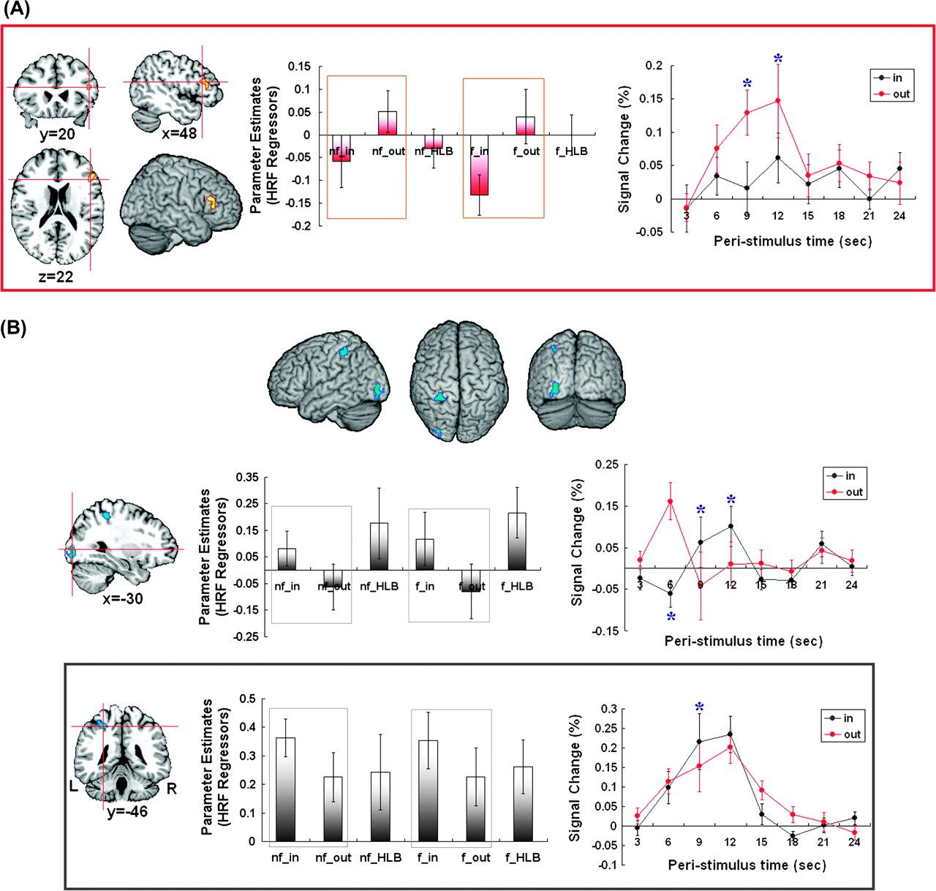
Figure 5. (A) Right IFG was differentially activated during zooming out as compared with zooming in, that is, “(f_out + ...
Notes:
Figure 5. (A) Right IFG was differentially activated during zooming out as compared with zooming in, that is, “(f_out + nf_out) > (f_in + nf_in).” Mean parameter estimates of the 6 types of event regressors were extracted from IFG. The conditions that constituted the SPM analysis were highlighted. The plot of parameter estimates showed that IFG was differentially involved in zooming out irrespective of eye movements. The plot of the BOLD response in IFG showed only height differences, but no temporal differences, between zooming out and zooming in, indicating that right IFG was specifically involved in zooming out, irrespective of the spatial distance. (B) Left LO-1 and left anterior IPS were differentially activated during zooming in as compared with zooming out, that is, “(f_in + nf_in) > (f_out + nf_out).” Plots of the parameter estimates showed that the 2 regions were activated by zooming in irrespective of the eye movements. Plots of the BOLD responses showed that the left LO-1 was also involved in the negative parametric modulation effect of spatial distance, whereas the left superior parietal cortex was specifically involved in the zooming in process independent of the distance confounds.
Unless provided in the caption above, the following copyright applies to the content of this slide: © The Author 2008. Published by Oxford University Press. All rights reserved. For permissions, please e-mail: journals.permissions@oxfordjournals.org

Slide 6
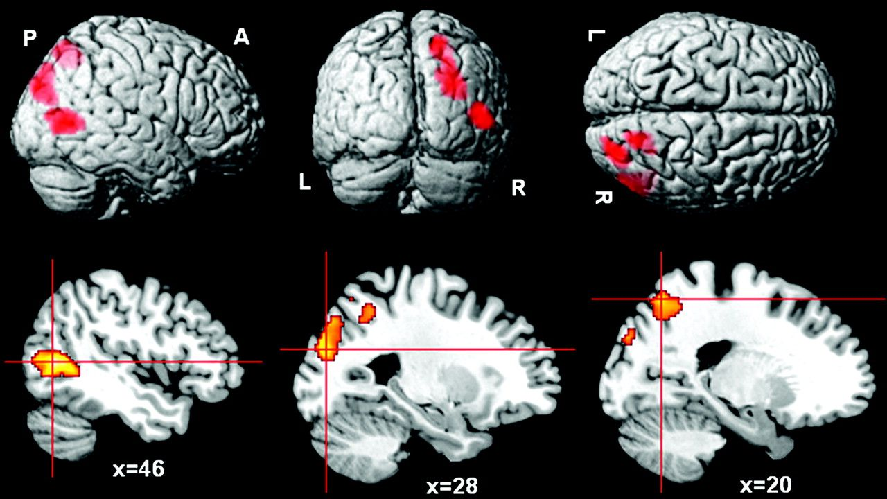
Figure 6. Shared neural activity in the right middle temporal gyrus, right superior occipital gyrus, and right superior ...
Notes:
Figure 6. Shared neural activity in the right middle temporal gyrus, right superior occipital gyrus, and right superior parietal regions between the zooming in and the zooming out process, that is, “(f_in + nf_in) > (f_HLB + nf_HLB)” ∩ “(f_out + nf_out) > (f_HLB + nf_HLB).”
Unless provided in the caption above, the following copyright applies to the content of this slide: © The Author 2008. Published by Oxford University Press. All rights reserved. For permissions, please e-mail: journals.permissions@oxfordjournals.org

Slide 7
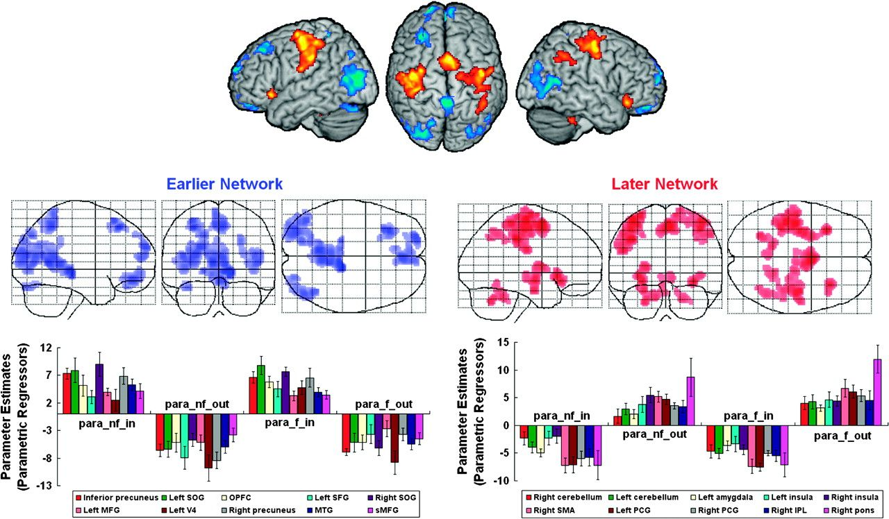
Figure 7. The positive and negative parametric modulation effects of temporal order. Bilateral middle occipital gyrus ...
Notes:
Figure 7. The positive and negative parametric modulation effects of temporal order. Bilateral middle occipital gyrus and the “default network” were activated by the negative parametric modulation effect of temporal order, by showing higher neural activity during the earlier processing phase of a stimulus train (blue), whereas bilateral motor cortex, supplementary motor area, bilateral insula, and some subcortical regions were activated by the positive parametric modulation effect of temporal order, by showing higher neural activity during the later processing phase of a stimulus train. Mean parameter estimates on the parametric regressors of events nf_in, nf_out, f_in, and f_out were extracted from regions in the 2 networks.
Unless provided in the caption above, the following copyright applies to the content of this slide: © The Author 2008. Published by Oxford University Press. All rights reserved. For permissions, please e-mail: journals.permissions@oxfordjournals.org

Slide 8
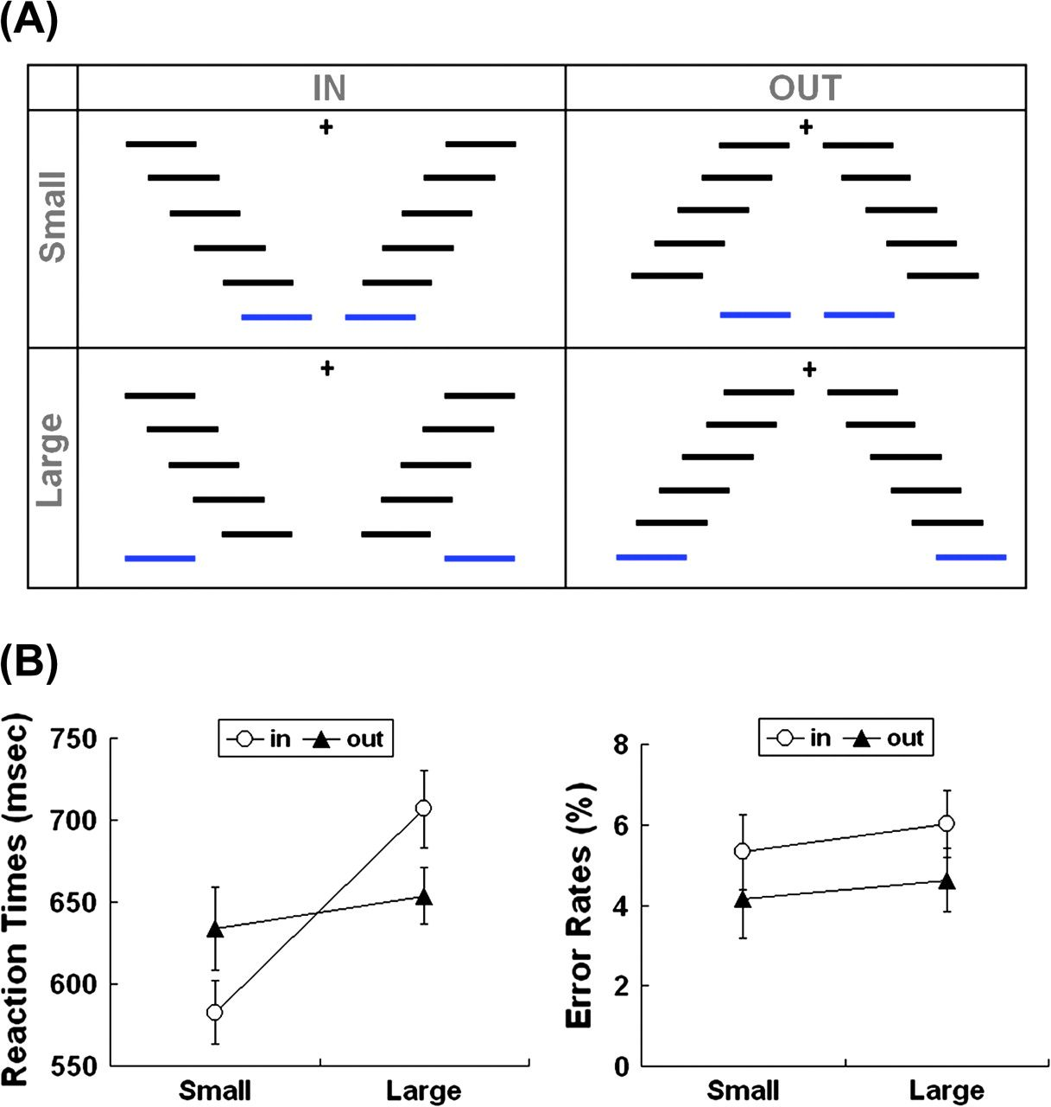
Figure 8. (A) Experimental design of Experiment 2. (B) Behavioral results of Experiment 2, that is, RTs (left) and ...
Notes:
Figure 8. (A) Experimental design of Experiment 2. (B) Behavioral results of Experiment 2, that is, RTs (left) and error rates (right) with standard errors in the 4 experimental conditions.
Unless provided in the caption above, the following copyright applies to the content of this slide: © The Author 2008. Published by Oxford University Press. All rights reserved. For permissions, please e-mail: journals.permissions@oxfordjournals.org

