Slide 1
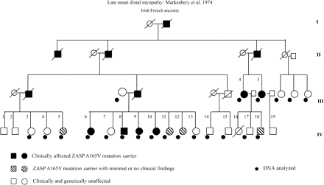
Fig. 1 Pedigree of family with late-onset distal myopathy. Individuals analysed in the current study are marked.
Notes:
Fig. 1 Pedigree of family with late-onset distal myopathy. Individuals analysed in the current study are marked.
Unless provided in the caption above, the following copyright applies to the content of this slide: © The Author (2007). Published by Oxford University Press on behalf of the Guarantors of Brain. All rights reserved. For Permissions, please email: journals.permissions@oxfordjournals.org

Slide 2
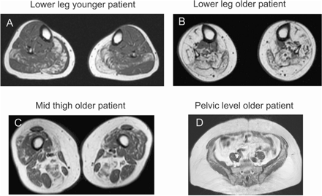
Fig. 2 MR muscle imaging. Early findings in a 54-year-old woman (case IV-9) at onset of clinical symptoms (tripping ...
Notes:
Fig. 2 MR muscle imaging. Early findings in a 54-year-old woman (case IV-9) at onset of clinical symptoms (tripping and stumbling) consisted of fatty degenerative changes in the posterior compartment of the legs: gastrocnemius and soleus muscles. These changes did not cause clinical muscle weakness in ankle plantar flexion (2A). In a 70-year-old woman (case III-4) with disease duration of 20 years there is fatty replacement and atrophy of gluteus maximus (2D), moderate to severe changes in semimembranosus, vastus medialis and lateralis and adductor magnus muscles (2C), there is severe end-stage replacement of muscle in gastrocnemius lateralis, soleus, lateral peroneal and anterior compartment muscles (2B). Deep long toe flexors and tibialis posterior muscles were more preserved.
Unless provided in the caption above, the following copyright applies to the content of this slide: © The Author (2007). Published by Oxford University Press on behalf of the Guarantors of Brain. All rights reserved. For Permissions, please email: journals.permissions@oxfordjournals.org

Slide 3
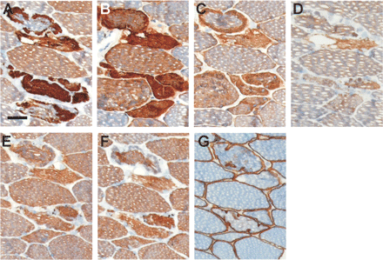
Fig. 3 Immunohistochemical staining of Z-disk proteins performed on serial sections of a banked quadriceps muscle ...
Notes:
Fig. 3 Immunohistochemical staining of Z-disk proteins performed on serial sections of a banked quadriceps muscle biopsy of ZASP A165V patient (III-5). Specific label (DAB) is brown, haematoxylin counterstain is blue. (A) Myotilin, (B) αB-crystallin, (C) desmin, (D) ZASP, (E) α-actinin, (F) telethonin/T-cap, (G) dystrophin C-terminus. Scale bar 20 µm.
Unless provided in the caption above, the following copyright applies to the content of this slide: © The Author (2007). Published by Oxford University Press on behalf of the Guarantors of Brain. All rights reserved. For Permissions, please email: journals.permissions@oxfordjournals.org

Slide 4
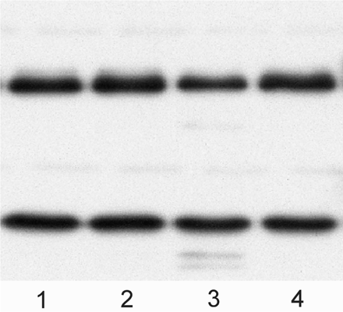
Fig. 4 Western blotting analysis of quadriceps muscle biopsies in two patients and two controls using the mouse ...
Notes:
Fig. 4 Western blotting analysis of quadriceps muscle biopsies in two patients and two controls using the mouse polyclonal ZASP antibody. Similar 78 and 32 kDa bands are seen in (1) and (2) healthy controls and (3) ZASP A165V patient (IV-9), (4) ZASP A165V patient (III-5).
Unless provided in the caption above, the following copyright applies to the content of this slide: © The Author (2007). Published by Oxford University Press on behalf of the Guarantors of Brain. All rights reserved. For Permissions, please email: journals.permissions@oxfordjournals.org

