Slide 1
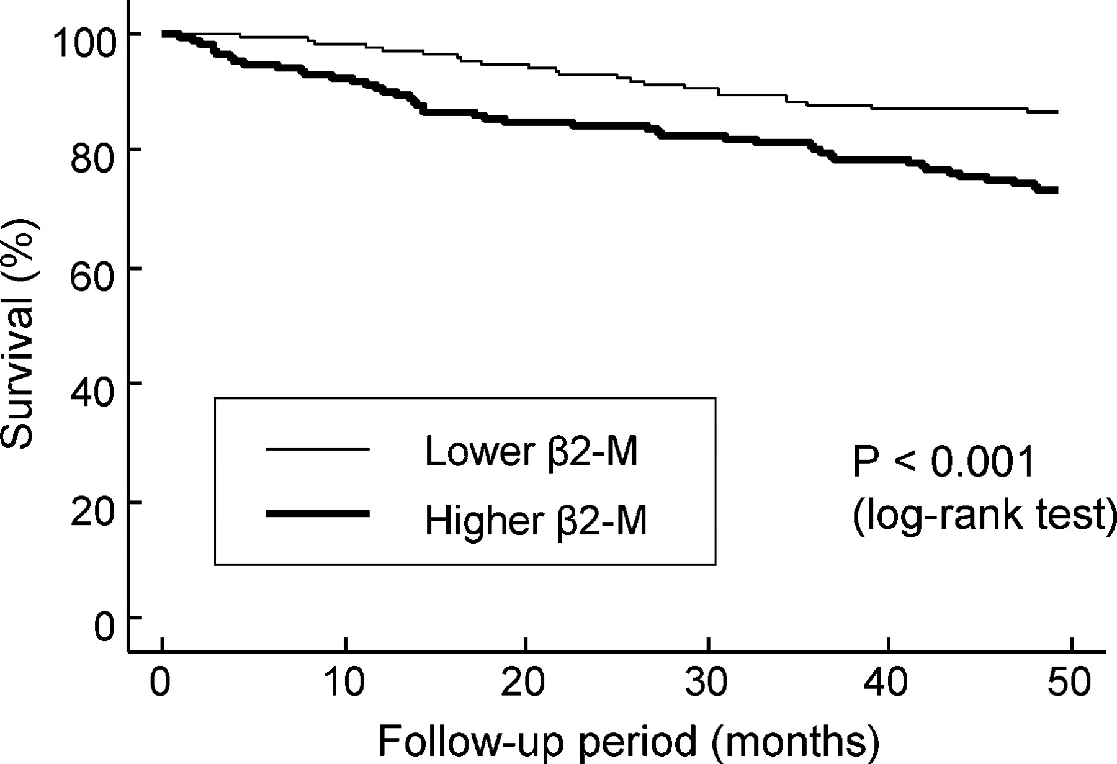
Fig. 3 Kaplan–Meier analysis of all-cause mortality of 490 haemodialysis patients, classified according to lower ...
Notes:
Fig. 3 Kaplan–Meier analysis of all-cause mortality of 490 haemodialysis patients, classified according to lower (<32.2 mg/L, n = 245) and higher (≥32.2 mg/L, n = 245) β 2 -microglobulin (β 2 -M) concentrations. Patients with higher β 2 -M concentrations (thick line) exhibited a significantly higher death rate compared to those with lower β 2 -M concentrations (thin line) (log-rank test, P < 0.001).
Unless provided in the caption above, the following copyright applies to the content of this slide: © Oxford University Press 2008

Slide 2
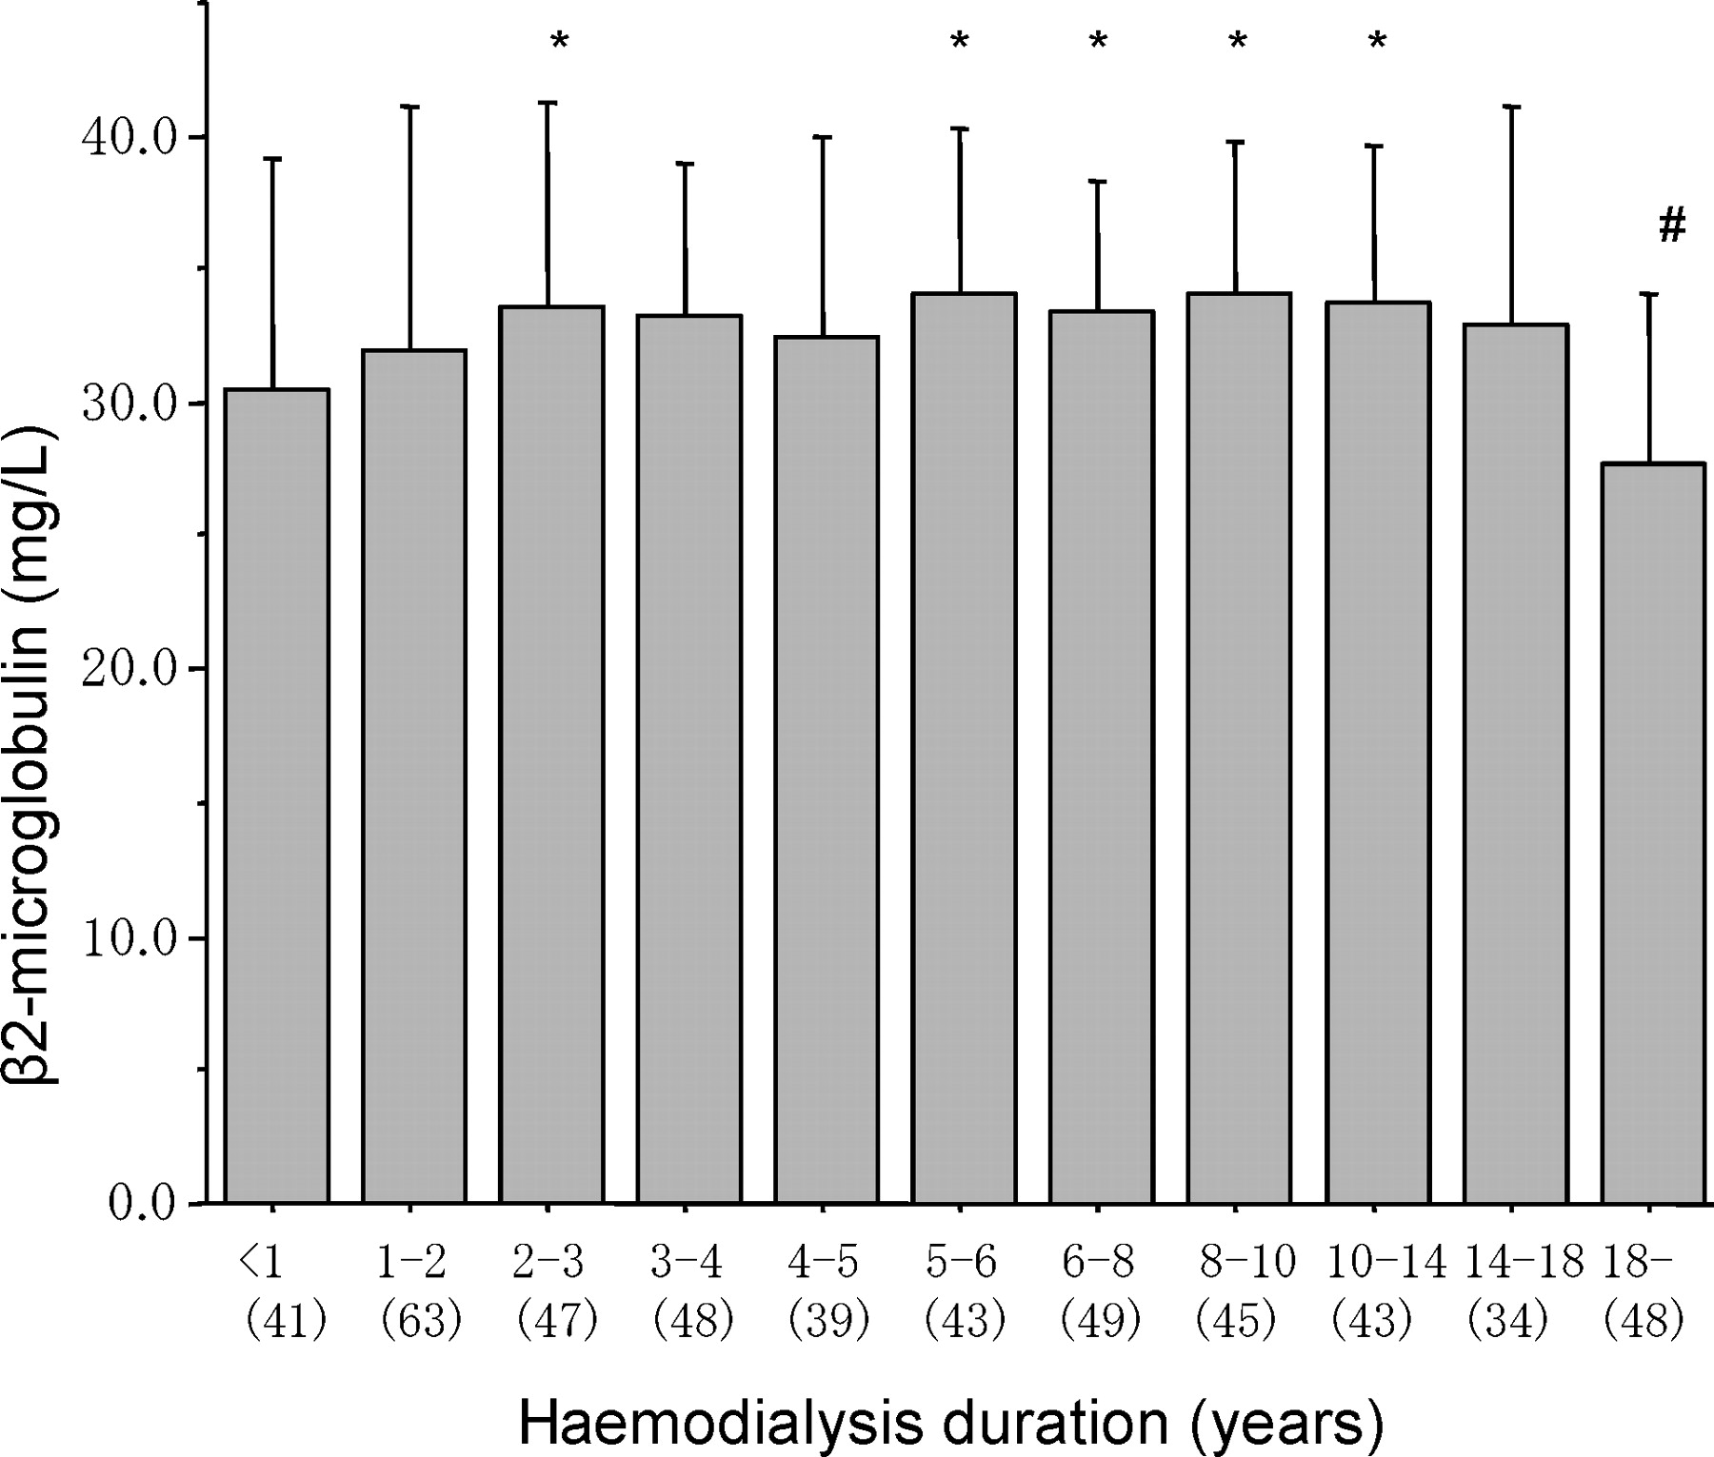
Fig. 2 Serum β ₂ -microglobulin concentration according to haemodialysis duration. Serum β ₂ ...
Notes:
Fig. 2 Serum β 2 -microglobulin concentration according to haemodialysis duration. Serum β 2 -microglobulin concentrations increased until 5 years, reached a plateau level, and then decreased after 18 years. * Denotes P <0.05 versus β 2 -microglobulin concentrations with haemodialysis duration of less than 1 year. # Denotes P < 0.01 versus β 2 -microglobulin concentrations with haemodialysis duration of 1–2, 2–3, 3–4, 4–5, 5–6, 6–8, 8–10, 10–14 and 14–18 years.
Unless provided in the caption above, the following copyright applies to the content of this slide: © Oxford University Press 2008

Slide 3
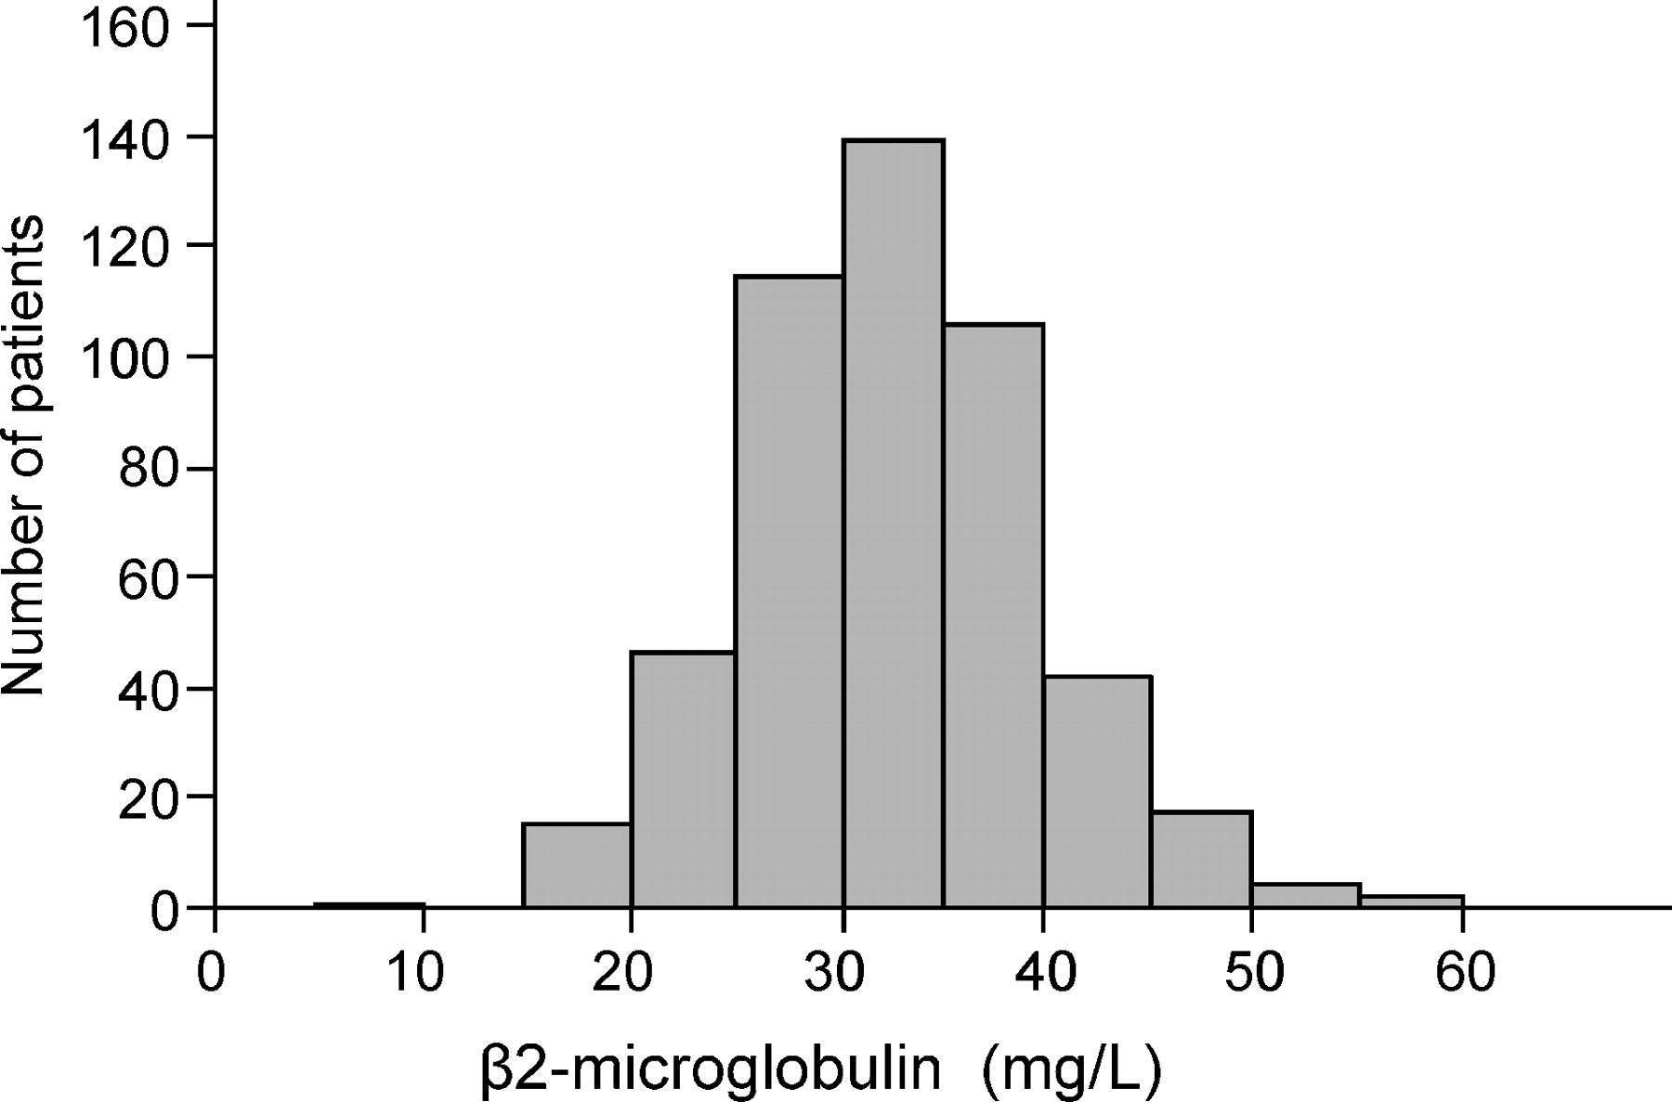
Fig. 1 Distribution of serum β ₂ -microglobulin concentrations. Serum β ₂ -microglobulin ...
Notes:
Fig. 1 Distribution of serum β 2 -microglobulin concentrations. Serum β 2 -microglobulin concentrations were distributed normally.
Unless provided in the caption above, the following copyright applies to the content of this slide: © Oxford University Press 2008

