Slide 1
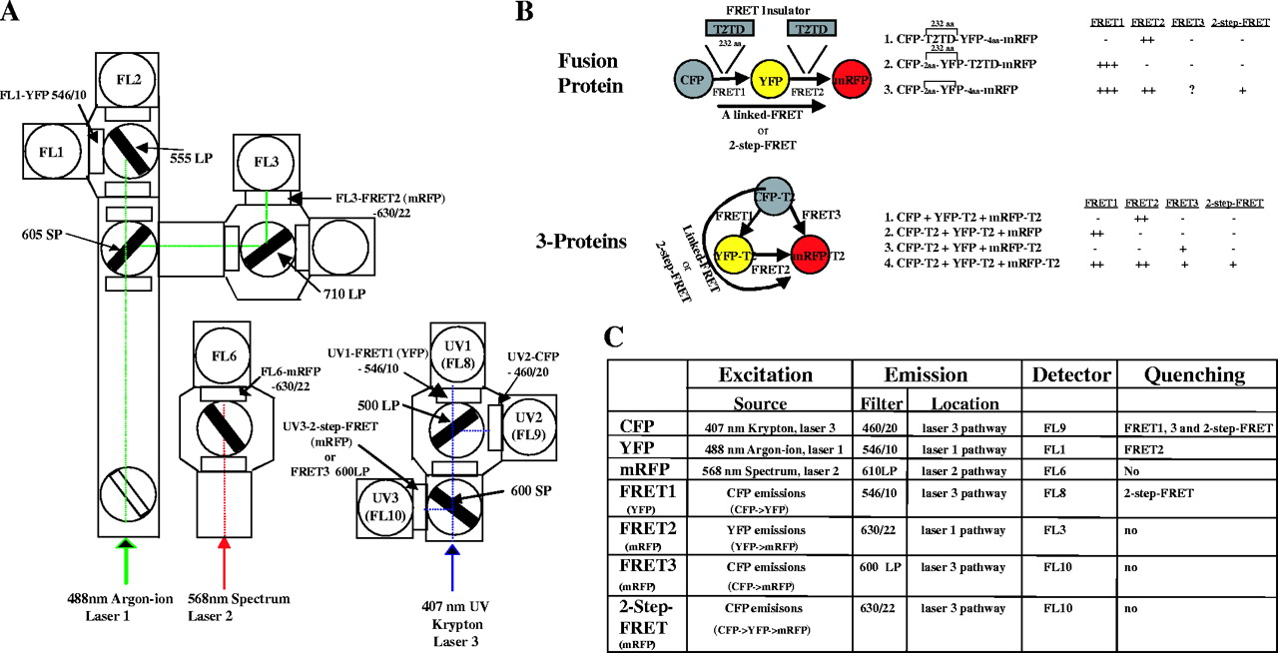
Figure 1 Optical configuration of the DakoCytomation MoFlo cytometer and its use in simultaneously measuring three ...
Notes:
Figure 1 Optical configuration of the DakoCytomation MoFlo cytometer and its use in simultaneously measuring three distinct FRET signals, CFP→YFP, CFP→YFP→mRFP and YFP→mRFP. ( A ) Optical configuration of the MoFlo used to detect CFP, YFP, mRFP, FRET1 (CFP→YFP), FRET2 (YFP→mRFP), potential FRET3 (CFP→mRFP) and two-step FRET (CFP→YFP→mRFP). Briefly, mRFP, an acceptor fluorophore for YFP (YFP→mRFP), was excited by the 568 nm line emitted by the Spectrum laser (laser 2) and its emission signal was collected with a 630/22 bandpass filter (FL6) in the second laser pathway. YFP is either a donor (YFP→mRFP) or an acceptor (CFP→YFP) or both (CFP→YFP→mRFP). It was excited by the 488 nm line emitted from the argon-ion laser (laser 1) and its signal was detected with a 546/10 bass-pass filter (FL1). The FRET2 signal emitted from sensitized mRFP molecules that were excited by closely approximated excited YFP moieties during YFP→mRFP FRET was collected with a 630/22 bandpass filter (FL3) in the first laser pathway. CFP, as a donor fluorophore (CFP→YFP FRET), was excited by the 407 nm line emitted from the krypton-ion laser (laser 3) and its signal was reflected with a 500 nm long-pass dichroic filter first and then detected with a 460/20 bandpass filter (FL9) in the third laser pathway. The FL8 detector in the third laser pathway was used to collect CFP→YFP FRET1 signals with a 546/10 bandpass filter. The FL10 detector in the third laser pathway was employed to collect the two-step-FRET signals emitted from mRFP in a two-step linked FRET reaction (CFP→YFP→mRFP) or possible mRFP FRET3 signals between CFP and mRFP with a 600 longpass filter, along with 600 shortpass splitter. ( B ) Fusion proteins composed of CFP, YFP and mRFP as well as TRAF2 (Ta) labeled with CFP, YFP or mRFP were used to validate the nature of the FRET signals. In the fusion protein system, the TRAF2 TRAF domain (T2TD), which forms a mushroom-shaped structure with a distance of 95 Å, as a FRET insulator, was inserted between fluorophores to prevent energy transfer. ( C ) Summary of excitation sources and emission signals for the different fluorophores (CFP, YFP, mRFP, FRET1, FRET2, FRET3 and two-step-FRET). The potential for donor quenching during the FRET process is also indicated.
Unless provided in the caption above, the following copyright applies to the content of this slide: © The Author 2005. Published by Oxford University Press. All rights reserved The online version of this article has been published under an open access model. Users are entitled to use, reproduce, disseminate, or display the open access version of this article for non-commercial purposes provided that: the original authorship is properly and fully attributed; the Journal and Oxford University Press are attributed as the original place of publication with the correct citation details given; if an article is subsequently reproduced or disseminated not in its entirety but only in part or as a derivative work this must be clearly indicated. For commercial re-use, please contact journals.permissions@oupjournals.org

Slide 2
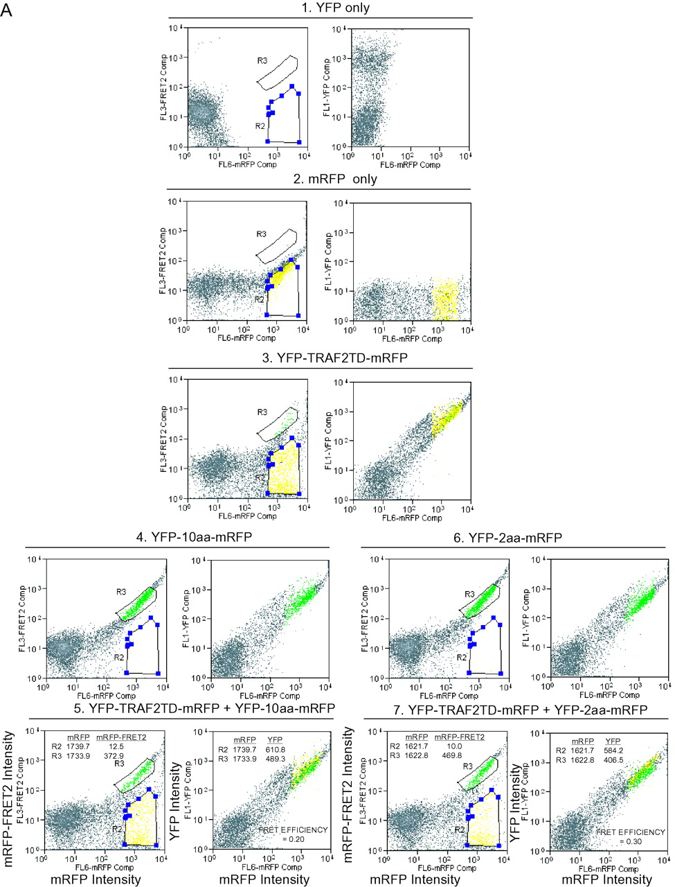
Figure 2 Flow cytometric profiles showing the presence of strong FRET (FRET2) between YFP and mRFP and weak FRET ...
Notes:
Figure 2 Flow cytometric profiles showing the presence of strong FRET (FRET2) between YFP and mRFP and weak FRET (FRET3) between CFP and mRFP. ( A ) FRET occurs from YFP to mRFP fluorophores when YFP is fused directly to mRFP with a 2 or 10-aa linker. Transfected cells were excited with the 488 nm line emitted from the argon-ion laser (laser1) and the 568 nm line emitted from the spectrum laser (laser2) and assessed for FRET2 (YFP→mRFP) shown on the y -axis or YFP emission also shown on the y -axis and mRFP emission shown on the x -axis. FRET2 (shown in R3 ) was positive in cells transfected with YFP-10aa-mRFP ( 4 ) and those transfected with YFP-2aa-mRFP ( 6 ), but not in those transfected with YFP-T2TD-mRFP ( 3 ) or transfected with either YFP or mRFP alone ( 1 and 2 ). FRET-negative control cells ( 3 ) were mixed with FRET-positive controls with 10-aa spacer ( 4 ) or with 2-aa linker ( 6 ) in order to determine FRET2 efficiency ( 5 and 7 ). FRET2 efficiency was calculated based on the donor YFP quenching from R3 to R2 where these two regions had equal amounts of mRFP acceptor intensity and significant differences in FRET2 signals. FRET efficiency was 0.3 and 0.2 for the YFP-mRFP constructs with 2-aa and 10-aa linkers between YFP and mRFP, respectively. FRET2 mean fluorescence intensity (MFI) for each region is shown in each panel. ( B ) Weak FRET3 was detected between CFP and mRFP. Transfected cells were excited with the 407 nm line from krypton-ion laser (laser3) and the 568 nm line from the spectrum laser (laser2) and assessed for potential FRET3 (CFP→mRFP) shown on the y -axis or CFP also on the y -axis and mRFP shown on the x -axis. The same 10-aa linker used in the YFP-10-aa-mRFP construct was inserted between CFP and mRFP and this fusion protein (CFP-10aa-mRFP) was examined for CFP→mRFP FRET3 detected as FRET3 ( R3 ) in FL10 ( 4 ). Positive FRET3 was detected between CFP and mRFP, but with less FRET efficiency (0.14, B5 , determined by mixing cells transfected with CFP-10aa-mRFP and those transfected with the FRET3-negative control CFP-T2TD-mRFP) than was noted between YFP and mRFP (0.20, A5 ). ( C ) As a control, strong FRET1 was noted between CFP and YFP when these two fluorophores are fused with a 2-aa linker. FRET1 was detected in cells transfected with CFP-2aa-YFP with a FRET1 efficiency of 0.54 ( 5 ), but not in those transfected with CFP-TRAF2TD-YFP ( 3 ) or with either CFP or YFP alone ( 1 and 2 ).
Unless provided in the caption above, the following copyright applies to the content of this slide: © The Author 2005. Published by Oxford University Press. All rights reserved The online version of this article has been published under an open access model. Users are entitled to use, reproduce, disseminate, or display the open access version of this article for non-commercial purposes provided that: the original authorship is properly and fully attributed; the Journal and Oxford University Press are attributed as the original place of publication with the correct citation details given; if an article is subsequently reproduced or disseminated not in its entirety but only in part or as a derivative work this must be clearly indicated. For commercial re-use, please contact journals.permissions@oupjournals.org

Slide 3
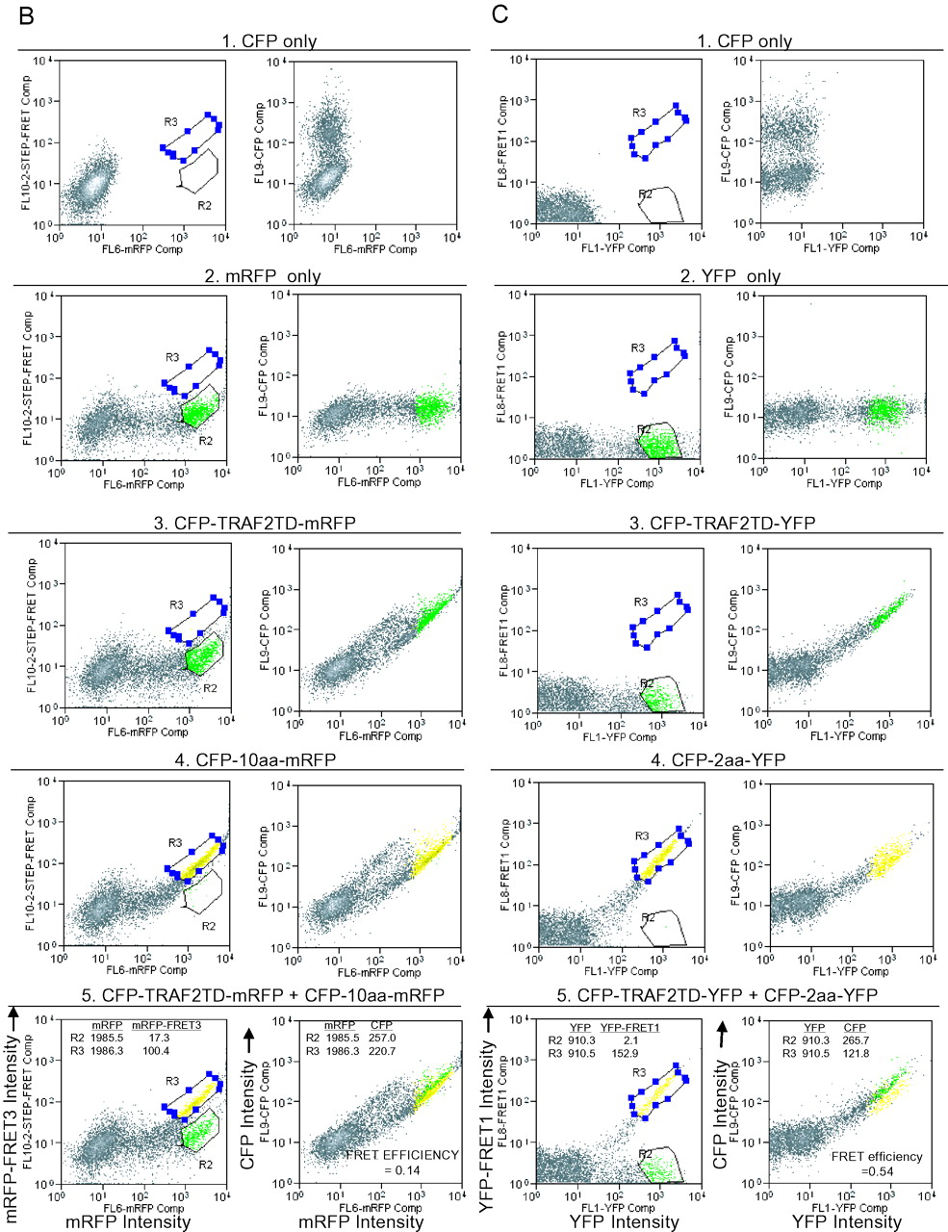
Figure 2 Flow cytometric profiles showing the presence of strong FRET (FRET2) between YFP and mRFP and weak FRET ...
Notes:
Figure 2 Flow cytometric profiles showing the presence of strong FRET (FRET2) between YFP and mRFP and weak FRET (FRET3) between CFP and mRFP. ( A ) FRET occurs from YFP to mRFP fluorophores when YFP is fused directly to mRFP with a 2 or 10-aa linker. Transfected cells were excited with the 488 nm line emitted from the argon-ion laser (laser1) and the 568 nm line emitted from the spectrum laser (laser2) and assessed for FRET2 (YFP→mRFP) shown on the y -axis or YFP emission also shown on the y -axis and mRFP emission shown on the x -axis. FRET2 (shown in R3 ) was positive in cells transfected with YFP-10aa-mRFP ( 4 ) and those transfected with YFP-2aa-mRFP ( 6 ), but not in those transfected with YFP-T2TD-mRFP ( 3 ) or transfected with either YFP or mRFP alone ( 1 and 2 ). FRET-negative control cells ( 3 ) were mixed with FRET-positive controls with 10-aa spacer ( 4 ) or with 2-aa linker ( 6 ) in order to determine FRET2 efficiency ( 5 and 7 ). FRET2 efficiency was calculated based on the donor YFP quenching from R3 to R2 where these two regions had equal amounts of mRFP acceptor intensity and significant differences in FRET2 signals. FRET efficiency was 0.3 and 0.2 for the YFP-mRFP constructs with 2-aa and 10-aa linkers between YFP and mRFP, respectively. FRET2 mean fluorescence intensity (MFI) for each region is shown in each panel. ( B ) Weak FRET3 was detected between CFP and mRFP. Transfected cells were excited with the 407 nm line from krypton-ion laser (laser3) and the 568 nm line from the spectrum laser (laser2) and assessed for potential FRET3 (CFP→mRFP) shown on the y -axis or CFP also on the y -axis and mRFP shown on the x -axis. The same 10-aa linker used in the YFP-10-aa-mRFP construct was inserted between CFP and mRFP and this fusion protein (CFP-10aa-mRFP) was examined for CFP→mRFP FRET3 detected as FRET3 ( R3 ) in FL10 ( 4 ). Positive FRET3 was detected between CFP and mRFP, but with less FRET efficiency (0.14, B5 , determined by mixing cells transfected with CFP-10aa-mRFP and those transfected with the FRET3-negative control CFP-T2TD-mRFP) than was noted between YFP and mRFP (0.20, A5 ). ( C ) As a control, strong FRET1 was noted between CFP and YFP when these two fluorophores are fused with a 2-aa linker. FRET1 was detected in cells transfected with CFP-2aa-YFP with a FRET1 efficiency of 0.54 ( 5 ), but not in those transfected with CFP-TRAF2TD-YFP ( 3 ) or with either CFP or YFP alone ( 1 and 2 ).
Unless provided in the caption above, the following copyright applies to the content of this slide: © The Author 2005. Published by Oxford University Press. All rights reserved The online version of this article has been published under an open access model. Users are entitled to use, reproduce, disseminate, or display the open access version of this article for non-commercial purposes provided that: the original authorship is properly and fully attributed; the Journal and Oxford University Press are attributed as the original place of publication with the correct citation details given; if an article is subsequently reproduced or disseminated not in its entirety but only in part or as a derivative work this must be clearly indicated. For commercial re-use, please contact journals.permissions@oupjournals.org

Slide 4
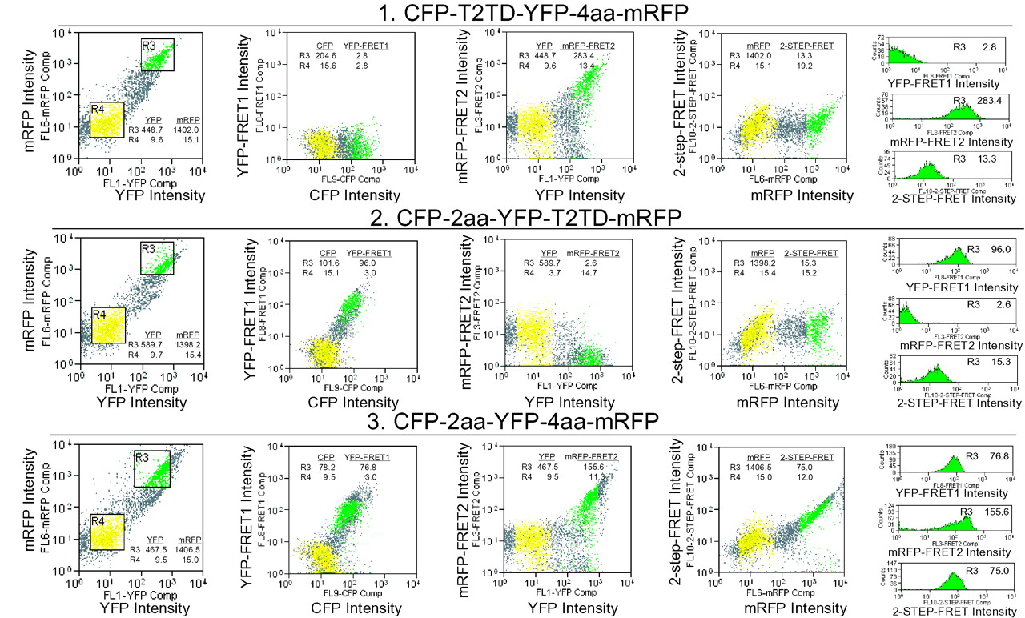
Figure 3 Validation of the two-step FRET measurement in living cells by flow cytometry using the CFP-YFP-mRFP fusion ...
Notes:
Figure 3 Validation of the two-step FRET measurement in living cells by flow cytometry using the CFP-YFP-mRFP fusion proteins. Signals of FRET1 (CFP→YFP), FRET2 (YFP→mRFP) and two-step-FRET or potential FRET3 (CFP→mRFP) were measured simultaneously using flow cytometry as described in Figure 1 . All FRET1, FRET2 and two-step-FRET measurement were carried out in cells transfected with CFP-2aa-YFP-4aa-mRFP ( 3 ). Only FRET2 was detected in the cells expressing CFP-T2TD-YFP-4aa-mRFP ( 1 ) whereas only FRET1 was detected in the cells expressing CFP-2aa-YFP-T2TD-mRFP ( 2 ). Region 3 (R3, in green) and region 4 (R4, in yellow) were gated with equal mRFP intensity in all transfectants as positively transfected cells and negatively transfected cells, respectively. The MFIs for FRET1, FRET2 and two-step-FRET are shown for each FRET panel. The histograms are shown in the right-hand side panels.
Unless provided in the caption above, the following copyright applies to the content of this slide: © The Author 2005. Published by Oxford University Press. All rights reserved The online version of this article has been published under an open access model. Users are entitled to use, reproduce, disseminate, or display the open access version of this article for non-commercial purposes provided that: the original authorship is properly and fully attributed; the Journal and Oxford University Press are attributed as the original place of publication with the correct citation details given; if an article is subsequently reproduced or disseminated not in its entirety but only in part or as a derivative work this must be clearly indicated. For commercial re-use, please contact journals.permissions@oupjournals.org

Slide 5
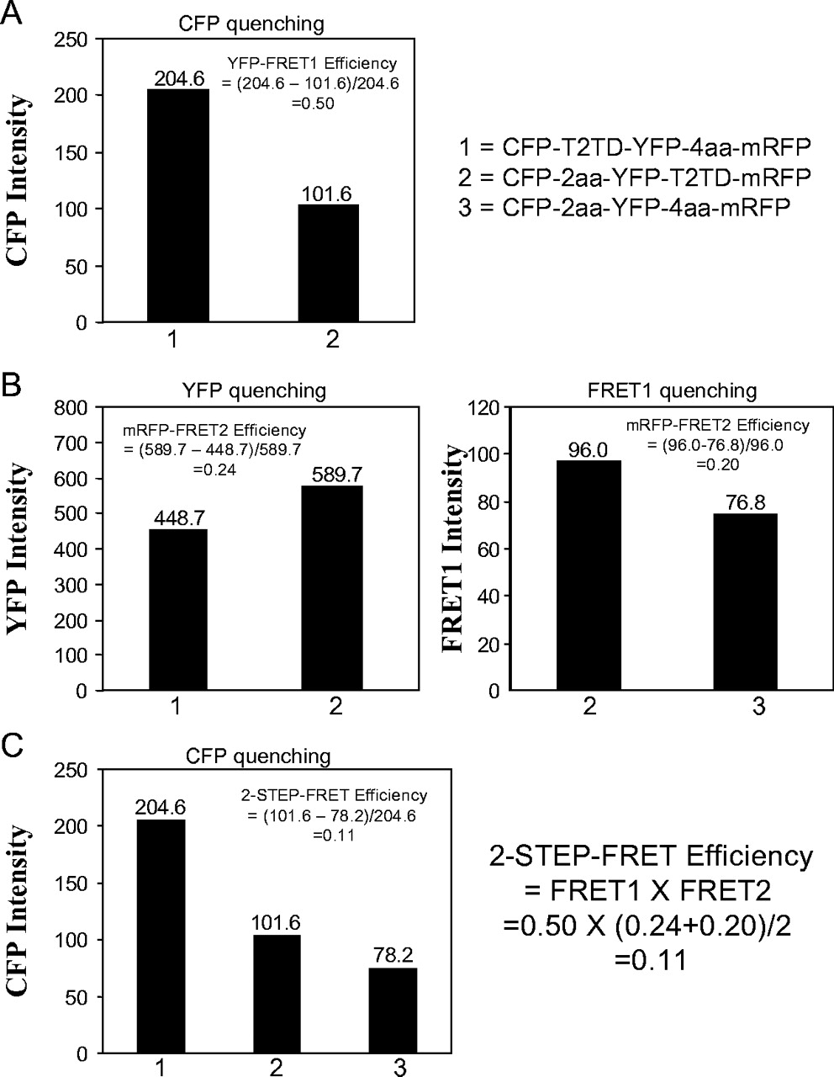
Figure 4 Calculations of FRET1, FRET2 and two-step-FRET efficiency by directly visualizing donor quenching. ( A ) CFP ...
Notes:
Figure 4 Calculations of FRET1, FRET2 and two-step-FRET efficiency by directly visualizing donor quenching. ( A ) CFP donor quenching was used to calculate the FRET1 efficiency from CFP to YFP with a 2-aa linker. CFP donor quenching was obtained by subtracting the intensity of CFP emission in cells transfected with CFP-2aa-YFP-T2TD-mRFP ( 2 ) from that in cells transfected with CFP-T2TD-YFP-4aa-mRFP ( 1 ) and the difference was used to calculate FRET1 efficiency. FRET1 efficiency is 0.50 for the 2-aa liner between CFP and YFP, and similar to that shown in Figure 2C . ( B ) The calculation of FRET2 efficiency from YFP to mRFP with 10-aa linker by visualizing YFP donor or FRET1 donor quenching. YFP donor quenching during YFP→mRFP was obtained by comparing YFP emission intensity between cells transfected with CFP-T2TD-4aa-mRFP ( 1 ) and those transfected with CFP-2aa-YFP-T2TD-4aa-mRFP ( 2 ). FRET1 quenching was observed by comparing FRET1 intensity between cells transfected with CFP2aa-YFP-T2TD-4aa-mRFP ( 2 ) and those transfected with CFP-2aa-YFP-4aa-mRFP ( 3 ). Both YFP and FRET1 quenching were used to calculate the efficiency of FRET2 from YFP to mRFP with a 4-aa linker, and both calculations produced a similar value. ( C ) The calculation of two-step-FRET efficiency by CFP quenching or simply by FRET1 efficiency times FRET2 efficiency that were obtained previously was comparable. CFP quenching because of two-step-FRET contribution was obtained by subtracting CFP intensity in cells transfected with CFP-2aa-YFP-4aa-mRFP ( 3 ) from those transfected with CFP-2aa-YFP-T2TD-mRFP ( 2 ). Based on CFP loss, two-step-FRET efficiency is 0.11, which is the same as determined by FRET1 times FRET2 efficiency.
Unless provided in the caption above, the following copyright applies to the content of this slide: © The Author 2005. Published by Oxford University Press. All rights reserved The online version of this article has been published under an open access model. Users are entitled to use, reproduce, disseminate, or display the open access version of this article for non-commercial purposes provided that: the original authorship is properly and fully attributed; the Journal and Oxford University Press are attributed as the original place of publication with the correct citation details given; if an article is subsequently reproduced or disseminated not in its entirety but only in part or as a derivative work this must be clearly indicated. For commercial re-use, please contact journals.permissions@oupjournals.org

Slide 6
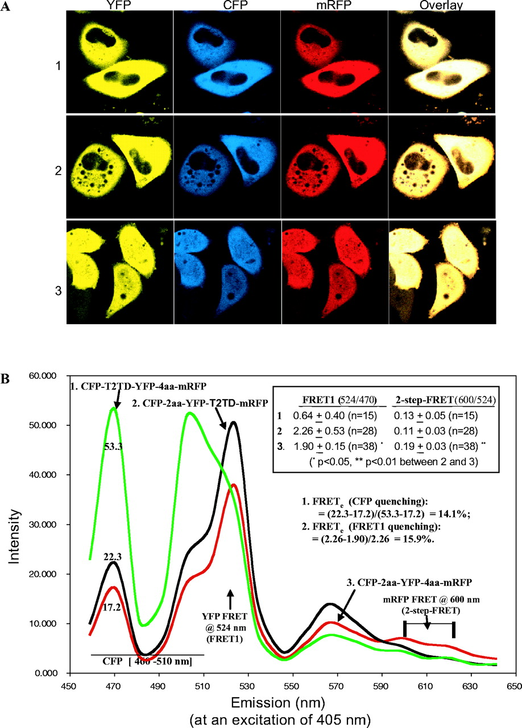
Figure 5 Validation of linked FRET in the CFP-YFP-mRFP fusion protein using confocal microscopy. ( A ) Images of YFP, ...
Notes:
Figure 5 Validation of linked FRET in the CFP-YFP-mRFP fusion protein using confocal microscopy. ( A ) Images of YFP, CFP, mRFP and their overlays in cells transfected with CFP-T2TD-YFP-4aa-mRFP ( 1 ), CFP-2aa-YFP-T2TD-mRFP ( 2 ) or CFP-2aa-YFP-4aa-mRFP ( 3 ). CFP was excited with the 405 nm line and its emissions were collected with a 480/20 filter. YFP was excited with the 488 nm line and its emissions were collected with a 520/20 filter, whereas mRFP was excited with 543 nm and its emissions were collected with a 600 LP filter. ( B ) The spectra of the mean emissions ranging from 460 to 640 nm for cells transfected with CFP-T2TD-4aa-mRFP ( 1 ), CFP-2aa-YFP-T2TD-mRFP ( 2 ) or CFP-2aa-YFP-4aa-mRFP ( 3 ). Two valleys at 488 and 543 nm resulted from the use of 488 and 543 filters in order to delete laser scatter noise in the pathway. The sensitized YFP or FRET1 emissions and two-step-FRET emissions are indicated by an arrow at 524 and 600 nm, respectively. A large number of transfected cells were analyzed for the FRET1 ratio (524/470 nm) and the two-step-FRET ratio (600/524 nm). The occurrence of FRET1 quenching and two-step-FRET signals was noted in cells transfected with CFP-2aa-YFP-4aa-mRFP ( 3 ) compared to those tranfected with CFP2aa-YFP-T2TD-mRFP ( 2 ). CFP intensity for each of the transfectants is indicated at 470 nm in the panel.
Unless provided in the caption above, the following copyright applies to the content of this slide: © The Author 2005. Published by Oxford University Press. All rights reserved The online version of this article has been published under an open access model. Users are entitled to use, reproduce, disseminate, or display the open access version of this article for non-commercial purposes provided that: the original authorship is properly and fully attributed; the Journal and Oxford University Press are attributed as the original place of publication with the correct citation details given; if an article is subsequently reproduced or disseminated not in its entirety but only in part or as a derivative work this must be clearly indicated. For commercial re-use, please contact journals.permissions@oupjournals.org

Slide 7
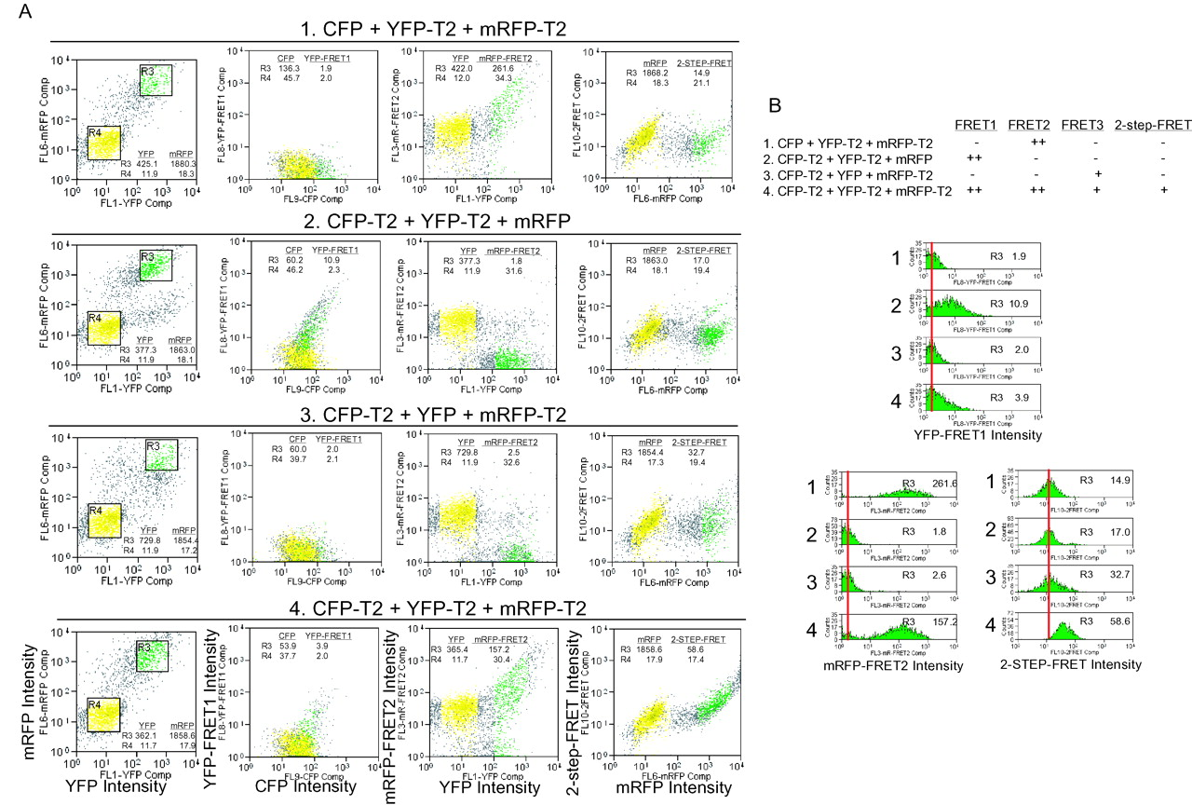
Figure 6 Validation of TRAF2 homotrimer formation in living cells by positive two-step FRET. ( A ) Flow cytometric ...
Notes:
Figure 6 Validation of TRAF2 homotrimer formation in living cells by positive two-step FRET. ( A ) Flow cytometric profiles showing simultaneous measurements of FRET1 (CFP→YFP), FRET2 (YFP→mRFP) and two-step-FRET (CFP→YFP→mRFP) or potential FRET3 (CFP→mRFP). Region 3 ( R3 ) with equal mRFP intensity for all transfected cells and region 4 ( R4 ) were gated as positively and negatively transfected cells, respectively. The positive FRET1, FRET2 and two-step-FRET signals were detected in cells co-expressing CFP-TRAF2, YFP-TRAF2 and mRFP-TRAF2 ( 4 ). In contrast, only FRET2 was detected in the cells co-expressing CFP/YFP-TRAF2/mRFP-TRAF2 ( 1 ), whereas only FRET1 was detected in the cells co-expressing CFP-TRAF2/YFP-TRAF2/mRFP ( 2 ). Weak positive FRET3 was detected in cells co-expressing CFP-TRAF2, YFP and mRFP-TRAF2 ( 3 ), indicating potential energy transfer from CFP-TRAF2 to mRFP-TRAF2. However, this transfer was significantly less than that detected in sample 4 (MFI: 32.7 versus 58.6). The MFIs of FRET1, FRET2 and two-step-FRET or potential FRET3 are shown for each FRET panel. ( B ) Flow cytometric histogram profiles showing the CFP→YFP FRET1 quenching and strong two-step-FRET signals, indicating trimerization of TRAF2 in cells co-expressing CFP-TRAF2, YFP-TRAF2 and mRFP-TRAF2 ( 4 ).
Unless provided in the caption above, the following copyright applies to the content of this slide: © The Author 2005. Published by Oxford University Press. All rights reserved The online version of this article has been published under an open access model. Users are entitled to use, reproduce, disseminate, or display the open access version of this article for non-commercial purposes provided that: the original authorship is properly and fully attributed; the Journal and Oxford University Press are attributed as the original place of publication with the correct citation details given; if an article is subsequently reproduced or disseminated not in its entirety but only in part or as a derivative work this must be clearly indicated. For commercial re-use, please contact journals.permissions@oupjournals.org

