Slide 1
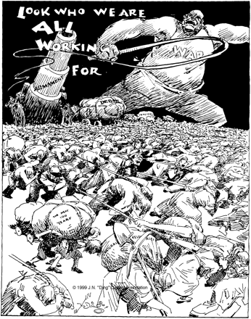
Figure 2 Unlike in Figure 1, where he focused on the way resource scarcities create war, in this cartoon, “Ding” ...
Notes:
Figure 2 Unlike in Figure 1, where he focused on the way resource scarcities create war, in this cartoon, “Ding” Darling warned of the long-term burden that war places on nature. This cartoon appeared just days after the German invasion of Poland prompted declarations of war from France and Great Britain in early September 1939. Credit: Jay N. Darling, “Speaking of Labor Day,” September 4, 1939. Courtesy of the Jay N. ‘Ding’ Darling Wildlife Society.
Unless provided in the caption above, the following copyright applies to the content of this slide: © 2012 The Author. Published by Oxford University Press on behalf of the American Society for Environmental History and the Forest History Society. All rights reserved. For Permissions, please email: journals.permissions@oup.com

Slide 2
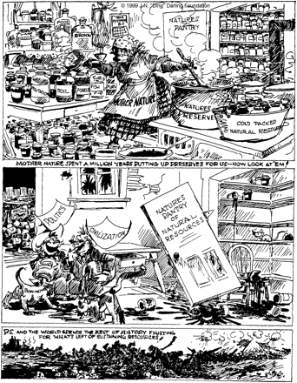
Figure 1 Jay N. “Ding” Darling's 1936 political cartoon laments how “politics” and “civilization” had abused Mother ...
Notes:
Figure 1 Jay N. “Ding” Darling's 1936 political cartoon laments how “politics” and “civilization” had abused Mother Nature's creations. Whereas earlier conservationists had decried the waste of inefficient production, in this cartoon Darling called attention to the waste of irresponsible consumption. Competition for the resulting scarce resources, Darling also warned in the final cartoon panel, fueled war. Credit: Jay N. Darling, “Time to Take an Inventory of Our Pantry,” September 15, 1936. Courtesy of the Jay N. ‘Ding’ Darling Wildlife Society.
Unless provided in the caption above, the following copyright applies to the content of this slide: © 2012 The Author. Published by Oxford University Press on behalf of the American Society for Environmental History and the Forest History Society. All rights reserved. For Permissions, please email: journals.permissions@oup.com

Slide 3
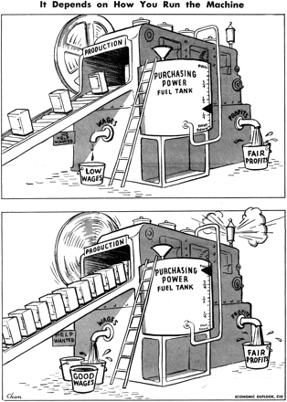
Figure 3 This CIO cartoon applauds the high wages that a Keynesian consumption-based high-production economy would ...
Notes:
Figure 3 This CIO cartoon applauds the high wages that a Keynesian consumption-based high-production economy would bring. But it also unintentionally expresses the concerns of conservationists such as Vogt and Osborn that a robust economy will strain natural resources and increase pollution. Credit: “It Depends on How You Run the Machine,” March 1946, Economic Outlook, Congress of Industrial Organization. Courtesy of The George Meany Memorial Archives/SN70.
Unless provided in the caption above, the following copyright applies to the content of this slide: © 2012 The Author. Published by Oxford University Press on behalf of the American Society for Environmental History and the Forest History Society. All rights reserved. For Permissions, please email: journals.permissions@oup.com

Slide 4
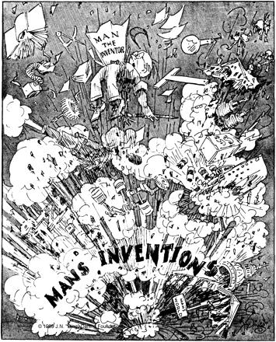
Figure 4 Well before the atomic blasts that ended the war in 1945, Darling displayed mounting concern about ...
Notes:
Figure 4 Well before the atomic blasts that ended the war in 1945, Darling displayed mounting concern about technology's threat to human survival. Darling's title was an ironic rebuke of those in a post-Darwin world who saw human beings as the highest stage of evolutionary advancement. Credit: Jay N. Darling, “The Ascent of Man—Final Stage,” February 11, 1941. Courtesy of the Jay N. ‘Ding’ Darling Wildlife Society.
Unless provided in the caption above, the following copyright applies to the content of this slide: © 2012 The Author. Published by Oxford University Press on behalf of the American Society for Environmental History and the Forest History Society. All rights reserved. For Permissions, please email: journals.permissions@oup.com

Slide 5
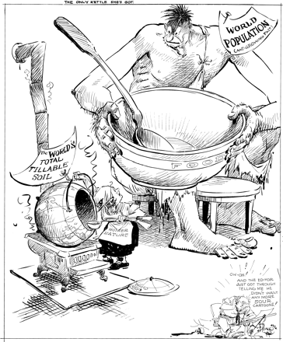
Figure 5 In this 1947 cartoon, Ding Darling showed the links between consumption and production, and he emphasized the ...
Notes:
Figure 5 In this 1947 cartoon, Ding Darling showed the links between consumption and production, and he emphasized the limits of the land by drawing attention to the world's total tillable soil. Extending this logic, proto-environmental conservationists such as William Vogt and Fairfield Osborn not just saw limits being reached but also warned of the declining productivity of land. Credit: Jay N. Darling, “The Only Kettle She's Got,” August 6, 1947. Courtesy of the Jay N. ‘Ding’ Darling Wildlife Society.
Unless provided in the caption above, the following copyright applies to the content of this slide: © 2012 The Author. Published by Oxford University Press on behalf of the American Society for Environmental History and the Forest History Society. All rights reserved. For Permissions, please email: journals.permissions@oup.com

