Slide 1
Figure 1. The workflow in constructing the CGDB database. Cycling genes that were identified via non-high throughput ...
Notes:
Figure 1. The workflow in constructing the CGDB database. Cycling genes that were identified via non-high throughput methods were collected from published literature and ortholog search was conducted subsequently. This data was then combined with cycling genes identified by high throughput methods. Finally, all cycling genes were annotated by established databases including Uniprot, NCBI and Ensembl.
Unless provided in the caption above, the following copyright applies to the content of this slide: © The Author(s) 2016. Published by Oxford University Press on behalf of Nucleic Acids Research.This is an Open Access article distributed under the terms of the Creative Commons Attribution License (http://creativecommons.org/licenses/by-nc/4.0/), which permits non-commercial re-use, distribution, and reproduction in any medium, provided the original work is properly cited. For commercial re-use, please contact journals.permissions@oup.com

Slide 2
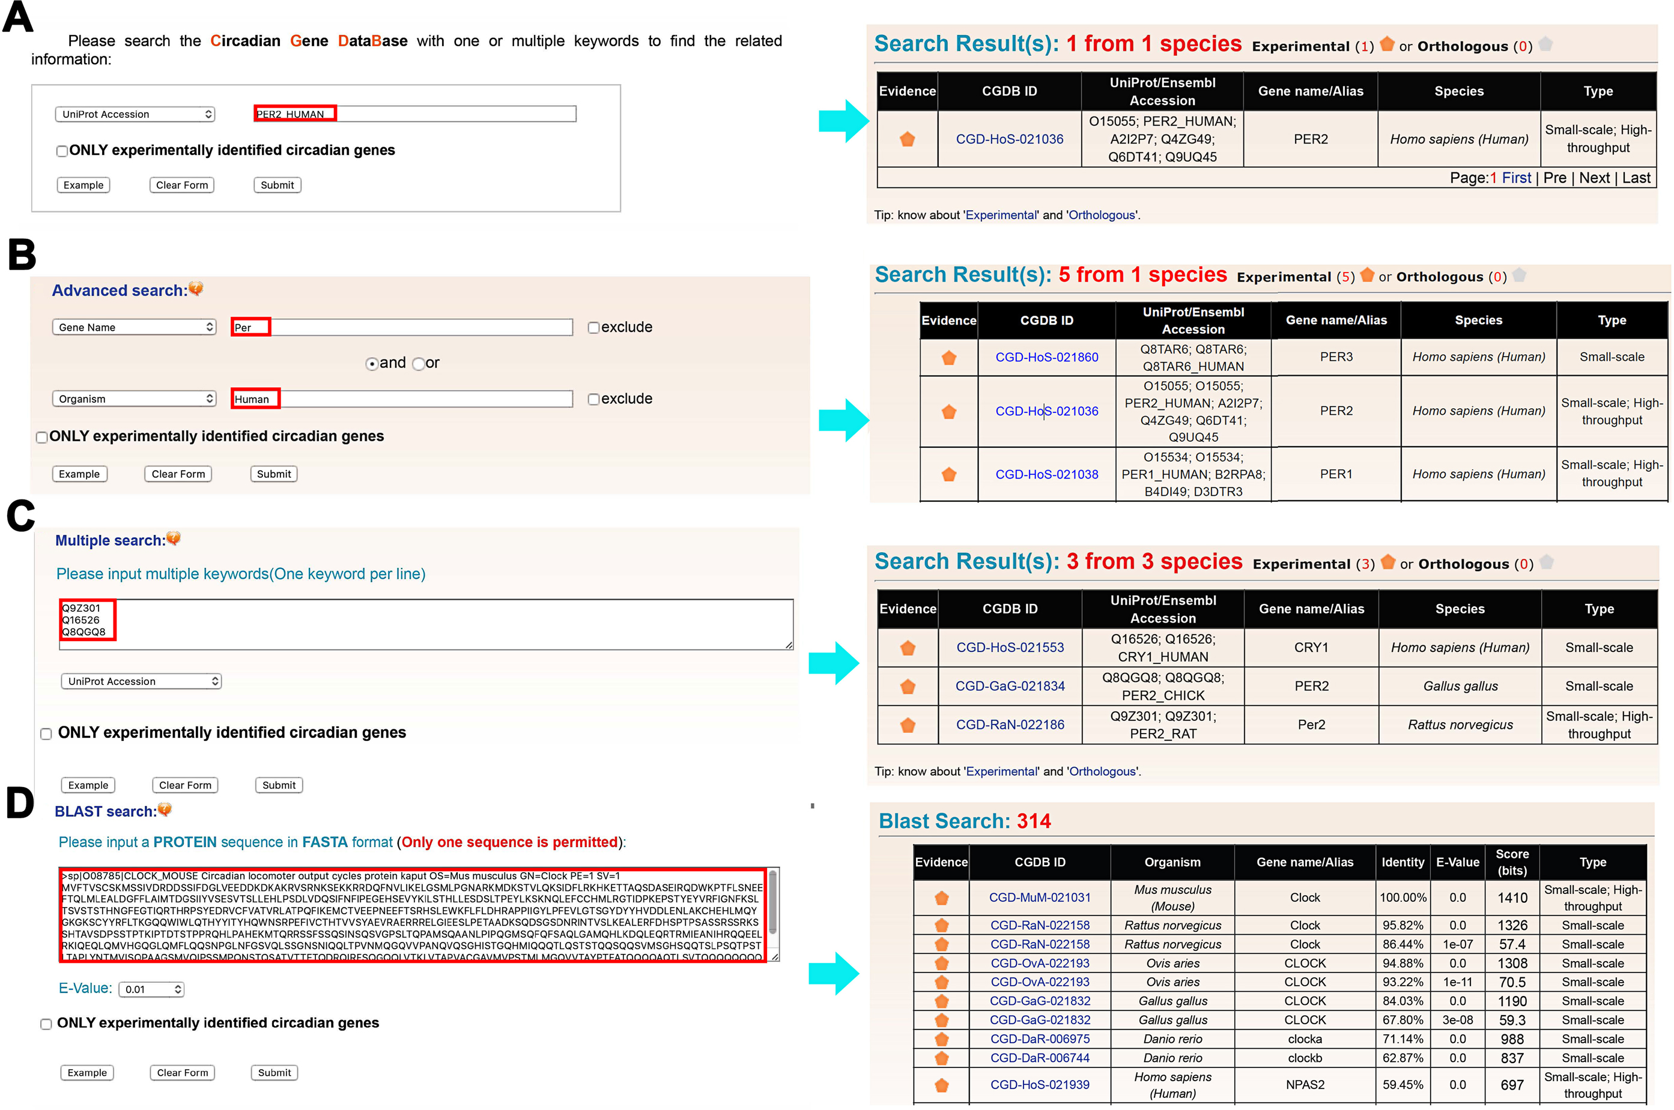
Figure 2. The search options of CGDB. (A) ‘Simple search’. The database can be queried with one or multiple keywords. ...
Notes:
Figure 2. The search options of CGDB. (A) ‘Simple search’. The database can be queried with one or multiple keywords. (B) ‘Advanced search’. Users can input up to two terms to perform a precise search. (D) ‘Multiple search’. A list of keywords in a line-by-line format can be input to search multiple genes at once. (C) ‘Blast search’. The option was designed for searching the database with one protein sequence in FASTA format.
Unless provided in the caption above, the following copyright applies to the content of this slide: © The Author(s) 2016. Published by Oxford University Press on behalf of Nucleic Acids Research.This is an Open Access article distributed under the terms of the Creative Commons Attribution License (http://creativecommons.org/licenses/by-nc/4.0/), which permits non-commercial re-use, distribution, and reproduction in any medium, provided the original work is properly cited. For commercial re-use, please contact journals.permissions@oup.com

Slide 3
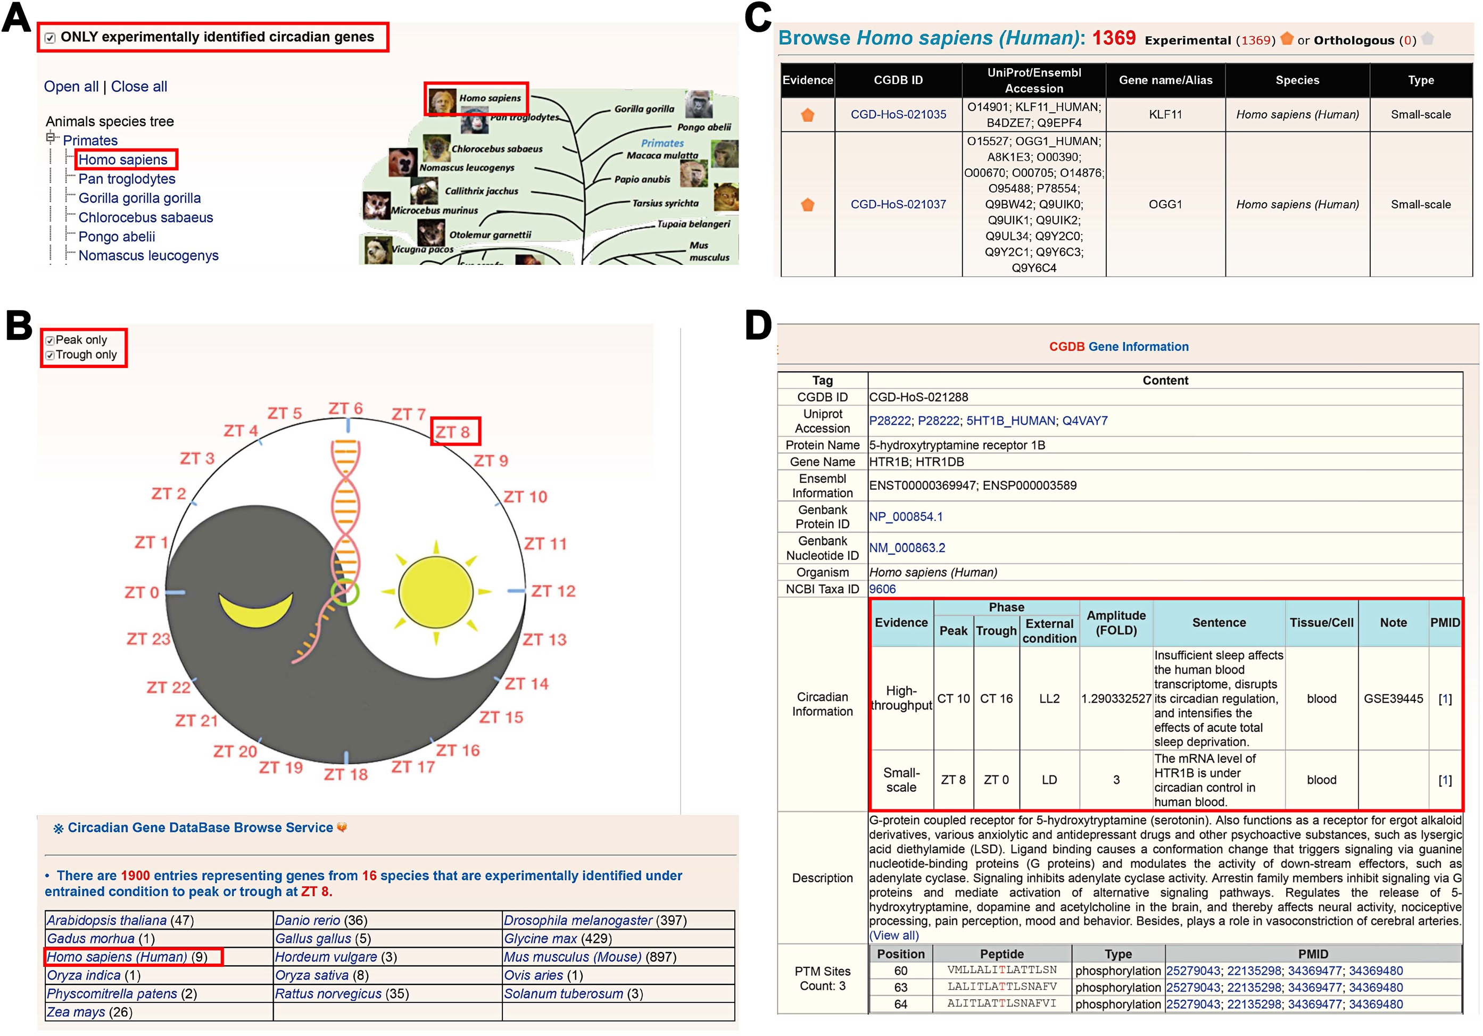
Figure 3. The browse options of CGDB. We provide two methods to browse the database: (A) by species and (B) by external ...
Notes:
Figure 3. The browse options of CGDB. We provide two methods to browse the database: (A) by species and (B) by external condition. (C) The browse results can be displayed in a tabular format with CGDB ID, UniProt/Ensembl accession, species, and protein name. (D) The detailed information of human HTR1B.
Unless provided in the caption above, the following copyright applies to the content of this slide: © The Author(s) 2016. Published by Oxford University Press on behalf of Nucleic Acids Research.This is an Open Access article distributed under the terms of the Creative Commons Attribution License (http://creativecommons.org/licenses/by-nc/4.0/), which permits non-commercial re-use, distribution, and reproduction in any medium, provided the original work is properly cited. For commercial re-use, please contact journals.permissions@oup.com

Slide 4
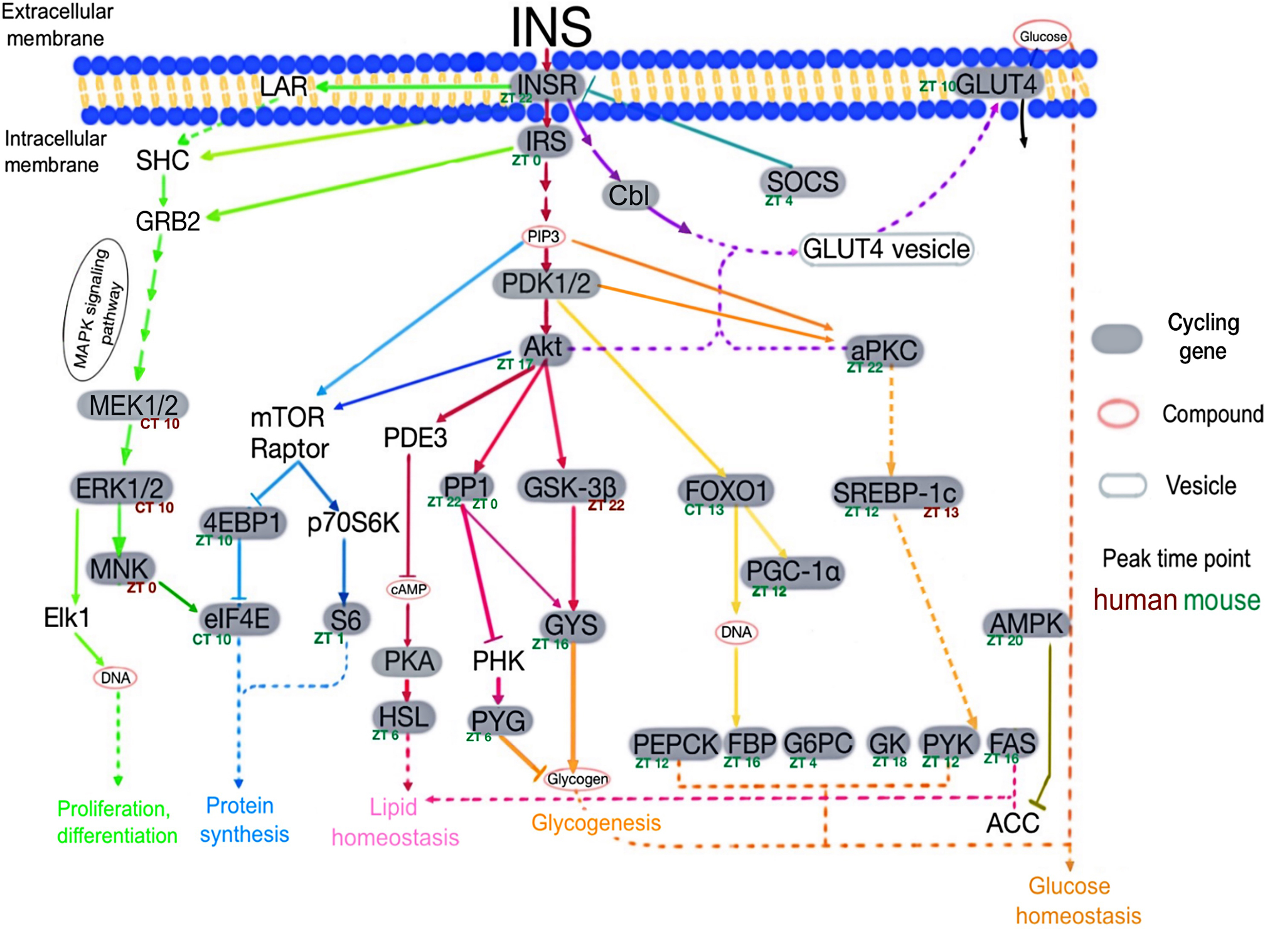
Figure 4. The insulin signaling pathway is significantly enriched in human cycling genes (the hypergeometric test, ...
Notes:
Figure 4. The insulin signaling pathway is significantly enriched in human cycling genes (the hypergeometric test, p-value = 9.70E-7, E-ratio = 2.26). Part of the insulin signaling pathway adapted from KEGG. Cycling genes are filled gray ovals, whereas compounds are open pink ovals and vesicles are open gray ovals. Peak time points for human and mouse cycling genes are indicated in brown and green, respectively. Solid lines indicate direct protein interactions while dashed lines indicate indirect effects (i.e. other factors are involved which are not shown in the figure). PP1 [regulatory subunit 3B (ZT22) /regulatory subunit 3C (ZT0)].
Unless provided in the caption above, the following copyright applies to the content of this slide: © The Author(s) 2016. Published by Oxford University Press on behalf of Nucleic Acids Research.This is an Open Access article distributed under the terms of the Creative Commons Attribution License (http://creativecommons.org/licenses/by-nc/4.0/), which permits non-commercial re-use, distribution, and reproduction in any medium, provided the original work is properly cited. For commercial re-use, please contact journals.permissions@oup.com

