Slide 1
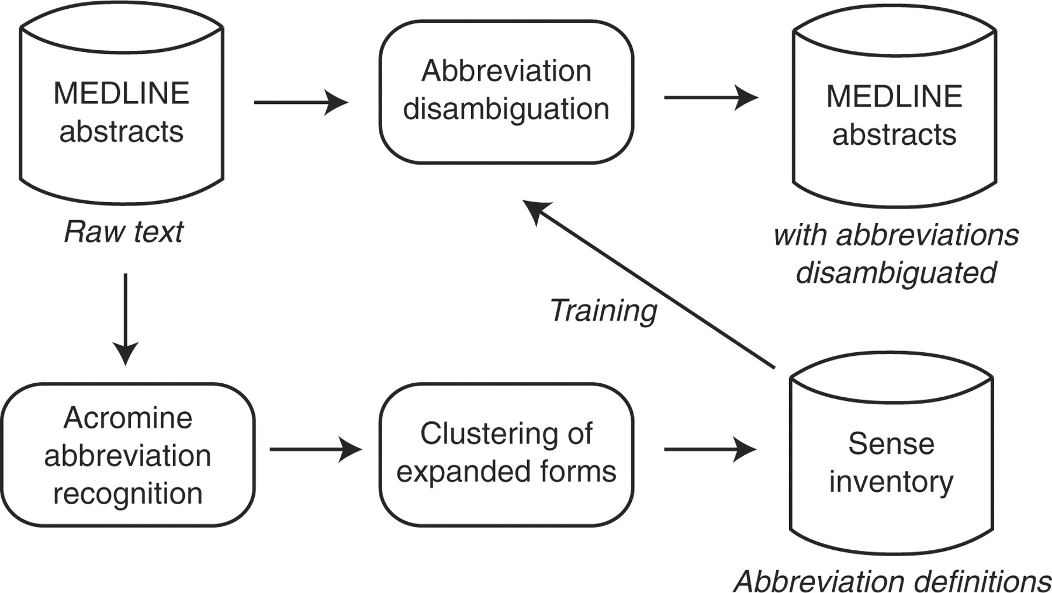
Fig. 2. Work flow of the proposed system.
Notes:
Fig. 2. Work flow of the proposed system.
Unless provided in the caption above, the following copyright applies to the content of this slide: © The Author(s) 2010. Published by Oxford University Press.This is an Open Access article distributed under the terms of the Creative Commons Attribution Non-Commercial License (http://creativecommons.org/licenses/by-nc/2.5), which permits unrestricted non-commercial use, distribution, and reproduction in any medium, provided the original work is properly cited.

Slide 2
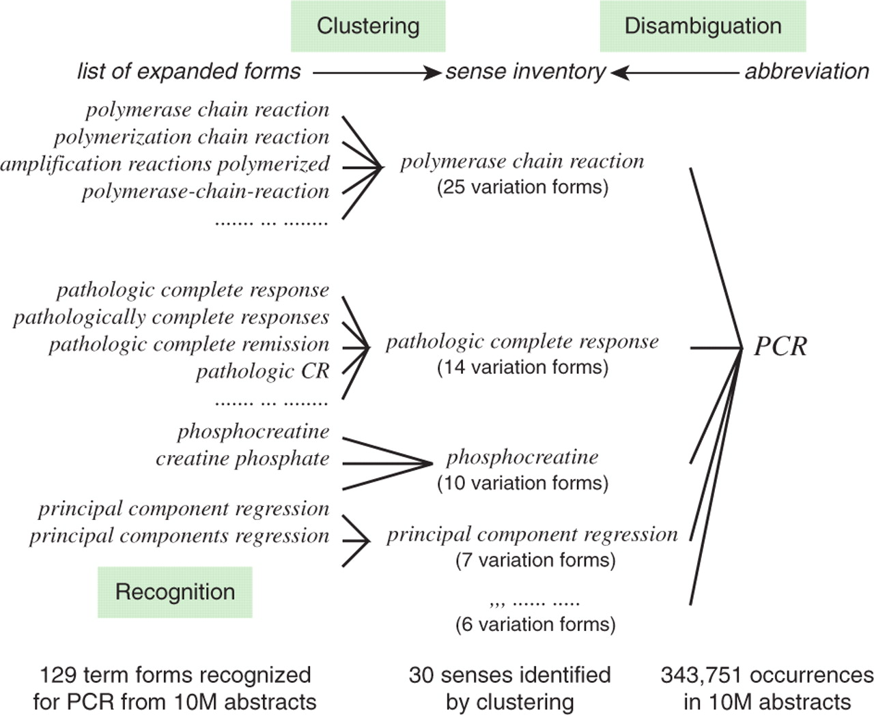
Fig. 1. Term variation and ambiguity of the abbreviation PCR.
Notes:
Fig. 1. Term variation and ambiguity of the abbreviation PCR.
Unless provided in the caption above, the following copyright applies to the content of this slide: © The Author(s) 2010. Published by Oxford University Press.This is an Open Access article distributed under the terms of the Creative Commons Attribution Non-Commercial License (http://creativecommons.org/licenses/by-nc/2.5), which permits unrestricted non-commercial use, distribution, and reproduction in any medium, provided the original work is properly cited.

Slide 3
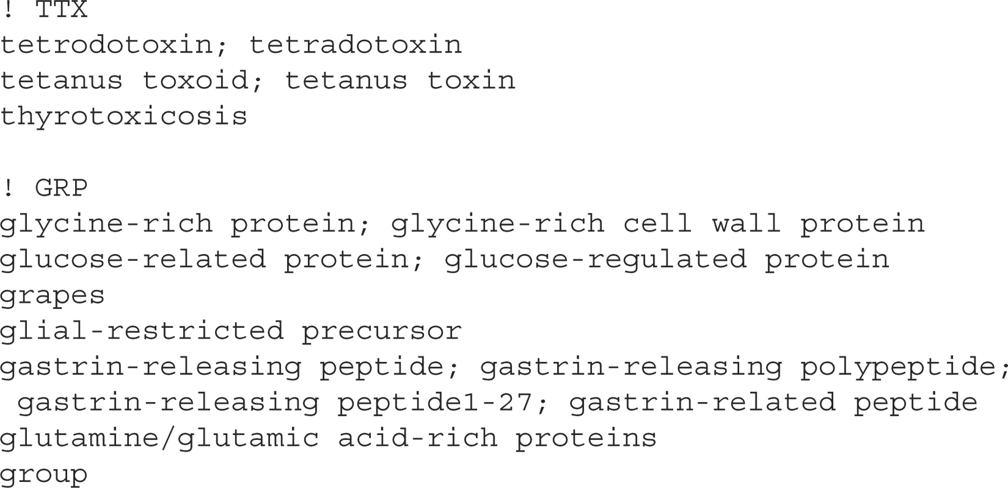
Fig. 3. Excerpt of the clusters of expanded forms.
Notes:
Fig. 3. Excerpt of the clusters of expanded forms.
Unless provided in the caption above, the following copyright applies to the content of this slide: © The Author(s) 2010. Published by Oxford University Press.This is an Open Access article distributed under the terms of the Creative Commons Attribution Non-Commercial License (http://creativecommons.org/licenses/by-nc/2.5), which permits unrestricted non-commercial use, distribution, and reproduction in any medium, provided the original work is properly cited.

Slide 4
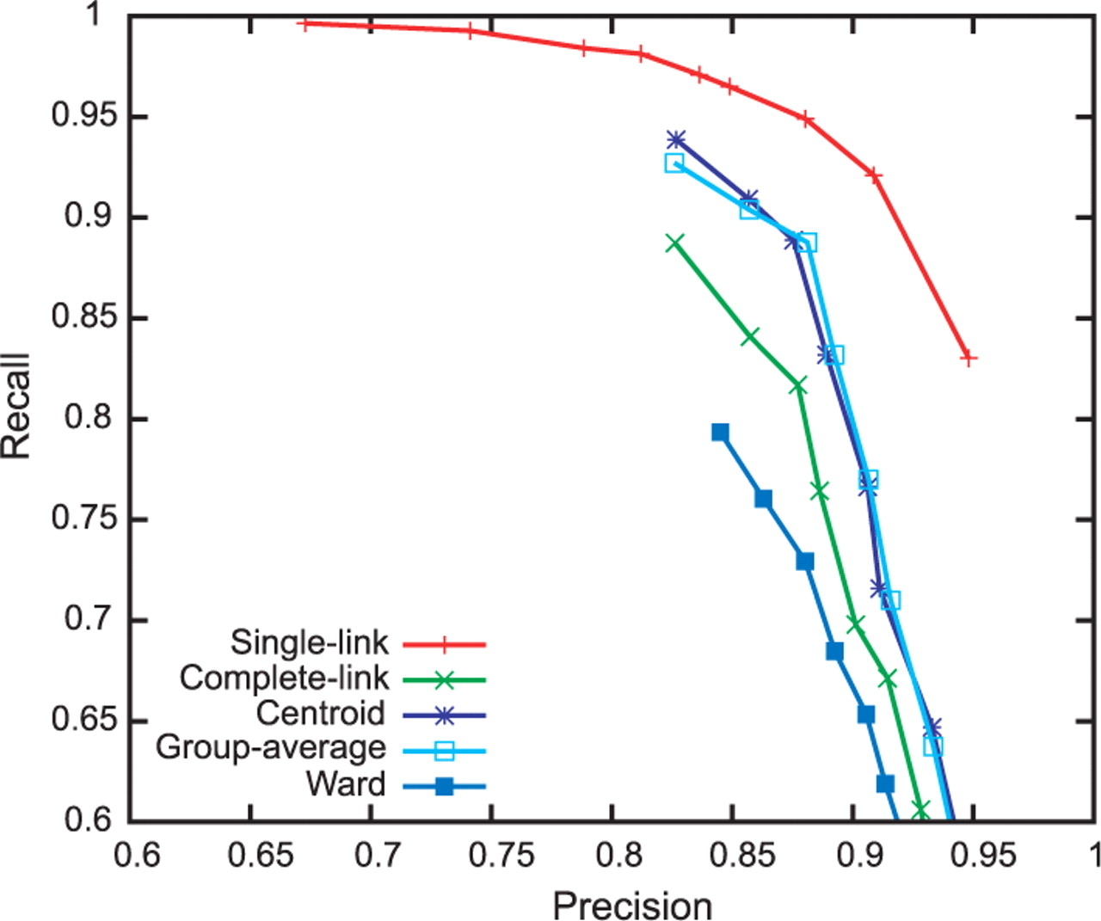
Fig. 4. Performance of clustering with different algorithms.
Notes:
Fig. 4. Performance of clustering with different algorithms.
Unless provided in the caption above, the following copyright applies to the content of this slide: © The Author(s) 2010. Published by Oxford University Press.This is an Open Access article distributed under the terms of the Creative Commons Attribution Non-Commercial License (http://creativecommons.org/licenses/by-nc/2.5), which permits unrestricted non-commercial use, distribution, and reproduction in any medium, provided the original work is properly cited.

