Slide 1
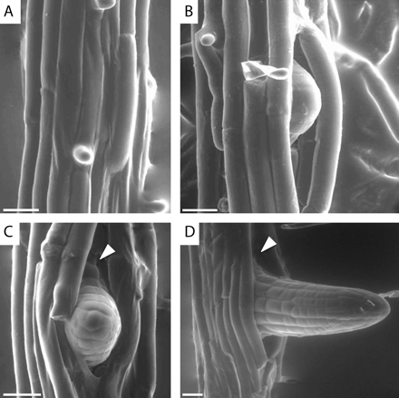
Fig. 1. Formation of a lateral root strongly impacts the primary root structure. Before the production of a new LR ...
Notes:
Fig. 1. Formation of a lateral root strongly impacts the primary root structure. Before the production of a new LR the epidermal cells are tightly attached (A). During the emergence process, the outer tissues undergo cell separation as the primordium pushes its way towards the rhizosphere (B, C). Once the LR formation process is over, the primary root still bears the effects of the emergence process (D). Note the formation of large gaps between the epidermal cells at sites of emergence (arrows). Environment scanning electron microscopy (ESEM) of 5–7-d-old Arabidopsis seedlings; scale bars are 20 μm.
Unless provided in the caption above, the following copyright applies to the content of this slide: © The Author [2009]. Published by Oxford University Press [on behalf of the Society for Experimental Biology]. All rights reserved. For Permissions, please e-mail: journals.permissions@oxfordjournals.org

Slide 2
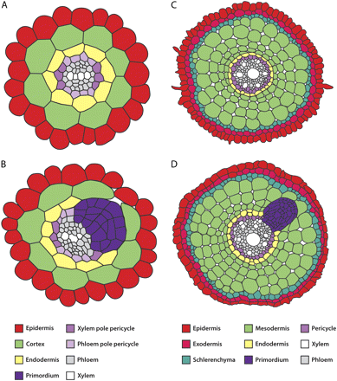
Fig. 2. Root sections of emerging lateral root primodia in the two model species Arabidopsis thaliana and Oryza ...
Notes:
Fig. 2. Root sections of emerging lateral root primodia in the two model species Arabidopsis thaliana and Oryza sativa (rice). The Arabidopsis root has a simple structure composed of the stele surrounded by three one-cell layers (A). The emerging LR primordium reprogrammes the outer cells to promote cell separation (B). Rice has a complex root system made of different root types (radicle, embryonic crown root, crown root, large lateral root, and small lateral root). The rice crown root is composed of the stele that is surrounded by five layers accounting for 5–15 cells in total (C). Emergence of a rice LR primordium involves more cell layers and is probably highly regulated (D). Arabidopsis root diameter is 100 μm (A, B) and rice root diameter is 300 μm (C, D).
Unless provided in the caption above, the following copyright applies to the content of this slide: © The Author [2009]. Published by Oxford University Press [on behalf of the Society for Experimental Biology]. All rights reserved. For Permissions, please e-mail: journals.permissions@oxfordjournals.org

Slide 3
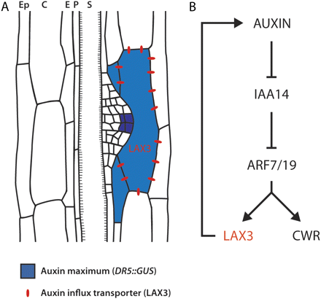
Fig. 3. Expression of the auxin influx transporter LAX3 in the cortical cells and later on in the epidermal cells ...
Notes:
Fig. 3. Expression of the auxin influx transporter LAX3 in the cortical cells and later on in the epidermal cells facing the primordium is necessary to facilitate its emergence (A). LAX3 is thought to amplify the auxin signal by a positive feedback loop mechanism: auxin triggers the degradation of the inhibitor IAA14/SLR1 which allows the activation of LAX3 by ARF7/ARF19. Because LAX3 is an auxin influx transporter, its expression results in more auxin entering the cell. As a result, a set of cell wall remodelling genes (CWR) are induced by auxin specifically in those cells (B). This mechanism allows not only auxin signal amplification but also the restriction of auxin accumulation in those cells directly touching the primordium. (The figure was constructed using results from Swarup et al., 2008.)
Unless provided in the caption above, the following copyright applies to the content of this slide: © The Author [2009]. Published by Oxford University Press [on behalf of the Society for Experimental Biology]. All rights reserved. For Permissions, please e-mail: journals.permissions@oxfordjournals.org

