Slide 1
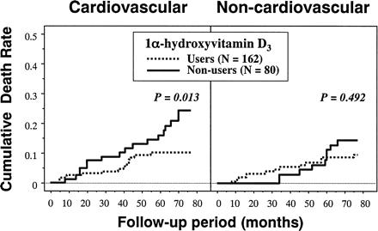
Fig. 1. Kaplan–Meier analysis of association of use of 1α-hydroxyvitamin D₃ and risk of death from ...
Notes:
Fig. 1. Kaplan–Meier analysis of association of use of 1α-hydroxyvitamin D3 and risk of death from cardiovascular and non-cardiovascular causes in a cohort of 242 haemodialysis patients. The difference in the survival curves between the two groups was assessed by log-rank test.
Unless provided in the caption above, the following copyright applies to the content of this slide: © ERA–EDTA 2003; all rights reserved

