Slide 1
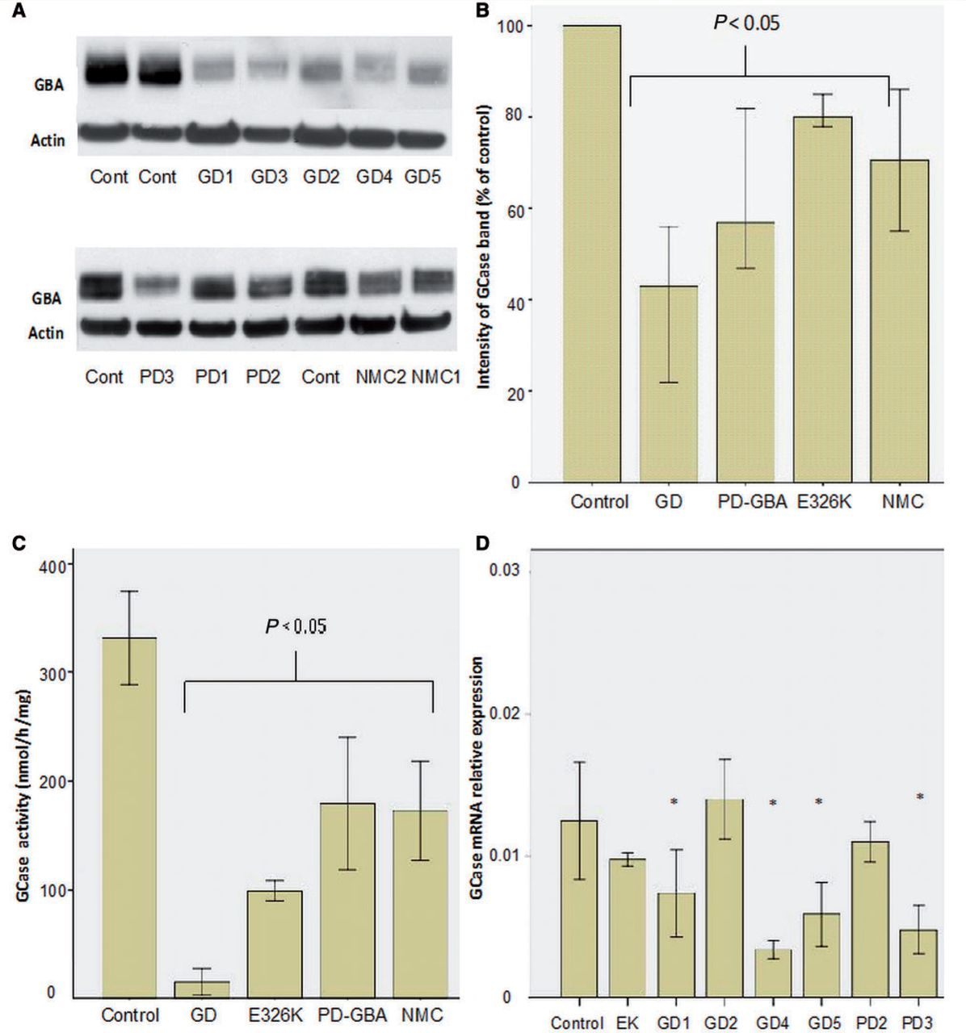
Figure 1 Glucosylceramidase protein, activity and transcript levels. (A) Representative western blots of ...
Notes:
Figure 1 Glucosylceramidase protein, activity and transcript levels. (A) Representative western blots of glucosylceramidase protein. Note reduction in glucosylceramidase protein levels in Gaucher disease (GD) fibroblasts with a lesser degree of reduction in Parkinson’s disease with glucocerebrosidase mutations (PD-GBA), non-manifesting carrier (NMC) and the E326K/E326K fibroblasts. (B) Bar chart summarizing glucosylceramidase protein levels as assessed by western blot normalized to control. Bars represent median value and 95% confidence interval for all cell lines in each group; each line was measured on three separate blots. There are significant reductions in Gaucher disease (Mann-Whitney U-test P < 0.001), Parkinson’s disease with glucocerebrosidase mutations (P < 0.001), non-manifesting carrier (P = 0.004) and E326K/E326K lines (P = 0.003). (C) Bar chart summarizing glucosylceramidase activity levels (nmol/h/mg). Enzyme activity was significantly reduced in fibroblasts from patients with Gaucher disease (t-test P = 0.001), patients with Parkinson’s disease with glucocerebrosidase mutations (P = 0.004), non-manifesting carriers (P = 0.009) and E326k/E326K lines (P = 0.001) compared with controls. Each bar represents all cell lines in each group. Results are mean ± 1 SD of three separate experiments done for each line. (D) GBA transcript levels in disease lines compared to controls (n = 3), there were reduced transcript levels in GD01, GD04, GD05, and PD03. *P < 0.05.
Unless provided in the caption above, the following copyright applies to the content of this slide: © The Author (2014). Published by Oxford University Press on behalf of the Guarantors of Brain.This is an Open Access article distributed under the terms of the Creative Commons Attribution License (http://creativecommons.org/licenses/by/3.0/), which permits unrestricted reuse, distribution, and reproduction in any medium, provided the original work is properly cited.

Slide 2
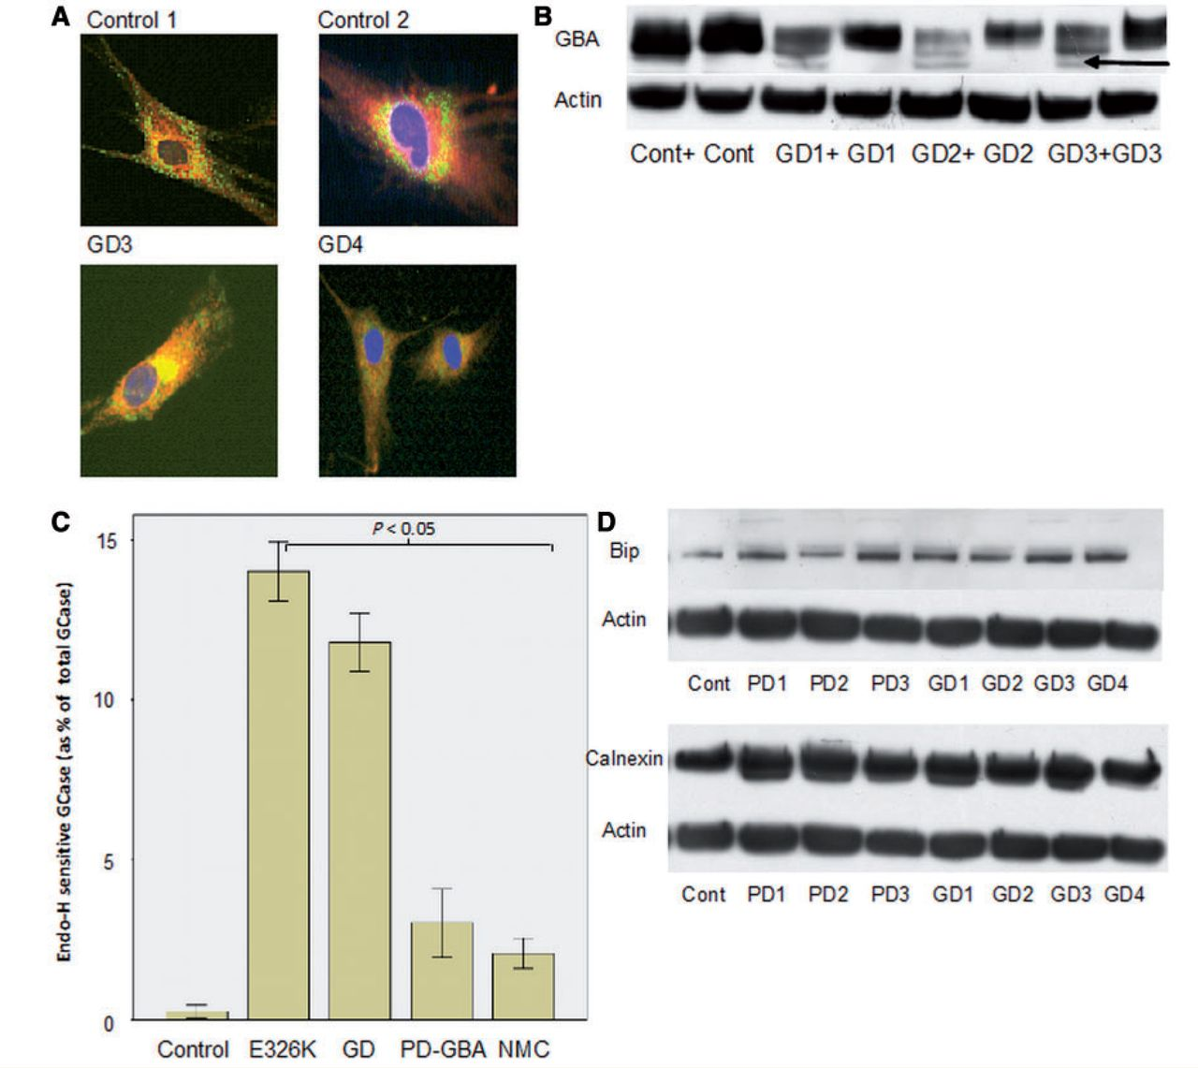
Figure 2 Evidence of endoplasmic reticulum retention of glucosylceramidase in Gaucher disease. (A) Top: ...
Notes:
Figure 2 Evidence of endoplasmic reticulum retention of glucosylceramidase in Gaucher disease. (A) Top: immunofluorescence of control cells showing vesicular staining of glucosylceramidase (green) at the periphery of the cell and perinuclear, reticular staining of calnexin (red, endoplasmic reticulum marker). Bottom: co-localization of glucosylceramidase and calnexin represented by yellow perinuclear staining with minimal green vesicular staining pattern in GD02 and GD03 cell lines. (B) Representative western blots of cell lysate treated with endoglycosidase-H for 12 h. Note appearance of low molecular weight band in Gaucher disease samples (arrow), which represents endoplasmic reticulum retained glucosylceramidase protein. ‘+’ lanes were treated with endoglycosidase-H. (C) Bar chart summarizing percentage of endoglycosidase-H sensitive glucosylceramidase in Gaucher disease (GD) (t-test P = 0.0001), Parkinson’s disease with glucocerebrosidase mutations (PD-GBA) (P = 0.01), non-manifesting carriers (NMC) and E326K/E326K (P = 0.001) compared with controls. Results are mean of three experiments. (D) Top: representative western blot of BiP expression. Bottom: representative western blot of calnexin expression. There was significant elevation of endoplasmic reticulum stress markers BiP and calnexin expression in all Gaucher disease, Parkinson’s disease with GBA mutation and non-manifesting carrier lines.
Unless provided in the caption above, the following copyright applies to the content of this slide: © The Author (2014). Published by Oxford University Press on behalf of the Guarantors of Brain.This is an Open Access article distributed under the terms of the Creative Commons Attribution License (http://creativecommons.org/licenses/by/3.0/), which permits unrestricted reuse, distribution, and reproduction in any medium, provided the original work is properly cited.

Slide 3
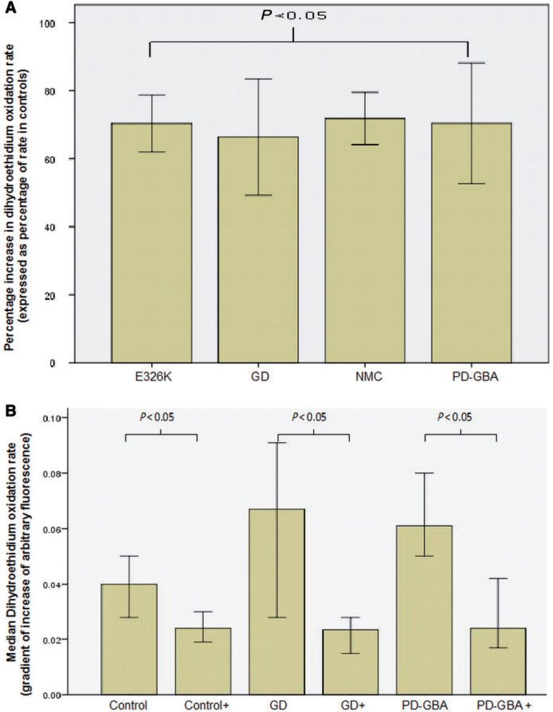
Figure 3 Oxidative stress assays in Gaucher and Parkinson’s disease fibroblasts. (A) Graph summarizing increases in ...
Notes:
Figure 3 Oxidative stress assays in Gaucher and Parkinson’s disease fibroblasts. (A) Graph summarizing increases in rates of dihydroethidium oxidation rates for Gaucher disease (GD) (Mann-Whitney U-test P < 0.001), Parkinson’s disease with glucocerebrosidase mutations (PD-GBA) (P < 0.001), non-manifesting carriers (NMC) (P < 0.001) and E326K/E326K (P < 0.001) compared with control cells. (B) Graph demonstrating significant reduction in dihydroethidium oxidation rates for controls (n = 2), Gaucher disease (n = 3) and Parkinson’s disease with glucocerebrosidase mutations fibroblasts (n = 2) treated with ambroxol compared to untreated cells. Results expressed as median rate of dihydroethidium oxidation ± 95% confidence interval.
Unless provided in the caption above, the following copyright applies to the content of this slide: © The Author (2014). Published by Oxford University Press on behalf of the Guarantors of Brain.This is an Open Access article distributed under the terms of the Creative Commons Attribution License (http://creativecommons.org/licenses/by/3.0/), which permits unrestricted reuse, distribution, and reproduction in any medium, provided the original work is properly cited.

Slide 4
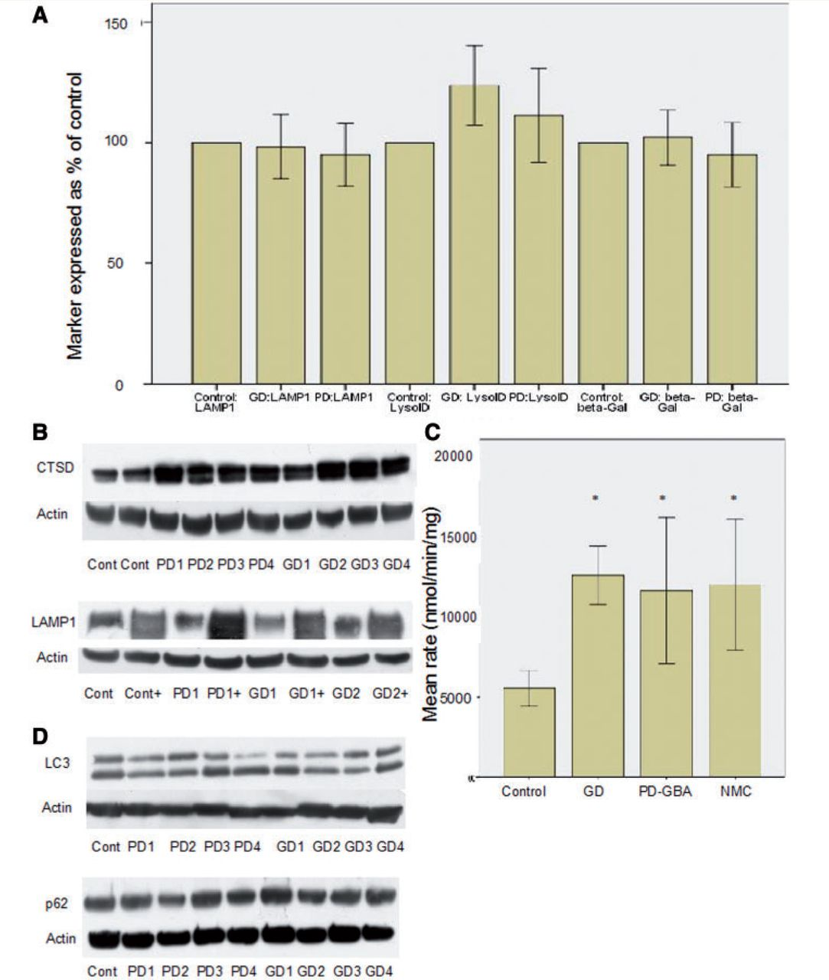
Figure 4 Analysis of lysosomal markers and autophagy. (A) Bar chart summarizing results for LAMP1 western blot, LysoID ...
Notes:
Figure 4 Analysis of lysosomal markers and autophagy. (A) Bar chart summarizing results for LAMP1 western blot, LysoID assay and beta-galactosidase activity. There is no significant difference in any of these variables, suggesting lysosomal mass is not altered. For each variable results are expressed as a percentage of results from control cells (n = 3). (B) Representative western blots demonstrating increased cathepsin D in Gaucher disease and Parkinson’s disease with GBA mutations compared to controls (top panel) and increased LAMP1 expression after ambroxol treatment (lanes marked ‘+’, bottom panel). (C) Bar chart summarizing increase in total beta-hexosaminidase activity in Gaucher disease (GD), Parkinson’s disease with GBA mutations (PD-GBA) and non-manifesting carriers (NMC) compared with controls. *P < 0.05. (D) Represenative western blots demonstrating LC3-II levels (top) and p62 (bottom). There was no significant difference in either marker in Gaucher disease or Parkinson’s disease with GBA mutations compared to control.
Unless provided in the caption above, the following copyright applies to the content of this slide: © The Author (2014). Published by Oxford University Press on behalf of the Guarantors of Brain.This is an Open Access article distributed under the terms of the Creative Commons Attribution License (http://creativecommons.org/licenses/by/3.0/), which permits unrestricted reuse, distribution, and reproduction in any medium, provided the original work is properly cited.

Slide 5
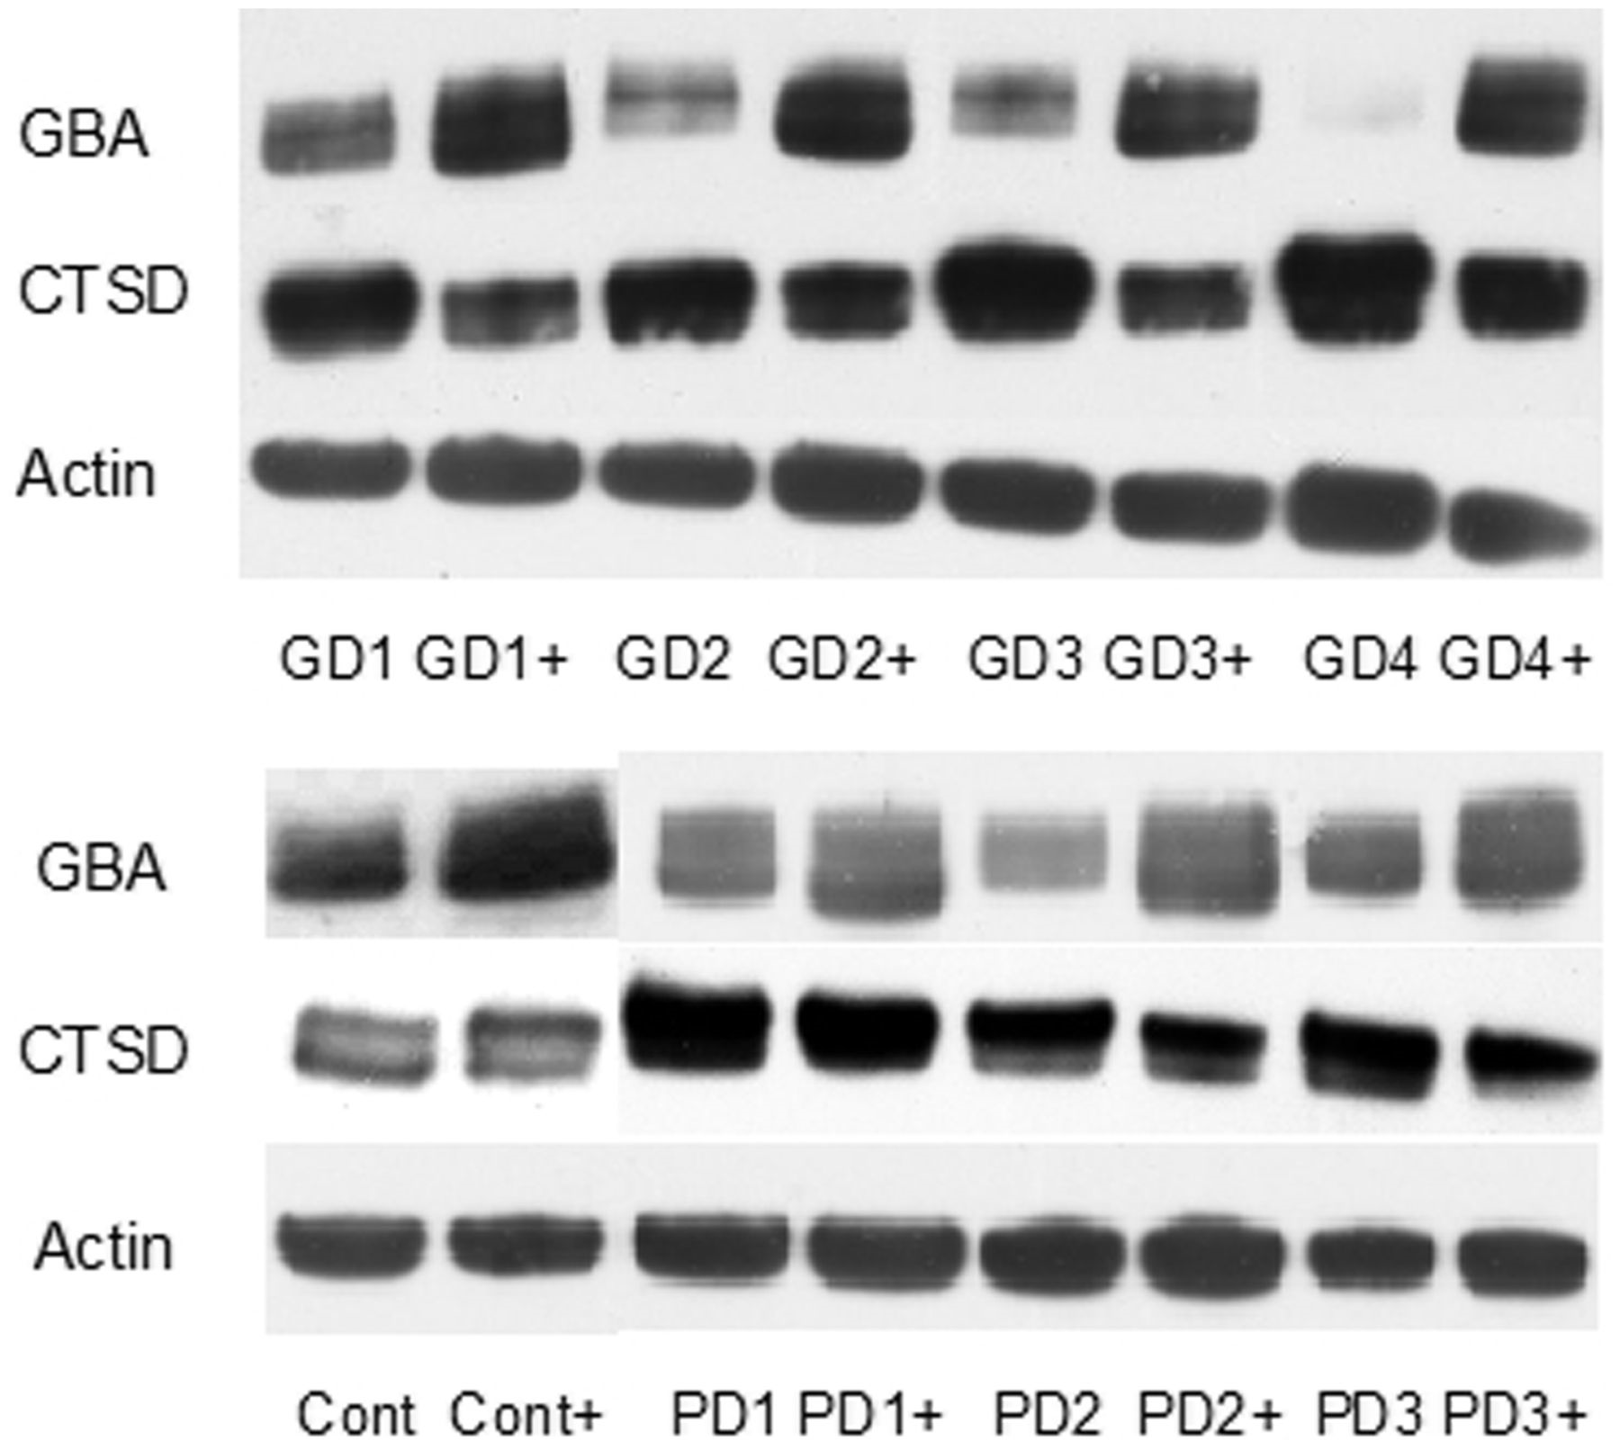
Figure 5 Ambroxol treatment significantly increases glucosylceramidase protein levels. Representative western blots ...
Notes:
Figure 5 Ambroxol treatment significantly increases glucosylceramidase protein levels. Representative western blots showing increased glucosylceramidase protein levels and decreased cathepsin D levels with ambroxol treatment. ‘+’ represents lanes treated with ambroxol. Ambroxol treatment resulted in a significant elevation of glucosylceramidase protein levels in control [median increase 30% of untreated cells (IQR 15–40%), Mann-Whitney U-test P = 0.0085], Gaucher disease (GD) [median increase 100% of untreated (IQR 87–200% increase), P = 0.004], Parkinson’s disease with GBA mutations (PD-GBA) [median increase 50% of untreated (IQR 40–130%), P = 0.04] and non-manifesting carrier (NMC) fibroblasts [median increase 35% of untreated cells (IQR 25–40% increase), P = 0.008]. Results are derived from all cell lines in each group and represent median value and IQR.
Unless provided in the caption above, the following copyright applies to the content of this slide: © The Author (2014). Published by Oxford University Press on behalf of the Guarantors of Brain.This is an Open Access article distributed under the terms of the Creative Commons Attribution License (http://creativecommons.org/licenses/by/3.0/), which permits unrestricted reuse, distribution, and reproduction in any medium, provided the original work is properly cited.

Slide 6
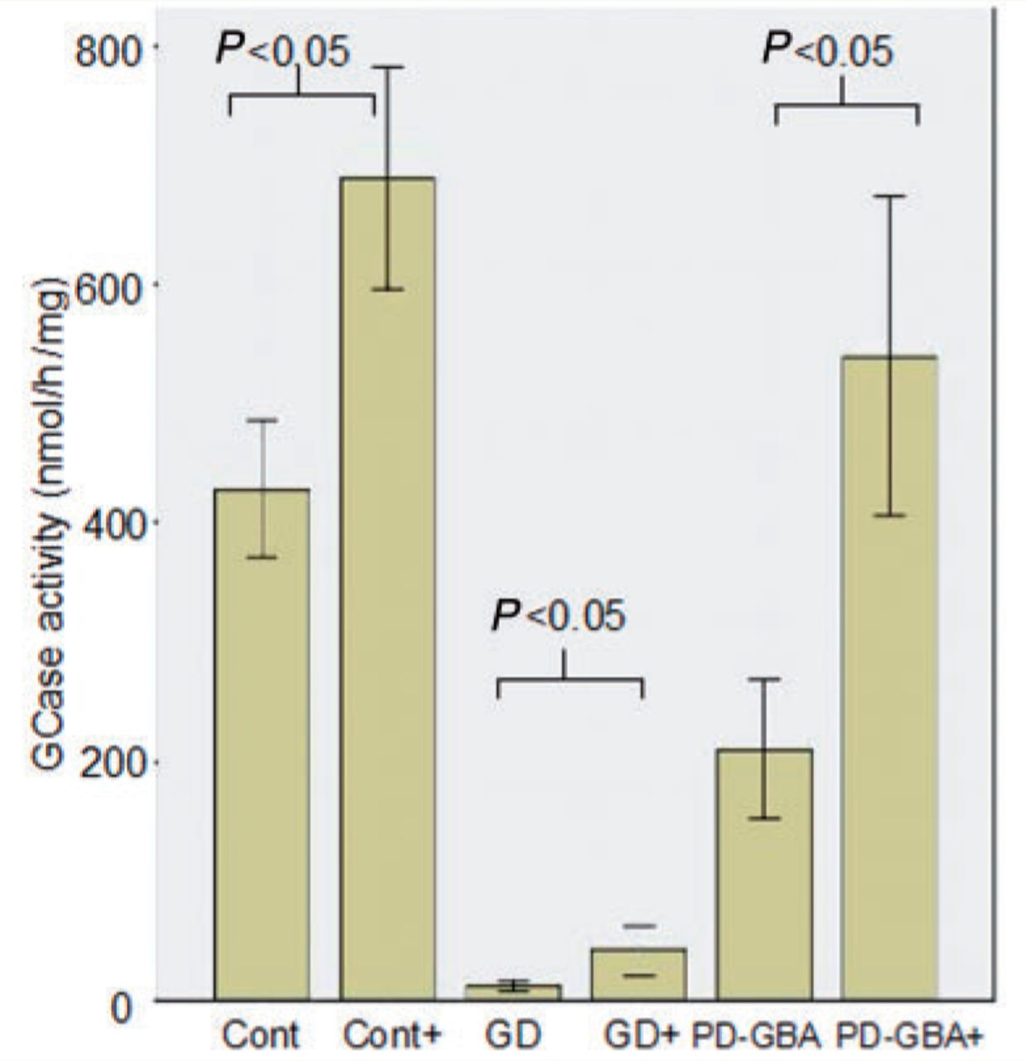
Figure 6 Ambroxol treatment significantly increases glucosylceramidase enzyme activity. Bar chart demonstrating ...
Notes:
Figure 6 Ambroxol treatment significantly increases glucosylceramidase enzyme activity. Bar chart demonstrating significant increase in glucosylceramidase activity (nmol/mg/h) with ambroxol treatment in controls (t-test P = 0.001), Gaucher disease (GD) (P = 0.0001) and Parkinson’s disease with glucocerebrosidase mutations (PD-GBA) (P = 0.0001). ‘+’ = with ambroxol treatment. Results are derived from all cell lines in each group and represent the mean of three experiments ± 1 standard deviation.
Unless provided in the caption above, the following copyright applies to the content of this slide: © The Author (2014). Published by Oxford University Press on behalf of the Guarantors of Brain.This is an Open Access article distributed under the terms of the Creative Commons Attribution License (http://creativecommons.org/licenses/by/3.0/), which permits unrestricted reuse, distribution, and reproduction in any medium, provided the original work is properly cited.

Slide 7
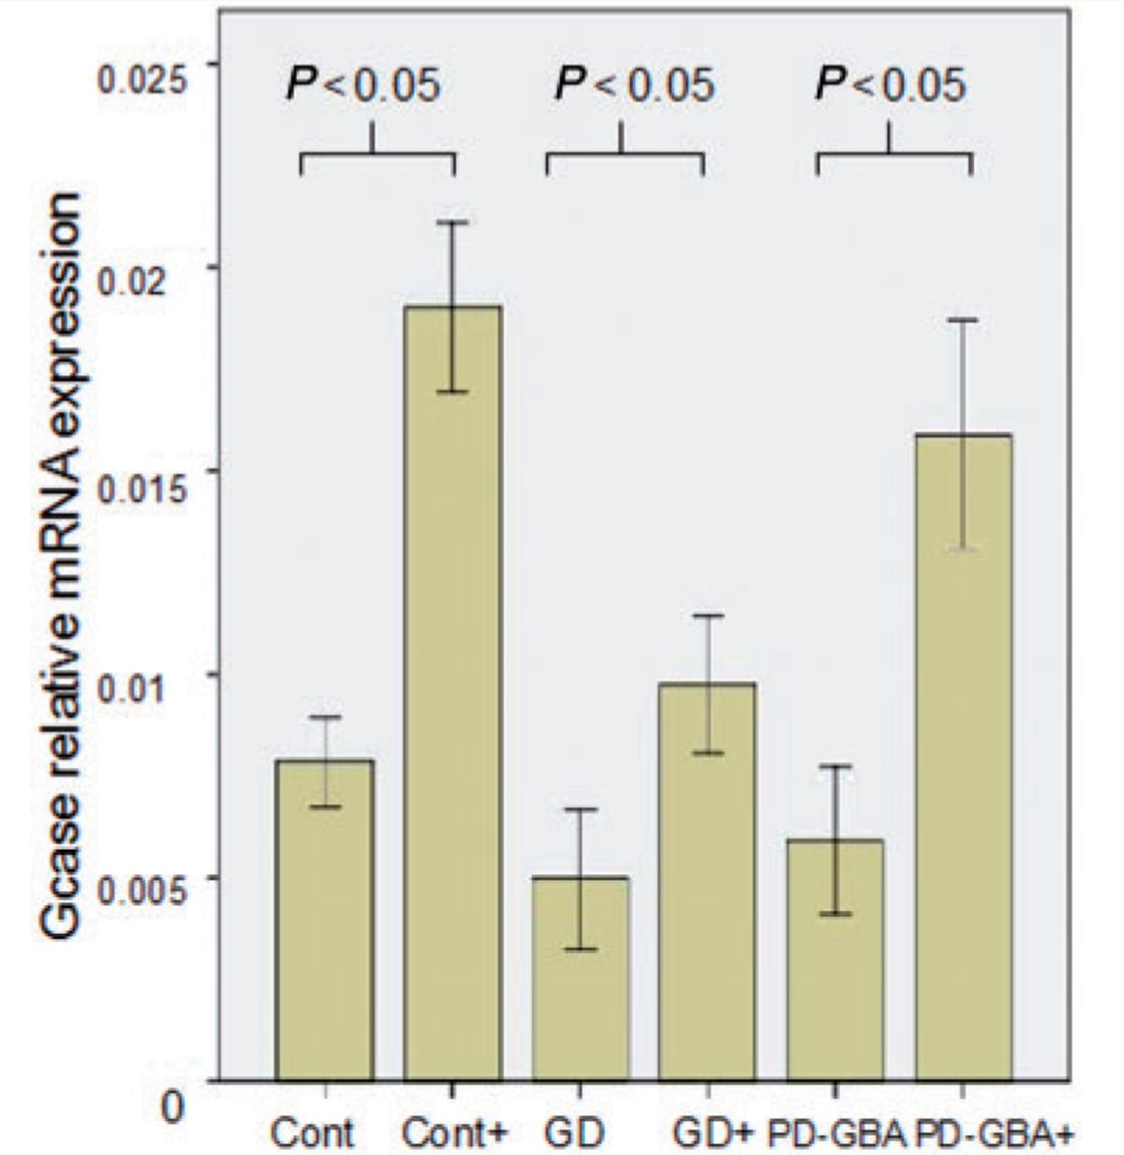
Figure 7 Ambroxol treatment significantly increases glucosylceramidase transcript levels. Bar chart demonstrating ...
Notes:
Figure 7 Ambroxol treatment significantly increases glucosylceramidase transcript levels. Bar chart demonstrating significant increase in glucosylceramidase (GCase) messenger RNA levels after ambroxol treatment in controls (Mann-Whitney U-test, P = 0.001), Gaucher disease (GD) (P = 0.0015) and Parkinson’s disease with glucocerebrosidase mutations (PD-GBA) (P = 0.001). Results are median of three experiments ± 95% confidence interval.
Unless provided in the caption above, the following copyright applies to the content of this slide: © The Author (2014). Published by Oxford University Press on behalf of the Guarantors of Brain.This is an Open Access article distributed under the terms of the Creative Commons Attribution License (http://creativecommons.org/licenses/by/3.0/), which permits unrestricted reuse, distribution, and reproduction in any medium, provided the original work is properly cited.

Slide 8
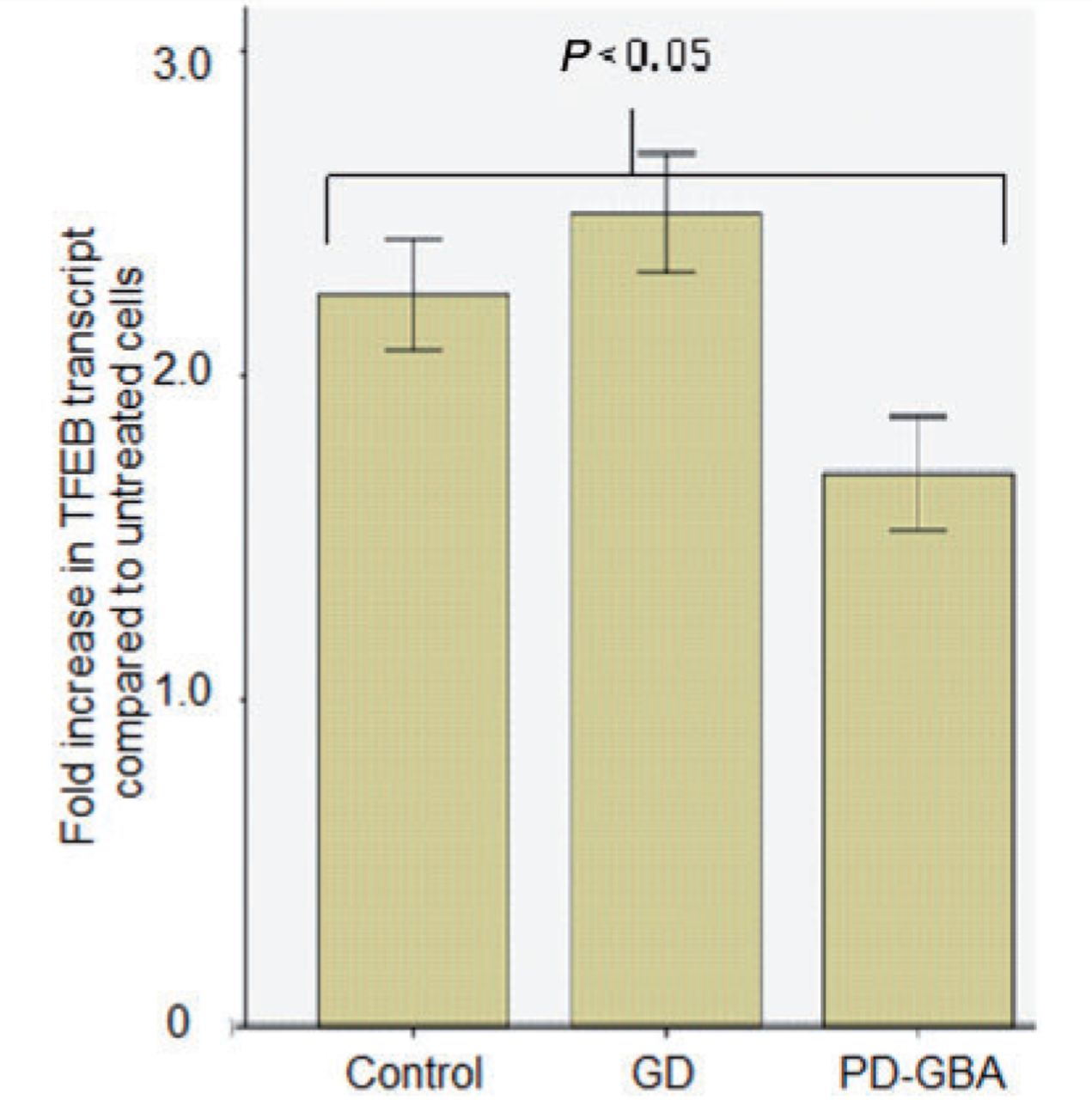
Figure 8 Ambroxol significantly increases TFEB transcript levels. Bar chart summarizing increase (fold increase) in ...
Notes:
Figure 8 Ambroxol significantly increases TFEB transcript levels. Bar chart summarizing increase (fold increase) in TFEB transcript levels in cells treated with ambroxol, data are from two cell lines in each group. There was a significant increase in TFEB transcript levels for control (Mann-Whitney U-test P = 0.02), Gaucher disease (GD) (P = 0.01) and Parkinson’s disease with glucocerebrosidase mutations (PD-GBA) (P = 0.03) after treatment with ambroxol.
Unless provided in the caption above, the following copyright applies to the content of this slide: © The Author (2014). Published by Oxford University Press on behalf of the Guarantors of Brain.This is an Open Access article distributed under the terms of the Creative Commons Attribution License (http://creativecommons.org/licenses/by/3.0/), which permits unrestricted reuse, distribution, and reproduction in any medium, provided the original work is properly cited.

Slide 9
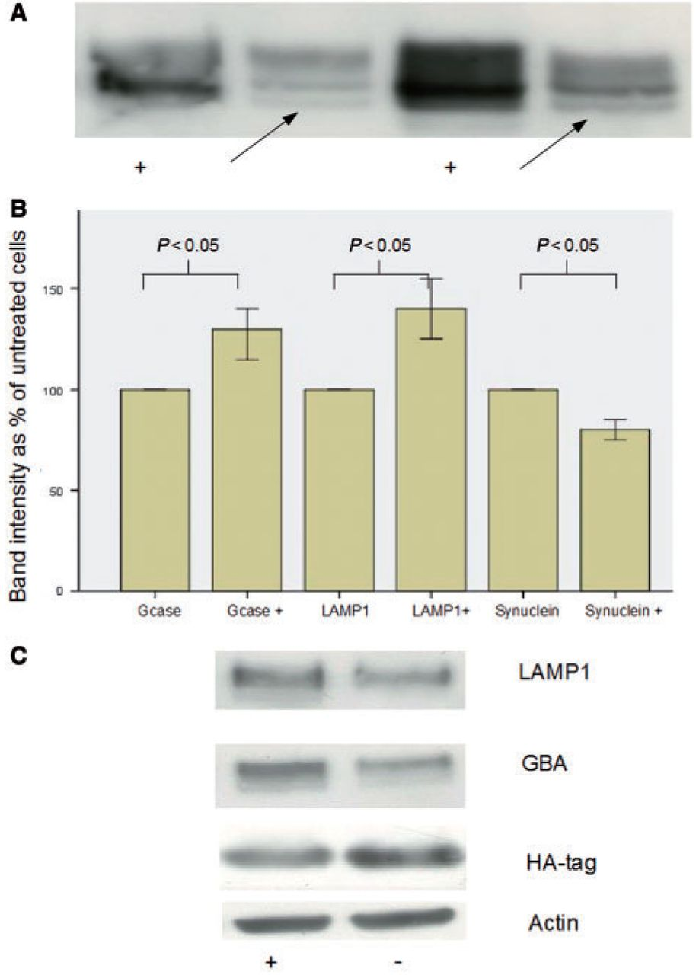
Figure 9 Effect of ambroxol on alpha-synuclein overexpressing neuroblastoma cell lines. (A) Representative western ...
Notes:
Figure 9 Effect of ambroxol on alpha-synuclein overexpressing neuroblastoma cell lines. (A) Representative western blots demonstrating disappearance of endoglycosidase-H sensitive band (arrow) in ambroxol treated Gaucher disease cell lines. ‘+’ = treated with ambroxol and the arrow indicates the endoglycosidase-H sensitive fraction. (B) Bar chart summarizing significant increase in glucosylceramidase and LAMP1 and significant decrease in alpha-synuclein (SNCA) after ambroxol treatment (bars marked ‘+’). (C) Representative western blots demonstrating increased LAMP1 and glucosylceramidase (GCase) after ambroxol treatment and decreased HA-tagged alpha-synuclein. ‘ambroxol’ = cells treated with ambroxol.
Unless provided in the caption above, the following copyright applies to the content of this slide: © The Author (2014). Published by Oxford University Press on behalf of the Guarantors of Brain.This is an Open Access article distributed under the terms of the Creative Commons Attribution License (http://creativecommons.org/licenses/by/3.0/), which permits unrestricted reuse, distribution, and reproduction in any medium, provided the original work is properly cited.

