Slide 1
Figure 1. L4 interneurons in the barrel cortex slice. (A) Acute thalamocortical slice through the “barrel” field in rat ...
Notes:
Figure 1. L4 interneurons in the barrel cortex slice. (A) Acute thalamocortical slice through the “barrel” field in rat somatosensory cortex with a patch pipette showing the recording position in layer 4. (B) IR-DIC image of a L4 interneuron during the experiment. (C) Biocytin staining of the same cell as shown in panel B with the characteristic dense axonal arborization pattern of interneuron axon within the barrel.
Unless provided in the caption above, the following copyright applies to the content of this slide: © The Author 2013. Published by Oxford University Press.This is an Open Access article distributed under the terms of the Creative Commons Attribution Non-Commercial License (http://creativecommons.org/licenses/by-nc/4.0/), which permits non-commercial re-use, distribution, and reproduction in any medium, provided the original work is properly cited. For commercial re-use, please contact journals.permissions@oup.com

Slide 2
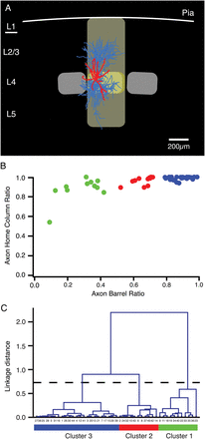
Figure 2. Quantitative identification of different FS L4 interneuron types. (A) Reconstruction of a biocytin-labeled L4 ...
Notes:
Figure 2. Quantitative identification of different FS L4 interneuron types. (A) Reconstruction of a biocytin-labeled L4 interneuron located in the center of a cortical barrel. Dendrites, red; axons, light blue. The home barrel of this interneuron is outlined in yellow, the home “barrel column” in light yellow. The 2 neighboring barrels are shown in light gray. (B) To classify L4 interneurons, the fractions of the axon within a barrel and within the home column were used. Cluster 1 interneurons are in green, cluster 2 interneurons in red and those of cluster 3 in blue (see panel C). (C) Based on these 2 parameters (axon–barrel ratio and axon–column ratio), a cluster analysis was performed that resulted in 3 distinct interneuron types: Cluster 1 interneurons had a relatively low axon–barrel ratio but generally high axon–column ratios, Cluster 3 interneurons had highly local axons that were confined to their home barrel and thus had both high axon-barrel and axon-barrel ratios. Cluster 2 L4 interneurons were intermediate.
Unless provided in the caption above, the following copyright applies to the content of this slide: © The Author 2013. Published by Oxford University Press.This is an Open Access article distributed under the terms of the Creative Commons Attribution Non-Commercial License (http://creativecommons.org/licenses/by-nc/4.0/), which permits non-commercial re-use, distribution, and reproduction in any medium, provided the original work is properly cited. For commercial re-use, please contact journals.permissions@oup.com

Slide 3
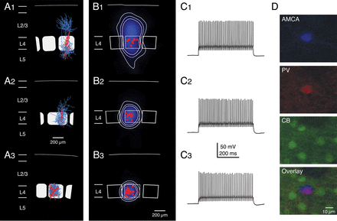
Figure 3. Average axonal domains and firing patterns of the 3 different types of fast-spiking L4 interneurons. (A1–3) ...
Notes:
Figure 3. Average axonal domains and firing patterns of the 3 different types of fast-spiking L4 interneurons. (A1–3) Representative Neurolucida reconstructions of L4 interneurons that were classified as cluster 1 (A1), cluster 2 (A2), and cluster 3 (A3) cells, respectively (axons are given in blue, the somatodendritic domain in red). (B1–3) Average axonal length density maps (blue) of the 3 different clusters, respectively. White, thin contour lines enclosing 70%, 80%, and 90% of the integrated axonal density are shown superimposed. The red triangles depict the location of the L4 interneuron somata with respect to the center of the barrel. Note that cluster 1 interneurons have axonal domains that project both throughout cortical layer 2/3, 4, and 5 with the highest density in layer 2/3. In contrast, cluster 3 interneurons have an axonal domain that resides almost exclusively within the home barrel. Cluster 2 interneurons constitute an intermediate class between cluster 1 and 3 neurons with an axon largely confined to the home barrel with only short vertically ascending axonal collaterals in lower layer 2/3. (C1–3) Examples of AP firing patterns elicited by rectangular current pulses injected at the soma of the 3 L4 interneuron types. The maximum firing frequency in all of these neurons was ∼300 Hz, that is, all 3 types can be classified as interneurons with FS characteristics. There were no significant differences in the firing characteristics and, thus, the L4 interneurons cannot be discriminated by these criteria. (D) Immunohistochemistry of a typical cluster 3 neuron. AMCA streptavidin was used to determine the location and morphology of the neuron, which was positive for PV but negative for CB.
Unless provided in the caption above, the following copyright applies to the content of this slide: © The Author 2013. Published by Oxford University Press.This is an Open Access article distributed under the terms of the Creative Commons Attribution Non-Commercial License (http://creativecommons.org/licenses/by-nc/4.0/), which permits non-commercial re-use, distribution, and reproduction in any medium, provided the original work is properly cited. For commercial re-use, please contact journals.permissions@oup.com

Slide 4
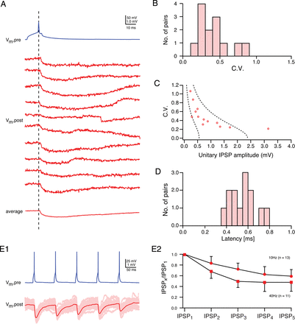
Figure 4. Synaptic connection between L4 interneurons and spiny neurons. (A) Presynaptic AP (blue) in a L4 BIn (cluster ...
Notes:
Figure 4. Synaptic connection between L4 interneurons and spiny neurons. (A) Presynaptic AP (blue) in a L4 BIn (cluster 3 neuron) and 10 consecutive IPSPs (red) in a L4 spiny neuron recorded at a membrane potential of −55 mV. Note the amplitude fluctuation between individual IPSPs. (B) Distribution of the coefficient of IPSP variation for BIn–L4 spiny neuron connections. (C) Relationship between unitary IPSP amplitudes and CVs displaying a high reliability (low variation) even for small IPSP amplitudes (n = 13). The 2 dashed lines represent the predictions of simple binomial release statistics for the CV as a function of the IPSP amplitude assuming 4 synaptic contacts (close to the number of putative synaptic contacts identified for this connection) and low qS = 0.14 mV (left) and high qS = 0.6 mV (right), respectively. (D) Latency distribution for this synaptic connection; the average latency was 0.55 ± 0.12 ms. (E1) Paired pulse behavior at BIn–L4 spiny neuron connection. Five APs (blue) elicited in a BIn and individual IPSPs (light red) evoked in the L4 spiny neuron together with the corresponding average IPSP (red) are shown. (E2) Paired pulse depression for 5 consecutive IPSPs elicited by APs at either 100 ms (10 Hz) or 25 ms (40 Hz) intervals. At both frequencies, a marked depression can be observed. The depression at 25-ms intervals between APs is markedly stronger.
Unless provided in the caption above, the following copyright applies to the content of this slide: © The Author 2013. Published by Oxford University Press.This is an Open Access article distributed under the terms of the Creative Commons Attribution Non-Commercial License (http://creativecommons.org/licenses/by-nc/4.0/), which permits non-commercial re-use, distribution, and reproduction in any medium, provided the original work is properly cited. For commercial re-use, please contact journals.permissions@oup.com

Slide 5
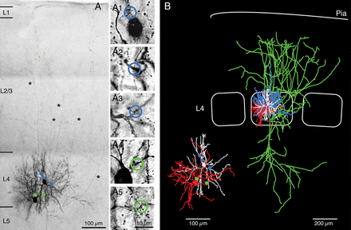
Figure 6. Identification of synaptic contacts. (A) Low-power photomontage of a synaptically connected pair of a BIn and ...
Notes:
Figure 6. Identification of synaptic contacts. (A) Low-power photomontage of a synaptically connected pair of a BIn and a spiny stellate cell that were filled with biocytin during recording. The 2 neurons showed reciprocal coupling. Putative, light microscopically identified GABAergic synaptic contacts between the presynaptic L4 interneuron (left) and the postsynaptic spiny stellate cell (right) are marked by green dots. Putative reciprocal excitatory synaptic contacts are indicated by blue dots. Asterisks highlight long axonal collaterals of the spiny stellate cell. (A1–5) High-power images of synaptic contacts. Blue open circles, inhibitory contacts (A1–3); green open circles, excitatory contacts (A4 and A5). (B) Neurolucida reconstruction of the same neuron pair shown in (A). Blue, L4 interneuron axon; red, L4 interneuron soma and dendrite; green, L4 spiny stellate axon; white, L4 spiny stellate soma and dendrite. The inset shows the dendritic arbor of pre- and postsynaptic neuron together with the putative synaptic contacts (same color code as for panel A).
Unless provided in the caption above, the following copyright applies to the content of this slide: © The Author 2013. Published by Oxford University Press.This is an Open Access article distributed under the terms of the Creative Commons Attribution Non-Commercial License (http://creativecommons.org/licenses/by-nc/4.0/), which permits non-commercial re-use, distribution, and reproduction in any medium, provided the original work is properly cited. For commercial re-use, please contact journals.permissions@oup.com

Slide 6
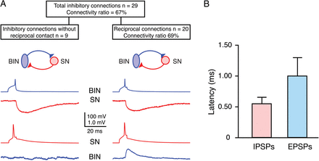
Figure 5. Connectivity between cell pairs of L4 interneurons and excitatory L4 spiny neurons. (A) Connectivity ratio ...
Notes:
Figure 5. Connectivity between cell pairs of L4 interneurons and excitatory L4 spiny neurons. (A) Connectivity ratio for L4 FS interneuron–L4 spiny neuron pairs; inhibitory connectivity was found to be 67% (29 of 43 postsynaptic spiny neurons tested). Traces show average IPSPs (red, upper row) and EPSPs (blue, lower row) of unidirectional inhibitory connections (left) and reciprocal connections (right), respectively, between L4 BIns and spiny neurons (BIn, blue; SN, red). (B) AP-to-PSP latencies for reciprocal BIn–SN pairs in layer 4. The latency for the excitatory postsynaptic response was significantly longer than the inhibitory response (1.09 ± 0.31 vs. 0.55 ± 0.11 ms, P < 0.001).
Unless provided in the caption above, the following copyright applies to the content of this slide: © The Author 2013. Published by Oxford University Press.This is an Open Access article distributed under the terms of the Creative Commons Attribution Non-Commercial License (http://creativecommons.org/licenses/by-nc/4.0/), which permits non-commercial re-use, distribution, and reproduction in any medium, provided the original work is properly cited. For commercial re-use, please contact journals.permissions@oup.com

Slide 7
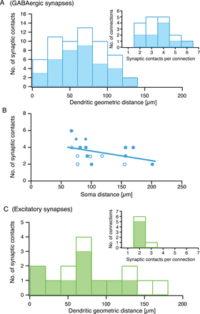
Figure 7. Synaptic contacts are broadly distributed along the postsynaptic dendritic tree. Individual geometric ...
Notes:
Figure 7. Synaptic contacts are broadly distributed along the postsynaptic dendritic tree. Individual geometric distances of the light microscopically identified putative synaptic contact sites in pairs of L4 interneurons and L4 spiny neurons (n = 17). (A) Bar histogram of geometric distances of putative inhibitory synaptic contacts to the soma of L4 spiny neurons. (B) Relationship between number of synaptic contacts and intersoma distance in BIn-L4 spiny neuron pairs. Filled circles represent BIn-L4 spiny neuron pairs, open circles connections with cluster 1 or 2 L4 interneurons. No correlation was found between the number of synaptic contacts and their distance from the soma. (C) Same diagram as in (A) but for excitatory synapses in reciprocally connected cell pairs (n = 7). Insets in (A) and (C) show the distribution of the number of synaptic contacts per connection. Filled bars in (A) and (C) and filled circles in (B) mark results obtained for BIn-L4 spiny neuron pairs alone, whereas open bars or circles represent connections including cluster 1 and cluster 2 FS L4 interneurons with L4 spiny neurons.
Unless provided in the caption above, the following copyright applies to the content of this slide: © The Author 2013. Published by Oxford University Press.This is an Open Access article distributed under the terms of the Creative Commons Attribution Non-Commercial License (http://creativecommons.org/licenses/by-nc/4.0/), which permits non-commercial re-use, distribution, and reproduction in any medium, provided the original work is properly cited. For commercial re-use, please contact journals.permissions@oup.com

