Slide 1
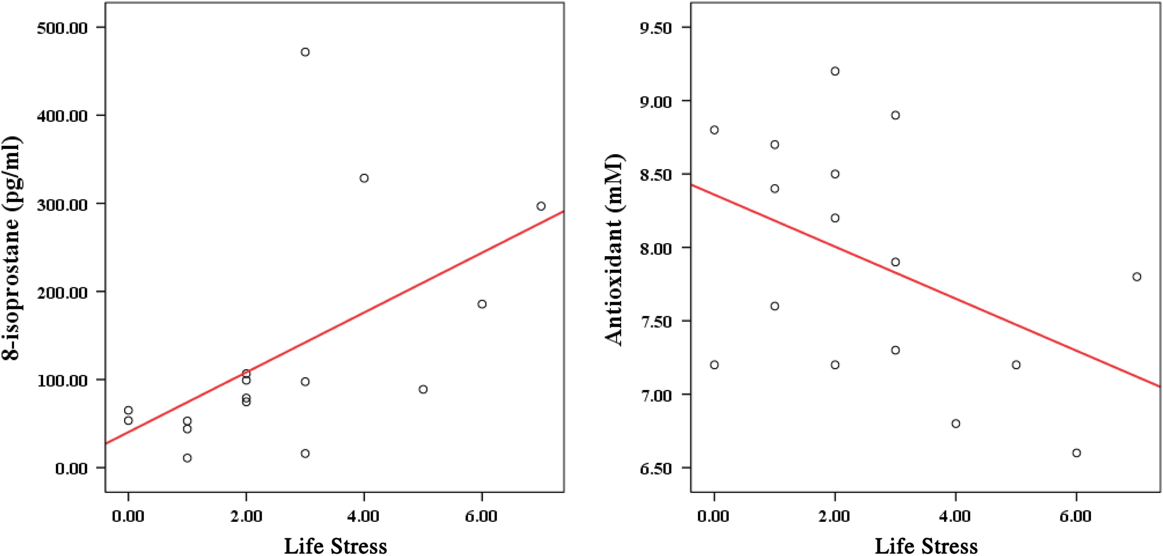
Figure 1: Scatter Plot of Associations between Life Stress and of Plasma Concentration of 8-Isoprostane and ...
Notes:
Figure 1: Scatter Plot of Associations between Life Stress and of Plasma Concentration of 8-Isoprostane and Antioxidant
Unless provided in the caption above, the following copyright applies to the content of this slide: © 2016 National Association of Social Workers

