Slide 1
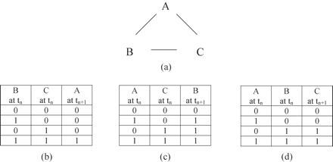
Figure 1 A simple Kauffman network.
Notes:
Figure 1 A simple Kauffman network.
Unless provided in the caption above, the following copyright applies to the content of this slide: © Oxford University Press 2008

Slide 2
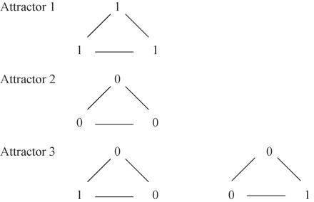
Figure 2 The attractors of a simple Kauffman network.
Notes:
Figure 2 The attractors of a simple Kauffman network.
Unless provided in the caption above, the following copyright applies to the content of this slide: © Oxford University Press 2008

Slide 3
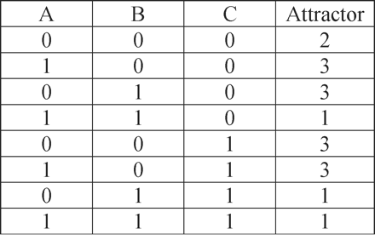
Figure 3 The basins of the attractors of a simple Boolean network.
Notes:
Figure 3 The basins of the attractors of a simple Boolean network.
Unless provided in the caption above, the following copyright applies to the content of this slide: © Oxford University Press 2008

Slide 4
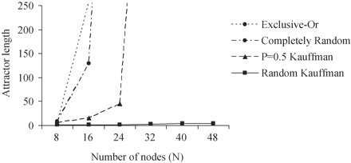
Figure 4 Median first attractor length in 500; exclusive-or networks, networks in which one state randomly determines ...
Notes:
Figure 4 Median first attractor length in 500; exclusive-or networks, networks in which one state randomly determines the next, networks with K = 2 and P = 0.5, and random K = 2 networks (i.e. Kauffman networks).
Unless provided in the caption above, the following copyright applies to the content of this slide: © Oxford University Press 2008

Slide 5
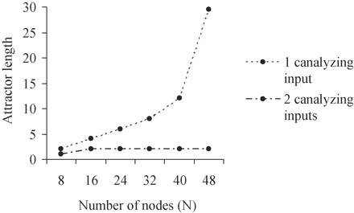
Figure 5 Median first attractor of 500 K = 6 networks of with one canalyzing input value and P = 0.75 functions and ...
Notes:
Figure 5 Median first attractor of 500 K = 6 networks of with one canalyzing input value and P = 0.75 functions and two canalyzing input values and P = 0.75 functions.
Unless provided in the caption above, the following copyright applies to the content of this slide: © Oxford University Press 2008

Slide 6
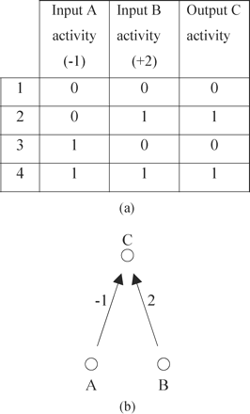
Figure 6 Quantitatively consistent node function of output C by inputs A and B.
Notes:
Figure 6 Quantitatively consistent node function of output C by inputs A and B.
Unless provided in the caption above, the following copyright applies to the content of this slide: © Oxford University Press 2008

Slide 7
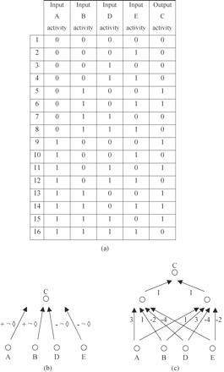
Figure 7 Qualitatively consistent regulation of output C by inputs A and B.
Notes:
Figure 7 Qualitatively consistent regulation of output C by inputs A and B.
Unless provided in the caption above, the following copyright applies to the content of this slide: © Oxford University Press 2008

Slide 8
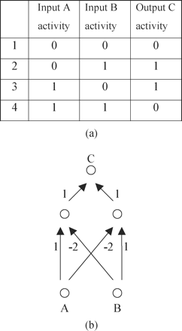
Figure 8 Qualitatively inconsistent regulation of output of C by inputs A and B.
Notes:
Figure 8 Qualitatively inconsistent regulation of output of C by inputs A and B.
Unless provided in the caption above, the following copyright applies to the content of this slide: © Oxford University Press 2008

Slide 9
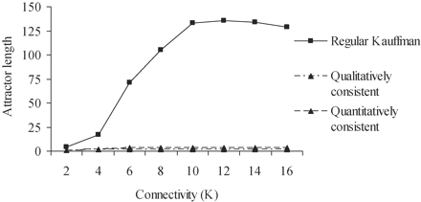
Figure 9 Median first attractor length in 500 Kauffman networks, 500 quantitatively consistent, and 500 qualitatively ...
Notes:
Figure 9 Median first attractor length in 500 Kauffman networks, 500 quantitatively consistent, and 500 qualitatively consistent networks of varying K and N = 16.
Unless provided in the caption above, the following copyright applies to the content of this slide: © Oxford University Press 2008

Slide 10
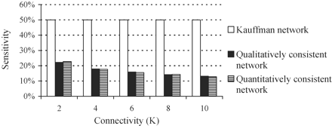
Figure 10 Reduction of average sensitivity with increase of inputs in 1000 consistent networks.
Notes:
Figure 10 Reduction of average sensitivity with increase of inputs in 1000 consistent networks.
Unless provided in the caption above, the following copyright applies to the content of this slide: © Oxford University Press 2008

Slide 11
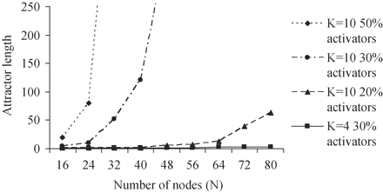
Figure 11 Median first attractor length in 500 networks of K = 10 with varying proportions of activators and K = 4 ...
Notes:
Figure 11 Median first attractor length in 500 networks of K = 10 with varying proportions of activators and K = 4 networks with 30% activators.
Unless provided in the caption above, the following copyright applies to the content of this slide: © Oxford University Press 2008

Slide 12
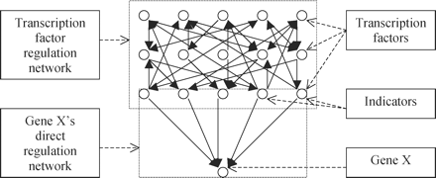
Figure 12 The connectionist view of gene regulation networks.
Notes:
Figure 12 The connectionist view of gene regulation networks.
Unless provided in the caption above, the following copyright applies to the content of this slide: © Oxford University Press 2008

Slide 13
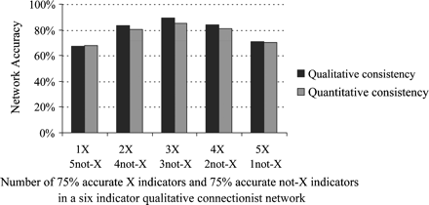
Figure 13 Average accuracy of 100 connectionist networks.
Notes:
Figure 13 Average accuracy of 100 connectionist networks.
Unless provided in the caption above, the following copyright applies to the content of this slide: © Oxford University Press 2008

Slide 14
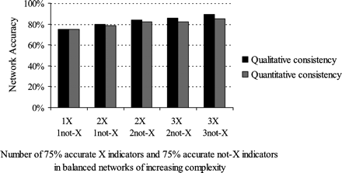
Figure 14 The adaptivity of a balanced qualitatively and quantitatively connectionist network increases with ...
Notes:
Figure 14 The adaptivity of a balanced qualitatively and quantitatively connectionist network increases with complexity.
Unless provided in the caption above, the following copyright applies to the content of this slide: © Oxford University Press 2008

Slide 15
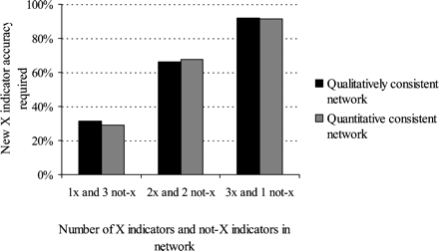
Figure 15 Accuracy required of added X indicator to improve network accuracy.
Notes:
Figure 15 Accuracy required of added X indicator to improve network accuracy.
Unless provided in the caption above, the following copyright applies to the content of this slide: © Oxford University Press 2008

