Slide 1
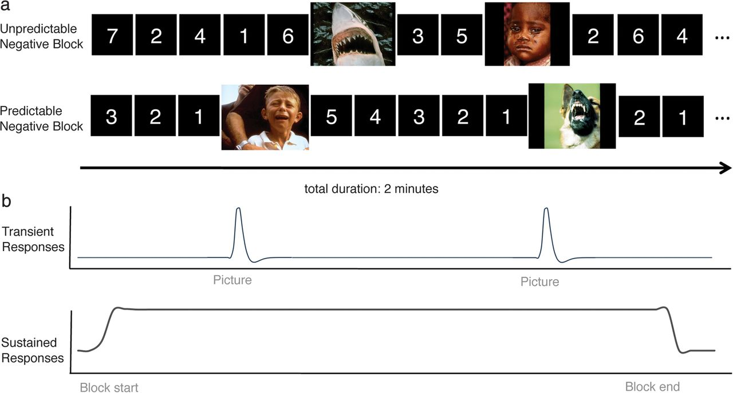
Figure 1. Experimental design and analysis schematic. (A) Within a task block, negative or neutral pictures are ...
Notes:
Figure 1. Experimental design and analysis schematic. (A) Within a task block, negative or neutral pictures are presented (3 s duration) embedded within variable-duration predictable or unpredictable timings. (B) Schematic images depicting canonical transient event responses (top) that are estimated separately from sustained responses that remain persistently active throughout the blocks (bottom). This figure is for illustration purposes only and is not intended to accurately represent the actual experimental parameters.
Unless provided in the caption above, the following copyright applies to the content of this slide: © The Author 2012. Published by Oxford University Press. All rights reserved. For permissions, please e-mail: journals.permissions@oup.com

Slide 2
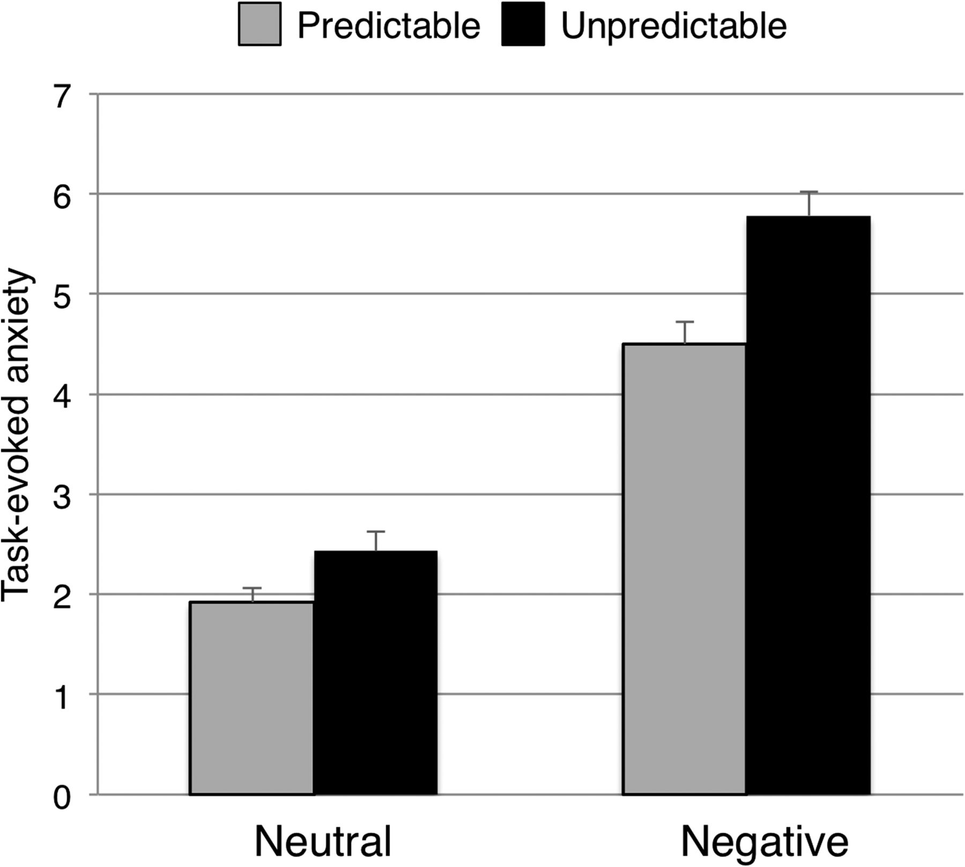
Figure 2. Task-evoked anxiety. Blocks containing only negative pictures evoked greater anxiety than blocks containing ...
Notes:
Figure 2. Task-evoked anxiety. Blocks containing only negative pictures evoked greater anxiety than blocks containing neutral pictures, and blocks with unpredictable timings evoked greater anxiety than blocks containing predictable timings. The effect of unpredictability was exaggerated when presented with negative pictures. Error bars denote standard error of the mean.
Unless provided in the caption above, the following copyright applies to the content of this slide: © The Author 2012. Published by Oxford University Press. All rights reserved. For permissions, please e-mail: journals.permissions@oup.com

Slide 3
Figure 3. Mean transient responses to negative versus neutral pictures. (A) The left and right amygdala responded more ...
Notes:
Figure 3. Mean transient responses to negative versus neutral pictures. (A) The left and right amygdala responded more strongly to negative than neutral pictures. Image threshold P < 0.05, whole-brain corrected. (B) Timecourse of right amygdala (x = 24, y = −1, z = −20) response to pictures as a function of valence and predictability. Timecourse values were derived from FIR parameter estimates; error bars denote standard error of the mean. (C) Greater IU predicts exaggerated right amygdala response to negative pictures when embedded within unpredictable timings. Gray curves denote 95% confidence interval.
Unless provided in the caption above, the following copyright applies to the content of this slide: © The Author 2012. Published by Oxford University Press. All rights reserved. For permissions, please e-mail: journals.permissions@oup.com

Slide 4
Figure 4. Sustained responses that increase as a function of greater task-evoked anxiety. (A) The right VBF/BNST, left ...
Notes:
Figure 4. Sustained responses that increase as a function of greater task-evoked anxiety. (A) The right VBF/BNST, left (B) and right insula increased in sustained activity with greater task-evoked anxiety. Image threshold P < 0.05, whole-brain corrected. (C) Mean signal estimates in right IFG/insula (x = 33, y = 29, z = −12) plotted for the 4 sustained conditions. Error bars denote standard error of the mean.
Unless provided in the caption above, the following copyright applies to the content of this slide: © The Author 2012. Published by Oxford University Press. All rights reserved. For permissions, please e-mail: journals.permissions@oup.com

Slide 5
Figure 5. Greater responding in less anxious states in the right ventral anterior cingulate/vmPFC (A). Image threshold ...
Notes:
Figure 5. Greater responding in less anxious states in the right ventral anterior cingulate/vmPFC (A). Image threshold P < 0.05, whole-brain corrected. (B) Signal estimates in (x = 3, y = 29, z = −12) plotted for the 4 sustained conditions. Error bars denote standard error of the mean. (C) Greater recruitment of vACC/vmPFC to unpredictable states predicts lesser transient amygdala response to unpredictable negative events. Gray curves denote 95% confidence interval.
Unless provided in the caption above, the following copyright applies to the content of this slide: © The Author 2012. Published by Oxford University Press. All rights reserved. For permissions, please e-mail: journals.permissions@oup.com

