Slide 1
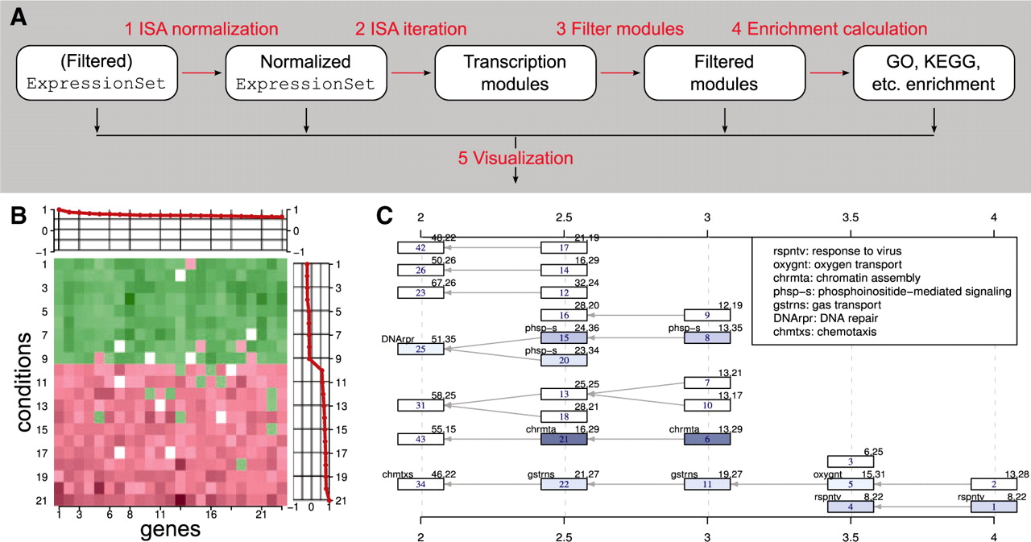
Fig. 1. (A) Work flow of a typical modular analysis with the eisa package. See text for details. (B and C) were ...
Notes:
Fig. 1. (A) Work flow of a typical modular analysis with the eisa package. See text for details. (B and C) were generated using the acute lymphoblastic leukemia dataset, (Chiaretti et al., 2004) and the ALL R package. (B) Heatmap for a single module, showing coherent expression of the genes across the samples. The red lines are the gene and sample scores. (C) Module tree. Each module is represented by a rectangle with its numeric id in the center. See the definition of the edges in the text. Modules are colored according to their Gene Ontology enrichment P-values, the codes of the enriched GO categories are shown in the top-left corner of the rectangles. The top-right corner shows the number of genes and conditions in the module. The gene thresholds used for finding the modules are shown on the horizontal axes.
Unless provided in the caption above, the following copyright applies to the content of this slide: © The Author 2010. Published by Oxford University Press. All rights reserved. For Permissions, please email: journals.permissions@oxfordjournals.org

