Slide 1
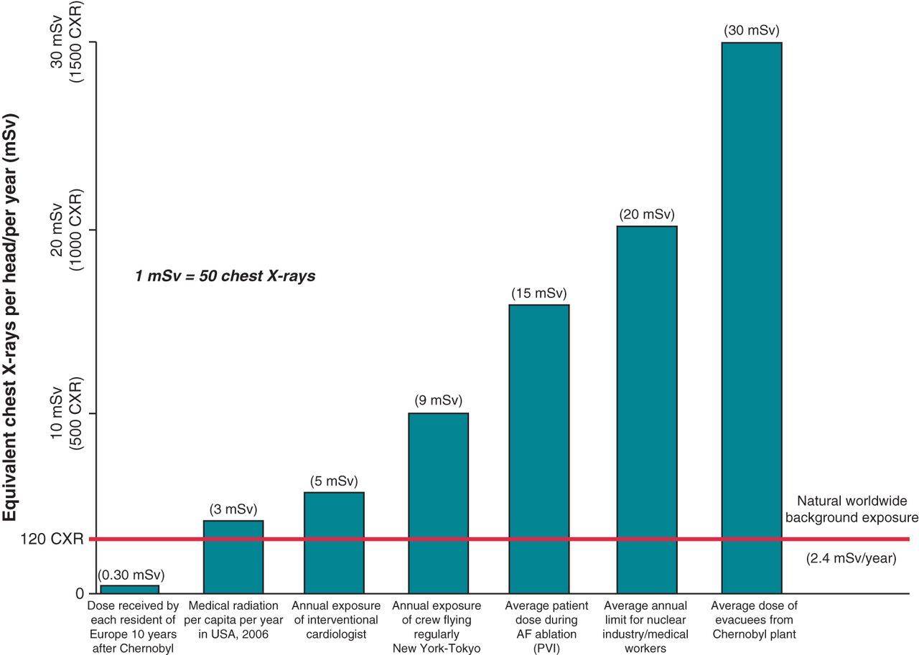
Figure 1 Medical, natural, and accidental sources of radiation. An ED of 1 mSv is equivalent to 50 chest X-rays. ...
Notes:
Figure 1 Medical, natural, and accidental sources of radiation. An ED of 1 mSv is equivalent to 50 chest X-rays. Modified from Picano,4 updated with Mettler et al.,5 and Peplow.6
Unless provided in the caption above, the following copyright applies to the content of this slide: Published on behalf of the European Society of Cardiology. All rights reserved. © The Author 2014. For permissions please email: journals.permissions@oup.com.

Slide 2
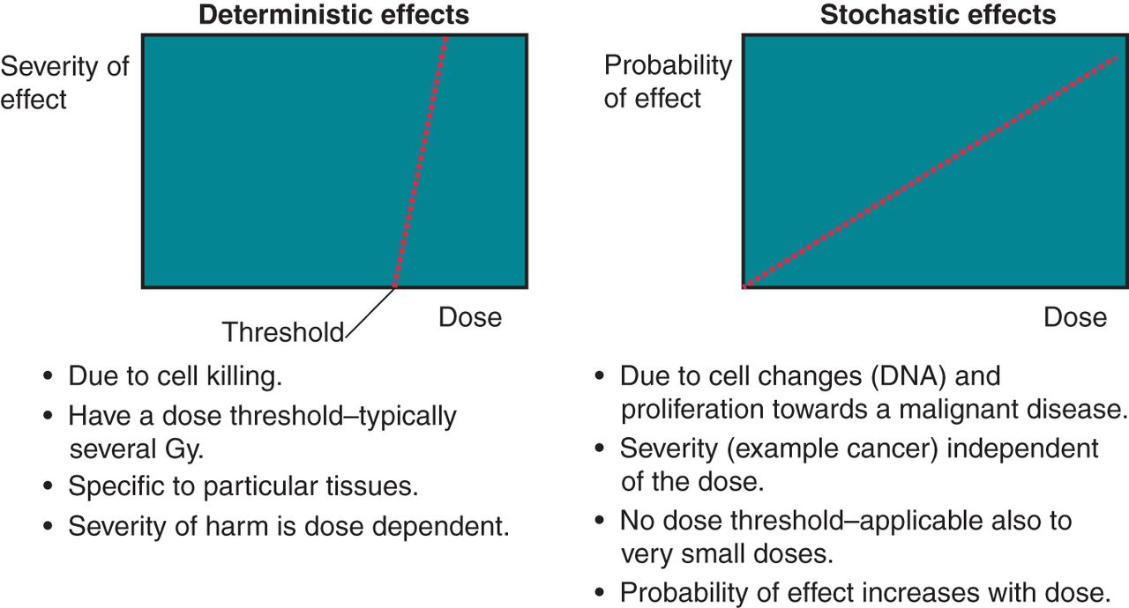
Figure 2 Deterministic and stochastic radiation risks. Source: IAEA free training material: ...
Notes:
Figure 2 Deterministic and stochastic radiation risks. Source: IAEA free training material: https://rpop.iaea.org/RPOP/RPoP/Content/AdditionalResources/Training/1_TrainingMaterial/Radiotherapy.htm.
Unless provided in the caption above, the following copyright applies to the content of this slide: Published on behalf of the European Society of Cardiology. All rights reserved. © The Author 2014. For permissions please email: journals.permissions@oup.com.

Slide 3
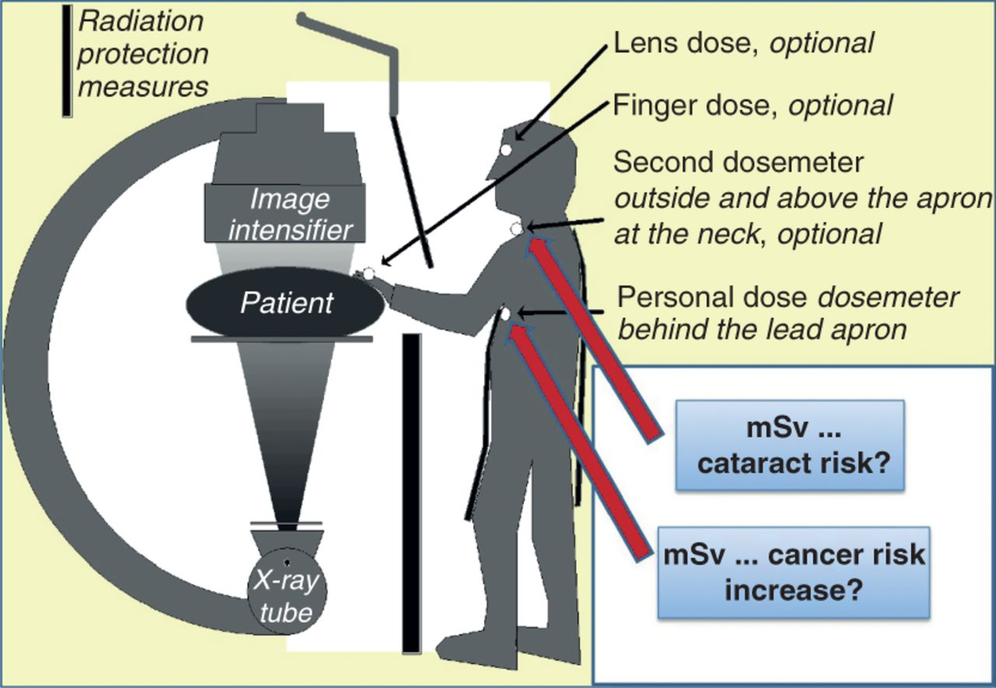
Figure 3 Recommended use of at least two dosimeters, one above and one underneath the lead apron. They allow risk ...
Notes:
Figure 3 Recommended use of at least two dosimeters, one above and one underneath the lead apron. They allow risk estimation for the deterministic effects (such as cataract) and the stochastic effects (such as cancer risks), respectively.
Unless provided in the caption above, the following copyright applies to the content of this slide: Published on behalf of the European Society of Cardiology. All rights reserved. © The Author 2014. For permissions please email: journals.permissions@oup.com.

Slide 4
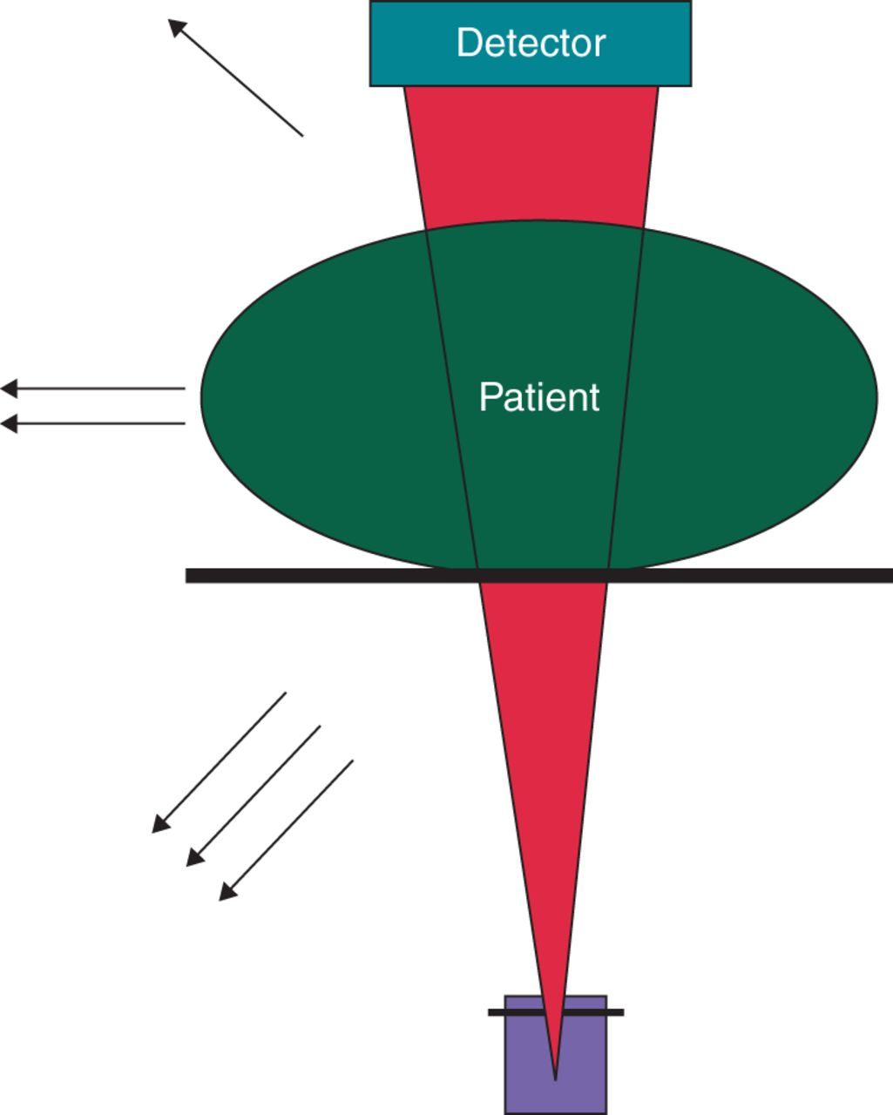
Figure 4 Scattered radiation. Scattered radiation is the main source of exposure for the operator and the other ...
Notes:
Figure 4 Scattered radiation. Scattered radiation is the main source of exposure for the operator and the other persons in the room. The arrows indicate the intensity of the scattered radiation. Most scatter originates from the beam entrance site, which is much closer to the operator during procedures from the groin for the LAO tube, but is closer to the operator during implantations in the shoulder region for the RAO tube.
Unless provided in the caption above, the following copyright applies to the content of this slide: Published on behalf of the European Society of Cardiology. All rights reserved. © The Author 2014. For permissions please email: journals.permissions@oup.com.

Slide 5
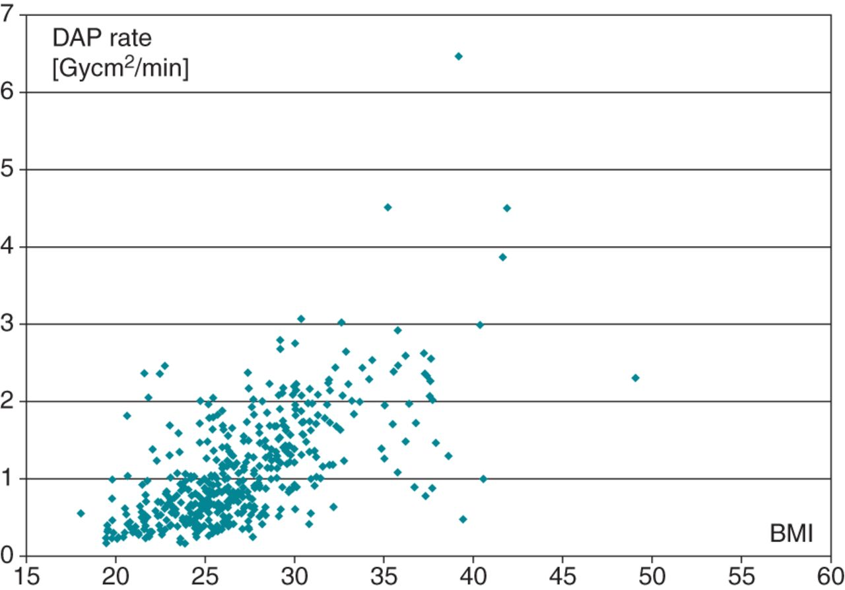
Figure 5 The impact of BMI on the radiation dose. The DAP values for 450 patients who underwent PV antrum isolation ...
Notes:
Figure 5 The impact of BMI on the radiation dose. The DAP values for 450 patients who underwent PV antrum isolation with sequential radiofrequency applications in the University Medical Center Utrecht, The Netherlands, are plotted against their BMI. Their difference in the radiation dose rate between patients with a BMI of 20 and 40 approximately is a factor of 6. The same factor also applies for the level of scattered radiation to the personnel in the cath lab.
Unless provided in the caption above, the following copyright applies to the content of this slide: Published on behalf of the European Society of Cardiology. All rights reserved. © The Author 2014. For permissions please email: journals.permissions@oup.com.

Slide 6
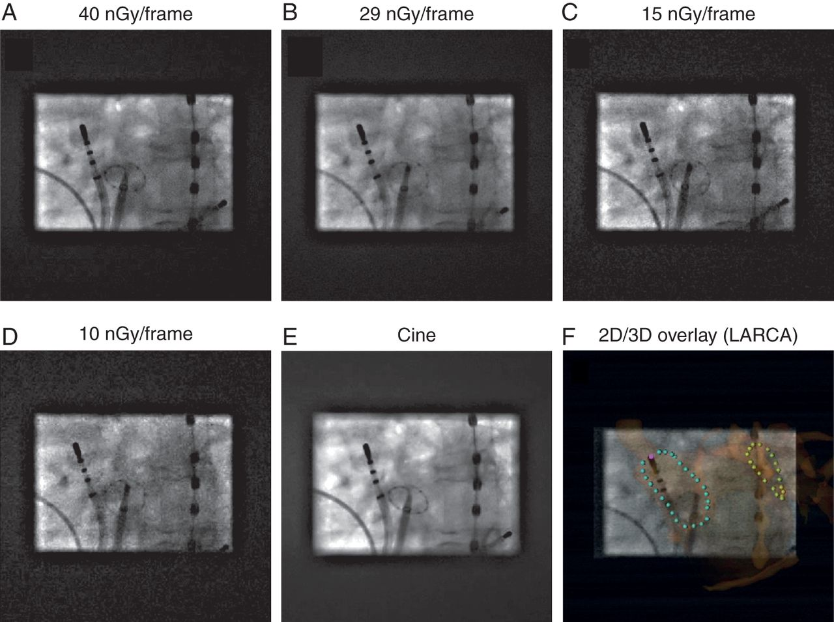
Figure 6 Fluoroscopic imaging with lower dose settings often suffices for EP applications (right PV isolation). See ...
Notes:
Figure 6 Fluoroscopic imaging with lower dose settings often suffices for EP applications (right PV isolation). See also Supplemental Video S1. The figure compares the images during fluoroscopy with four different settings that regulate the output for a detector entrance dose of 40 and 29 nGy/frame (standard values), 15 and 10 nGy/frame in panels A, B, C and D, respectively. The dose setting protocols also include adaptations in Cu filtering. (E) Same image with cine settings. The right PVs are being ablated, with a Lasso-catheter in the right inferior PV. Note that the optimized (symmetric) collimation in all images could easily be set due to 2D–3D overlay (here with LARCA),63 as shown in panel F. Only the LAO images are shown. Although the image gets grainier with reduced dose settings, they still are largely sufficient to visualize the regular EP catheters. This can be appreciated even better in movie mode, as can be judged from the online Supplemental Video S1 (taken at 3 fps), that also shows the RAO acquisitions. In the lowest dose images, the Lasso® catheter becomes more difficult to see, although in this case of a slightly obese lady (172 cm, 77 kg, BMI 26) even the lowest dose setting allowed the identification of the individual electrodes. If required for verification or adjustment in more obese patients, one could temporarily switch to a higher dose setting. The optimal setting will largely depend on the patient's BMI. Therefore, the equipment should have many settings available, allowing the choice of the most appropriate one throughout different stages of the procedure.
Unless provided in the caption above, the following copyright applies to the content of this slide: Published on behalf of the European Society of Cardiology. All rights reserved. © The Author 2014. For permissions please email: journals.permissions@oup.com.

Slide 7
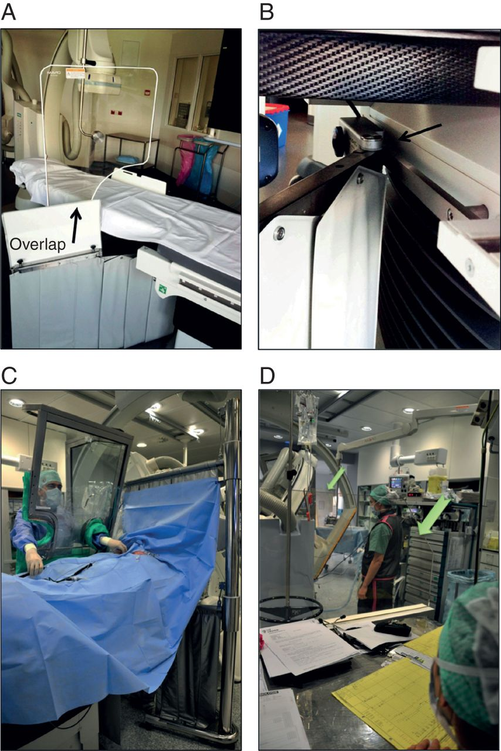
Figure 7 Shielding measures during EP procedures. (A) Lead-glass shielding screens above and below the table. Take ...
Notes:
Figure 7 Shielding measures during EP procedures. (A) Lead-glass shielding screens above and below the table. Take care of the overlap between both screens. (B) Details showing the fixation of the lower lead screen to the upper part of the table foot (instead of to the moving table), avoiding hindrance by the screen during table movements. (C) Both the use of the lead flaps above and under the table, as the concomitant use of a radiation protection cabin, to optimally reduce exposure to the operator, but also to nurses working at the foot of the table. The height of the upper lead flaps support is adjusted so that the flaps just touch the patients belly, to minimize scatter towards the cath lab. Since the operator is fully protected and can perform the full procedure from within the cabin, he does not have to wear a lead apron, thyroid collar, or lead glasses anymore, while the cabin also reduces orthopaedic strain. Of course, in case the operator wants to perform part of the procedure without the cabin, or has to assist a co-worker who stands inside the cabin, lead protection is deserved. (D) Lead screens that protect the anaesthesiologist. One screen is put at the front of a small table; the other one between the patient and the equipment cart (arrows). The screens are moveable to allow for repositioning of the C-arms if needed.
Unless provided in the caption above, the following copyright applies to the content of this slide: Published on behalf of the European Society of Cardiology. All rights reserved. © The Author 2014. For permissions please email: journals.permissions@oup.com.

Slide 8
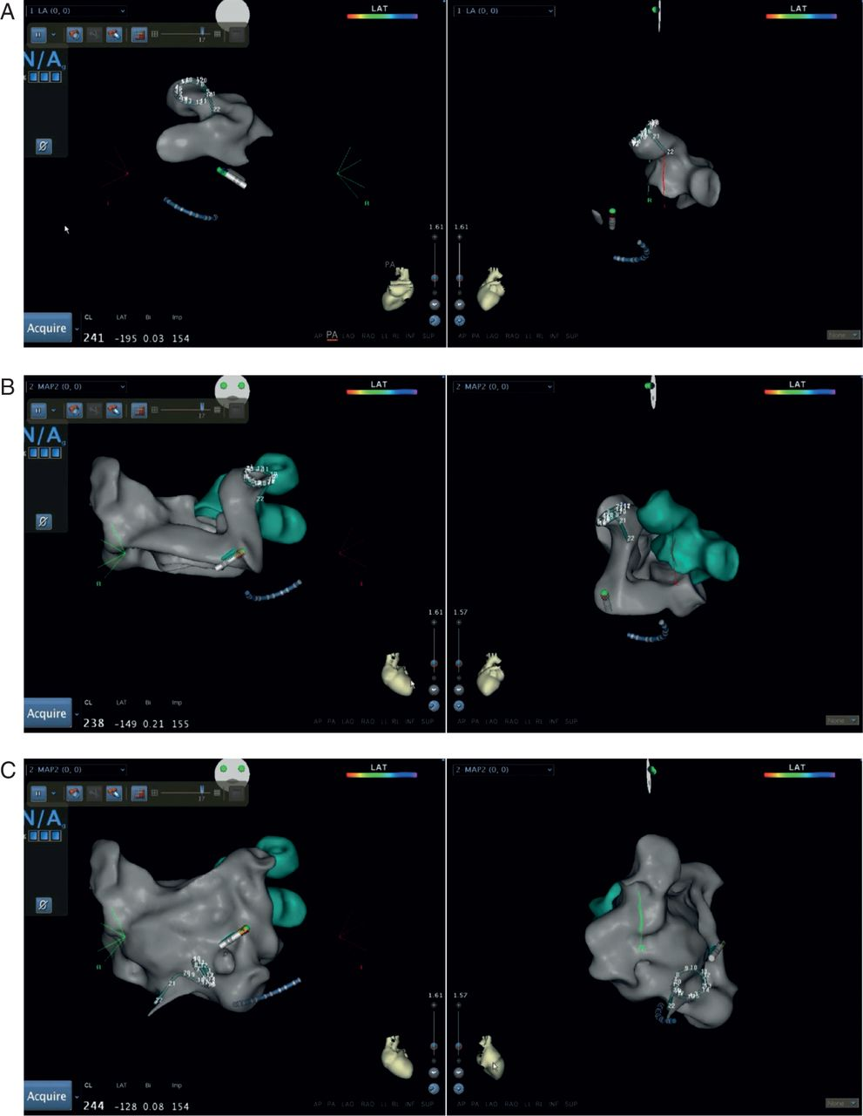
Figure 8 Radiation free construction of an LA geometry using an NFM system. See also Supplemental Video S2A and B, A ...
Notes:
Figure 8 Radiation free construction of an LA geometry using an NFM system. See also Supplemental Video S2A and B, A geometry of the LA is being created on the Carto3 system by using the PV mapping catheter. Up to this point in the procedure, 2 min of fluoroscopy have been used to perform the transseptal punctures. From now on the AF ablation is radiation free. The geometry is created in two stages for the Carto3 to refine the anatomy between the left PVs (LPVs) and the LA appendage. (A). Creation of the left PV geometry. In this case the PV catheter starts in the left lower (LLPV) and is rotated and pushed back and forward to fill out the PV geometry. It is then pulled further back and rotated clockwise until it flicks up into the anterior and more superior left upper PV (LUPV). (B). The LPV geometry is shown and is a reference point for the rest of the geometry. The body of the LA geometry is now created. The PV catheter is rotated clockwise and pulled back until it turns into the RUPV. The catheter is then withdrawn, deflected and turned slightly anticlockwise until it is seen to drop off the RUPV. It is seen to drop briefly into the RLPV but then flicks out. Rotation clockwise allows it to turn back into the RLPV. It is then pulled out and rotated anticlockwise to move it to the anterior LA and advanced into the LAA. (C). Once these five anatomical reference points have been marked the rest of the geometry is easily filled in. The first step for this is to pull the PV catheter out of the LAA and fully deflect it while gently advancing it. The catheter inverts and can then be pulled back in this orientation to the septum without concern that it will come back through the transseptal puncture. The catheter tip will stop moving when it hits the septum and can then be advanced and retracted while rotating it to fill the septal aspect of the LA. The catheter can then be straightened and pulled back to the septum so that the shaft of the PV comes slightly back through the transseptal puncture and a tongue of tissue is seen extending back through the septum. This allows the site of the transseptal puncture to be marked so that the catheters can be advanced back into the LA without the X-ray if they are withdrawn to the right heart. The operator can now position the PV catheter in one of the PVs and the ablation can begin.
Unless provided in the caption above, the following copyright applies to the content of this slide: Published on behalf of the European Society of Cardiology. All rights reserved. © The Author 2014. For permissions please email: journals.permissions@oup.com.

Slide 9
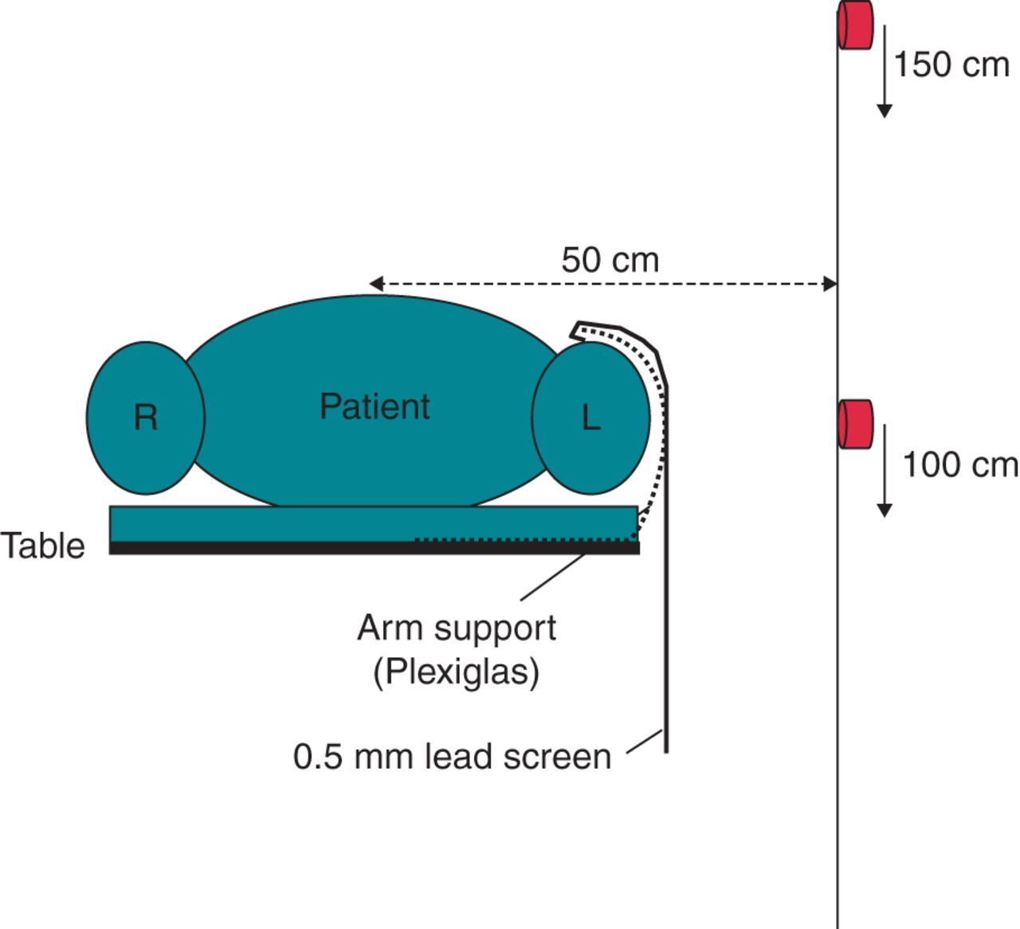
Figure 9 Optimization of the lead protection during device implantation procedures, Cross-sectional view of a patient ...
Notes:
Figure 9 Optimization of the lead protection during device implantation procedures, Cross-sectional view of a patient on the fluoroscopy table. The operator usually stands on the left side of the patient and therefore the dose rates were measured at that side at 100 and 150 cm above the floor with the patients heart in the isocentre. The dosimeters are sketched in red. The custom 0.5 mm lead screen, made of 50 × 50 cm apron material, hangs on a custom Plexiglas arm support and shields both the upper part of the patients arm as well as the left side of the patient from the operator. That screen reduced the operator exposure with 22–94% depending on the projection angle and the measurement position (Table 6).
Unless provided in the caption above, the following copyright applies to the content of this slide: Published on behalf of the European Society of Cardiology. All rights reserved. © The Author 2014. For permissions please email: journals.permissions@oup.com.

Slide 10
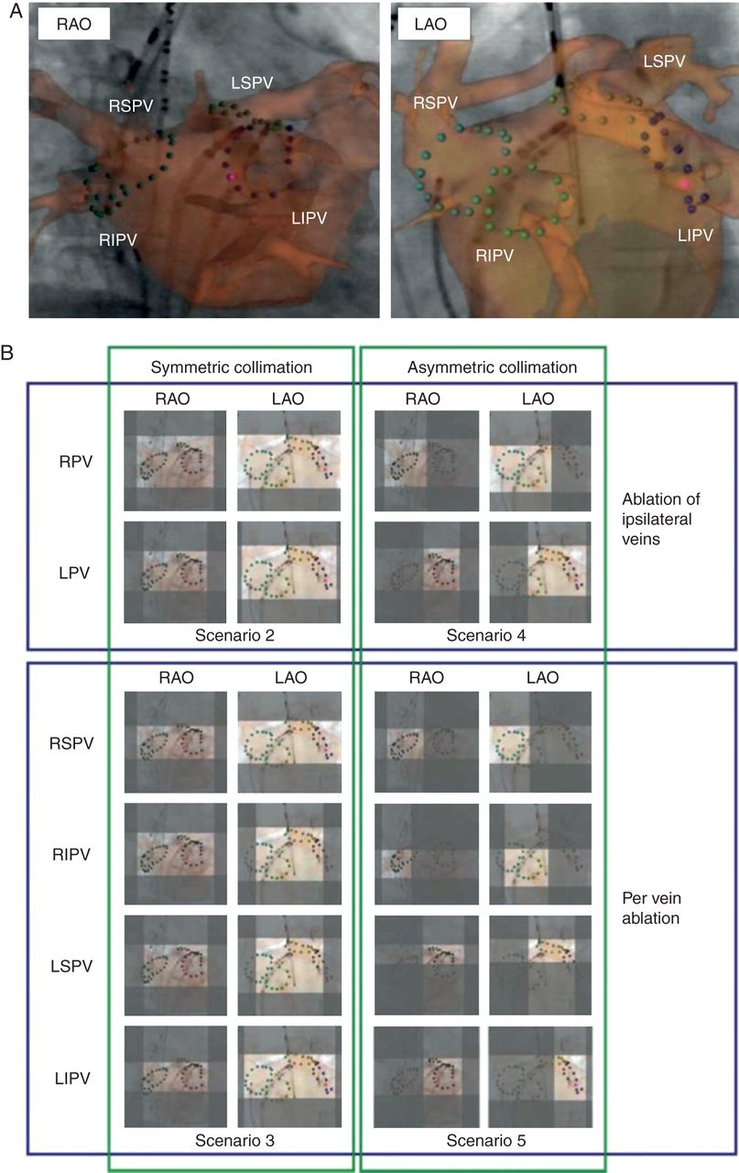
Figure 10 Importance of collimation: symmetrically or asymmetrically, (A) Fluoroscopic images in RAO and LAO view with ...
Notes:
Figure 10 Importance of collimation: symmetrically or asymmetrically, (A) Fluoroscopic images in RAO and LAO view with a superimposed 3D image of the LA, the PVs, and the ostia. The collimation is wide open, revealing all the intracardiac catheters. Often such a view is used throughout a whole ablation procedure. However, mapping and ablation usually focuses on a particular part of the heart. With all the other catheters in stable position, the collimation field can be further reduced as is shown in (B), when the target is the ablation of both the ipsilateral veins with a common encircling, or when the individual veins would be targeted. The left side of the panel shows what can be achieved by classical collimation where the lamels can be adjusted only in pairs (horizontal and vertical), with equal movement of both sides (‘symmetric collimation’). This results in a reduction of the field to (only) 22–43%, with near proportional reduction of the radiation dose. With movement of the table, further optimization would be possible. However, moving the table implies another intervention, which hampers its (repeated) implementation during a procedure. In biplane setups, table movement is not desirable since the isocentre position gets lost, with difficult repositioning of the table to guarantee optimal collimation in both planes. Therefore, a much more practical solution would be the implementation of asymmetric collimation, as illustrated on the right side. It could reduce the radiation dose for isolation of the four PVs by 66–89%. Such an asymmetric collimation could be implemented in a user-friendly software interface, and even semi-automated in case a 3D image of the heart chamber (from rotational or pre-acquired CT) has been registered as in this figure. Adapted from De Buck et al., with permission.
Unless provided in the caption above, the following copyright applies to the content of this slide: Published on behalf of the European Society of Cardiology. All rights reserved. © The Author 2014. For permissions please email: journals.permissions@oup.com.

