Slide 1
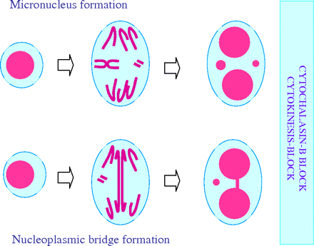
Fig. 1 MN and NPB formation in cells undergoing nuclear division. MN originate from either lagging whole chromosomes ...
Notes:
Fig. 1 MN and NPB formation in cells undergoing nuclear division. MN originate from either lagging whole chromosomes or acentric chromosome fragments. NPBs originate from dicentric chromosomes that may be caused by misrepair of double-strand DNA breaks or telomere end fusions. These events can only be observed in cells completing nuclear division, which are recognised by their binucleated appearance after cytokinesis blocking with cytochalasin-B.
Unless provided in the caption above, the following copyright applies to the content of this slide: © The Author 2010. Published by Oxford University Press on behalf of the UK Environmental Mutagen Society. All rights reserved. For permissions, please e-mail: journals.permissions@oxfordjournals.org.

Slide 2
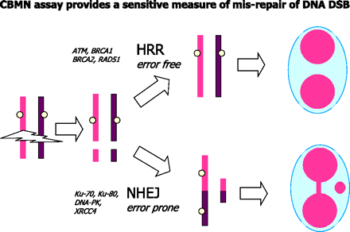
Fig. 2 Defects in genes involved in homologous recombinational repair genes (e.g. ATM, BRCA1, BRCA2 and RAD51) could ...
Notes:
Fig. 2 Defects in genes involved in homologous recombinational repair genes (e.g. ATM, BRCA1, BRCA2 and RAD51) could be detected using the CBMNcyt assay. Under these conditions, the cell would resort to the error prone non-homologous end-joining (NHEJ) repair mechanism that is likely to lead to mis-repair of double-strand breaks in DNA, formation of dicentric chromosomes and acentric chromosome fragments, which are ultimately detectable as NPBs and MN in the CBMNcyt assay.
Unless provided in the caption above, the following copyright applies to the content of this slide: © The Author 2010. Published by Oxford University Press on behalf of the UK Environmental Mutagen Society. All rights reserved. For permissions, please e-mail: journals.permissions@oxfordjournals.org.

Slide 3
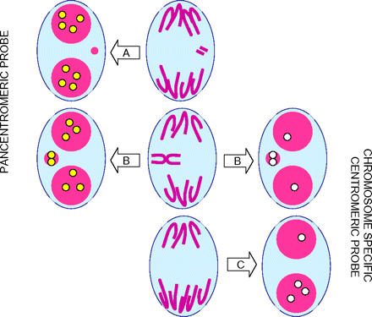
Fig. 3 The use of molecular techniques for identifying (A) an MN originating from a lagging acentric chromosome ...
Notes:
Fig. 3 The use of molecular techniques for identifying (A) an MN originating from a lagging acentric chromosome fragment, (B) an MN originating from a lagging whole chromosome and (C) non-disjunction of a specific chromosome leading to aneuploid daughter nuclei. The yellow spots in the nuclei and MN of the binucleated cells on the left of each panel show the centromeric or kinetochore pattern of staining when pancentromeric probes or kinetochore antibodies are used. The white spots in the nuclei and MN of the binucleated cells on the right of each panel show the pattern of centromeric staining when a centromeric probe specific to the chromosomes involved in MN formation or non-disjunction events is used. The example shown is for a hypothetical cell with only two pairs of chromosomes. Pancentromeric probes should be used only for distinguishing between microinuclei originating from chromosome breaks (centromere negative) and chromosome loss (centromere positive). Chromosome-specific centromere probes should be used only to measure malsegregation (due to non-disjunction or chromosome loss) involving unique chromosomes. It is important to note that pancentromeric probes cannot be used to determine non-disjunction because of difficulty in reliably counting all the centromeres within the nuclei.
Unless provided in the caption above, the following copyright applies to the content of this slide: © The Author 2010. Published by Oxford University Press on behalf of the UK Environmental Mutagen Society. All rights reserved. For permissions, please e-mail: journals.permissions@oxfordjournals.org.

Slide 4
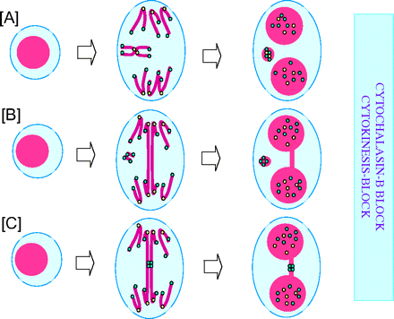
Fig. 4 Pancentromeric and telomeric probes can be used to distinguish (i) between MN originating from whole ...
Notes:
Fig. 4 Pancentromeric and telomeric probes can be used to distinguish (i) between MN originating from whole chromosome loss (A) and MN originating from acentric chromosome fragments (B) and (ii) NPBs from dicentric chromosomes resulting from misrepair of DNA strand breaks (B) and dicentric chromosomes caused by telomere end fusions (C). In the latter case, it is important to note that the telomere end fusions detectable by this system are those caused by telomere dysfunction with telomere sequence loss as a result of defects in assembly of telomere capping proteins. In the case of telomere end fusions due to complete erosion of the telomere sequence, the NPB originating from such a mechanism can only be recognised with a specific probe that hybridises in the sub-telomeric region adjacent to the telomeric repetitive sequence track. The yellow dots represent probes that hybridise to the centromeric region of chromosomes. The light blue dots represent probes that hybridise with the telomeric sequences in chromosomes.
Unless provided in the caption above, the following copyright applies to the content of this slide: © The Author 2010. Published by Oxford University Press on behalf of the UK Environmental Mutagen Society. All rights reserved. For permissions, please e-mail: journals.permissions@oxfordjournals.org.

Slide 5
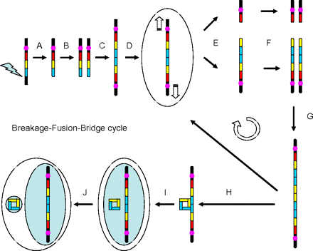
Fig. 5 Gene amplification via BFB cycles and elimination of amplified genes by nuclear budding. (A) Chromosome loses ...
Notes:
Fig. 5 Gene amplification via BFB cycles and elimination of amplified genes by nuclear budding. (A) Chromosome loses telomeric sequence on long arm due to an induced chromosome break occurring sub-telomerically. (B) The chromosome lacking telomere sequence is replicated. (C) Fusion of the chromosome ends of the sister chromosomes lacking telomeres produces a dicentric chromosome. (D) The centromeres of the resulting dicentric chromosome are pulled to opposite poles at anaphase. (E) The dicentric chromosome breaks unevenly resulting in one daughter chromosome losing the yellow and blue gene blocks and the other chromosome gaining an extra copy of these gene blocks. (F) The abnormal chromosomes are replicated in the daughter cells. (G) Because they lack telomeres, the sister chromosomes fuse again repeating the gene amplification cycle (i.e. repeating steps D–F). Alternatively, recombination may occur between homologous sequences (H) and result in the ‘looping-out’ of a circular acentric DNA fragment or double minute (I), which may be subsequently extruded from the nucleus via nuclear budding (J) to form an MN.
Unless provided in the caption above, the following copyright applies to the content of this slide: © The Author 2010. Published by Oxford University Press on behalf of the UK Environmental Mutagen Society. All rights reserved. For permissions, please e-mail: journals.permissions@oxfordjournals.org.

Slide 6
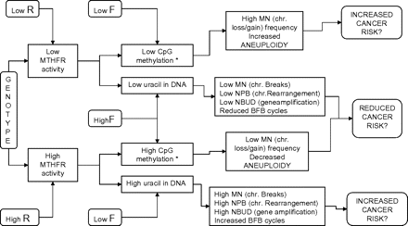
Fig. 6 Mechanistic framework explaining the molecular interrelationship between the ...
Notes:
Fig. 6 Mechanistic framework explaining the molecular interrelationship between the methylenetetrahydrofolatereductase (MTHFR) genotype, riboflavin (R) and folic acid (F) with respect to CBMNcyt assay biomarkers of DNA damage and altered cancer risks. Folate and riboflavin concentration levels combined with the MTHFR genotype can affect: (i) CpG methylation and uracil in DNA, (ii) aneuploidy and MN originating from chromosome loss events, (iii) MN (originating from acentric chromosome fragments), NBUDs, NPBs and BFB cycles, (iv) initiation of cancer caused by CpG hypomethylation and aneuploidy and (v) initiation of cancer caused by increased BFB cycles, MN (originating from acentric chromosome fragments), NBUD and NPB. Asterisk represents: for brevity, other carcinogenic mechanisms induced by altered genome methylation, such as silencing of tumour suppressor genes and/or activation of oncogenes, are not included in the diagram. For more detailed explanation, refer to (60).
Unless provided in the caption above, the following copyright applies to the content of this slide: © The Author 2010. Published by Oxford University Press on behalf of the UK Environmental Mutagen Society. All rights reserved. For permissions, please e-mail: journals.permissions@oxfordjournals.org.

