Slide 1
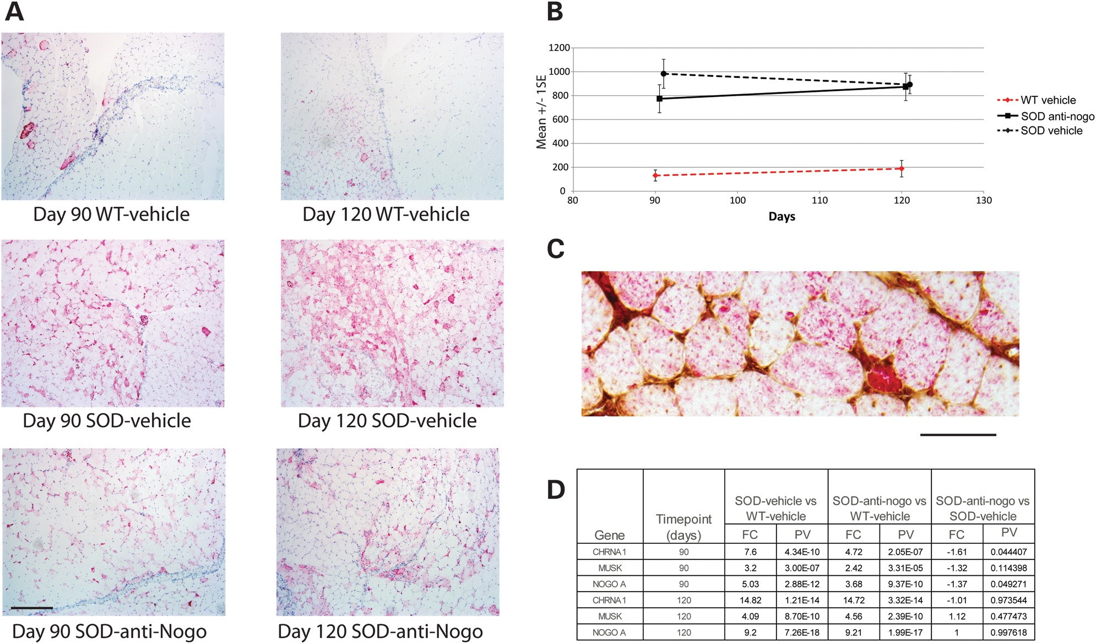
Figure 1. Accumulation of Nogo-A in muscle fibres of SOD1^{G93A} mice. (A) Representative images and (B) ...
Notes:
Figure 1. Accumulation of Nogo-A in muscle fibres of SOD1G93A mice. (A) Representative images and (B) quantitation of sections of gastrocnemius muscles stained for Nogo-A from WT and SOD1G93A mice at 90 and 120 days, treated with either vehicle or anti-Nogo A antibody (Y-axis = Nogo-A integral sum/gastroc area sum); (C) gastrocnemius muscle stained for Nogo-A and anti-Nogo-A antibody; (D) mRNA expression of Nogo-A and markers of denervation (CHRNA1 and MUSK) in gastrocnemius muscle from WT and SOD1G93A mice at 90 and 120 days, treated with either vehicle or anti-Nogo A antibody (PV = P-value); n = 5 animals per group. Scale bars (A) 200 μm; (C) 50 μm.
Unless provided in the caption above, the following copyright applies to the content of this slide: © The Author 2014. Published by Oxford University Press. All rights reserved. For Permissions, please email: journals.permissions@oup.com

Slide 2
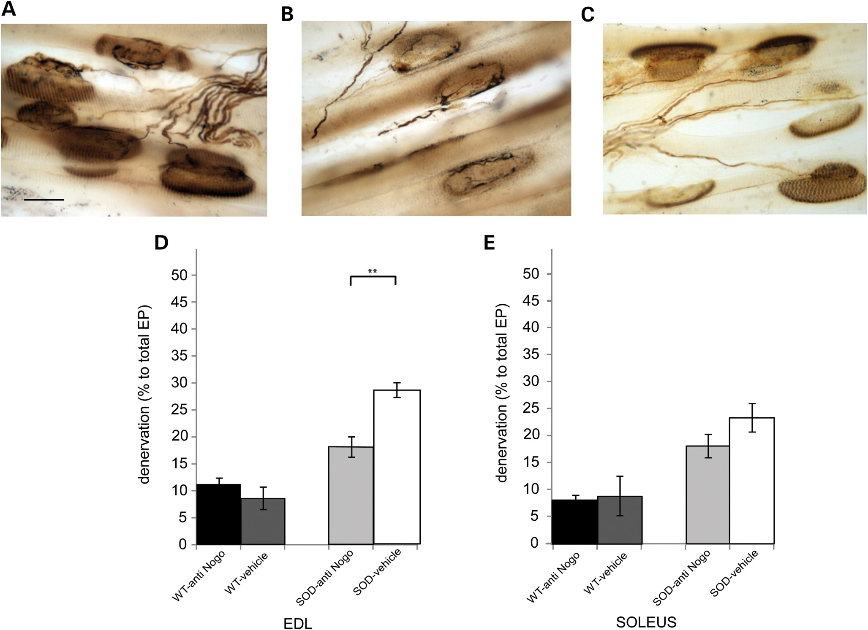
Figure 2. Treatment with an anti-Nogo-A antibody preserves hindlimb muscle innervation in SOD1^{G93A} mice at ...
Notes:
Figure 2. Treatment with an anti-Nogo-A antibody preserves hindlimb muscle innervation in SOD1G93A mice at 90 days of age. The photomicrographs show examples of EDL muscle sections stained with silver cholinesterase from (A) WT animals and (B) vehicle-treated SOD1G93A mice and (C) anti-Nogo-A antibody-treated SOD1G93A mice at 90 days of age. The number of endplates that were contacted by a nerve terminal was determined in muscles of each animal. The results are summarized in the bar charts which show the number of denervated endplates expressed as a percentage of the total number of endplates counted in (D) EDL and (E) soleus muscles of 90 day old mice. n = min 5 animals per group. Error bars = SEM **P < 0.01, scale bar = 10 µm.
Unless provided in the caption above, the following copyright applies to the content of this slide: © The Author 2014. Published by Oxford University Press. All rights reserved. For Permissions, please email: journals.permissions@oup.com

Slide 3
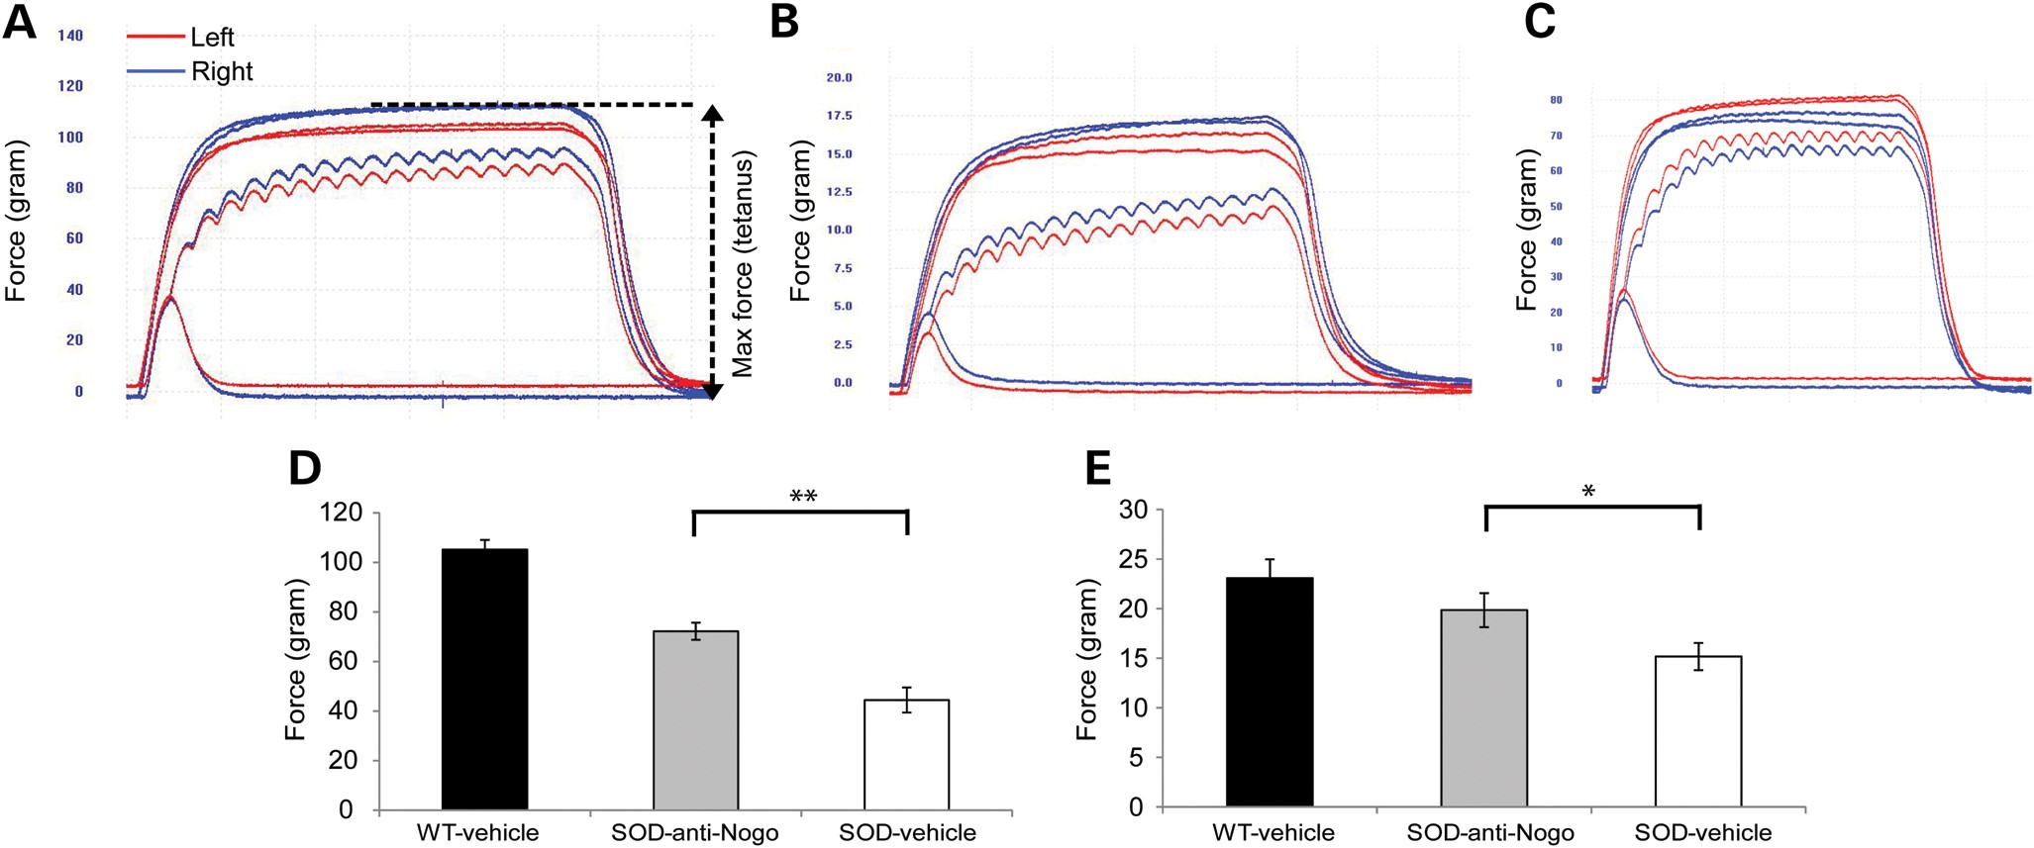
Figure 3. Treatment with an anti-Nogo-A antibody improves hindlimb muscle force in 90 day old SOD1^{G93A} mice. ...
Notes:
Figure 3. Treatment with an anti-Nogo-A antibody improves hindlimb muscle force in 90 day old SOD1G93A mice. Typical examples of isometric force traces showing the maximum force generated by TA muscles in the left (red trace) and right (blue trace) hindlimbs of (A) vehicle-treated WT and (B) vehicle-treated SOD1G93A mice and (C) anti-Nogo-A antibody-treated SOD1G93A mice at 90 days of age are shown. From traces such as these, the maximum tetanic force was determined. The bar charts show the mean maximum tetanic force of (D) TA and (E) EDL muscles of 90 day old vehicle-treated WT mice and SOD1G93A mice treated with either vehicle or an anti-Nogo-A antibody. n = min 5 mice in each group, muscles from both legs were analysed. Error bars = SEM. *P < 0.05; **P < 0.01.
Unless provided in the caption above, the following copyright applies to the content of this slide: © The Author 2014. Published by Oxford University Press. All rights reserved. For Permissions, please email: journals.permissions@oup.com

Slide 4
Figure 4. Treatment with an anti-Nogo-A antibody improves motor unit survival in 90 day old SOD1^{G93A} mice. ...
Notes:
Figure 4. Treatment with an anti-Nogo-A antibody improves motor unit survival in 90 day old SOD1G93A mice. (A) Examples of motor unit traces from EDL muscles of vehicle-treated WT mice and SOD1G93A mice treated with vehicle or anti-Nogo-A antibody at 90 days of age. (B) The number of motor units present in each muscle was established and the results are summarized in the bar chart. n = min 5 mice in each group, muscles from both legs were analysed. Error bars = SEM. *P < 0.05.
Unless provided in the caption above, the following copyright applies to the content of this slide: © The Author 2014. Published by Oxford University Press. All rights reserved. For Permissions, please email: journals.permissions@oup.com

Slide 5
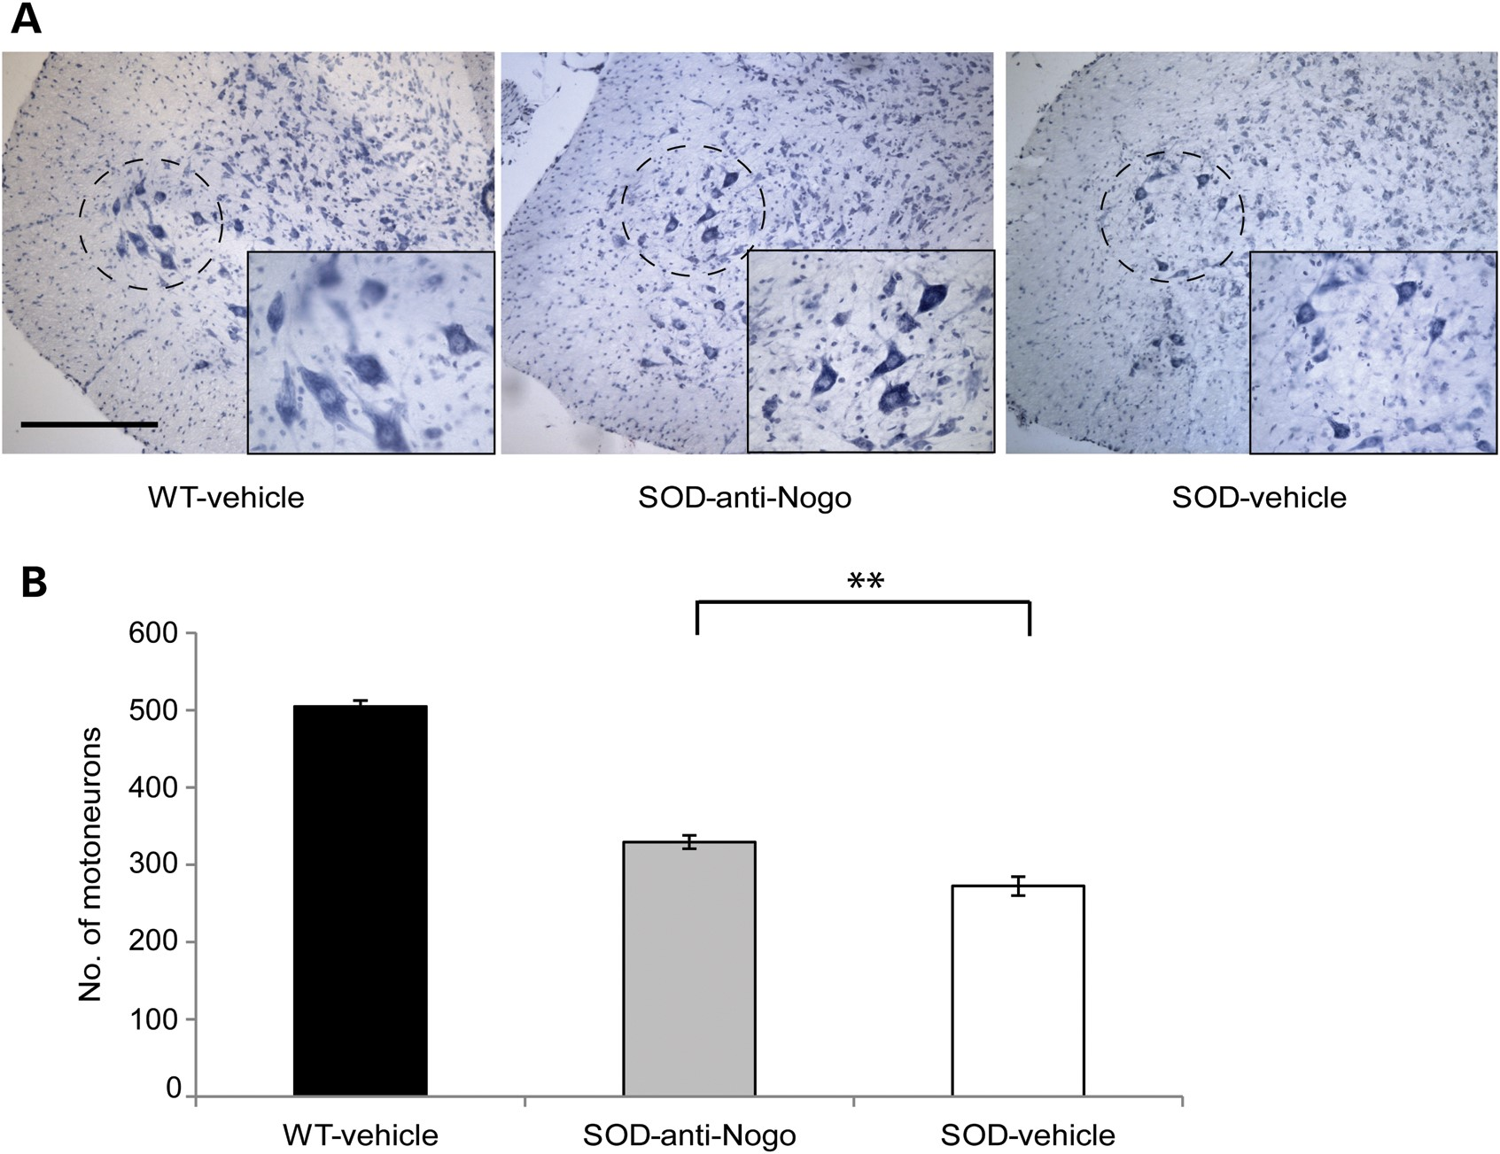
Figure 5. Treatment with anti-Nogo-A antibody improves motor neuron survival in 90 day old SOD1^{G93A} mice. ...
Notes:
Figure 5. Treatment with anti-Nogo-A antibody improves motor neuron survival in 90 day old SOD1G93A mice. Examples of cross-sections of spinal cord of 90 day old vehicle-treated WT mice and SOD1G93A mice treated with vehicle or anti-Nogo-A antibody, showing motor neurons within the ventral horn. The location of the sciatic motor pool is shown within the dotted circles, which is enlarged within the magnified inserts. The number of motor neurons in the sciatic motor pool of each spinal cord was determined and the results are summarized in the bar chart. n = 5 per group. Error bars represent SEM. **P < 0.01, scale bars = 200 µm.
Unless provided in the caption above, the following copyright applies to the content of this slide: © The Author 2014. Published by Oxford University Press. All rights reserved. For Permissions, please email: journals.permissions@oup.com

Slide 6
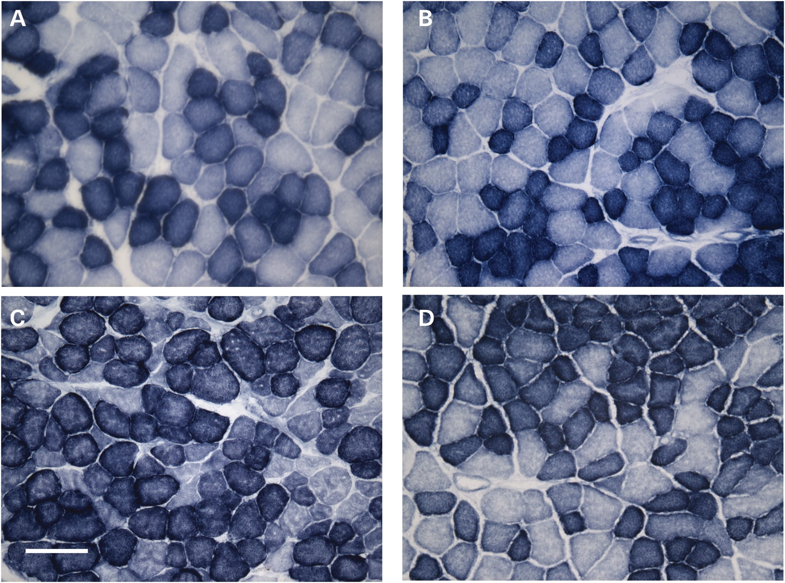
Figure 6. Treatment with an anti-Nogo-A antibody prevents the transformation in the phenotype of TA muscle in 90 day ...
Notes:
Figure 6. Treatment with an anti-Nogo-A antibody prevents the transformation in the phenotype of TA muscle in 90 day old SOD1G93A mice. The photomicrographs show examples of cross-sections of TA muscles stained for SDH, an indicator of oxidative capacity. Sections are from 90 day old WT mice treated with either vehicle (A) or anti-Nogo-A antibody (B) and SOD mice treated with either vehicle (C) or anti-Nogo-A antibody (D). n = 5 per group. Scale bar = 70 µm.
Unless provided in the caption above, the following copyright applies to the content of this slide: © The Author 2014. Published by Oxford University Press. All rights reserved. For Permissions, please email: journals.permissions@oup.com

Slide 7
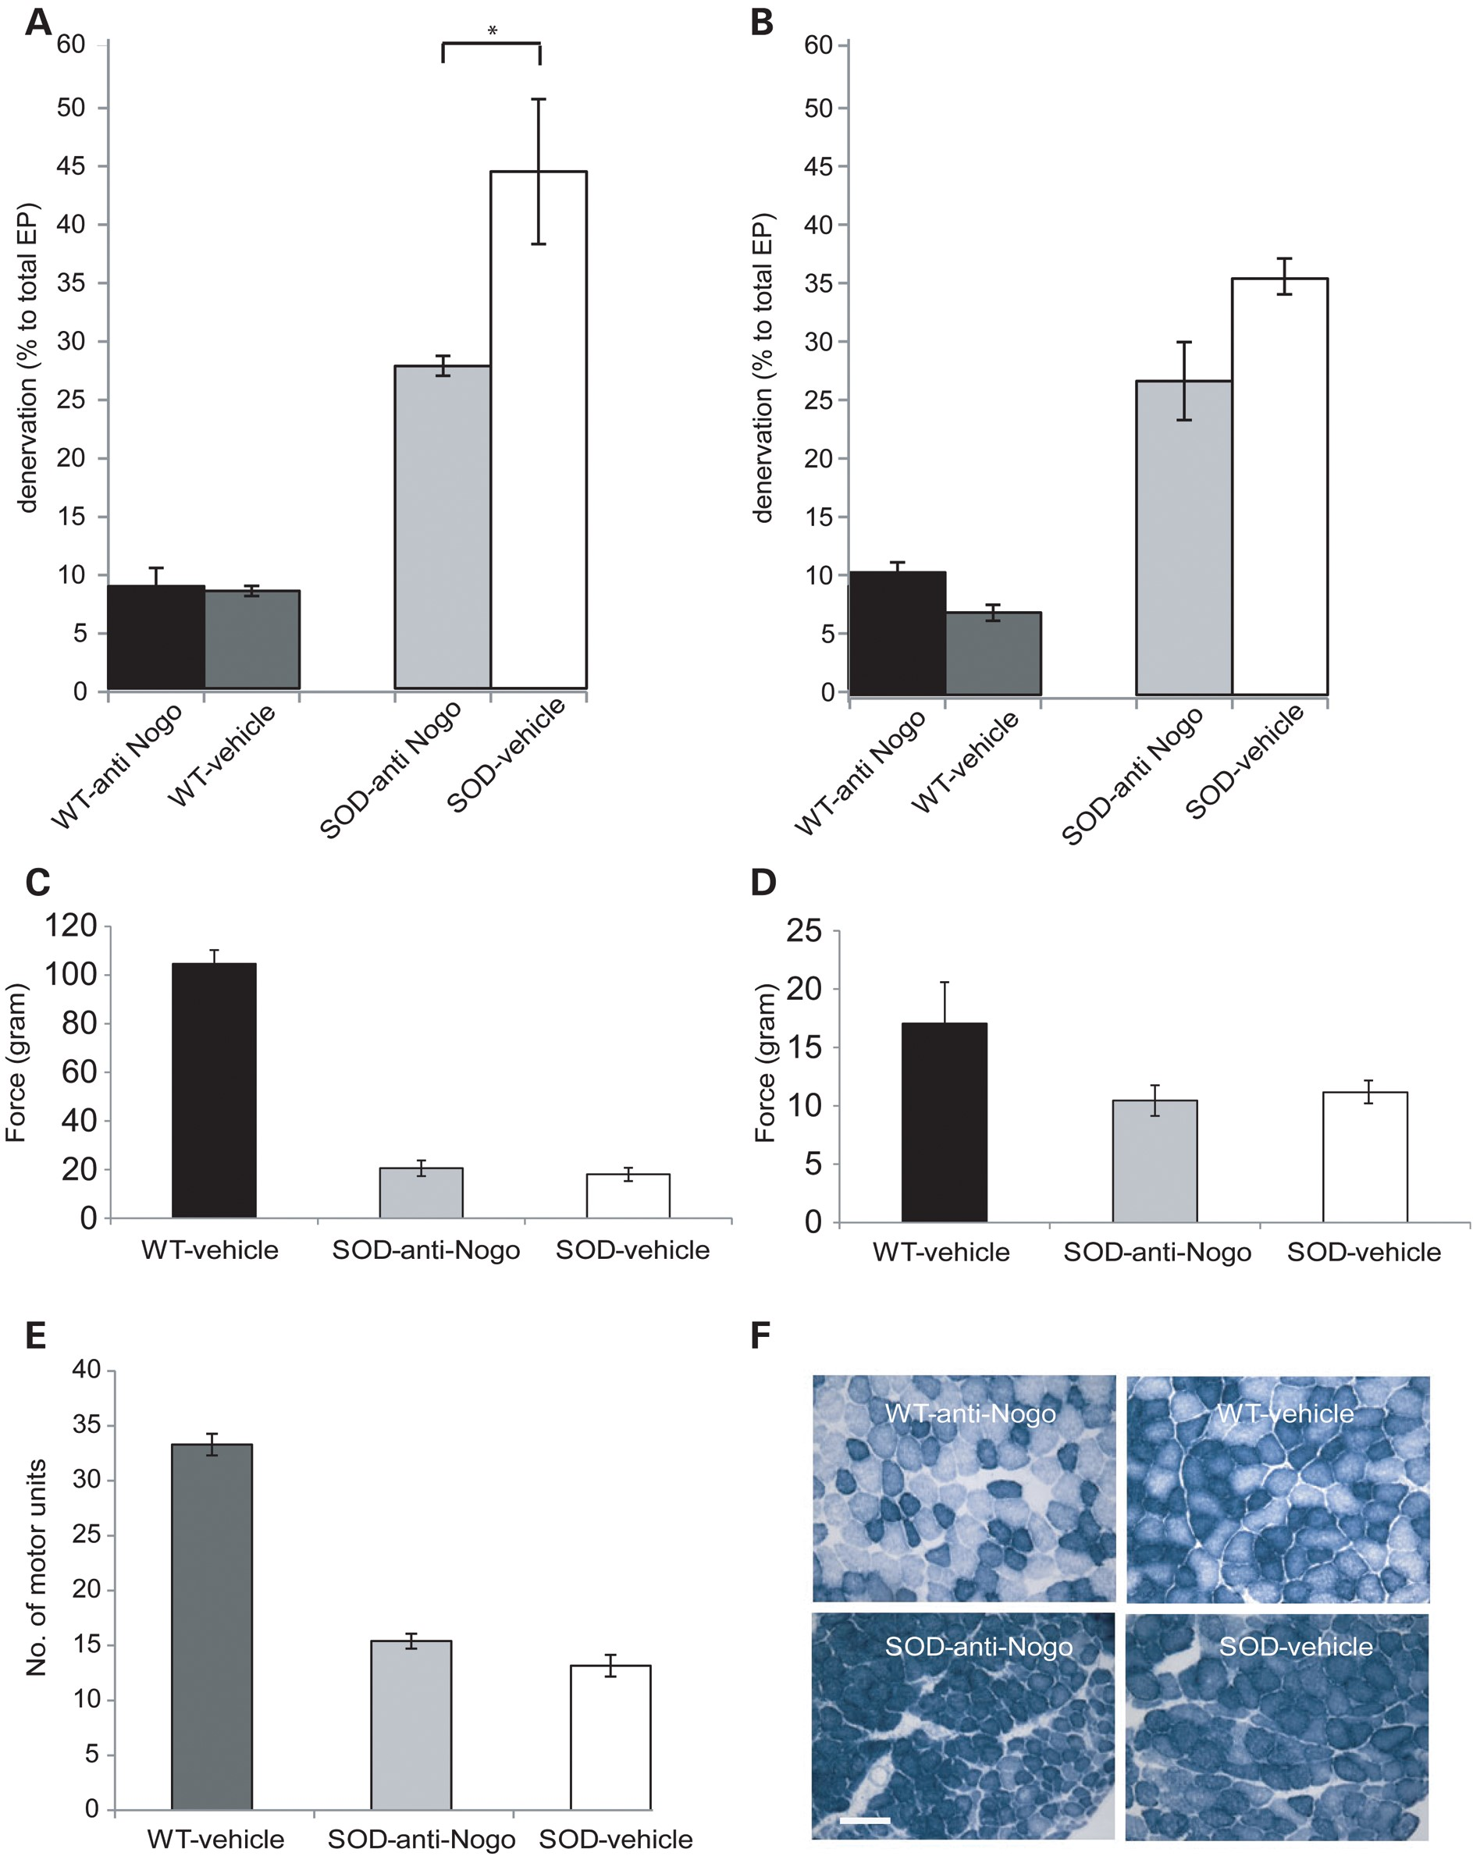
Figure 7. The effects of an anti-Nogo-A antibody on disease phenotype in 120 day old SOD1^{G93A} mice. The ...
Notes:
Figure 7. The effects of an anti-Nogo-A antibody on disease phenotype in 120 day old SOD1G93A mice. The long-term effects of treatment of SOD1G93A mice with the anti-Nogo-A antibody were established at 120 days of age by comparing WT and SOD1G93A mice treated with either vehicle or anti-Nogo-A antibody. The bar charts show the number of denervated endplates expressed as a percentage of the total number of endplates counted in (A) EDL and (B) soleus muscles of WT and SOD1G93A mice. The bar charts show the mean maximum tetanic force of (C) TA and (D) EDL muscles of vehicle and antibody-treated WT mice and SOD1G93A mice. (E) The mean number of motor units in the EDL muscle of WT mice and SOD1G93A mice is summarized. (F) The photomicrographs show examples of cross-sections of TA and EDL muscles of WT and SOD1G93A mice at 120 days of age, stained for SDH. (*P < 0.05) n = min 5 mice in each group, muscles from both legs were analysed. Error bars = SEM. Scale bar = 70 µm.
Unless provided in the caption above, the following copyright applies to the content of this slide: © The Author 2014. Published by Oxford University Press. All rights reserved. For Permissions, please email: journals.permissions@oup.com

Slide 8
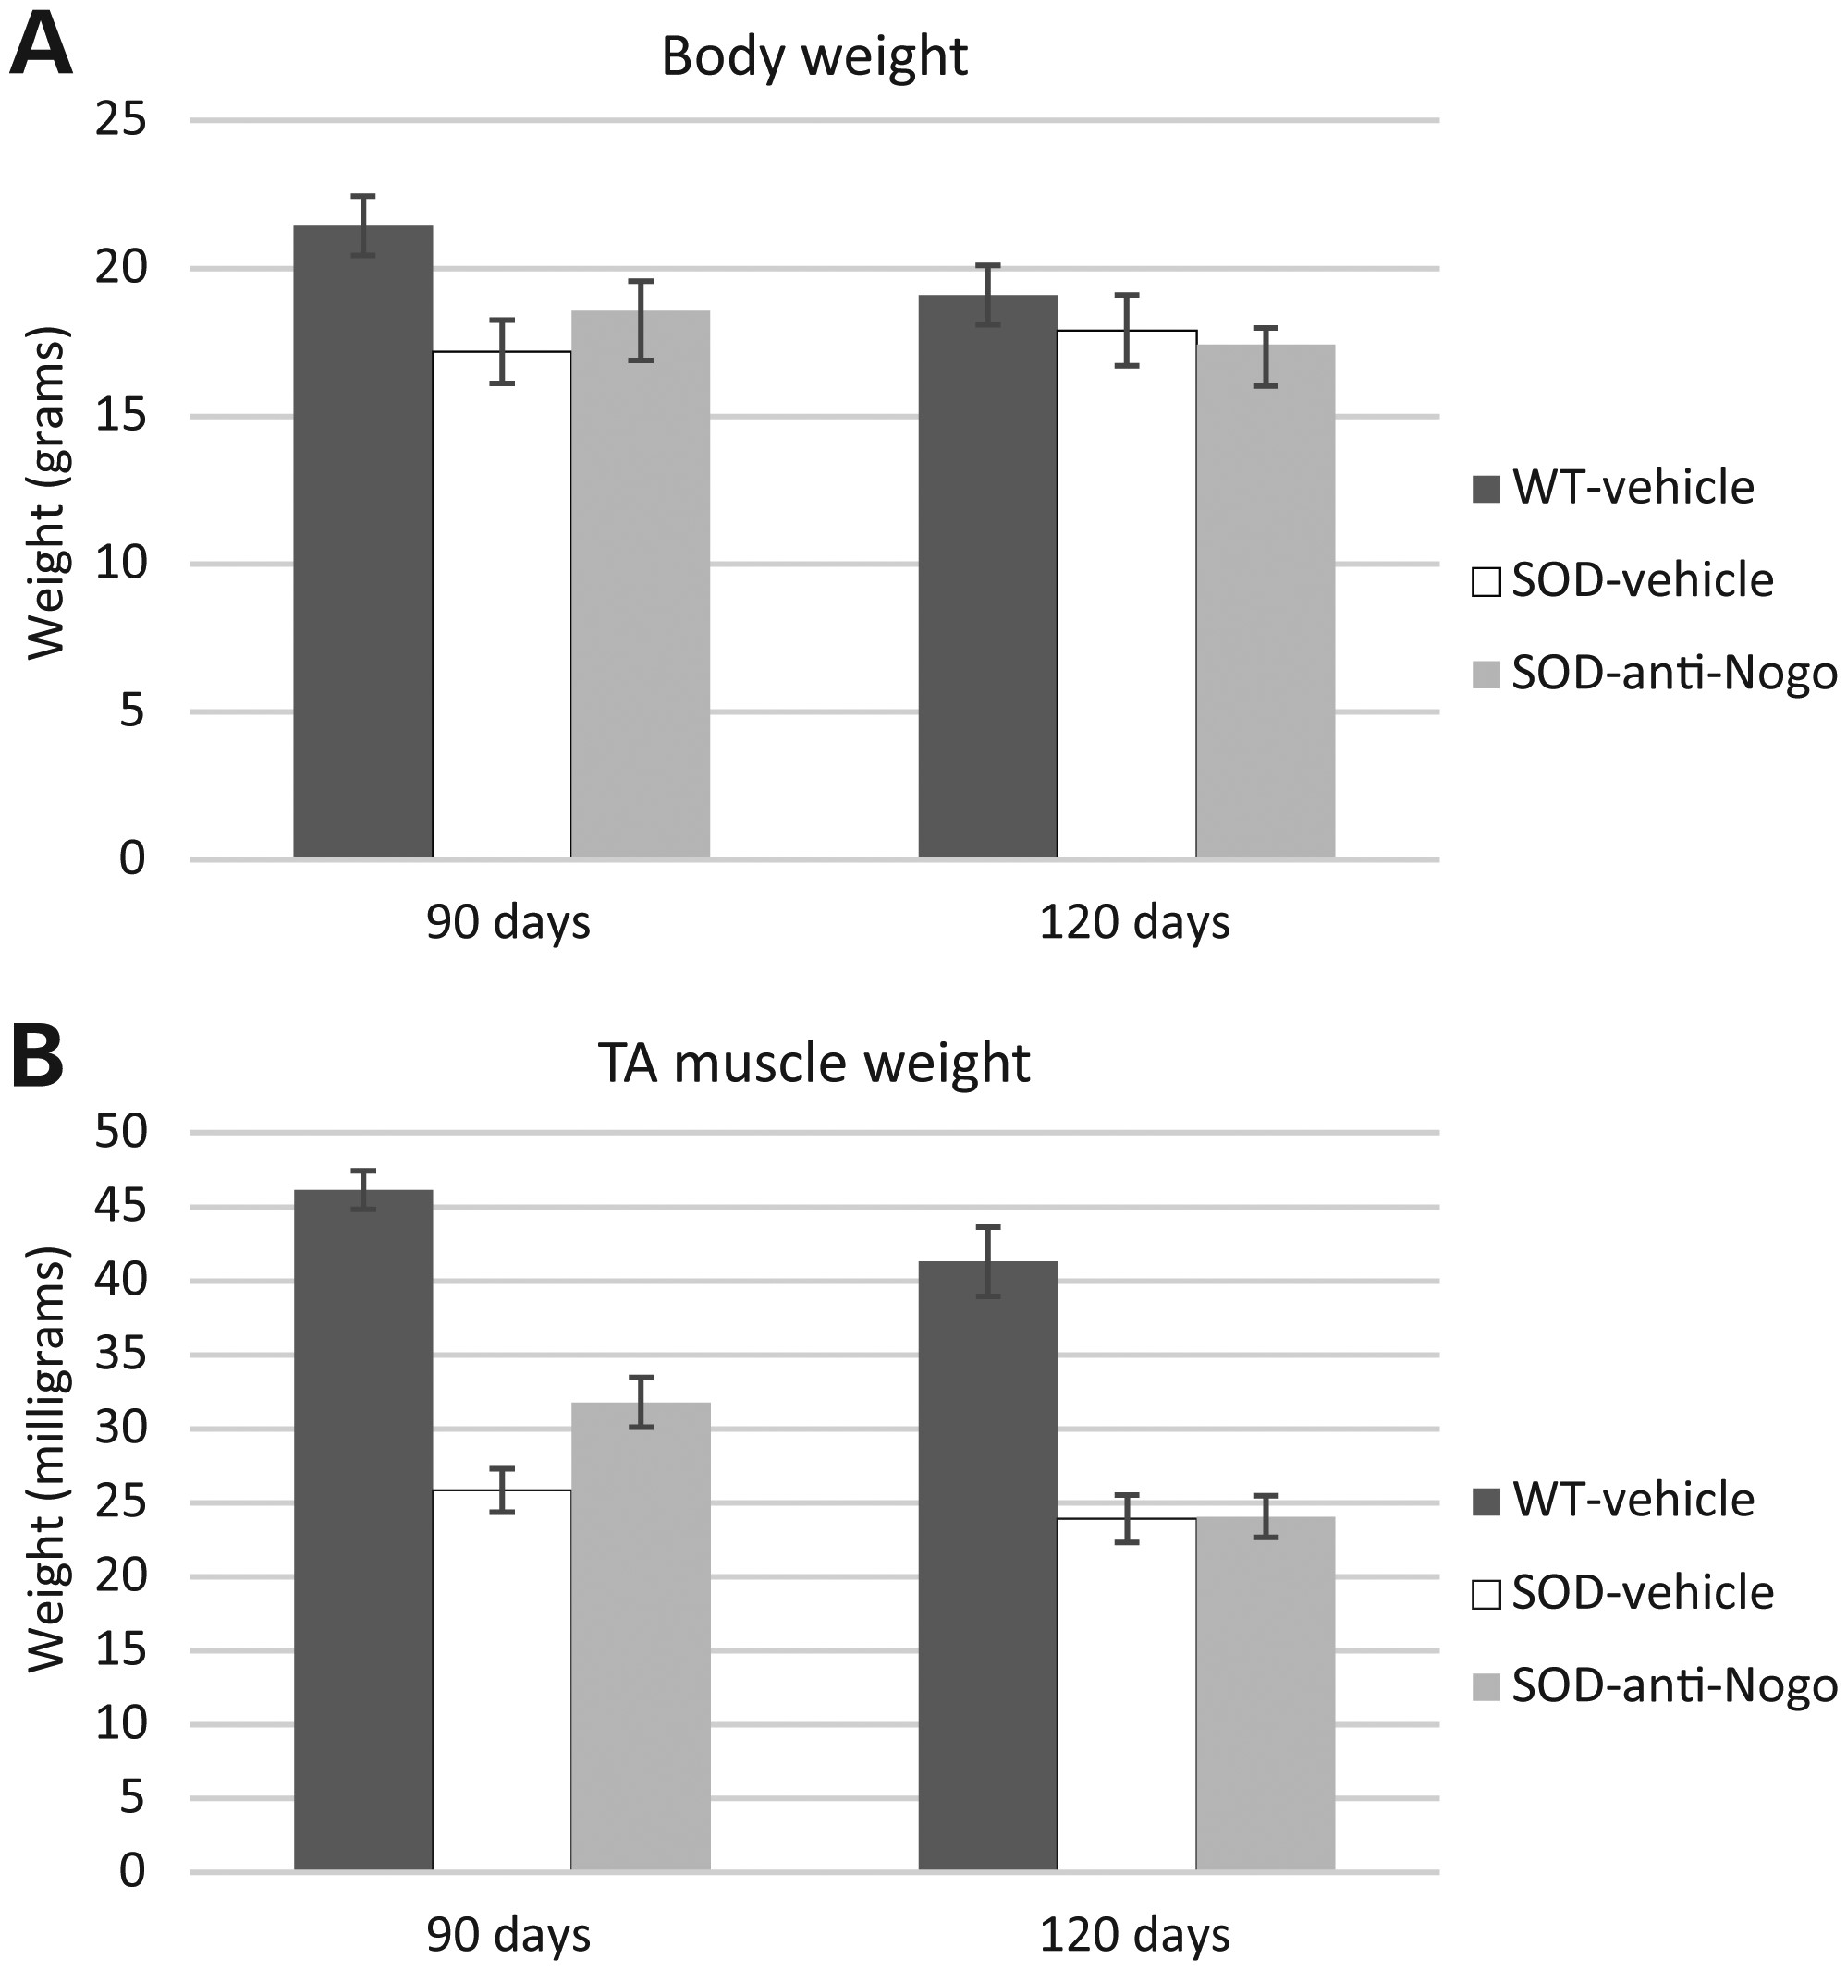
Figure 8. The effects of an anti-Nogo-A antibody on TA muscle weight and body weight in 90 and 120 day old ...
Notes:
Figure 8. The effects of an anti-Nogo-A antibody on TA muscle weight and body weight in 90 and 120 day old SOD1G93A mice. The bar charts show (A) the mean weight of TA muscles and (B) the mean body weight of WT, vehicle- and anti-Nogo-A-treated SOD1G93A mice at 90 and 120 days. n = min 5 mice in each group; TA muscles from both legs were analysed. Error bars = SEM.
Unless provided in the caption above, the following copyright applies to the content of this slide: © The Author 2014. Published by Oxford University Press. All rights reserved. For Permissions, please email: journals.permissions@oup.com

