Slide 1
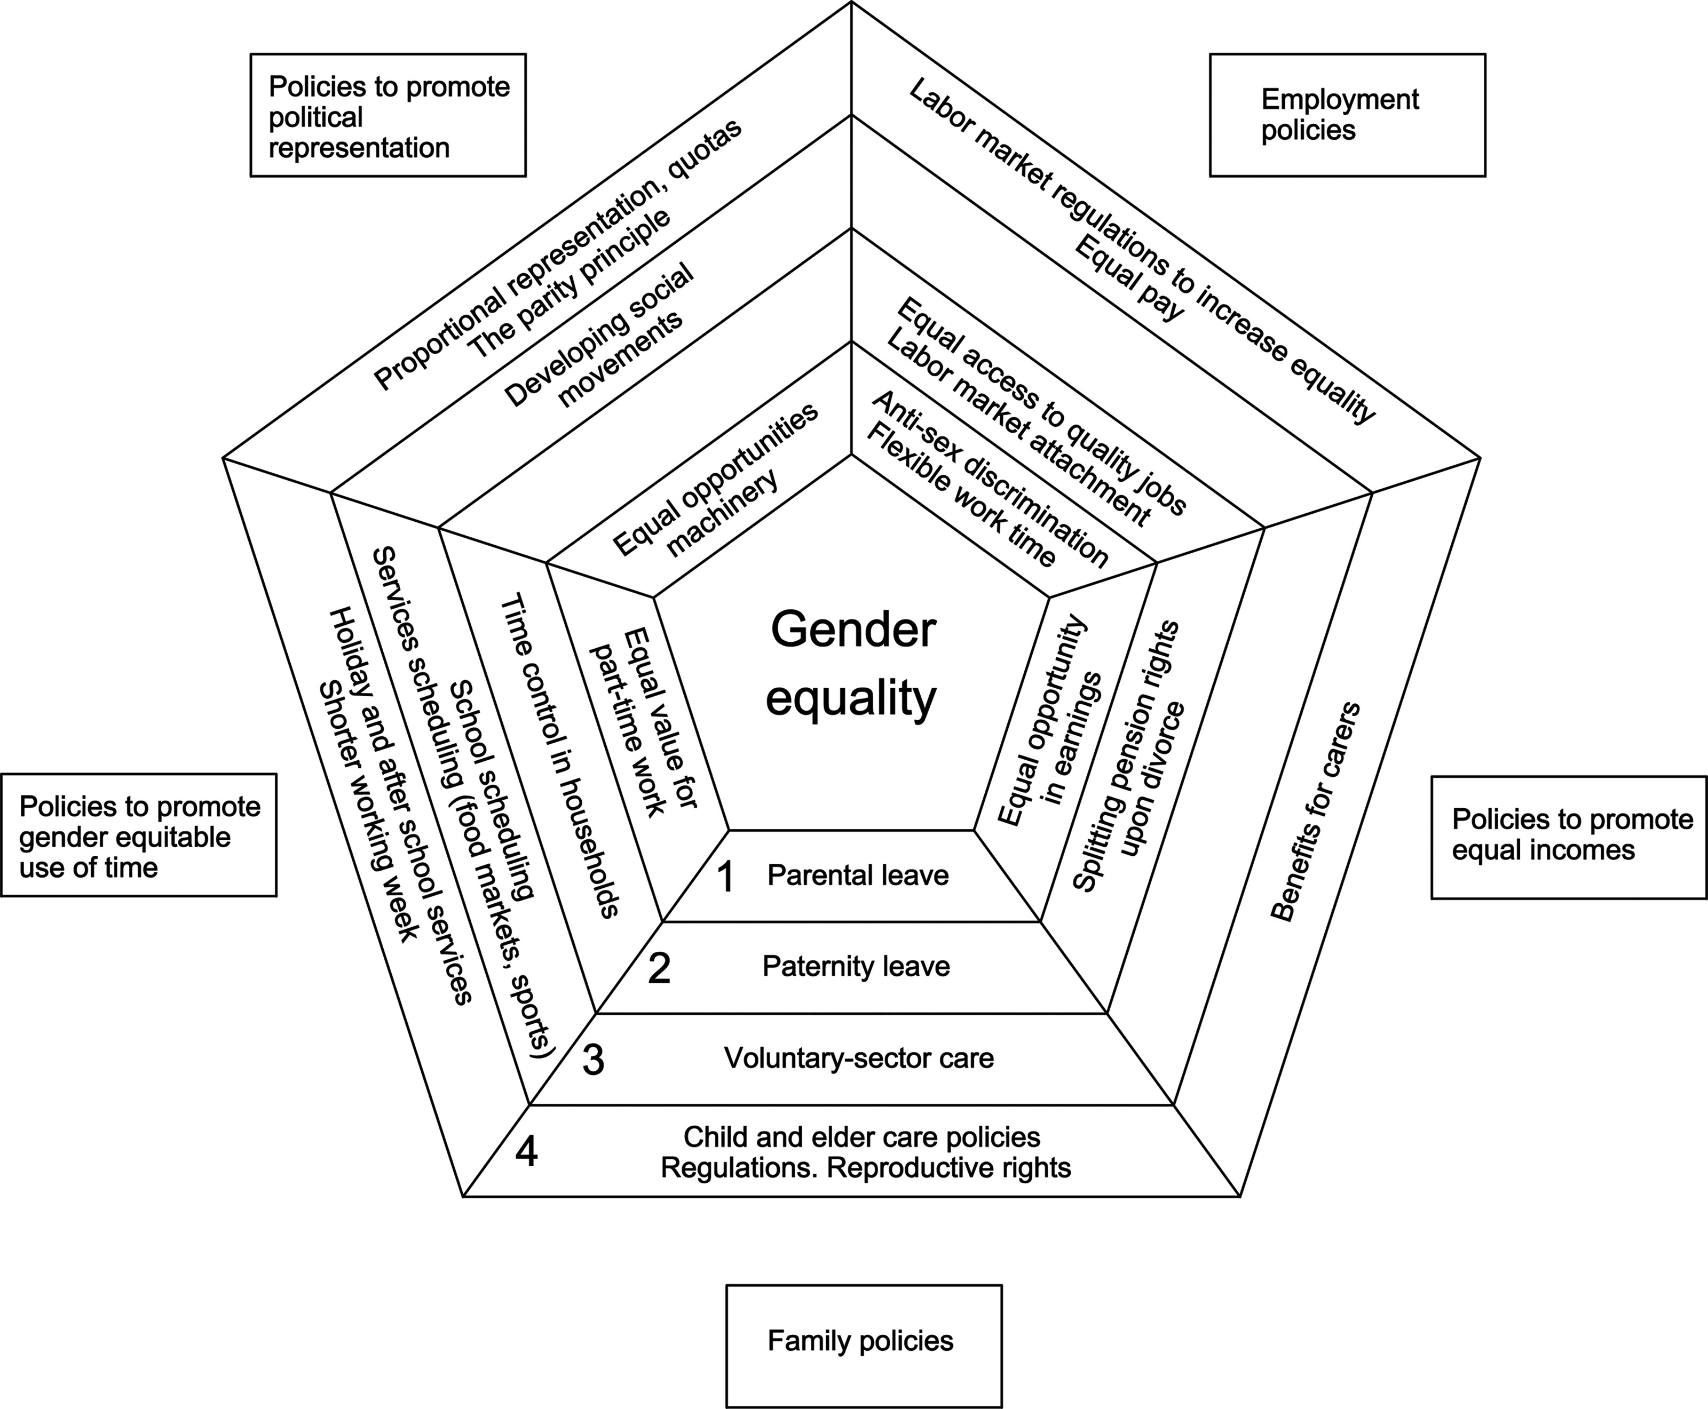
Figure 1. Policies for gender equality. Modified from Pascall and Lewis (J Soc Policy. 2004;33(3):373–394) (40). Levels ...
Notes:
Figure 1. Policies for gender equality. Modified from Pascall and Lewis (J Soc Policy. 2004;33(3):373–394) (40). Levels of policy intervention: 1, individual; 2, household; 3, civic/community; 4, society/politic.
Unless provided in the caption above, the following copyright applies to the content of this slide: © The Author 2013. Published by Oxford University Press on behalf of the Johns Hopkins Bloomberg School of Public Health. All rights reserved. For permissions, please e-mail: journals.permissions@oup.com.

