Slide 1
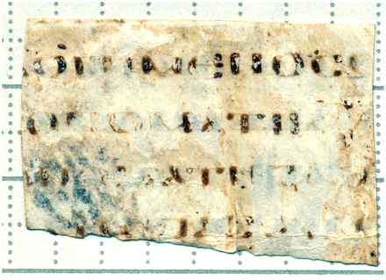
Plate 1. Testamentum Domini fragment, flesh side [recto] (image: Benet Salway)
Notes:
Plate 1. Testamentum Domini fragment, flesh side [recto] (image: Benet Salway)
Unless provided in the caption above, the following copyright applies to the content of this slide: © The Authors 2011. Published by Oxford University Press. All rights reserved. For Permissions, please email: journals.permissions@oup.com

Slide 2
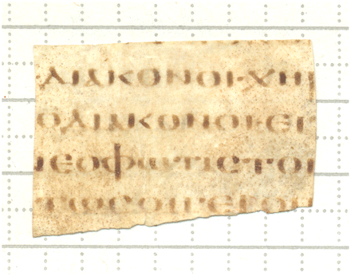
Plate 2. Testamentum Domini fragment, hair side [verso] (image: Benet Salway)
Notes:
Plate 2. Testamentum Domini fragment, hair side [verso] (image: Benet Salway)
Unless provided in the caption above, the following copyright applies to the content of this slide: © The Authors 2011. Published by Oxford University Press. All rights reserved. For Permissions, please email: journals.permissions@oup.com

