Slide 1
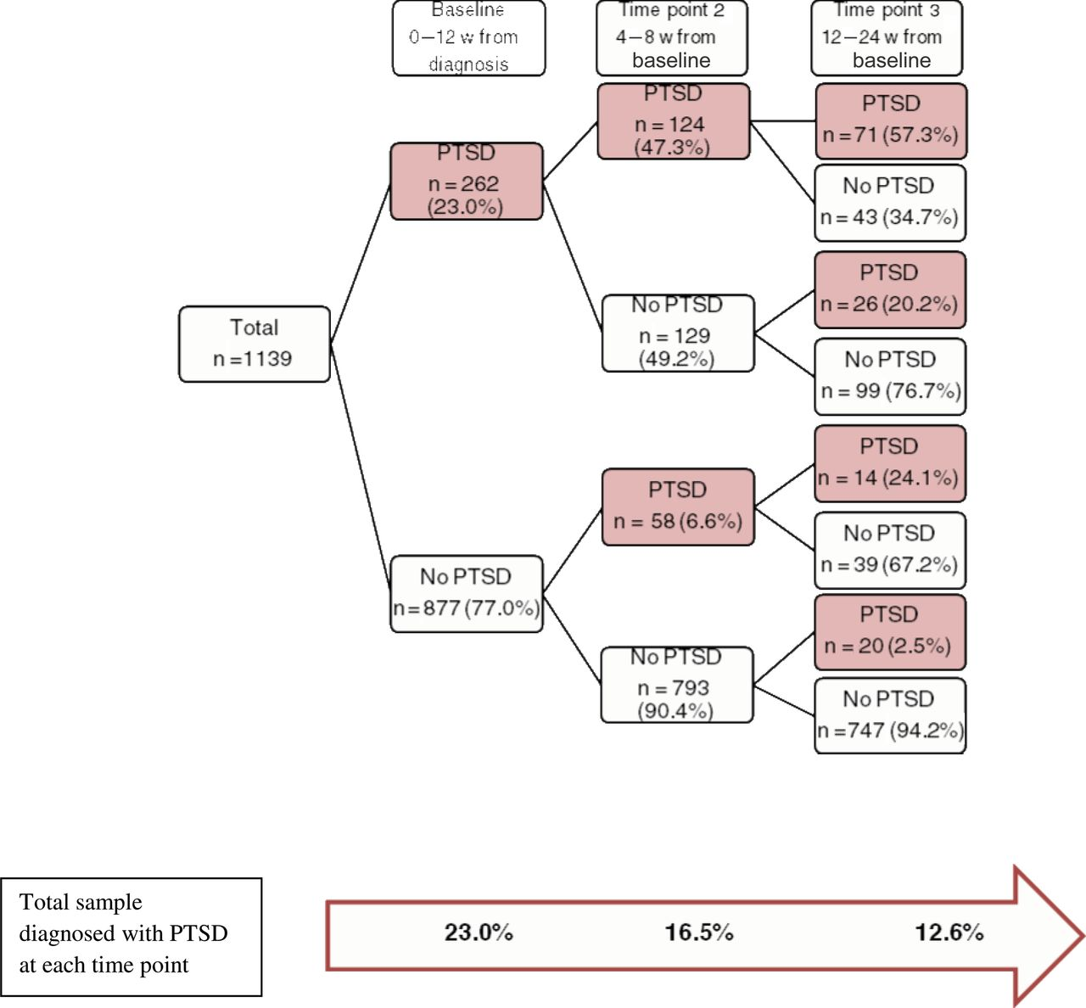
Figure 1. Posttraumatic stress disorder (PTSD) patterns among participants in the Breast Cancer Quality of Care Study, ...
Notes:
Figure 1. Posttraumatic stress disorder (PTSD) patterns among participants in the Breast Cancer Quality of Care Study, May 2006 to June 2010 (n = 1139). Note that the number at each interview does not add up to the number at the previous interview because all participants did not complete all interviews. We had 35 missing observations at time point 2 and 45 at time point 3.
Unless provided in the caption above, the following copyright applies to the content of this slide: © The Author 2013. Published by Oxford University Press. All rights reserved. For Permissions, please e-mail: journals.permissions@oup.com.

