Slide 1
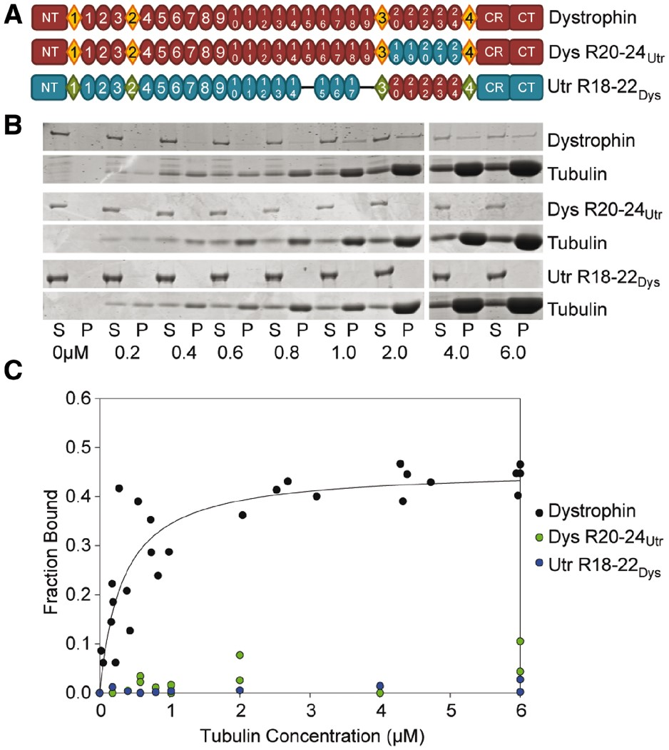
Figure 1. Domain structure and microtubule binding properties of dystrophin/utrophin hybrid constructs. (A) Schematic ...
Notes:
Figure 1. Domain structure and microtubule binding properties of dystrophin/utrophin hybrid constructs. (A) Schematic representation of full-length dystrophin and utrophin hybrid constructs used in this study. Ovals represent spectrin-like repeats, diamonds represent hinge regions. NT, N-terminus; CR, cysteine-rich domain; CT, C-terminus. Blue ovals represent portions of utrophin swapped into dystrophin. Red ovals represent dystrophin repeats swapped into utrophin. (B) Representative coomassie blue stained SDS-PAGE microtubule cosedimentation gels for dystrophin, Dys 20–24Utr, and Utr 18–22Dys. S, supernatant (fraction not bound to microtubules); P, pellet (fraction bound to microtubules). Tubulin dimer concentration is listed below each pair of lanes. (C) Microtubule binding curves. Substituting dystrophin repeats 20–24 for utrophin repeats 18–22 ablates-specific microtubule binding. However, substituting utrophin repeats 18–22 for dystrophin repeats 20–24 does not confer microtubule binding to utrophin. Full-length dystrophin data was previously published and shown here for reference (9).
Unless provided in the caption above, the following copyright applies to the content of this slide: © The Author 2016. Published by Oxford University Press. All rights reserved. For Permissions, please email: journals.permissions@oup.com

Slide 2
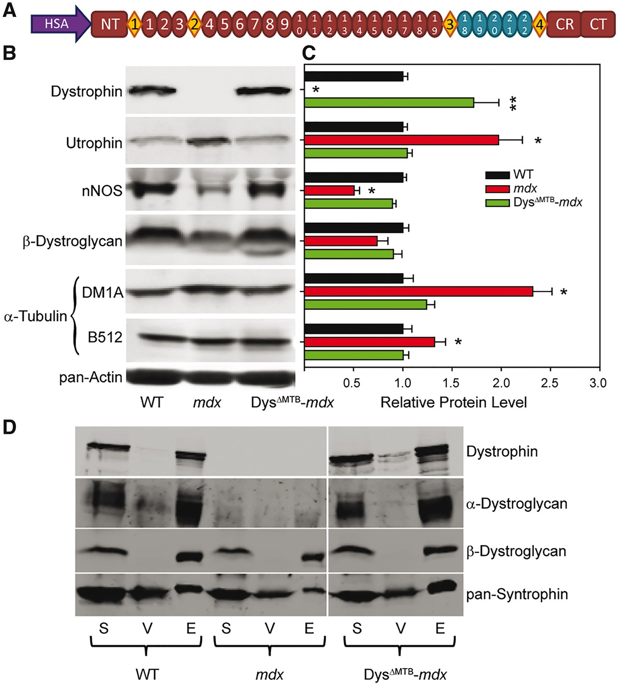
Figure 2. Generation of a transgenic mouse model expressing a dystrophin incapable of directly binding microtubules. ...
Notes:
Figure 2. Generation of a transgenic mouse model expressing a dystrophin incapable of directly binding microtubules. (A) Constructs used to generate transgenic mice expressing a muscle-specific dystrophin incapable of binding microtubules. Ovals and diamonds are as in Figure 1. HSA, human skeletal α-actin promoter; NT, N-terminus; CR, cysteine rich domain; CT, C-terminus. (B–C) Dystrophin protein levels in DysΔMTB-mdx mice are ∼170% of WT levels. Utrophin and α-tubulin levels are elevated in mdx mice as compared with WT levels, but are restored to WT levels in the presence of transgenic dystrophin. nNOS and β-dystroglycan levels are reduced in mdx mice, but restored to WT levels in DysΔMTB-mdx mice. DM1A and B512 both recognize α-tubulin (see Materials and Methods), although DM1A shows a greater difference in immunoreactivity when probing mdx lysates than B512, as we previously reported (8). Sixty micrograms of quadriceps muscle lysate were run in each lane. Quantitation of protein levels is relative to pan-actin levels for all proteins. n = 3 mice per genotype. Statistics were carried out using one-way ANOVA with post-hoc t-test analyses with P < 0.05 considered significant *Statistically different from WT and DysΔMTB-mdx. **Statistically different from WT and mdx. (D) Transgenic dystrophin incorporates into the dystrophin–glycoprotein complex of DysΔMTB-mdx mice as evidenced by its presence in the elution fraction of the WGA enrichment. The dystroglycans and syntrophins are also present in the elution fraction. S, starting lysate; V, void fraction not bound to WGA beads; E, elution fraction from WGA beads.
Unless provided in the caption above, the following copyright applies to the content of this slide: © The Author 2016. Published by Oxford University Press. All rights reserved. For Permissions, please email: journals.permissions@oup.com

Slide 3
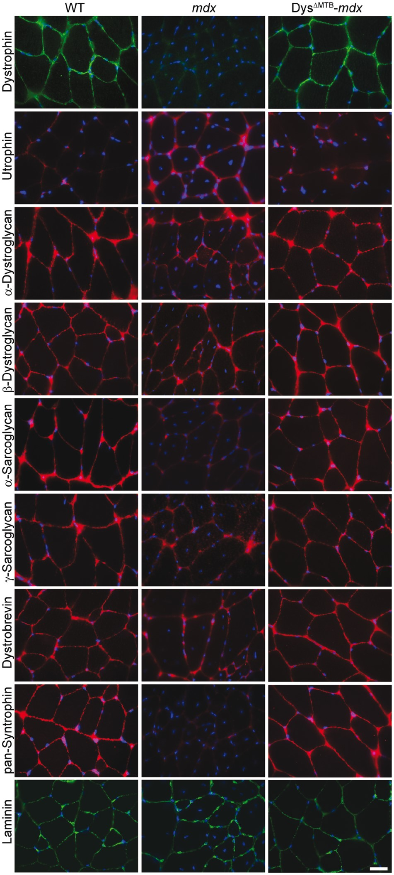
Figure 3. Restoration of the sarcolemmal dystrophin–glycoprotein complex in Dys^{ΔMTB}-mdx mice. Dystrophin is ...
Notes:
Figure 3. Restoration of the sarcolemmal dystrophin–glycoprotein complex in DysΔMTB-mdx mice. Dystrophin is absent in mdx mice. Utrophin levels are upregulated in mdx mice as compared with WT and DysΔMTB-mdx mice. DysΔMTB-mdx mice show presence of all dystrophin–glycoprotein complex components assayed at the sarcolemma. Bar, 20 μm.
Unless provided in the caption above, the following copyright applies to the content of this slide: © The Author 2016. Published by Oxford University Press. All rights reserved. For Permissions, please email: journals.permissions@oup.com

Slide 4
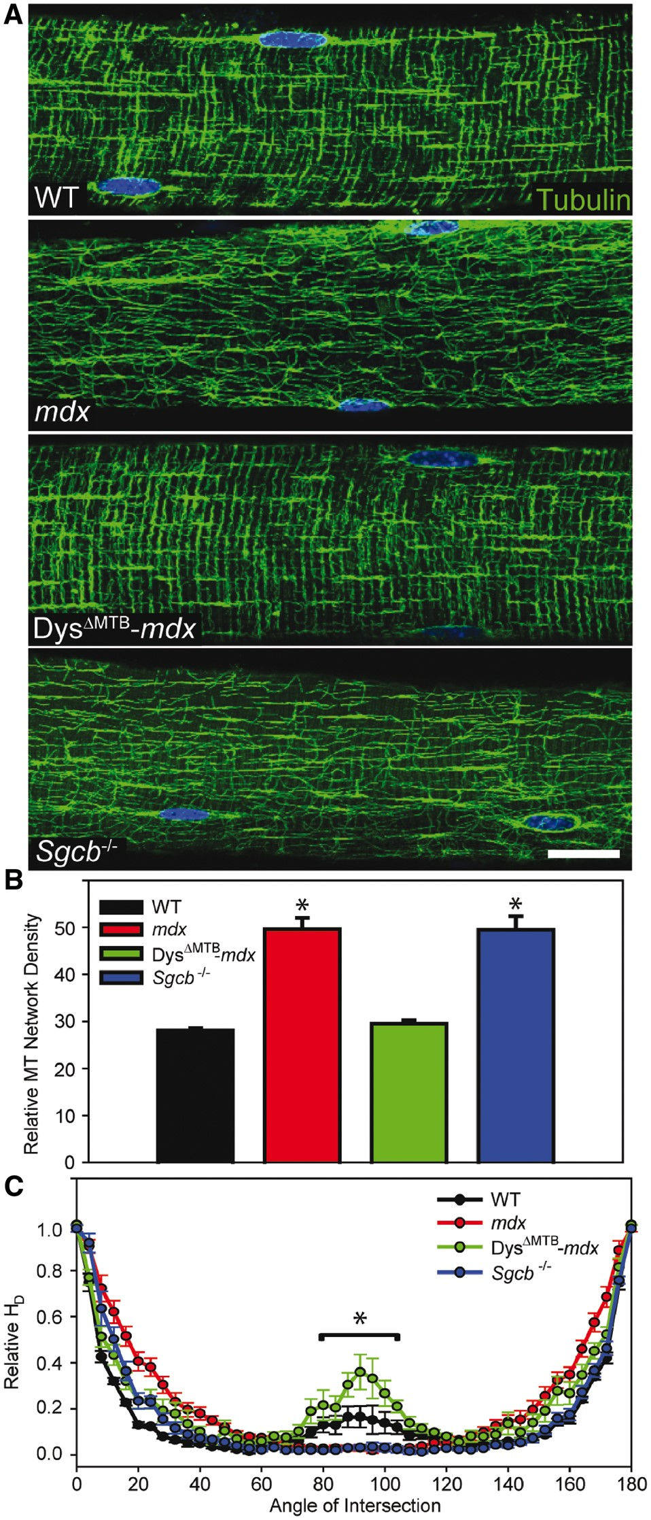
Figure 4. Rescue of subsarcolemmal microtubule lattice organization in Dys^{ΔMTB}-mdx mice. (A) Microtubules ...
Notes:
Figure 4. Rescue of subsarcolemmal microtubule lattice organization in DysΔMTB-mdx mice. (A) Microtubules are organized into a rectilinear lattice beneath the sarcolemma in WT and DysΔMTB-mdx mice in contrast to the perturbed microtubule lattice in mdx and Sgcb-/- mice. Images are representative of those obtained for n ≥ 10 fibers from each of n ≥ 3 mice per genotype. Bar, 20 μm. (B) WT and DysΔMTB-mdx mouse EDL fibers display the least dense microtubule network whereas mdx and Sgcb-/- mouse fibers display higher microtubule network density. *Statistically different from WT and DysΔMTB-mdx. (C) Transversely-oriented microtubules (centered around 90°) were significantly greater in WT and DysΔMTB-mdx mice compared with mdx and Sgcb-/- mice. Longitudinally oriented microtubules (0° and 180°) were not different between the mouse lines. Statistics were performed using one-way (density) or two-way (orientation) ANOVA with post-hoc t-test analyses with P < 0.05 considered significant. *WT and DysΔMTB-mdx mice are significantly different from mdx and Sgcb-/- between 80° and 100°.
Unless provided in the caption above, the following copyright applies to the content of this slide: © The Author 2016. Published by Oxford University Press. All rights reserved. For Permissions, please email: journals.permissions@oup.com

Slide 5
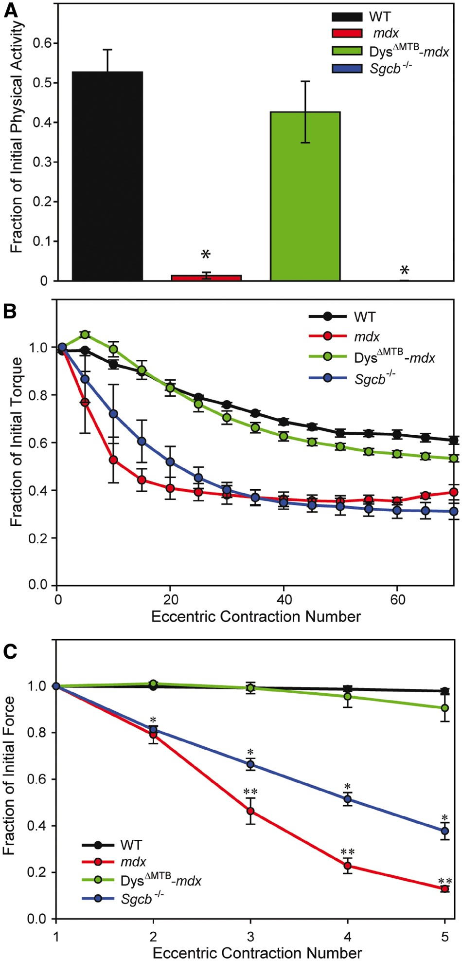
Figure 5. Normal skeletal muscle physiology in Dys^{ΔMTB}-mdx mice. (A) Physical activity of mice immediately ...
Notes:
Figure 5. Normal skeletal muscle physiology in DysΔMTB-mdx mice. (A) Physical activity of mice immediately following mild treadmill exercise. WT and DysΔMTB-mdx mice exhibited ∼40–50% of their initial cage activity after mild exercise whereas post-exercise activity in mdx and Sgcb-/- mice dropped >99% of their initial activity. n ≥ 4 for each line. (B) As compared with WT and DysΔMTB-mdx mice, mdx and Sgcb-/- mice showed drastic loss of in vivo torque production of anterior crural muscles during a series of eccentric contractions. n ≥ 4 for each line. (C) As compared with EDL muscles of WT and DysΔMTB-mdx mice, those of mdx mice show significant loss of ex vivo force after eccentric contraction. Isolated Sgcb-/- muscles also displayed significant loss of force after eccentric contraction, but not to the extent seen in mdx mice. n ≥ 4 for each line. Statistics were performed using two-way ANOVA with post-hoc t-test analyses with P < 0.05 considered significant. *Statistically different from WT and DysΔMTB-mdx mice. **Statistically different from WT, DysΔMTB-mdx and Sgcb-/- mice. WT data were previously reported and shown here for comparison (9). Physiological parameters of isolated EDL muscles used in ex vivo force measurements WTmdxDysΔMTB-mdxSgcb-/-P valueEDL mass (mg)12.8 ± 0.4a18.1 ± 0.7b11.7 ± 0.2c22.7 ± 0.4b,c,dP < 0.001L0 (mm)13.3 ± 0.2a13.1 ± 0.212.2 ± 0.2b,c13.6 ± 0.1dP = 0.003CSA (cm2)0.021 ± 0.001a0.030 ± 0.001b0.021 ± 0.001c0.036 ± 0.001b,c,dP < 0.001Passive stiffness (N/m)13.9 ± 0.9a19.9 ± 0.8b13.1 ± 1.3c16.2 ± 1.2b,c,dP < 0.001P0 (mN)449 ± 8.8a415 ± 12.8424 ± 21.3347 ± 25.0b,c,dP < 0.001Specific P0 (N/cm2)21.8 ± 0.5a14.1 ± 0.3b20.6 ± 0.9c9.7 ± 0.6b,c,dP < 0.001ΔP0 (%)11.1 ± 3.1a86.7 ± 2.6b11.0 ± 5.1c80.9 ± 2.5b,dP < 0.001Force drop (%)9.4 ± 5.7a87.1 ± 1.3b8.5 ± 2.3c62.3 ± 3.0b,c,dP < 0.001Values are means ± SE. L0 = optimal muscle length, CSA = physiological cross sectional area, P0 = maximal isometric tetanic force. ΔP0 = change in P0 after eccentric contractions. Force drop =change in eccentric force from the first to the fifth eccentric contraction. n ≥ 4 for each line. Statistics were performed using two-way ANOVA with post-hoc t-test analyses with P < 0.05 considered significant. aWT data were previously reported and shown here for comparison (9) bSignificantly different than WT. cSignificantly different than mdx. dSignificantly different than DysΔMTB-mdx.
Unless provided in the caption above, the following copyright applies to the content of this slide: © The Author 2016. Published by Oxford University Press. All rights reserved. For Permissions, please email: journals.permissions@oup.com

Slide 6
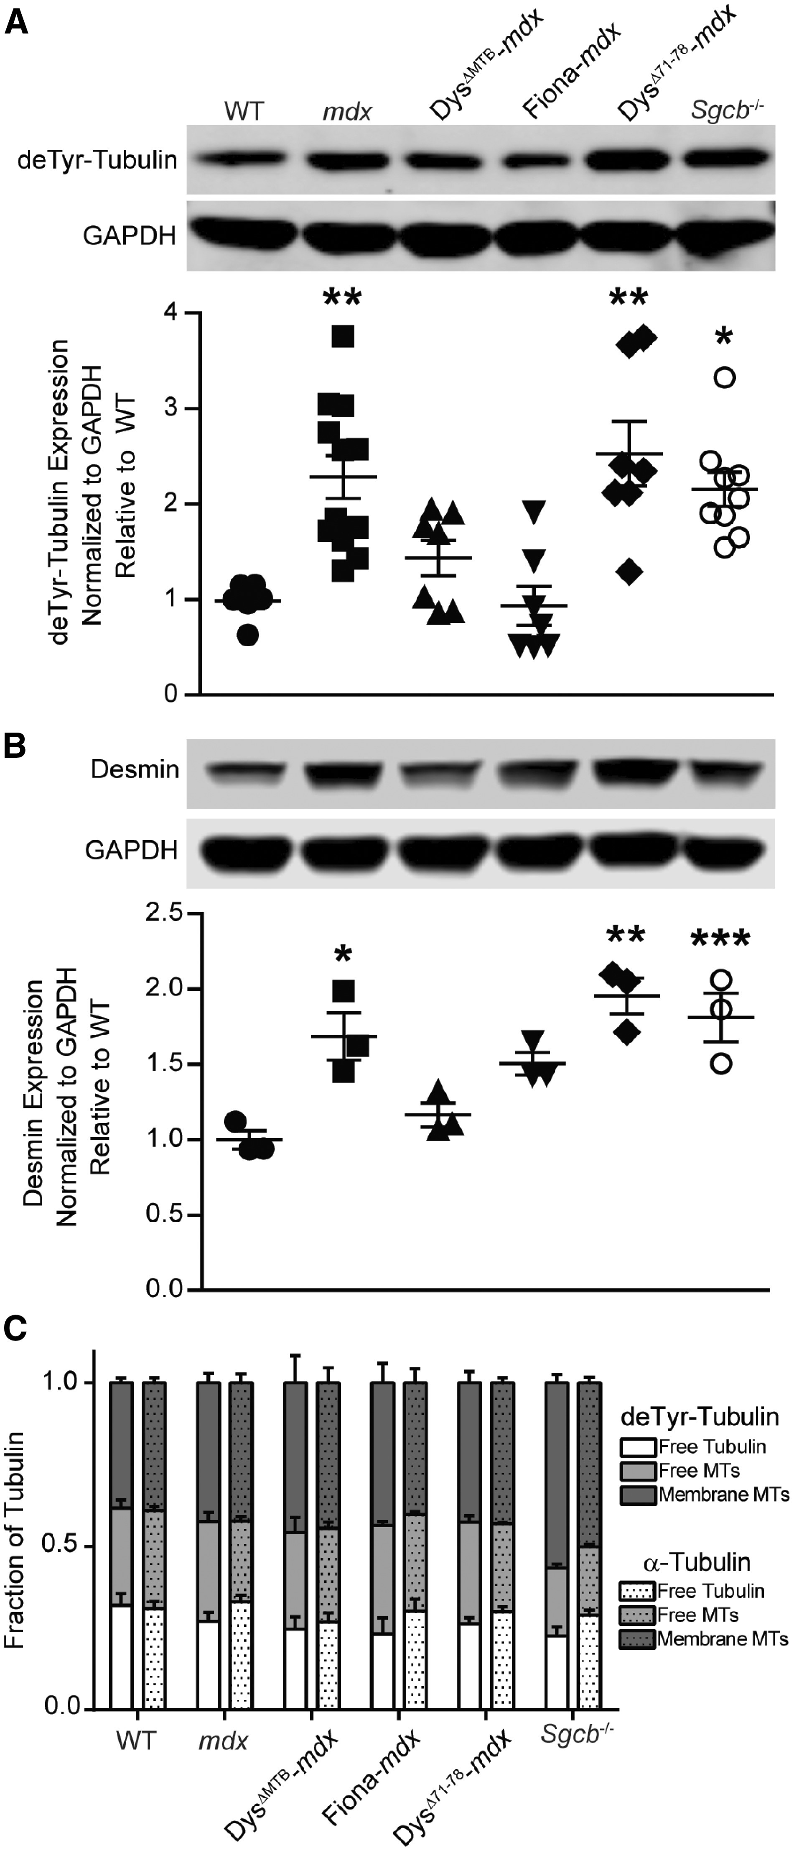
Figure 6. Analysis of cytoskeletal composition. (A–B). deTyr-tubulin (detyrosination of α-tubulin) and desmin levels ...
Notes:
Figure 6. Analysis of cytoskeletal composition. (A–B). deTyr-tubulin (detyrosination of α-tubulin) and desmin levels are increased in mdx, DysΔ71-78-mdx and Sgcb-/- mice, but remain at WT levels in DysΔMTB-mdx and Fiona-mdx mice. n ≥ 3 for each genotype. *P < 0.05, **P < 0.01, ***P < 0.001 as compared with WT. (C) Each tubulin fraction was blotted for total α-tubulin (DM1A) and deTyr-tubulin. n ≥ 3 for each genotype. Proportions of each isoform in each fraction were plotted for each mouse strain and analyzed within each strain and between strains using ANOVA with post-hoc t-test analyses with P < 0.05 considered significant. No statistically significant differences were seen for any measured parameter.
Unless provided in the caption above, the following copyright applies to the content of this slide: © The Author 2016. Published by Oxford University Press. All rights reserved. For Permissions, please email: journals.permissions@oup.com

