Slide 1
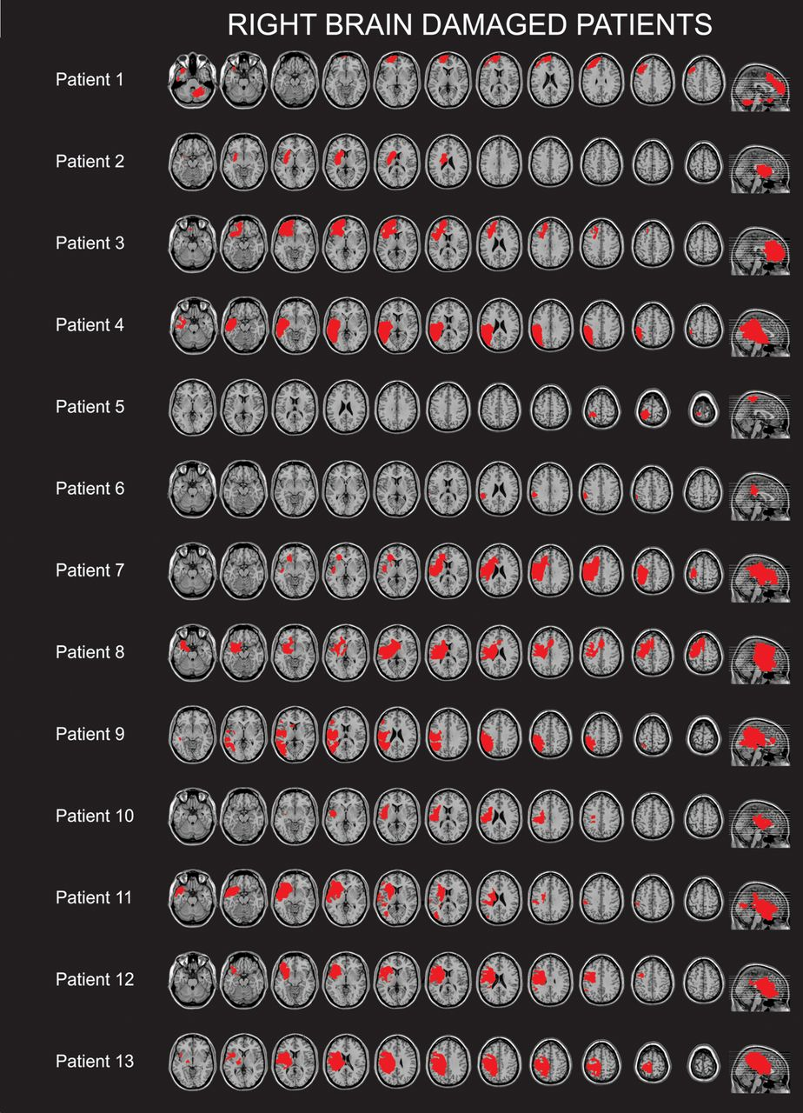
Figure 1. Lesion tracings for all 13 RBD patients superimposed on an MNI template (see Materials and Methods). Lesions ...
Notes:
Figure 1. Lesion tracings for all 13 RBD patients superimposed on an MNI template (see Materials and Methods). Lesions are presented in a radiological convention (right hemisphere presented on the left).
Unless provided in the caption above, the following copyright applies to the content of this slide: © The Author 2011. Published by Oxford University Press. All rights reserved. For permissions, please e-mail: journals.permissions@oup.com

Slide 2
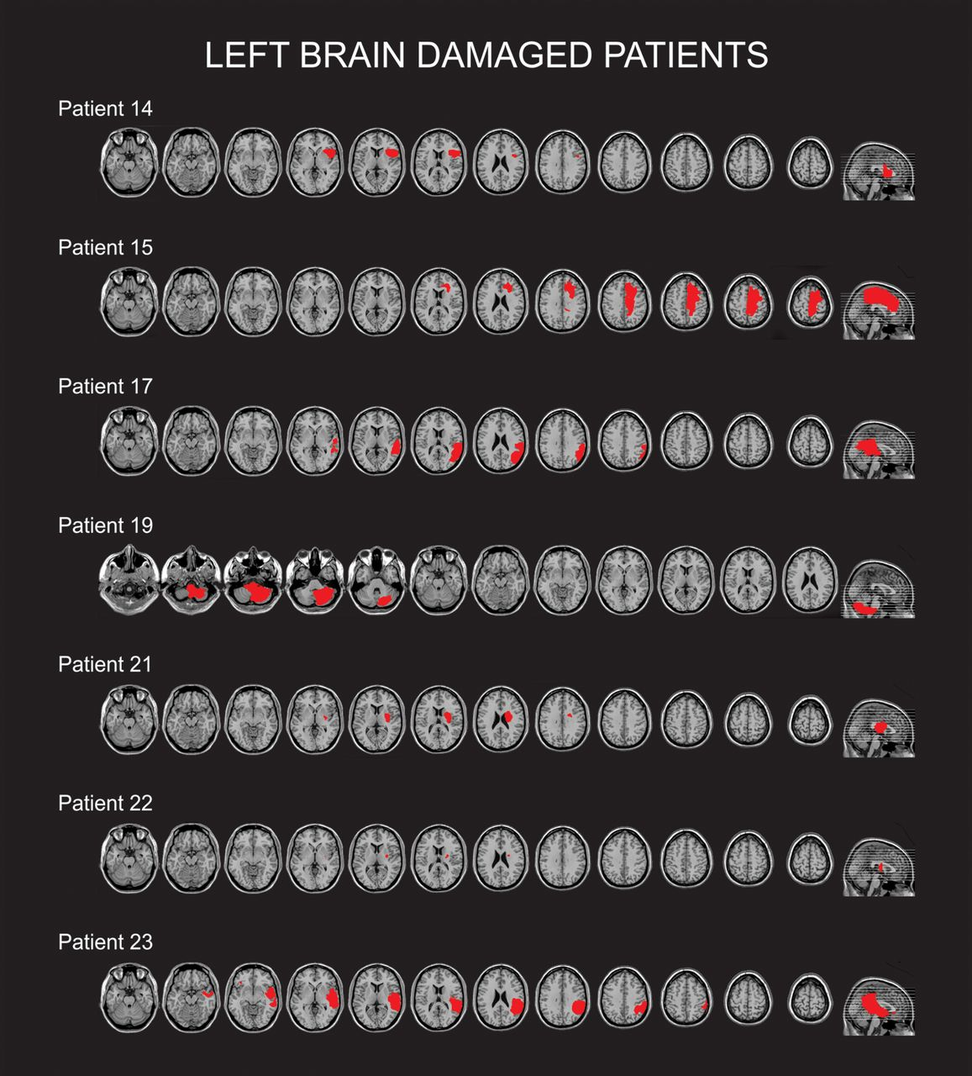
Figure 2. Lesion tracings for 7 of the LBD patients for whom scans were available superimposed on an MNI template (see ...
Notes:
Figure 2. Lesion tracings for 7 of the LBD patients for whom scans were available superimposed on an MNI template (see Materials and Methods). Lesions are presented in a radiological convention (right hemisphere presented on the left).
Unless provided in the caption above, the following copyright applies to the content of this slide: © The Author 2011. Published by Oxford University Press. All rights reserved. For permissions, please e-mail: journals.permissions@oup.com

Slide 3
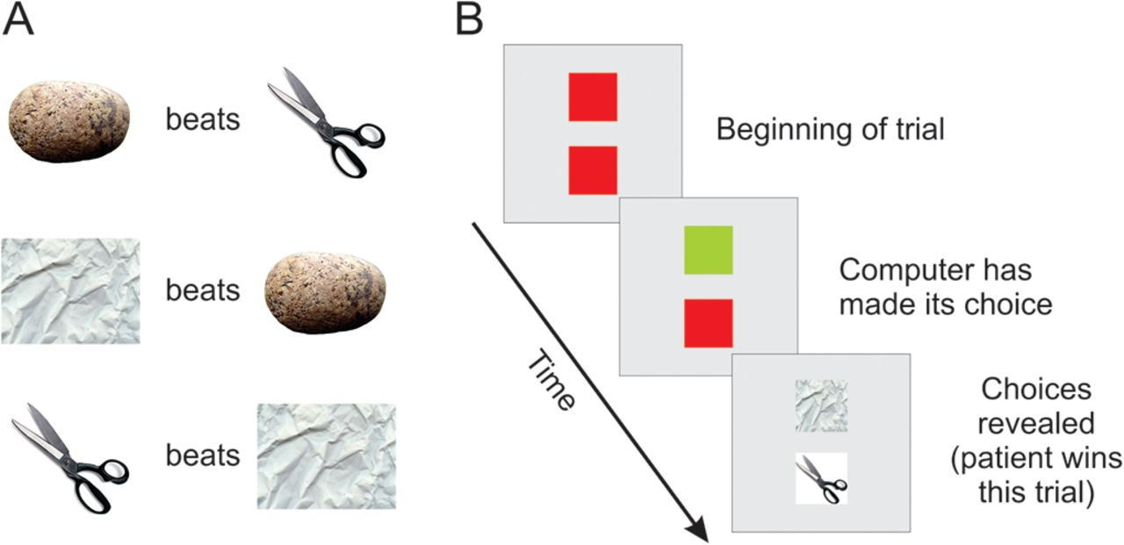
Figure 3. Schematic representation of the RPS game. Panel A shows the stimuli used to represent each option and ...
Notes:
Figure 3. Schematic representation of the RPS game. Panel A shows the stimuli used to represent each option and demonstrates the rules of the game (i.e., which choice wins in a given pair). Panel B shows a single trial of the task (for details see Materials and Methods).
Unless provided in the caption above, the following copyright applies to the content of this slide: © The Author 2011. Published by Oxford University Press. All rights reserved. For permissions, please e-mail: journals.permissions@oup.com

Slide 4
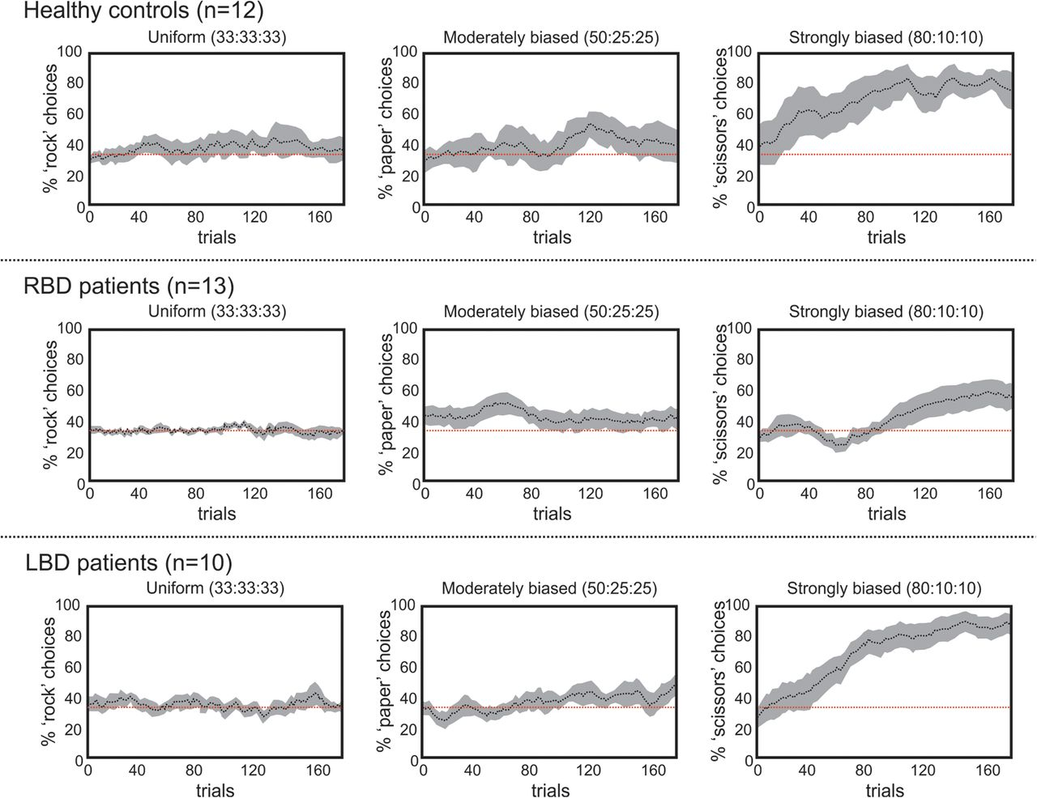
Figure 4. Moving averages (i.e., across 20 trial windows) of choices for healthy controls (upper panels), the RBD ...
Notes:
Figure 4. Moving averages (i.e., across 20 trial windows) of choices for healthy controls (upper panels), the RBD patients (middle panels) and the LBD group (lower panels). Note that for the uniform condition, we plotted the percentage of rock choices; for the moderately biased condition, we plotted the percentage of paper choices as this should maximize win rate given that the computer opponent now chose rock on 50% of trials; and for the strongly biased condition, we plotted the percentage of scissors choices given that the computer opponent now chose paper on 80% of the trials. Error bars (shaded gray regions) represent standard error.
Unless provided in the caption above, the following copyright applies to the content of this slide: © The Author 2011. Published by Oxford University Press. All rights reserved. For permissions, please e-mail: journals.permissions@oup.com

Slide 5
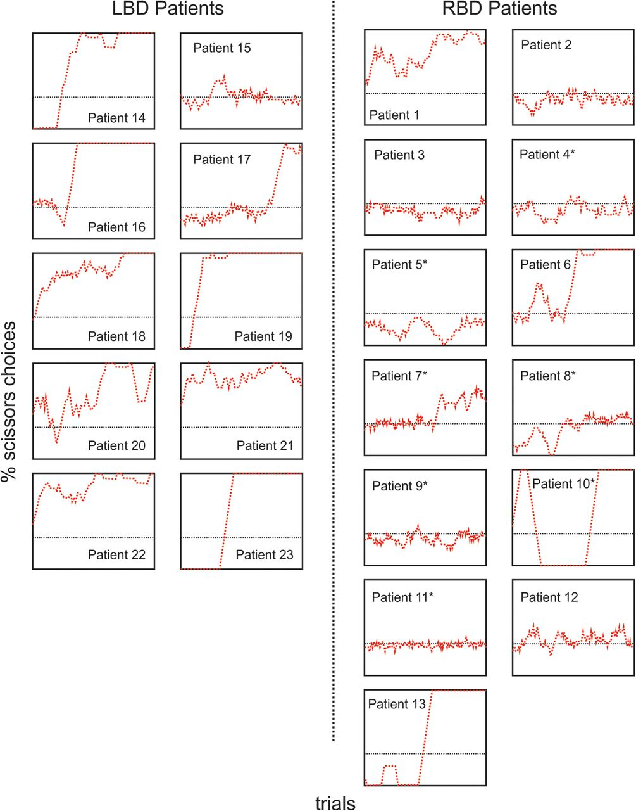
Figure 5. Plots of the percentage of scissors choices made in the strongly biased condition for all patients (RBD ...
Notes:
Figure 5. Plots of the percentage of scissors choices made in the strongly biased condition for all patients (RBD patients are presented to the right and LBD patients are presented to the left). In each plot, trial number from 0 to 180 is presented on the x-axis with percentage of scissors choices from 0 to 100 presented on the y-axis. *indicates the patients with neglect.
Unless provided in the caption above, the following copyright applies to the content of this slide: © The Author 2011. Published by Oxford University Press. All rights reserved. For permissions, please e-mail: journals.permissions@oup.com

Slide 6
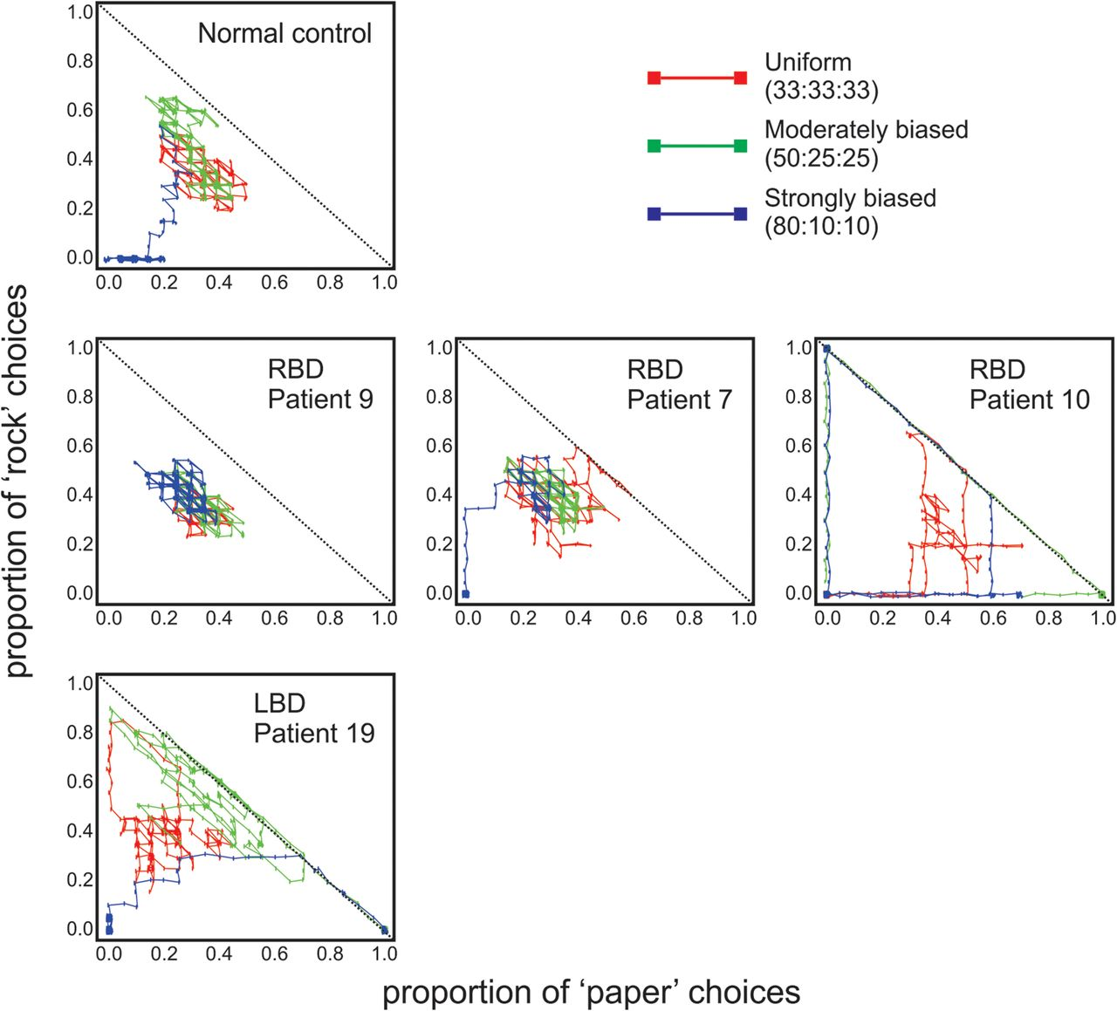
Figure 6. Examples of state space exploration from a healthy control (upper panel), 3 RBD patients (middle panels) and ...
Notes:
Figure 6. Examples of state space exploration from a healthy control (upper panel), 3 RBD patients (middle panels) and an LBD patient (lower panel). The proportion of paper choices is represented on the x-axis with the proportion of rock choices represented on the y-axis averaged over 20 trial “blocks” in each of the 3 conditions. Performance in the uniform condition is represented in red, performance in the moderately biased condition is represented in green, with performance in the strongly biased condition represented in blue. As can be seen from the upper panel, the healthy control quickly finds the optimal strategy in the strongly biased condition (blue). That is, the optimal choice in the strongly biased condition would be to choose scissors on most trials (i.e., the computer opponent chooses paper 80% of the time), which would be represented as 0:0 in the 2D vector shown here (i.e., rarely if ever choosing paper or rock). The RBD patient represented in the middle left panel (patient 9) never changes his play across all 3 conditions. In contrast, the RBD patient in the middle right panel (patient 10) perseverates on choices in the moderately and strongly biased conditions although those choices are not always optimal (e.g., substantial time was spent perseverating on rock in the moderately nonrandom condition—represented in green—thus leading to a large proportion of ties). The RBD patient represented in the center middle panel (patient 7) eventually adopts the optimal strategy in the strongly biased condition despite taking far longer than the control to do so (this is evident in the area of state space overlapping across the 3 conditions). Finally, the lower panel shows a typical LBD patient (patient 19) who, like controls, quickly adopts the optimal strategy in the strongly biased condition and appears overall to explore more of the game's strategy space than do some controls.
Unless provided in the caption above, the following copyright applies to the content of this slide: © The Author 2011. Published by Oxford University Press. All rights reserved. For permissions, please e-mail: journals.permissions@oup.com

Slide 7
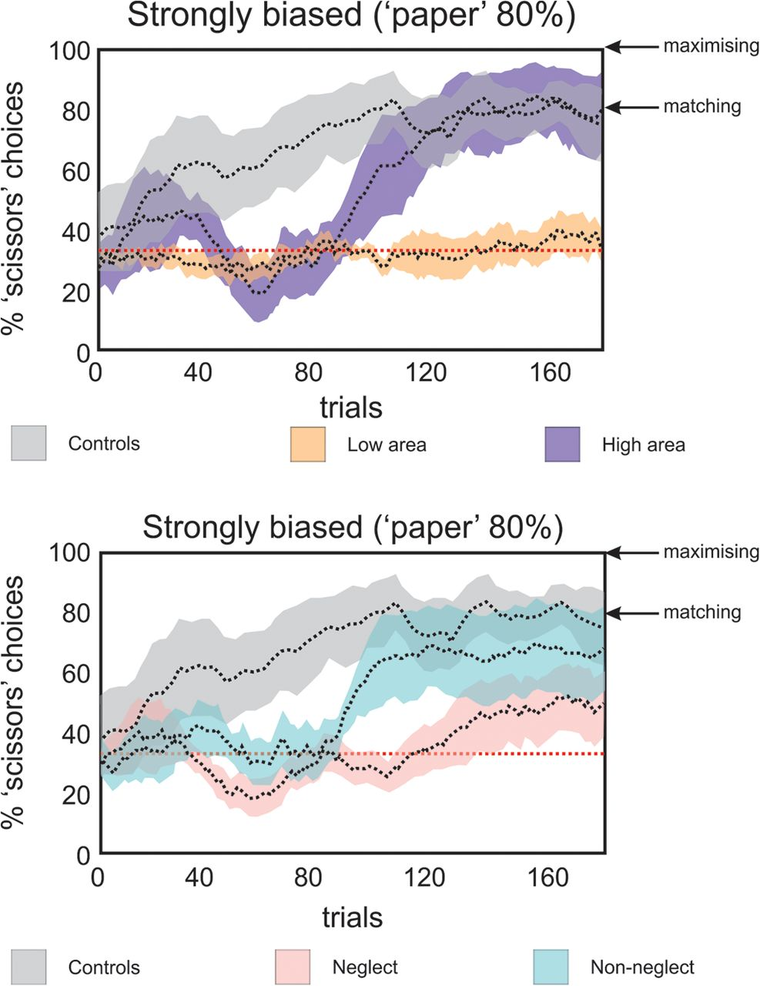
Figure 7. Panel A. Percentage of scissors choices made in the strongly biased condition for patients in the low ...
Notes:
Figure 7. Panel A. Percentage of scissors choices made in the strongly biased condition for patients in the low (orange) and high (purple) exploration groups over a moving average window of 20 trials. Panel B. Percentage of scissors choices made in the strongly biased condition for patients with (pink) and without (blue) neglect. Error bars are standard error of the mean.
Unless provided in the caption above, the following copyright applies to the content of this slide: © The Author 2011. Published by Oxford University Press. All rights reserved. For permissions, please e-mail: journals.permissions@oup.com

Slide 8
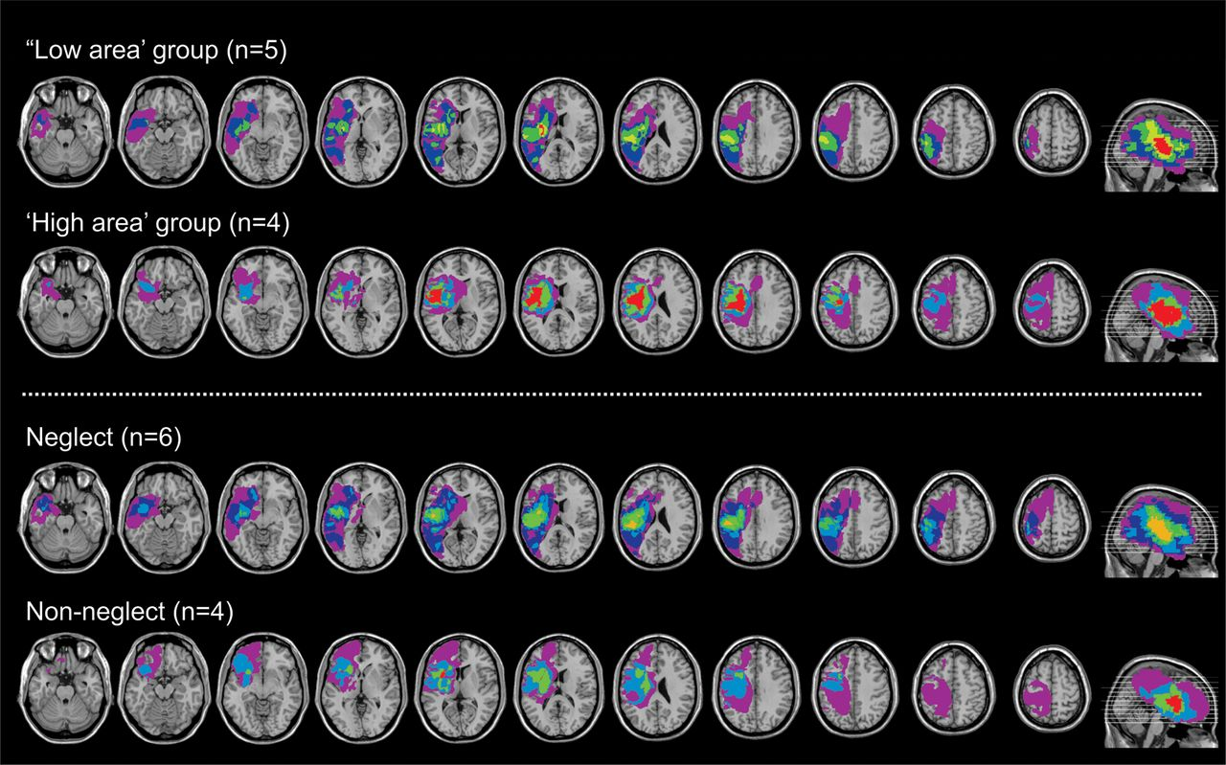
Figure 8. The upper section shows lesion overlay maps for 5 of the 7 patients in the low exploration group who showed ...
Notes:
Figure 8. The upper section shows lesion overlay maps for 5 of the 7 patients in the low exploration group who showed some degree of overlap in their lesions and 4 of the 6 patients in the high exploration group who showed some degree of overlap in their lesions. The remaining patients had lesions that did not intersect at all with any other patient. The lower section shows lesion overlay maps for the 6 (of 7) neglect patients who demonstrated some degree of overlap in their lesions and the 4 (of 6) patients without neglect who also showed some degree of overlap with their lesions. The remaining patients had lesions that did not intersect at all with any other patient (see Table 3 for details).
Unless provided in the caption above, the following copyright applies to the content of this slide: © The Author 2011. Published by Oxford University Press. All rights reserved. For permissions, please e-mail: journals.permissions@oup.com

