Slide 1
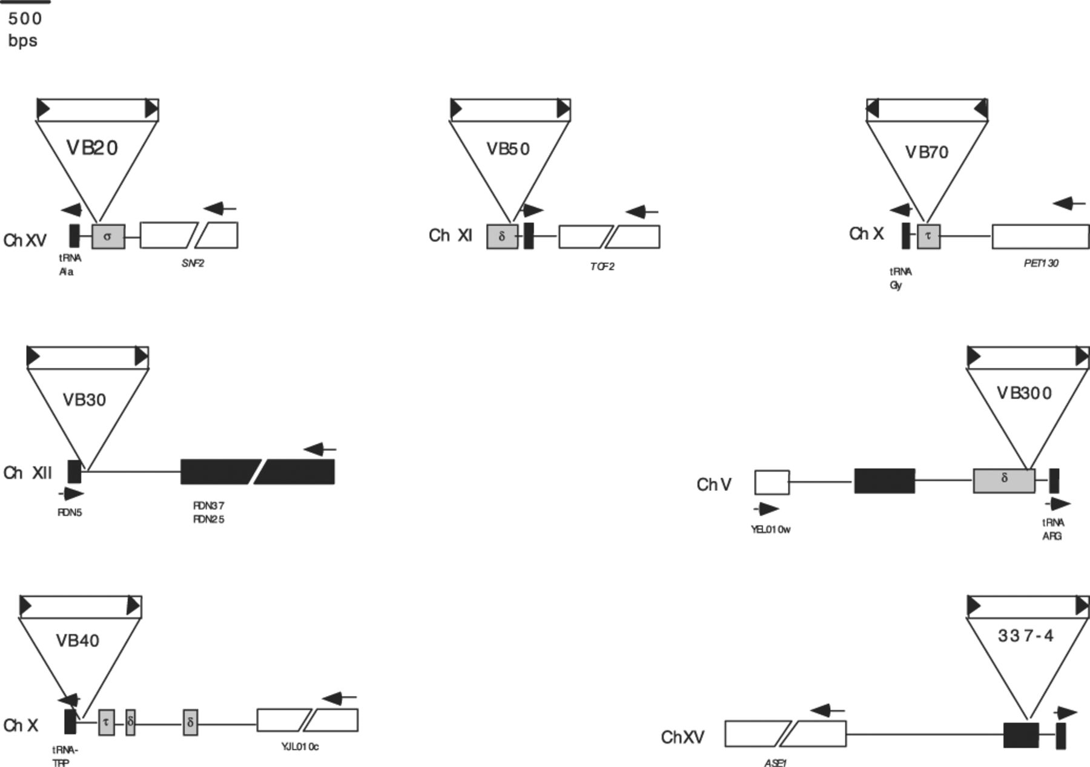
1 Schematic representation of Ty1 insertions in the strains studied. Newly inserted Ty1 is represented by an ...
Notes:
1 Schematic representation of Ty1 insertions in the strains studied. Newly inserted Ty1 is represented by an open box with triangles at either end to denote LTRs, which also designate the orientation of transcription of the Ty1 element. Open reading frame (ORF) diagrams are based on those from the Saccharomyces genome database (SGD). The chromosome number is located to the left of each figure. Filled boxes are tRNA genes and stippled boxes are genomic LTRs from previous transposition events. Striped boxes represent rDNA. ORFs are open boxes and known ORFs are shown with their gene name, while unknown ORFs are described by their SGD identification. Ty1 insertions are not on the same scale as the ORF diagram. Note that in VB70, there is a τ present in the diagram. This sequence element is absent in S288c. Arrow heads show the orientation of transcription of genomic sequences. For detailed information regarding these insertions, see Table 1.
Unless provided in the caption above, the following copyright applies to the content of this slide: © 2003 Federation of European Microbiological Societies. Published by Elsevier B.V. All rights reserved.

