Slide 1
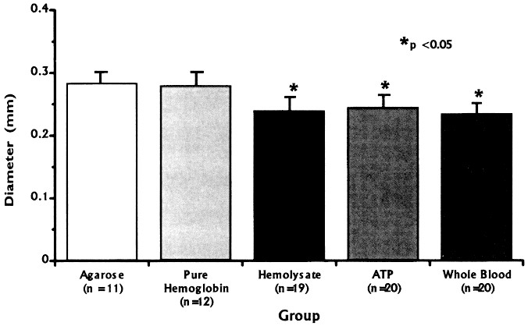
FIGURE 1. Bar graph showing diameter of femoral arteries 7 days after the perivascular application of agarose, purified ...
Notes:
FIGURE 1. Bar graph showing diameter of femoral arteries 7 days after the perivascular application of agarose, purified hemoglobin, hemolysate, ATP, or clotted blood. Femoral artery diameters were significantly smaller after the application of hemolysate, ATP, or clotted blood (P < 0.05). Bars represent means, anderror bars represent standard errors of the means.
Unless provided in the caption above, the following copyright applies to the content of this slide:

Slide 2
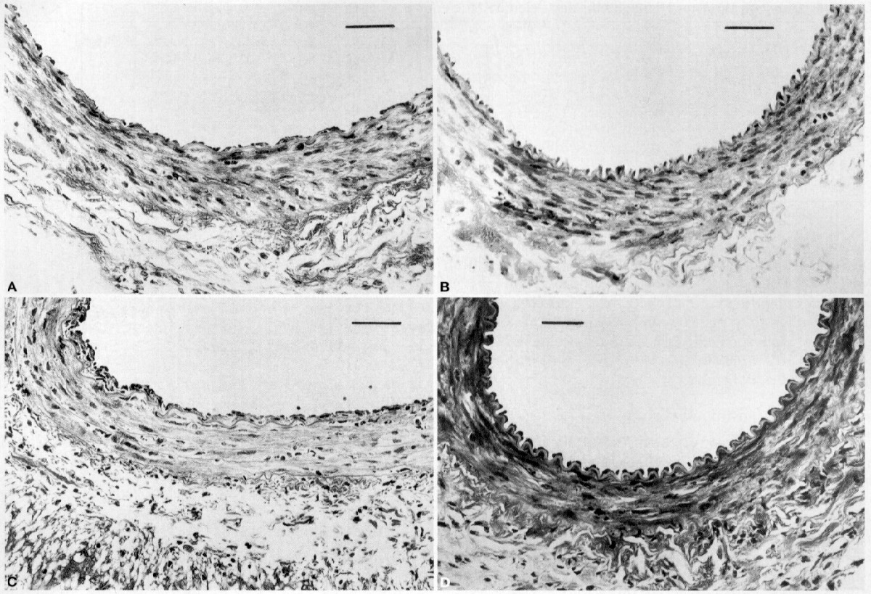
FIGURE 2. Photomicrographs of femoral arteries 7 days after perivascular application of agarose (A), ATP(B), purified ...
Notes:
FIGURE 2. Photomicrographs of femoral arteries 7 days after perivascular application of agarose (A), ATP(B), purified hemoglobin (C), or hemolysate (D). There is arterial narrowing with corrugation of the internal elastic lamina after exposure to ATP (B) and hemolysate (D). Histological changes, such as endothelial proliferation and inflammation, are more prominent after exposure to purified hemoglobin (C) and hemolysate(D) (hematoxylin and eosin) (scale bar, 50µm).
Unless provided in the caption above, the following copyright applies to the content of this slide:

Slide 3
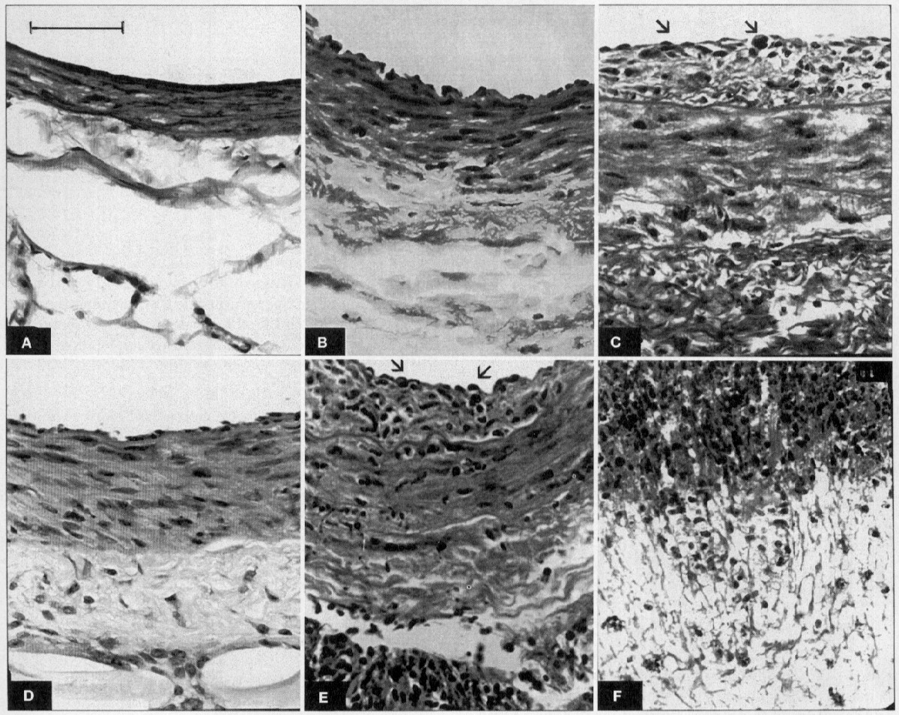
FIGURE 3. Photomicrographs of the entire arterial wall of normal rat femoral artery (A) and of femoral arteries 7 days ...
Notes:
FIGURE 3. Photomicrographs of the entire arterial wall of normal rat femoral artery (A) and of femoral arteries 7 days after perivascular application of agarose (B), ATP(C), hemolysate (D), or purified hemoglobin (E, tunica intima and media; F, tunica adventitia). The arterial wall is thicker after agarose placement (B) compared to a normal artery(A), but there is no inflammation, intimal proliferation, or folding of the internal elastic lamina. Corrugation of the internal elastic lamina is observed after exposure to ATP (C) and hemolysate (D). Endothelial proliferation (arrows) can be observed in arteries exposed to purified hemoglobin (E) or hemolysate (D). Inflammation in the adventitia and extending into the tunica media also is observed after perivascular application of hemoglobin (F) or hemolysate (D). There is marked thickening of the arterial wall with hemolysate or hemoglobin. E and F represent sequential photomicrographs through the entire thickness of an artery exposed to hemoglobin (hematoxylin and eosin) (scale bar, 40 µm).
Unless provided in the caption above, the following copyright applies to the content of this slide:

Slide 4
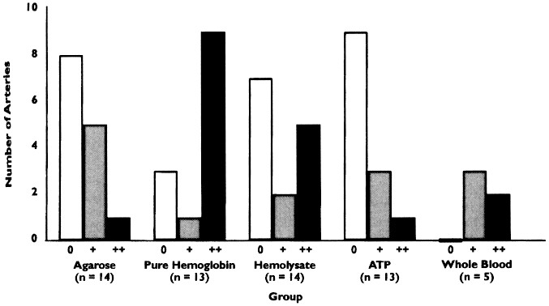
FIGURE 4. Bar graph showing amount of endothelial proliferation as judged semiquantitatively on a 3-point scale for ...
Notes:
FIGURE 4. Bar graph showing amount of endothelial proliferation as judged semiquantitatively on a 3-point scale for arteries exposed to agarose, purified hemoglobin, hemolysate, ATP, or clotted blood for 7 days. There is significantly more endothelial proliferation after application of purified hemoglobin, hemolysate, or clotted blood (P< 0.005).
Unless provided in the caption above, the following copyright applies to the content of this slide:

Slide 5
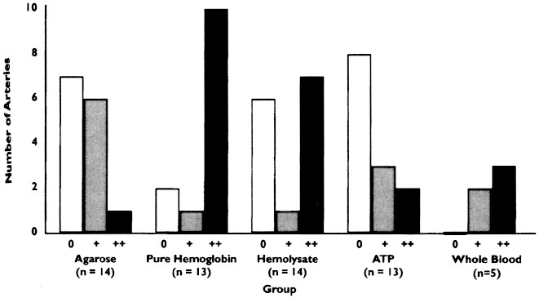
FIGURE 5. Bar graph showing amount of perivascular inflammation as judged semiquantitatively on a 3-point scale for ...
Notes:
FIGURE 5. Bar graph showing amount of perivascular inflammation as judged semiquantitatively on a 3-point scale for arteries exposed to agarose, purified hemoglobin, hemolysate, ATP, or clotted blood for 7 days. There is significantly more perivascular inflammation after application of purified hemoglobin, hemolysate, or clotted blood (P< 0.005).
Unless provided in the caption above, the following copyright applies to the content of this slide:

Slide 6
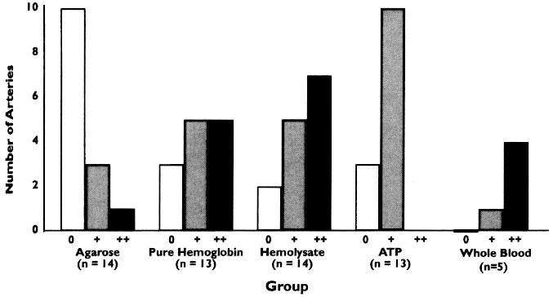
FIGURE 6. Bar graph showing amount of smooth muscle cell damage as judged semiquantitatively on a 3-point scale for ...
Notes:
FIGURE 6. Bar graph showing amount of smooth muscle cell damage as judged semiquantitatively on a 3-point scale for arteries exposed to agarose, purified hemoglobin, hemolysate, ATP, or clotted blood for 7 days. There is significantly more smooth muscle cell damage after application of purified hemoglobin, hemolysate, or clotted blood (P< 0.005).
Unless provided in the caption above, the following copyright applies to the content of this slide:

