Slide 1
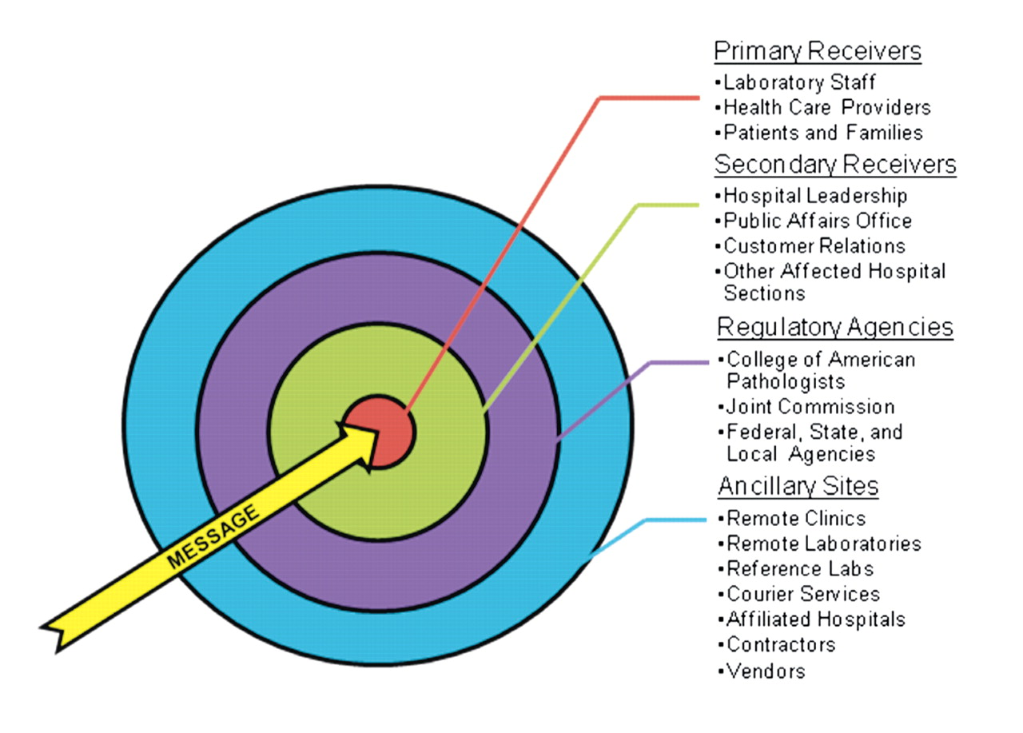
Figure 1 Potential audiences to target for communicating laboratory change. A stakeholder analysis will enable the ...
Notes:
Figure 1 Potential audiences to target for communicating laboratory change. A stakeholder analysis will enable the laboratory manager and communication team to identify required receivers for their messages of change.
Unless provided in the caption above, the following copyright applies to the content of this slide: © American Society of Clinical Pathologists

