Slide 1
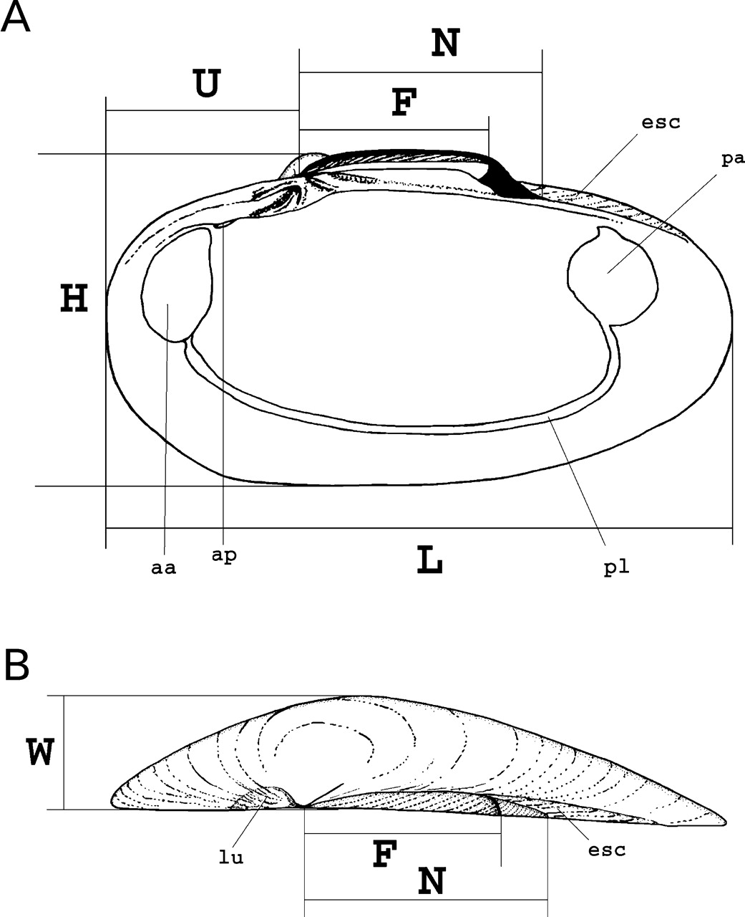
Figure 1. Diagrammatic views of Calyptogena illustrating the terminology and measurements applied in this study. A. ...
Notes:
Figure 1. Diagrammatic views of Calyptogena illustrating the terminology and measurements applied in this study. A. Right valve, internal view. B. Right valve, dorsal view. Abbreviations: aa, anterior adductor scar; ap, anterior pedal retractor scar; esc, escutcheon; F, fibrous ligament layer; H, height of valve; L, length of valve; lu, lunule; N, posterior lamellar ligament layer; pa, posterior adductor scar; pl, pallial line; U, distance from umbo to anterior margin; W, width of valve.
Unless provided in the caption above, the following copyright applies to the content of this slide: © The Author 2006. Published by Oxford University Press on behalf of The Malacological Society of London, all rights reserved

Slide 2
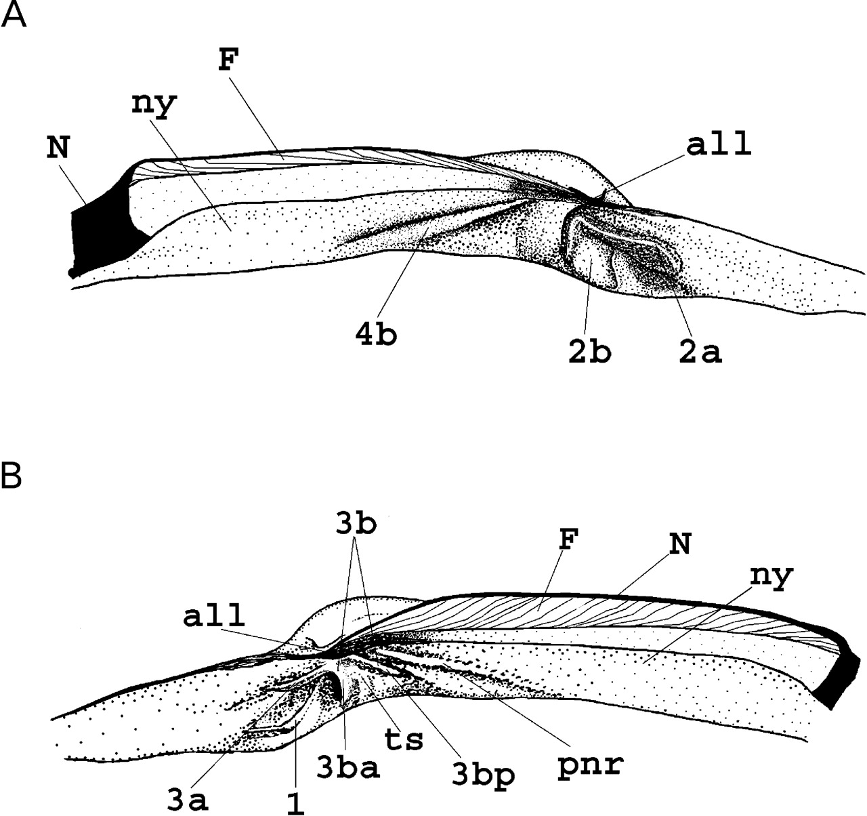
Figure 2. Hinge margins in Calyptogena. A. Left valve. B. Right valve. Abbreviations: 1, ventral cardinal tooth; 2a, ...
Notes:
Figure 2. Hinge margins in Calyptogena. A. Left valve. B. Right valve. Abbreviations: 1, ventral cardinal tooth; 2a, anterior ramus of subumbonal cardinal tooth; 2b, posterior ramus of subumbonal cardinal tooth; 3a, anterior ramus of subumbonal cardinal; 3b, posterior ramus of subumbonal cardinal; 3ba, anterior edge of 3b; 3 bp, posterior edge of 3b; ts, top surface of 3b; 4b, posterodorsal cardinal tooth; pnr, posterior nymphal ridge; all, anterior lamellar ligament layer; F, fibrous ligament layer; N, posterior lamellar ligament layer; ny, nymph.
Unless provided in the caption above, the following copyright applies to the content of this slide: © The Author 2006. Published by Oxford University Press on behalf of The Malacological Society of London, all rights reserved

Slide 3
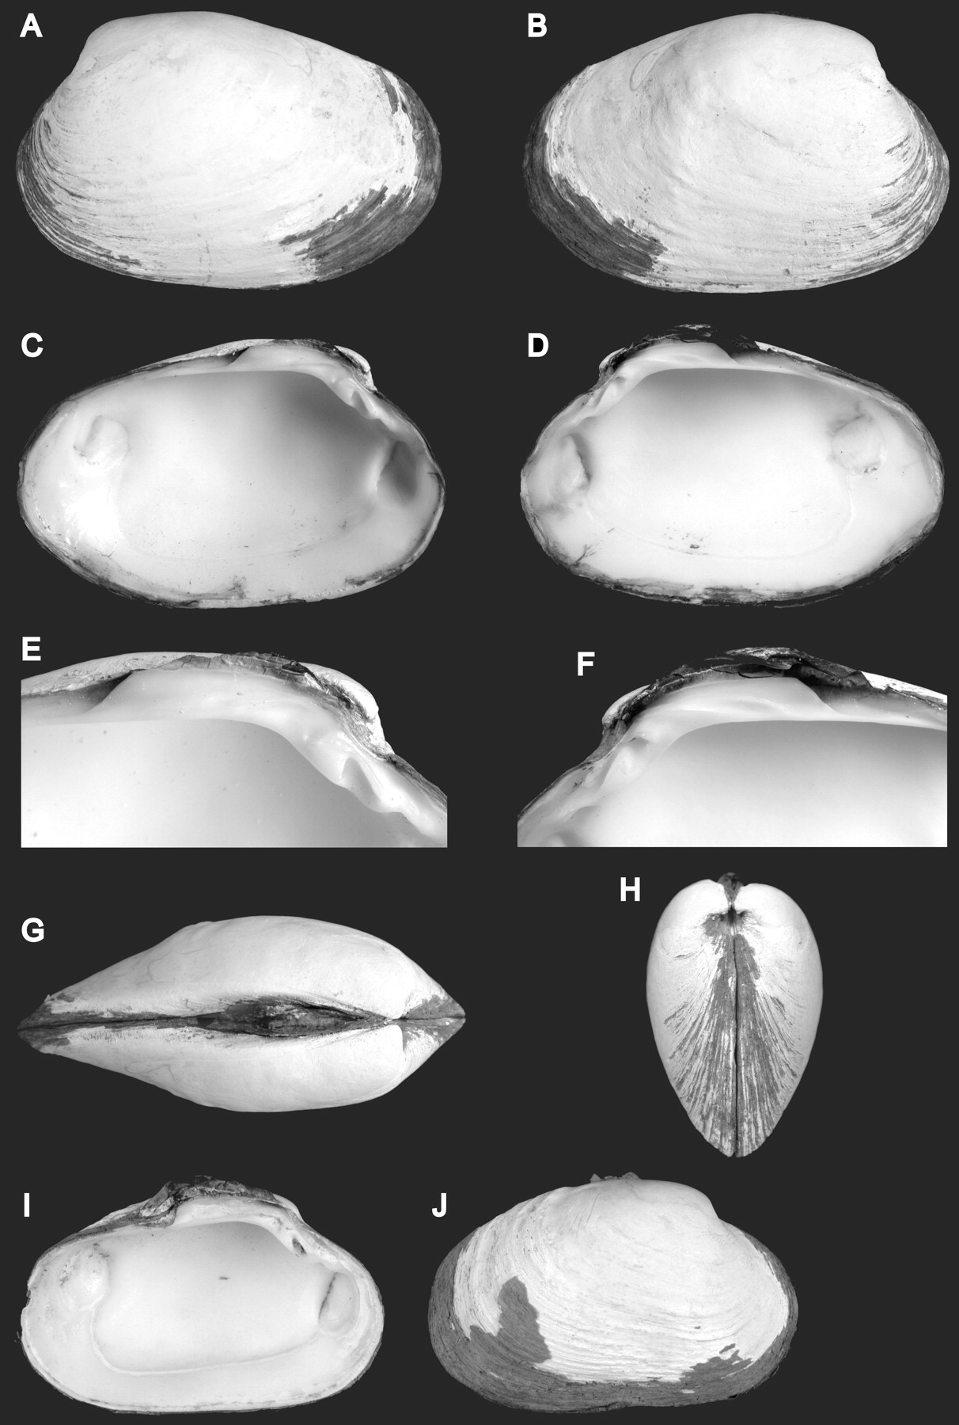
Figure 3. Calyptogena pacificaDall, 1891. A–H. RV Atlantis, Alvin dive 2646, L=38.00 mm. A. Exterior of left valve. B. ...
Notes:
Figure 3. Calyptogena pacificaDall, 1891. A–H. RV Atlantis, Alvin dive 2646, L=38.00 mm. A. Exterior of left valve. B. Exterior of right valve. C. Interior of left valve. D. Interior of right valve. E. Left hinge plate. F. Right hinge plate. G. Dorsal view. H. Anterior view. I, J. RV Akademik Mstislav Keldysh, stn 2320, L=44.2 mm. I. Interior of left valve. J. Exterior of right valve.
Unless provided in the caption above, the following copyright applies to the content of this slide: © The Author 2006. Published by Oxford University Press on behalf of The Malacological Society of London, all rights reserved

Slide 4
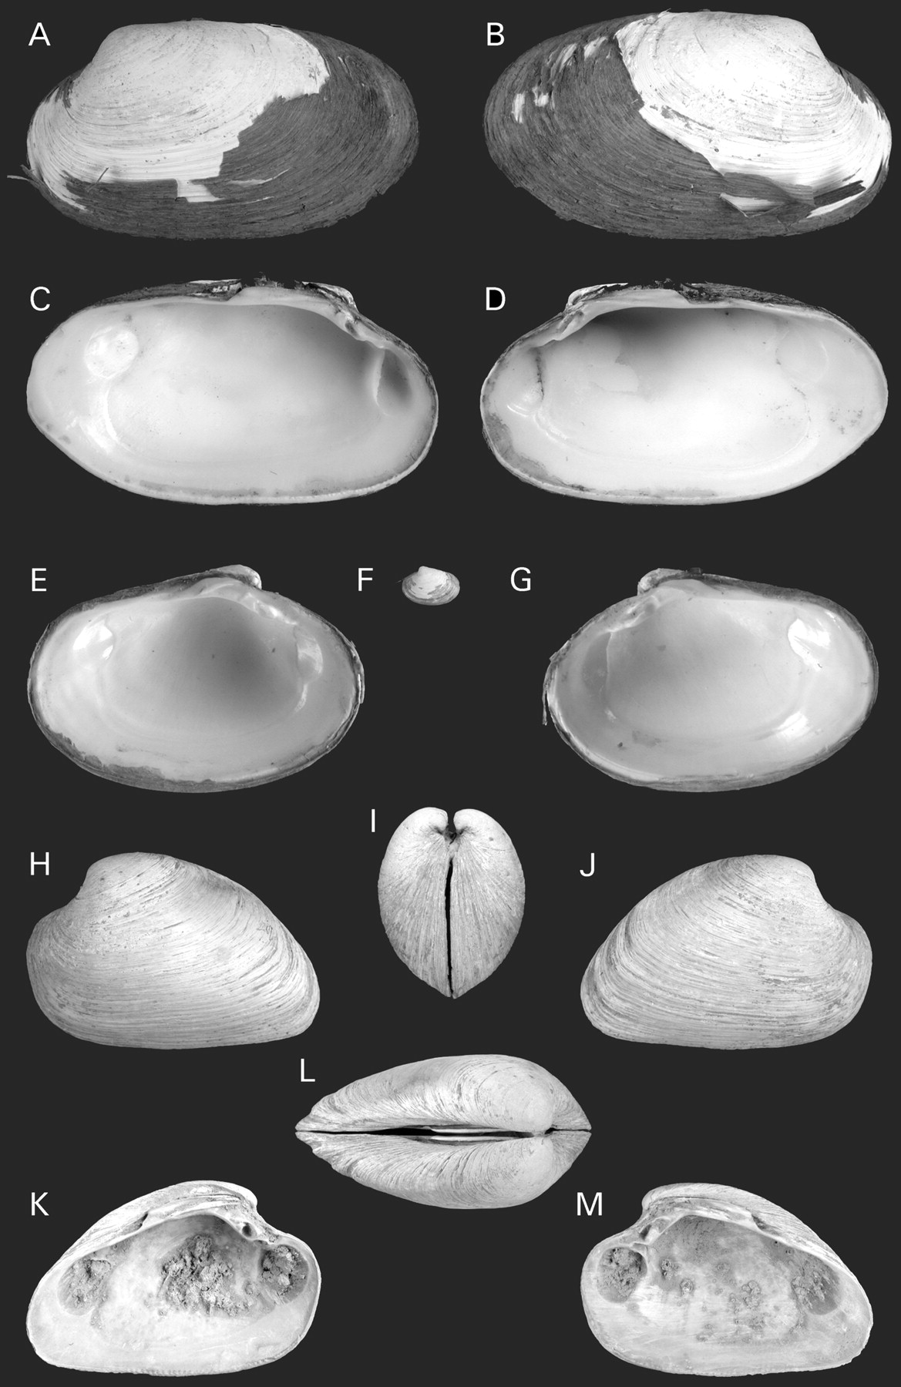
Figure 4. Calyptogena pacificaDall, 1891. A–D. Monterey Bay, L=53 mm. A. Exterior of left valve. B. Exterior of right ...
Notes:
Figure 4. Calyptogena pacificaDall, 1891. A–D. Monterey Bay, L=53 mm. A. Exterior of left valve. B. Exterior of right valve. C. Interior of left valve. D. Interior of right valve. E–G.Sonne, stn 115, L=8.5 mm. E. Interior of left valve. F. Exterior of left valve. G. Interior of right valve. H–MSonne, stn 121, L=38.3 mm. H. Exterior of left valve. I. Anterior view. J. Exterior of right valve. K. Interior of left valve. L. Dorsal view. M. Interior of right valve.
Unless provided in the caption above, the following copyright applies to the content of this slide: © The Author 2006. Published by Oxford University Press on behalf of The Malacological Society of London, all rights reserved

Slide 5
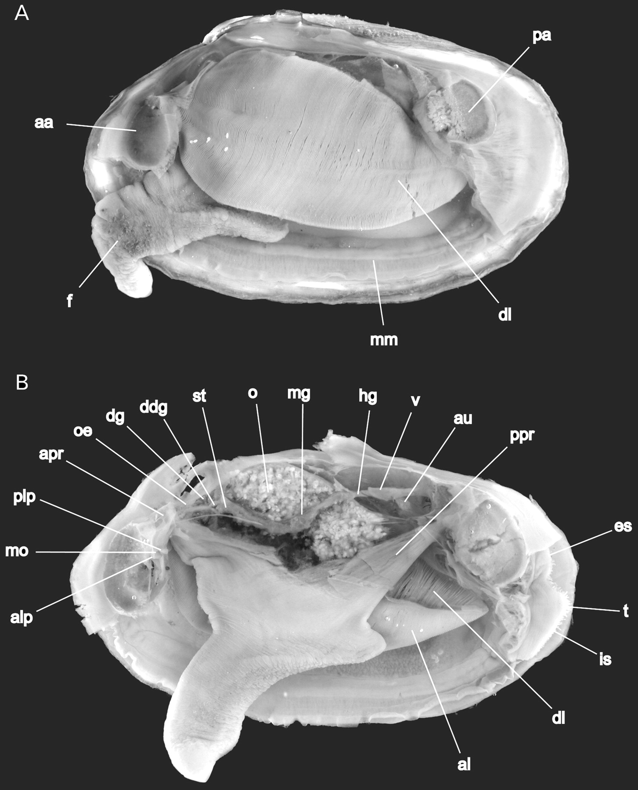
Figure 5. Calyptogena pacificaDall, 1891, RV Sonne, st. 187, L=25.2 mm. A. Soft parts as seen from left; L=26.5 mm: B. ...
Notes:
Figure 5. Calyptogena pacificaDall, 1891, RV Sonne, st. 187, L=25.2 mm. A. Soft parts as seen from left; L=26.5 mm: B. Soft parts as seen from left, left gill removed. Abbreviations: aa, anterior adductor muscle; al, ascending lamella of demibranch; alp, anterior labial palps; apr, anterior pedal retractor muscle; au, auricle; ddg, ductus of digestive gland; dg, digestive gland; dl, descending lamella of demibranch; es, exhalant siphon; f, foot; hg, hindgut; is, inhalant siphon; mm, mantle; mg, midgut; mo, mouth; o, ovarium; oe, oesophagus; pa, posterior adductor muscle; plp, posterior labial palps; ppr, posterior pedal retractor muscle; st, stomach; t, tentacles; v, ventricle.
Unless provided in the caption above, the following copyright applies to the content of this slide: © The Author 2006. Published by Oxford University Press on behalf of The Malacological Society of London, all rights reserved

Slide 6
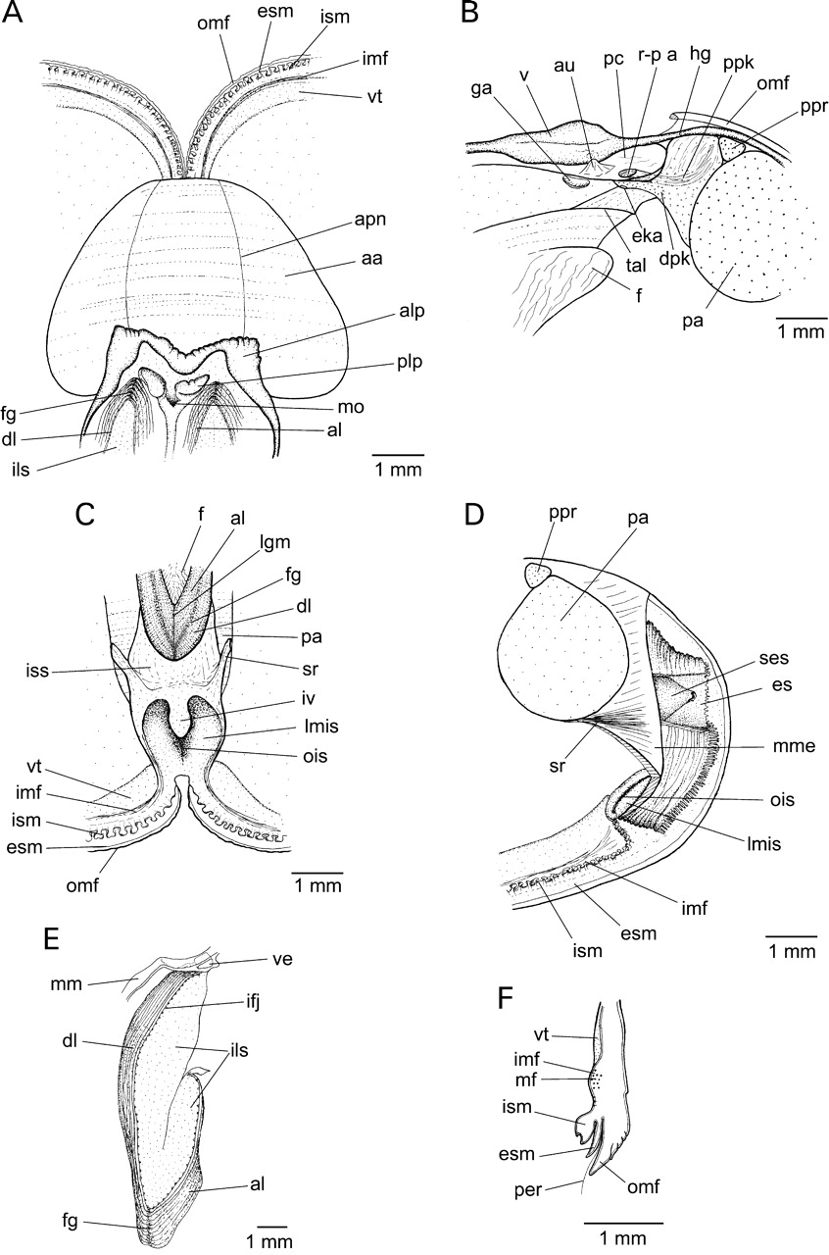
Figure 6. Calyptogena pacificaDall, 1891. Anatomical details. A. Ventral view of the labial palps. B. Heart and kidney. ...
Notes:
Figure 6. Calyptogena pacificaDall, 1891. Anatomical details. A. Ventral view of the labial palps. B. Heart and kidney. C. Interior view of posterior part of mantle cavity. D. Posterior part of the body. E. Medial part of ctenidium. F. Transverse section through mantle margin. Abbreviations: aa, anterior adductor muscle; al, ascending lamella of demibranch; alp, anterior labial palps; apn, anterior pallial nerve; au, auricle; dl, descending lamella of demibranch; dpk, distal portions of kidney; eka, external kidney aperture; es, exhalant siphon; esm, external sub-fold of middle mantle fold; f, foot; fg, food groove; ga, genital apertures; hg, hindgut; ifj, interfilamental junctions; ils, interlamellar septum; imf, inner mantle fold; is, inhalant siphon; ism, internal sub-fold of middle mantle fold; iss, intersiphonal septum; iv, inner vulva of inhalant siphon; lgm, line of fusion of dorsal margin of ascending demibranchs; lmis, lateral margin of inhalant siphon; mf, muscle fibres; mm, mantle; mme, mantle muscularized envelope; mo, mouth; ois, inner opening of inhalant siphon; omf, outer mantle fold; pa, posterior adductor muscle; pc, pericardial cavity; per, periostracum; plp, posterior labial palps; ppk, proximal portion of kidney; ppr, posterior pedal retractor muscle; r-p a, reno-pericardial aperture; ses, sleeve of exhalant siphon; sr, siphonal retractor; tal – trace of attachment of dorsal margin of ascending lamellar; v, ventricle; ve, blood vessel; vt, vascularized thickening.
Unless provided in the caption above, the following copyright applies to the content of this slide: © The Author 2006. Published by Oxford University Press on behalf of The Malacological Society of London, all rights reserved

Slide 7
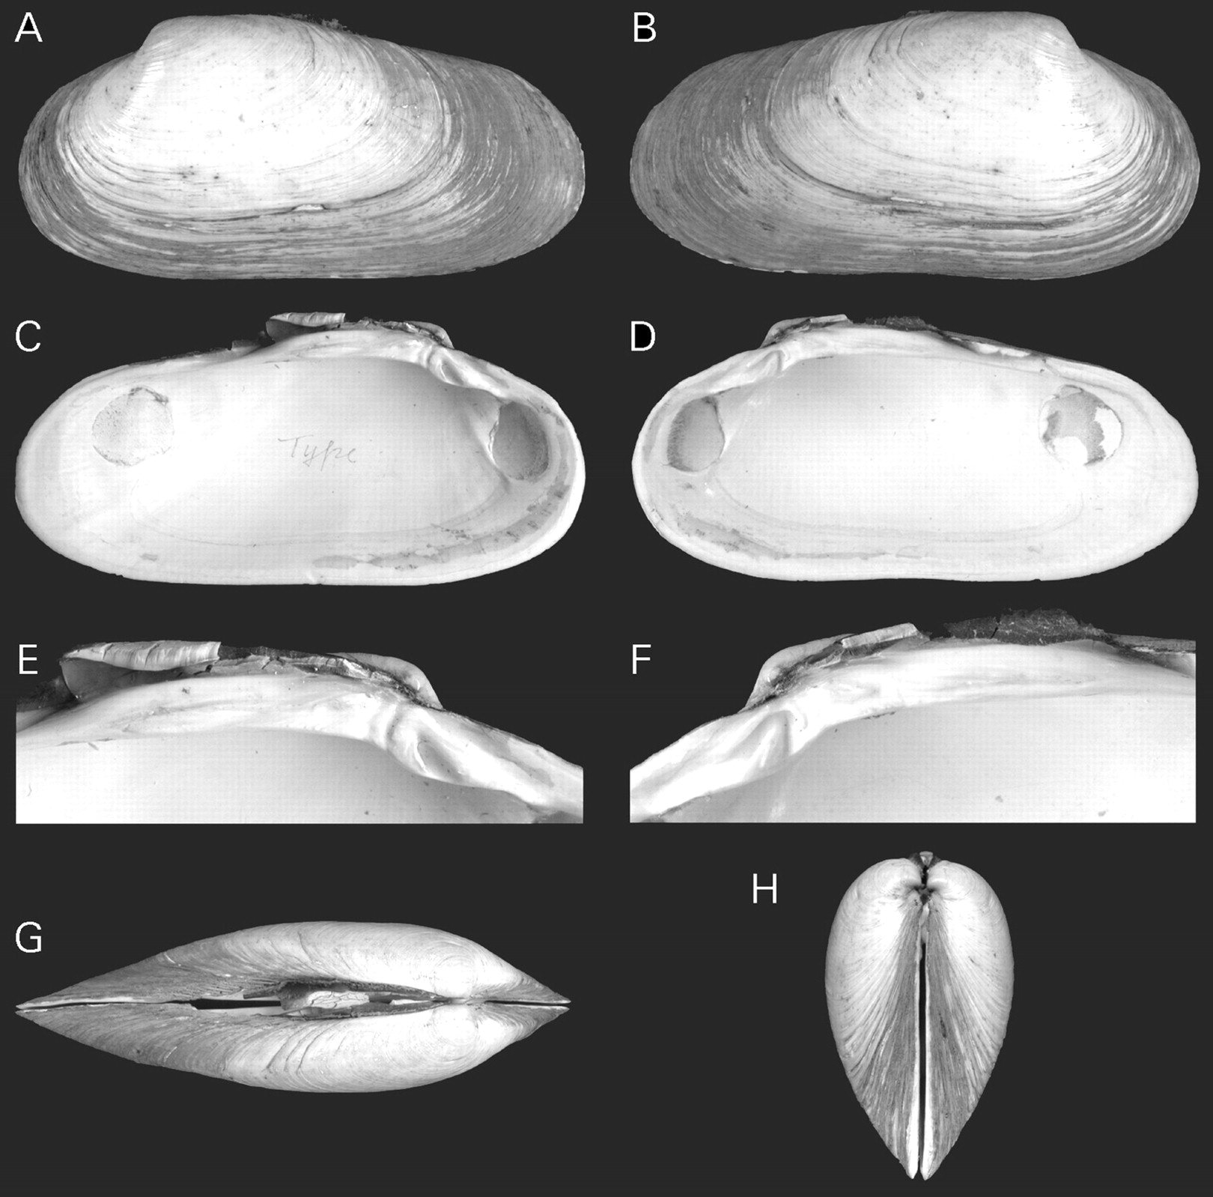
Figure 7. Calyptogena faustaOkutani, Fujikura & Hashimoto, 1993, Shinkai 2000, Dive 596, holotype, USMT-Mo 69872, ...
Notes:
Figure 7. Calyptogena faustaOkutani, Fujikura & Hashimoto, 1993, Shinkai 2000, Dive 596, holotype, USMT-Mo 69872, L=61.0 mm. A. Exterior of left valve. B. Exterior of right valve. C. Interior of left valve. D. Interior of right valve. E. Left hinge plate. F. Right hinge plate. G. Dorsal view. H. Anterior view.
Unless provided in the caption above, the following copyright applies to the content of this slide: © The Author 2006. Published by Oxford University Press on behalf of The Malacological Society of London, all rights reserved

Slide 8
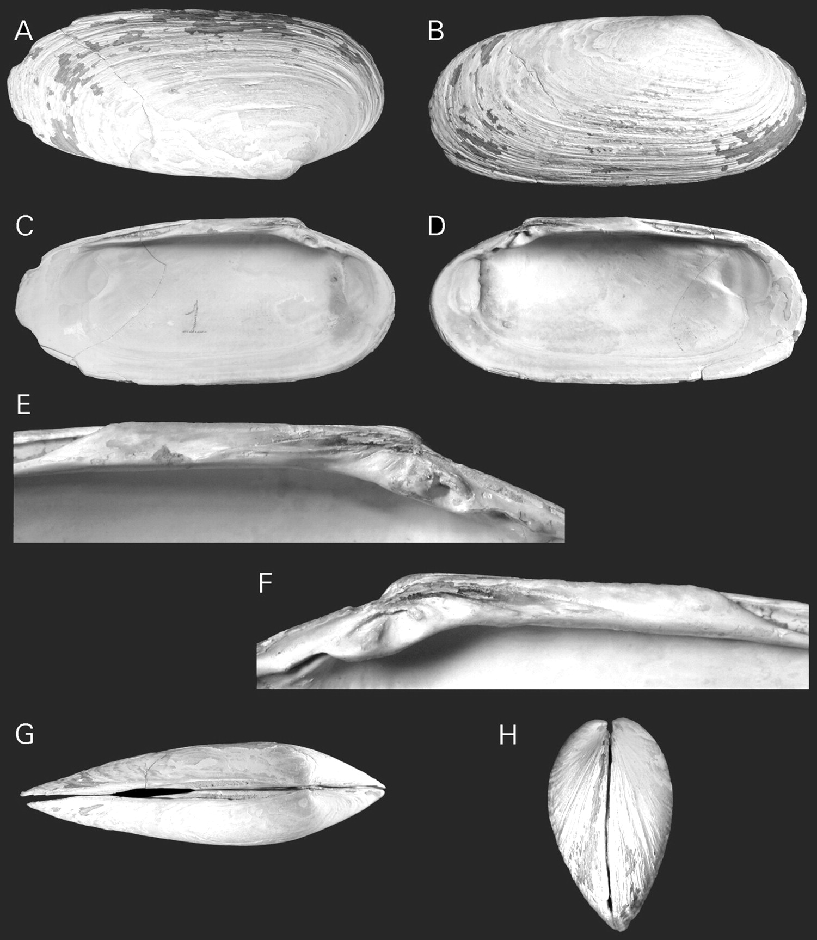
Figure 8. Calyptogena rectimargoScarlato, 1981, RV Gagara, stn 231, holotype, ZIN RAN 9970, L=48.2 mm. A. Exterior of ...
Notes:
Figure 8. Calyptogena rectimargoScarlato, 1981, RV Gagara, stn 231, holotype, ZIN RAN 9970, L=48.2 mm. A. Exterior of left valve. B. Exterior of right valve. C. Interior of left valve. D. Interior of right valve. E. Left hinge plate. F. Right hinge plate. G. Dorsal view. H. Anterior view.
Unless provided in the caption above, the following copyright applies to the content of this slide: © The Author 2006. Published by Oxford University Press on behalf of The Malacological Society of London, all rights reserved

Slide 9
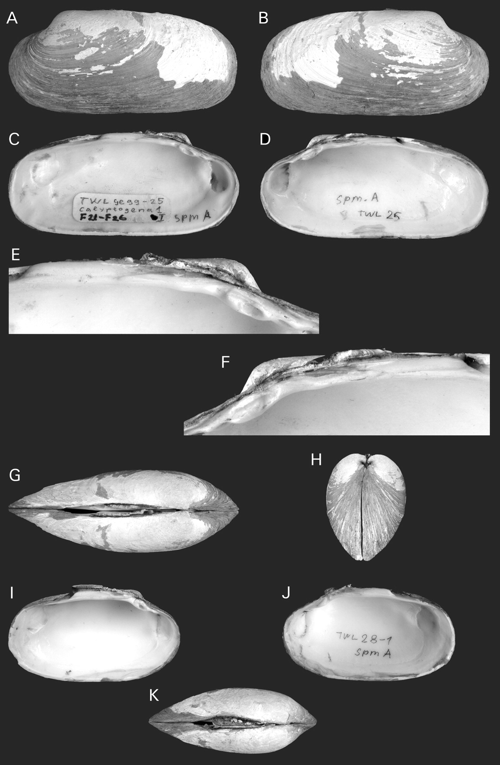
Figure 9. Calyptogena rectimargoScarlato, 1981. A–H. RV Marshal Gelovani, stn 25-1, L=68.4 mm. A. Exterior of left ...
Notes:
Figure 9. Calyptogena rectimargoScarlato, 1981. A–H. RV Marshal Gelovani, stn 25-1, L=68.4 mm. A. Exterior of left valve. B. Exterior of right valve. C. Interior of left valve. D. Interior of right valve. E. Left hinge plate. F. Right hinge plate. G. Dorsal view. H. Anterior view. I–K. St 28-1, L=57.5 mm. I. Interior of left valve. J. Interior of right valve. K. Dorsal view.
Unless provided in the caption above, the following copyright applies to the content of this slide: © The Author 2006. Published by Oxford University Press on behalf of The Malacological Society of London, all rights reserved

Slide 10
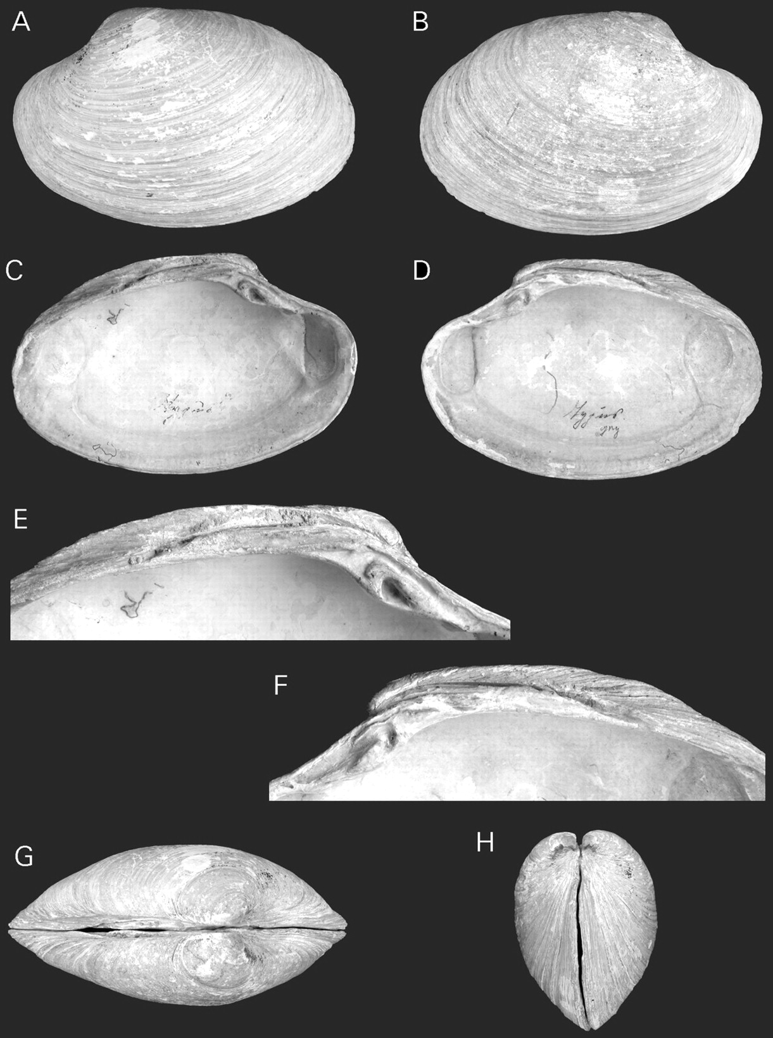
Figure 10. Calyptogena valdiviae (Thiele & Jaeckel, 1931), RV Valdivia, stn 33, lectotype, ZMB 101.598a, L=59.2 mm. A. ...
Notes:
Figure 10. Calyptogena valdiviae (Thiele & Jaeckel, 1931), RV Valdivia, stn 33, lectotype, ZMB 101.598a, L=59.2 mm. A. Exterior of left valve. B. Exterior of right valve. C. Interior of left valve. D. Interior of right valve. E. Left hinge plate. F. Right hinge plate. G. Dorsal view. H. Anterior view.
Unless provided in the caption above, the following copyright applies to the content of this slide: © The Author 2006. Published by Oxford University Press on behalf of The Malacological Society of London, all rights reserved

Slide 11
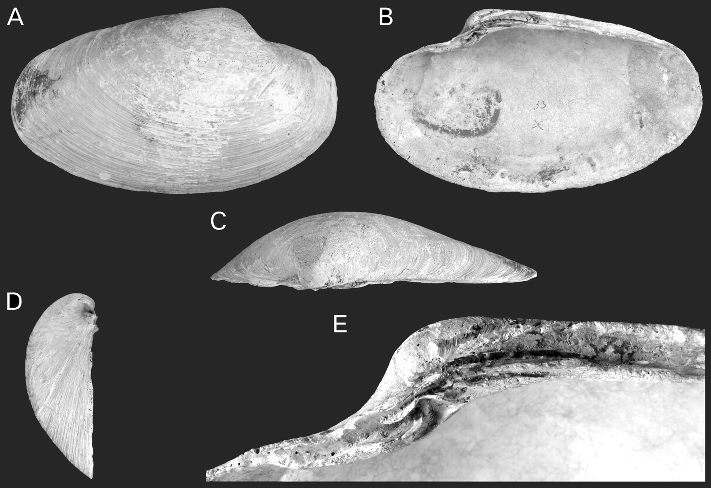
Figure 11. Vesicomya longaThiele & Jaeckel, 1931 [=Calyptogena valdiviae (Thiele, & Jaeckel, 1931)], RV Valdivia, stn ...
Notes:
Figure 11. Vesicomya longaThiele & Jaeckel, 1931 [=Calyptogena valdiviae (Thiele, & Jaeckel, 1931)], RV Valdivia, stn 33, holotype, ZMB 101.601, L=70.6 mm. A. Exterior of right valve. B. Interior of right valve. C. Dorsal view. D. Anterior view. E. Right hinge plate.
Unless provided in the caption above, the following copyright applies to the content of this slide: © The Author 2006. Published by Oxford University Press on behalf of The Malacological Society of London, all rights reserved

Slide 12
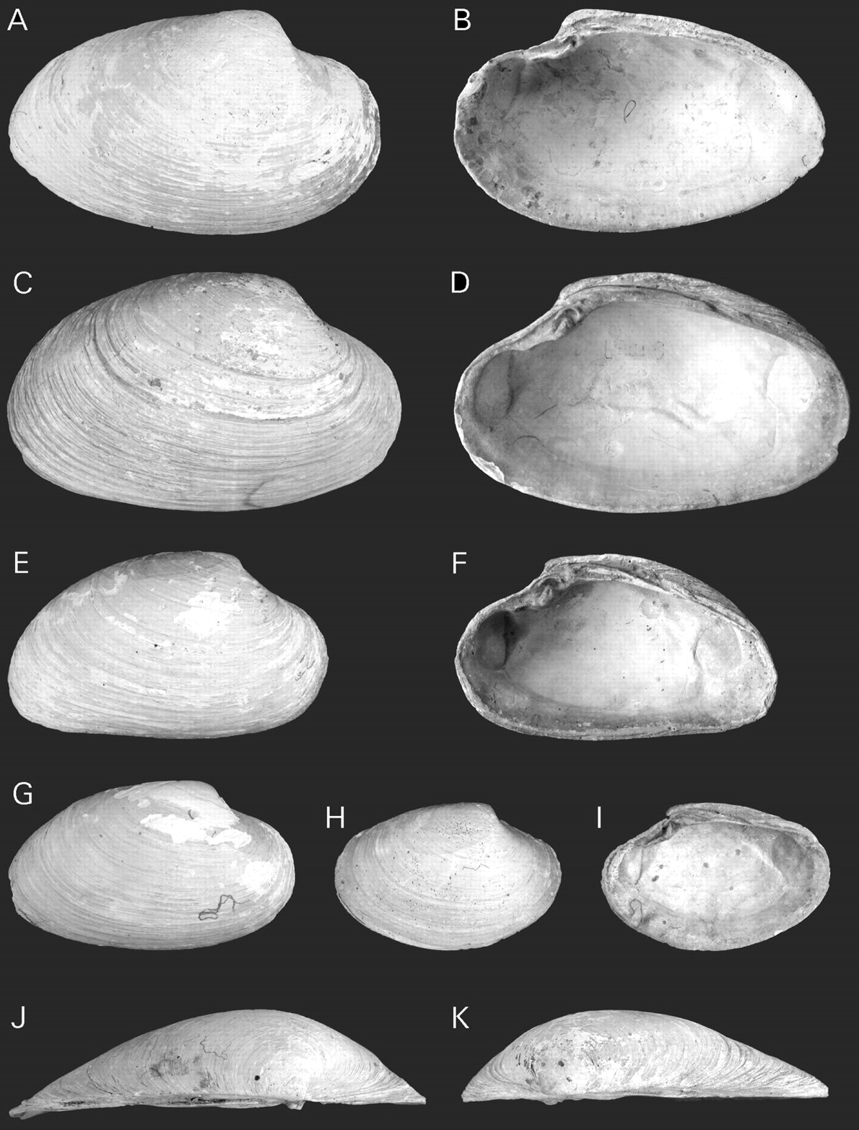
Figure 12. A, B, J.Vesicomya longaThiele & Jaeckel, 1931 [=Calyptogena valdiviae (Thiele, & Jaeckel, 1931)], RV ...
Notes:
Figure 12. A, B, J.Vesicomya longaThiele & Jaeckel, 1931 [=Calyptogena valdiviae (Thiele, & Jaeckel, 1931)], RV Valdivia, stn 63, ZMB 101.602, paratype, L=57.9 mm. A. Exterior of right valve. B. Interior of right valve. J. Dorsal view. C-I, K.Calyptogena valdiviae (Thiele & Jaeckel, 1931), Valdivia, stn 33, ZMB 101.598b. C, D, K. Paralectotype, L=61.9 mm. C. Exterior of right valve. D. Interior of right valve. K. Dorsal view. E, F. Paralectotype, L=50.2 mm. E. Exterior of right valve. F. Interior of right valve. G. Paralectotype, L=45.2 mm, exterior of right valve. H, I. Paralectotype, L=35.9 mm. H. Exterior of right valve. I. Interior of right valve.
Unless provided in the caption above, the following copyright applies to the content of this slide: © The Author 2006. Published by Oxford University Press on behalf of The Malacological Society of London, all rights reserved

Slide 13
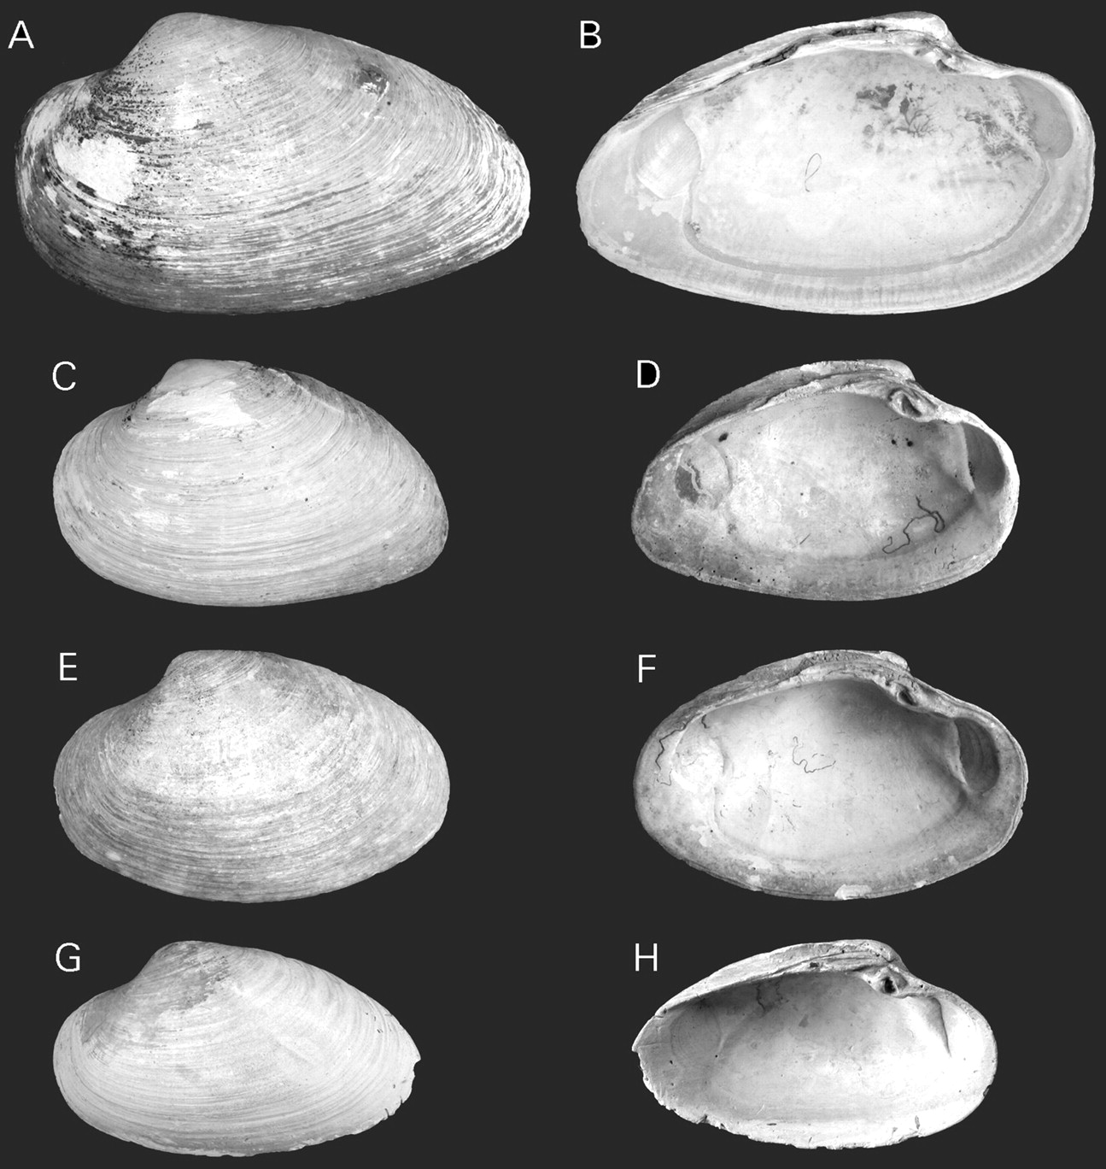
Figure 13. A, B. Vesicomya longaThiele & Jaeckel, 1931 [=Calyptogena valdiviae (Thiele, Jaeckel, 1931)], RV Valdivia, ...
Notes:
Figure 13. A, B. Vesicomya longaThiele & Jaeckel, 1931 [=Calyptogena valdiviae (Thiele, Jaeckel, 1931)], RV Valdivia, stn 63, ZMB 101.602, paratype, L=63.3 mm. A. Exterior of left valve. B. Interior of left valve. C–H.Calyptogena valdiviae (Thiele, Jaeckel, 1931). RV Valdivia, stn 33, ZMB 101.598b. C, D. Paralectotype, L=47.5 mm. C. Exterior of left valve. D. Interior of left valve. E, F. Paralectotype, L=49.0 mm. E. Exterior of left valve. F. Interior of left valve. G, H. Paralectotype, L=45 mm. G. Exterior of left valve. H. Interior of left valve.
Unless provided in the caption above, the following copyright applies to the content of this slide: © The Author 2006. Published by Oxford University Press on behalf of The Malacological Society of London, all rights reserved

Slide 14
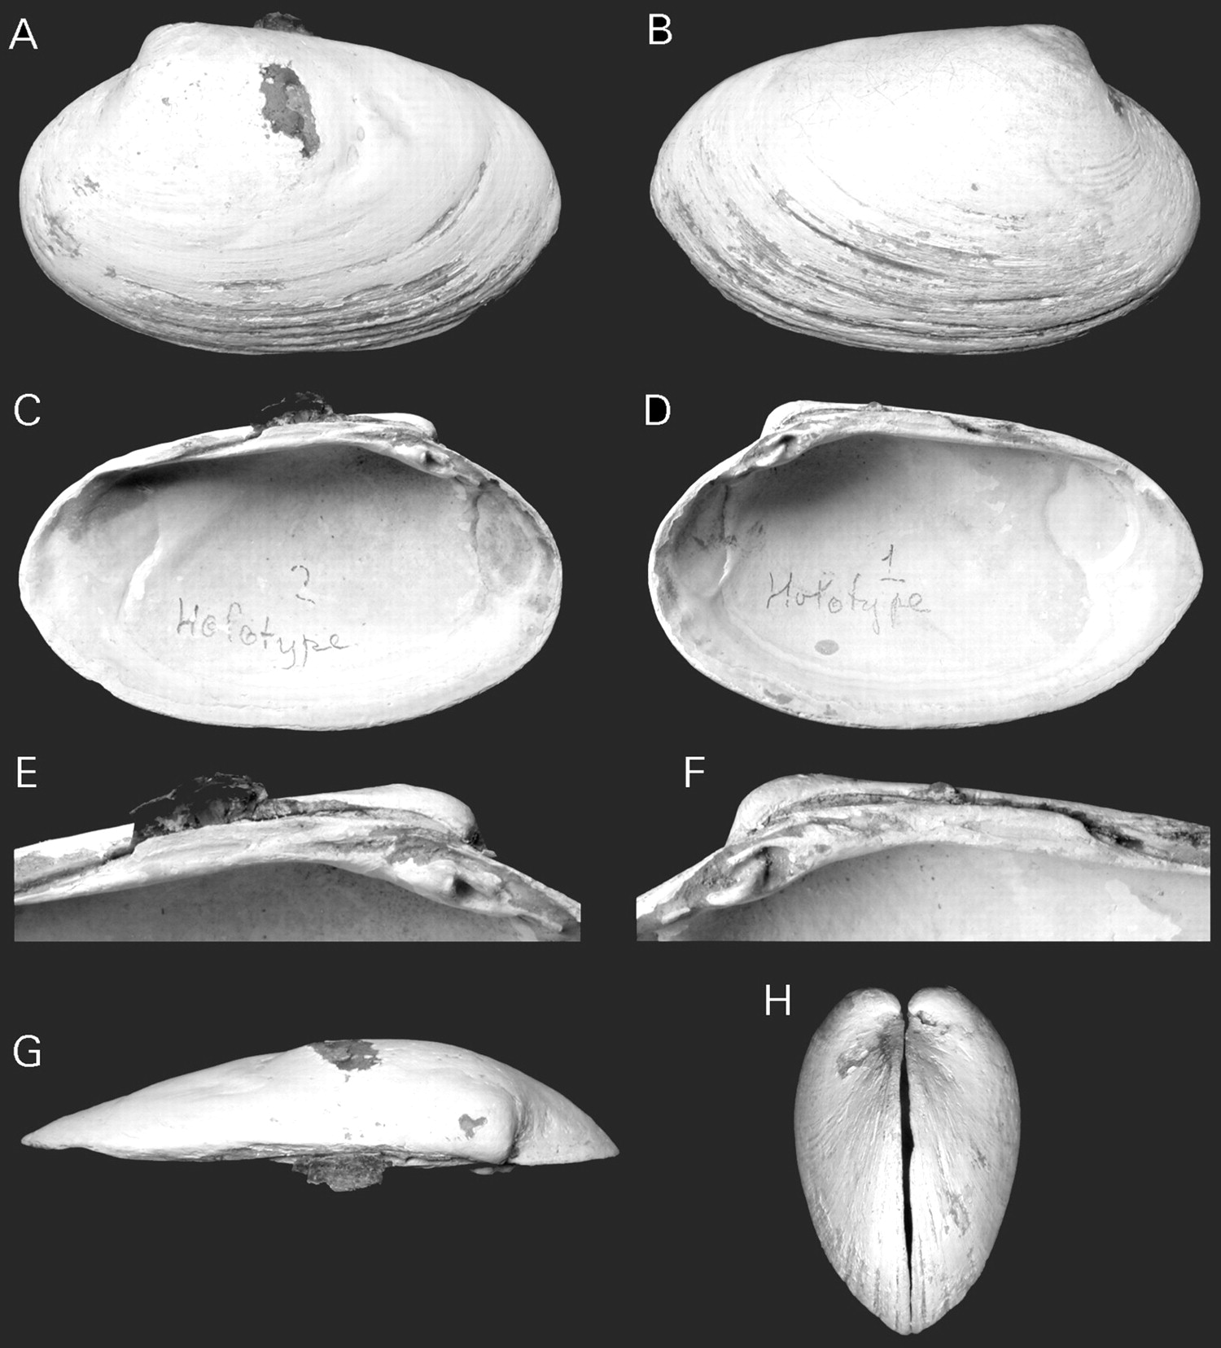
Figure 14. Calyptogena gallardoiSellanes & Krylova, 2005, RV Kay Kay, stn 40, holotype, MNHNCL-200734, L=41.3 mm. A. ...
Notes:
Figure 14. Calyptogena gallardoiSellanes & Krylova, 2005, RV Kay Kay, stn 40, holotype, MNHNCL-200734, L=41.3 mm. A. Exterior of left valve. B. Exterior of right valve. C. Interior of left valve. D. Interior of right valve. E. Left hinge plate. F. Right hinge plate. G. Dorsal view of left valve. H. Anterior view.
Unless provided in the caption above, the following copyright applies to the content of this slide: © The Author 2006. Published by Oxford University Press on behalf of The Malacological Society of London, all rights reserved

Slide 15
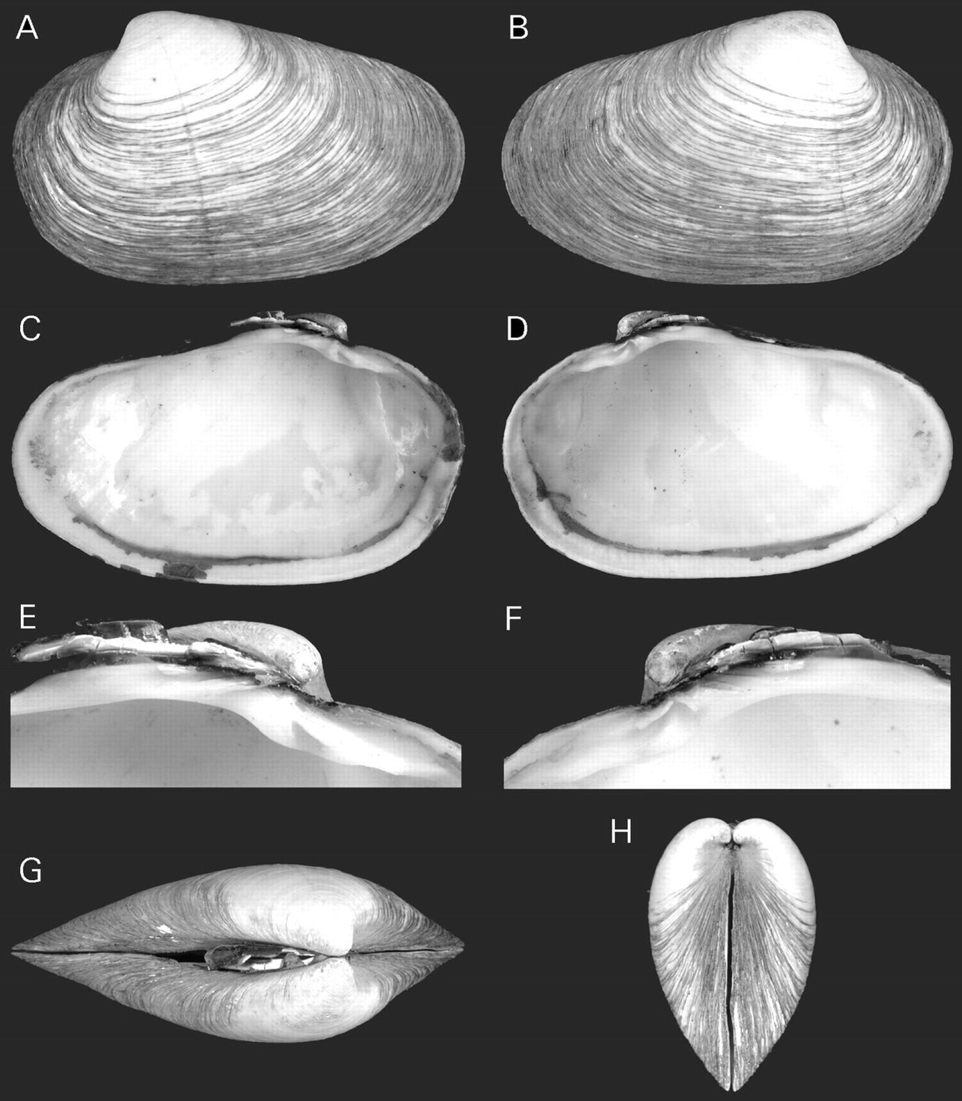
Figure 15. Calyptogena goffrediae n. sp., RV Sonne, stn 1, holotype, SMF 327534, L=38.1 mm. A. Exterior of left valve. ...
Notes:
Figure 15. Calyptogena goffrediae n. sp., RV Sonne, stn 1, holotype, SMF 327534, L=38.1 mm. A. Exterior of left valve. B. Exterior of right valve. C. Interior of left valve. D. Interior of right valve. E. Left hinge plate. F. Right hinge plate. G. Dorsal view. H. Anterior view.
Unless provided in the caption above, the following copyright applies to the content of this slide: © The Author 2006. Published by Oxford University Press on behalf of The Malacological Society of London, all rights reserved

Slide 16
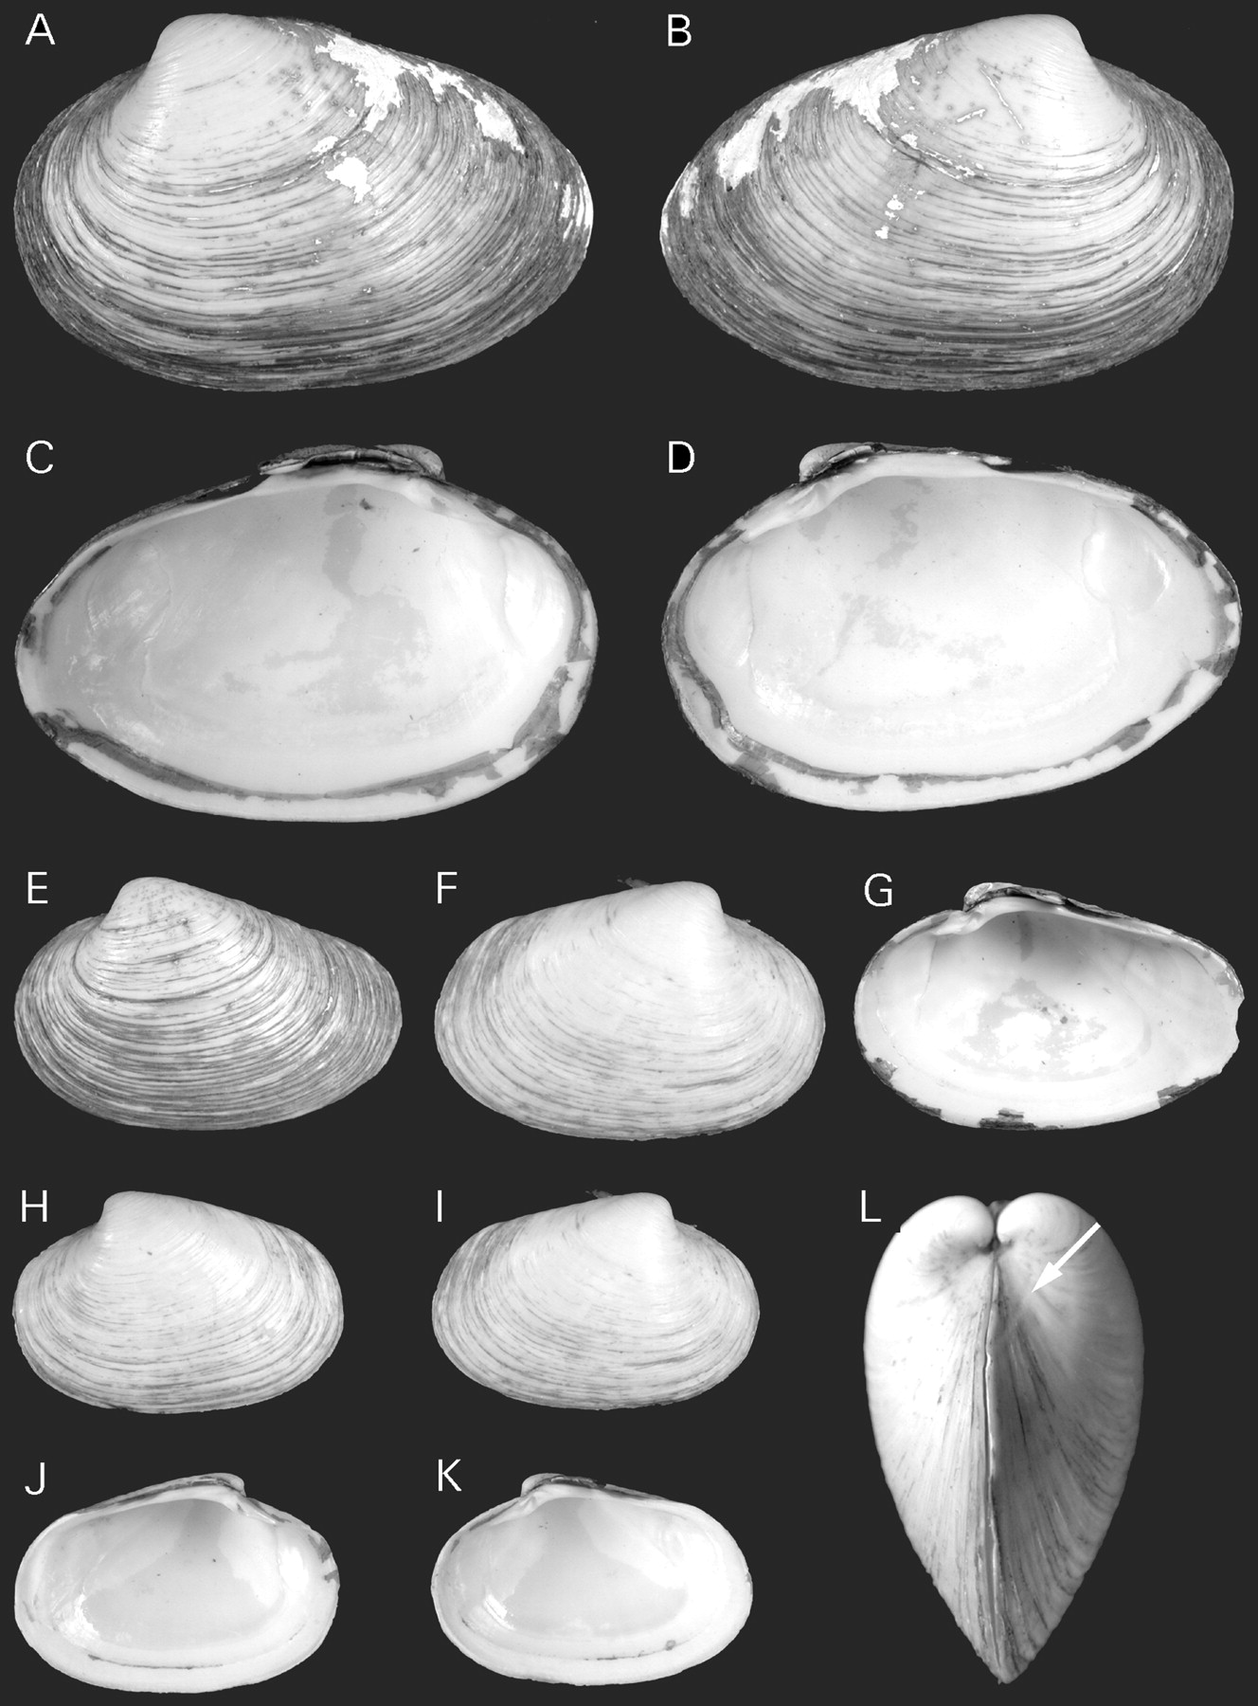
Figure 16. Calyptogena goffrediae n. sp., RV Sonne, stn 1. A–D. Paratype, SMF 327535, L – 36.4 mm. A. Exterior of left ...
Notes:
Figure 16. Calyptogena goffrediae n. sp., RV Sonne, stn 1. A–D. Paratype, SMF 327535, L – 36.4 mm. A. Exterior of left valve. B. Exterior of right valve. C. Interior of left valve. D. Interior of right valve. E–G. Paratype, SMF 327536, L=24.6 mm. E. Exterior of left valve. F. Exterior of right valve. G. Interior of right valve. H–L. Paratype, L=20.6 mm. H. Exterior of left valve. I. Exterior of right valve. J. Interior of left valve. K. Interior of right valve. L. Anterior view; arrow indicates lunular incision.
Unless provided in the caption above, the following copyright applies to the content of this slide: © The Author 2006. Published by Oxford University Press on behalf of The Malacological Society of London, all rights reserved

Slide 17
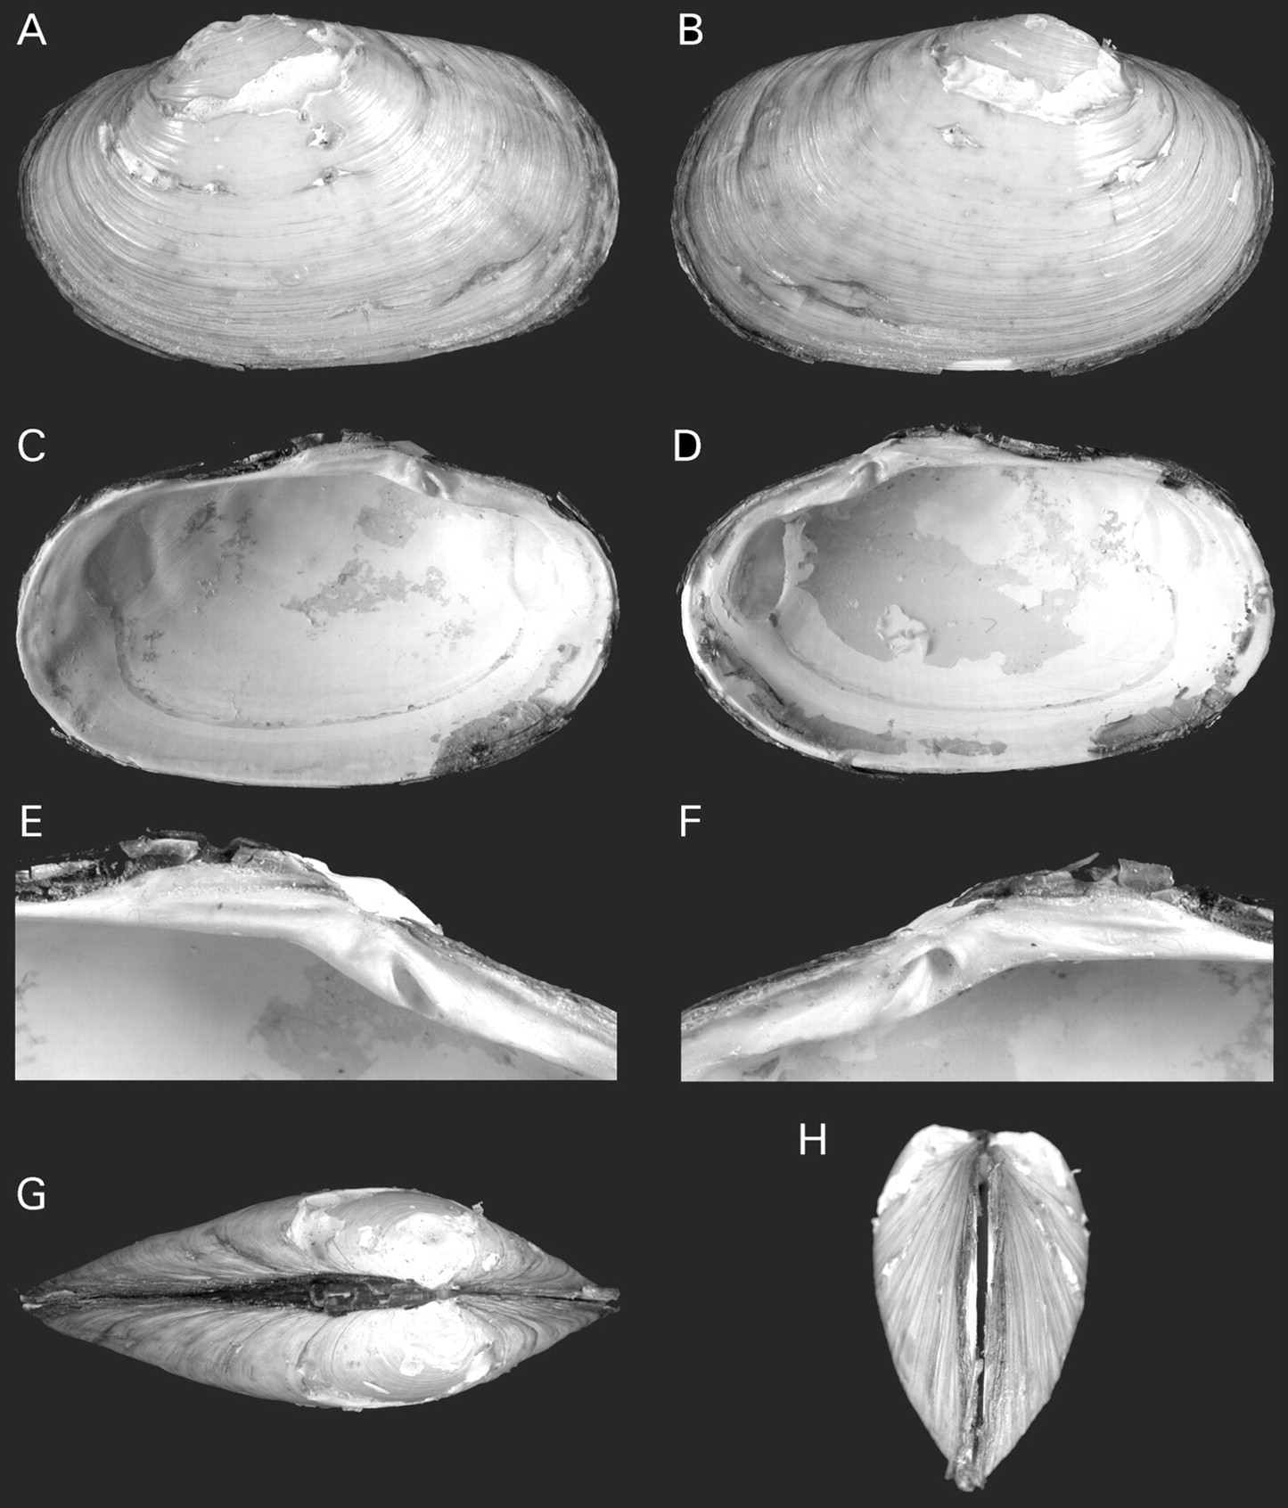
Figure 17. Calyptogena starobogatovi n. sp. RV Akademik Mstislav Keldysh, stn 1505, holotype, ZMMU Ld-3001, L=33.8 mm. ...
Notes:
Figure 17. Calyptogena starobogatovi n. sp. RV Akademik Mstislav Keldysh, stn 1505, holotype, ZMMU Ld-3001, L=33.8 mm. A. Exterior of left valve. B. Exterior of right valve. C. Interior of left valve. D. Interior of right valve. E. Left hinge plate. F. Right hinge plate. G. Dorsal view. H. Anterior view.
Unless provided in the caption above, the following copyright applies to the content of this slide: © The Author 2006. Published by Oxford University Press on behalf of The Malacological Society of London, all rights reserved

Slide 18
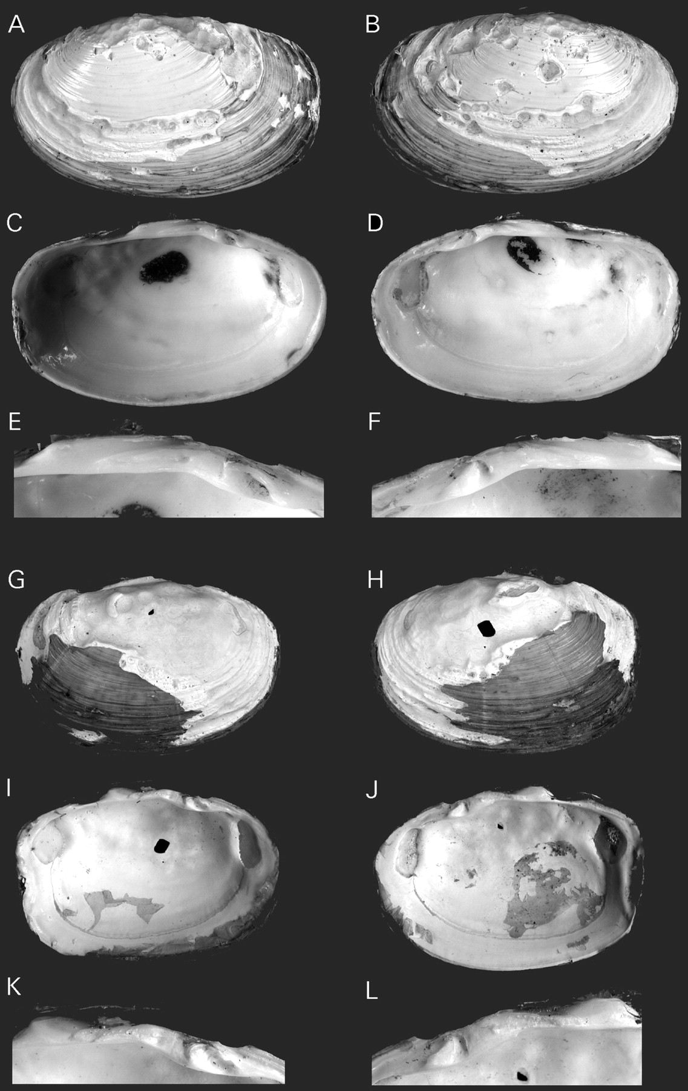
Figure 18. Calyptogena starobogatovi n. sp., RV Akademik Mstislav Keldysh, stn 1505. A–F. Paratype, SMF 327538, ...
Notes:
Figure 18. Calyptogena starobogatovi n. sp., RV Akademik Mstislav Keldysh, stn 1505. A–F. Paratype, SMF 327538, L=41.4 mm. A. Exterior of left valve. B. Exterior of right valve. C. Interior of left valve. D. Interior of right valve. E. Left hinge plate. F. Right hinge plate. G–L. L=36.4 mm. G. Exterior of left valve. H. Exterior of right valve. I. Interior of left valve. J. Interior of right valve. K. Left hinge plate. L. Right hinge plate.
Unless provided in the caption above, the following copyright applies to the content of this slide: © The Author 2006. Published by Oxford University Press on behalf of The Malacological Society of London, all rights reserved

Slide 19
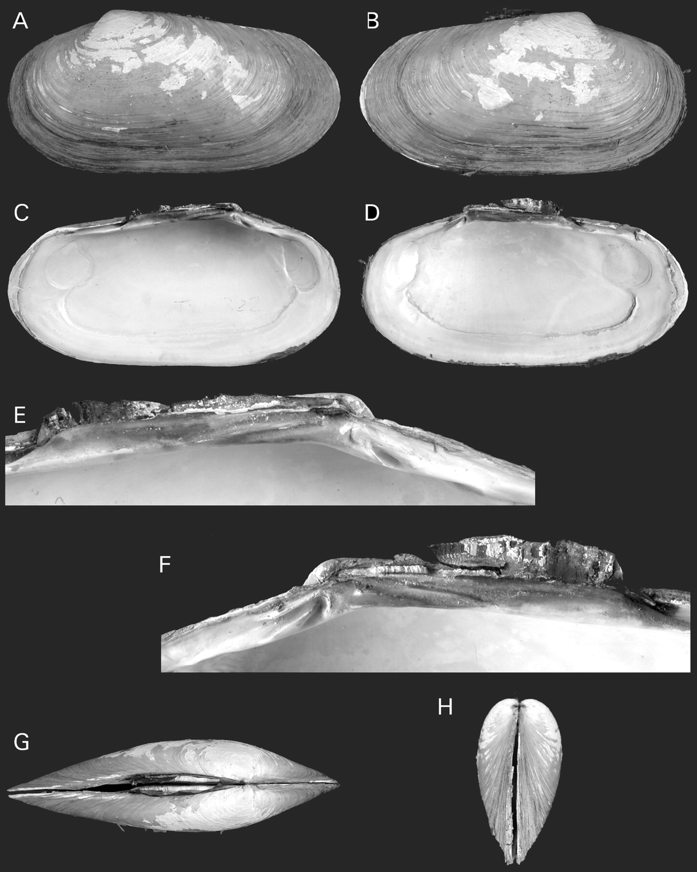
Figure 19. Calyptogena makranensis n. sp., RV Sonne, stn 322, holotype, SMF 327540, L=62.8 mm. A. Exterior of left ...
Notes:
Figure 19. Calyptogena makranensis n. sp., RV Sonne, stn 322, holotype, SMF 327540, L=62.8 mm. A. Exterior of left valve. B. Exterior of right valve. C. Interior of left valve. D. Interior of right valve. E. Left hinge plate. F. Right hinge plate. G. Dorsal view. H. Anterior view.
Unless provided in the caption above, the following copyright applies to the content of this slide: © The Author 2006. Published by Oxford University Press on behalf of The Malacological Society of London, all rights reserved

Slide 20
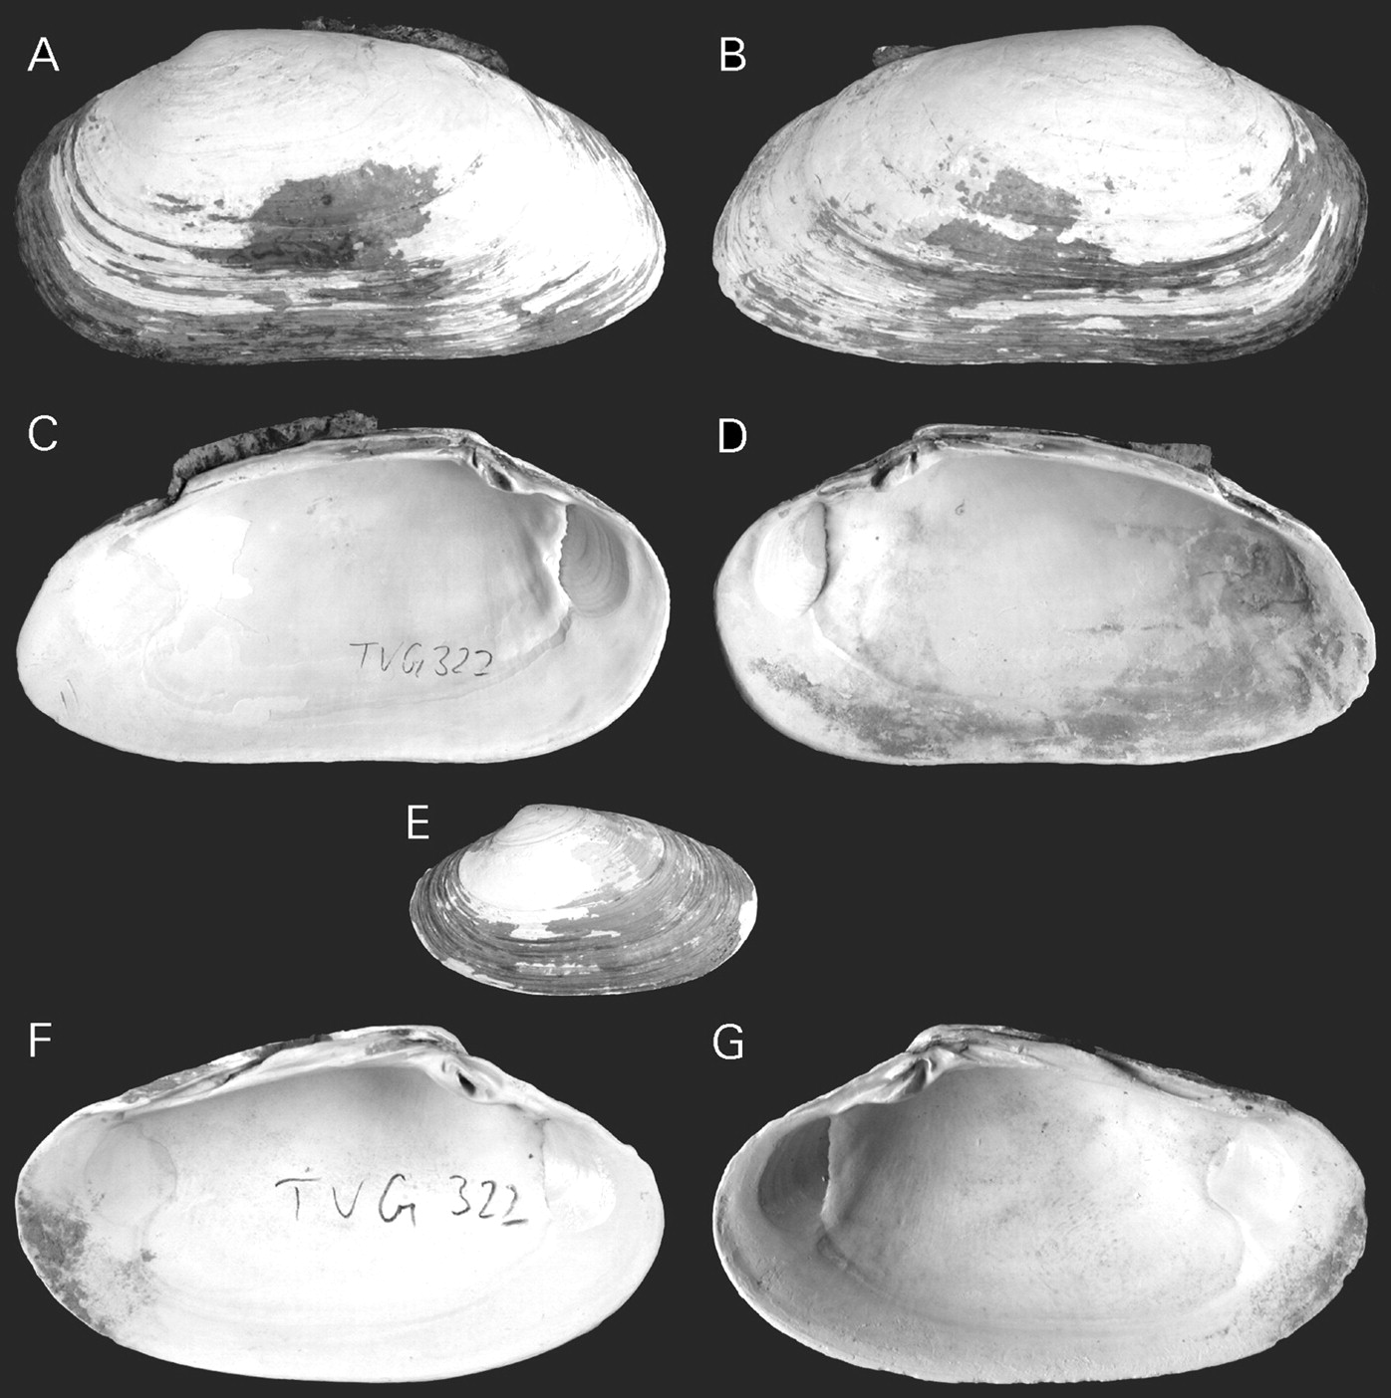
Figure 20. Calyptogena makranensis n. sp., RV Sonne, stn 322. A–D. Paratype, SMF 327541, L=66.5 mm. A. Exterior of left ...
Notes:
Figure 20. Calyptogena makranensis n. sp., RV Sonne, stn 322. A–D. Paratype, SMF 327541, L=66.5 mm. A. Exterior of left valve. B. Exterior of right valve. C. Interior of left valve. D. Interior of right valve. E–G. Paratype, SMF 327542, L=33.7 mm. E. Exterior of left valve. F. Interior of left valve. G. Interior of right valve.
Unless provided in the caption above, the following copyright applies to the content of this slide: © The Author 2006. Published by Oxford University Press on behalf of The Malacological Society of London, all rights reserved

Slide 21
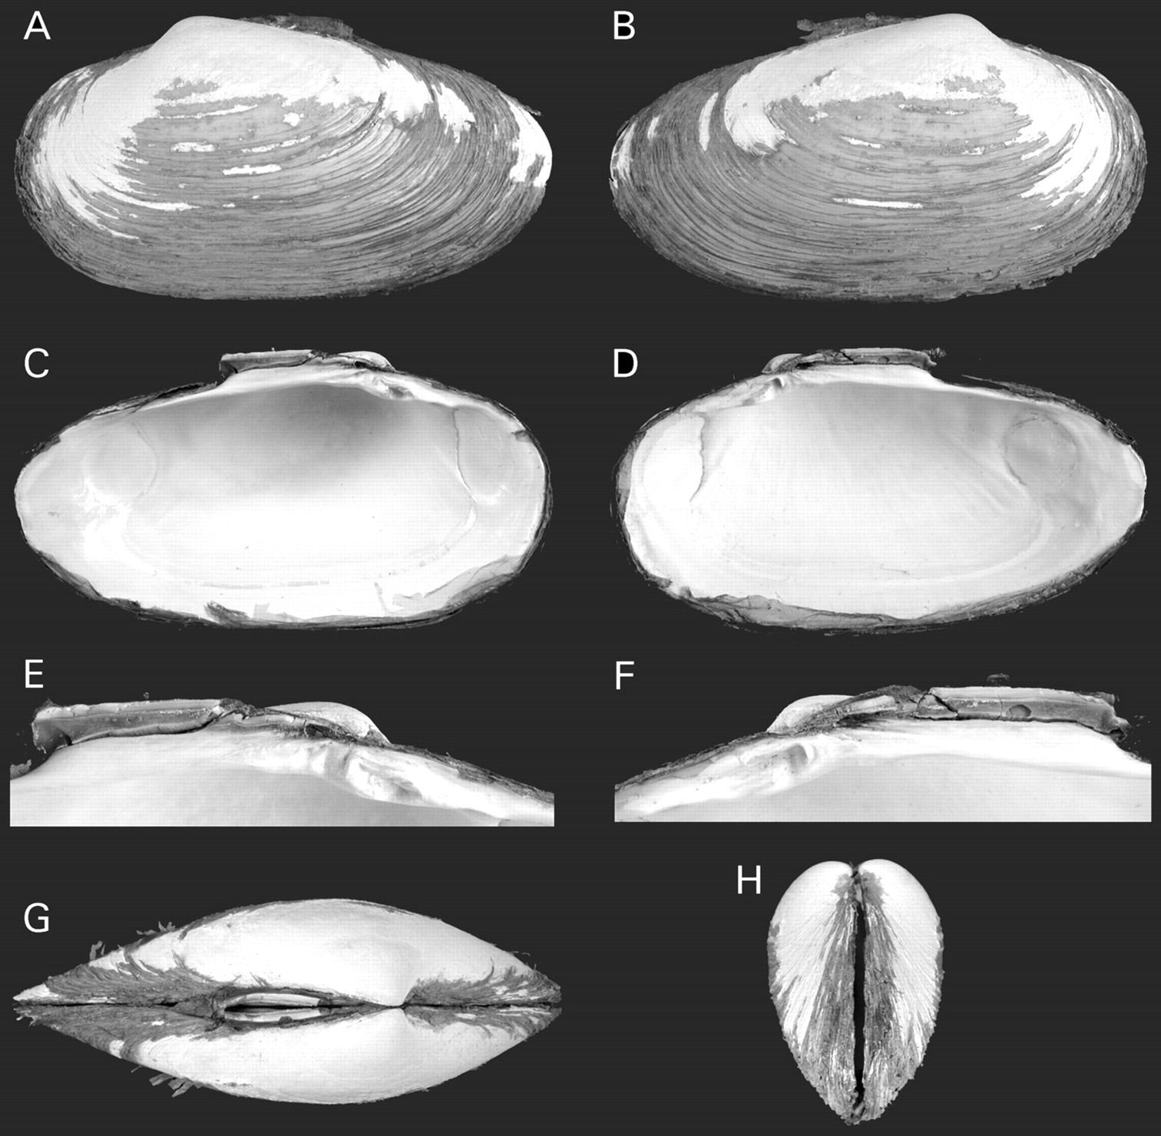
Figure 21. Calyptogena costaricana n. sp., RV Meteor, stn 123, holotype, SMF 327544, L=50.8 mm. A. Exterior of left ...
Notes:
Figure 21. Calyptogena costaricana n. sp., RV Meteor, stn 123, holotype, SMF 327544, L=50.8 mm. A. Exterior of left valve. B. Exterior of right valve. C. Interior of left valve. D. Interior of right valve. E. Left hinge plate. F. Right hinge plate. G. Dorsal view. H. Anterior view.
Unless provided in the caption above, the following copyright applies to the content of this slide: © The Author 2006. Published by Oxford University Press on behalf of The Malacological Society of London, all rights reserved

Slide 22
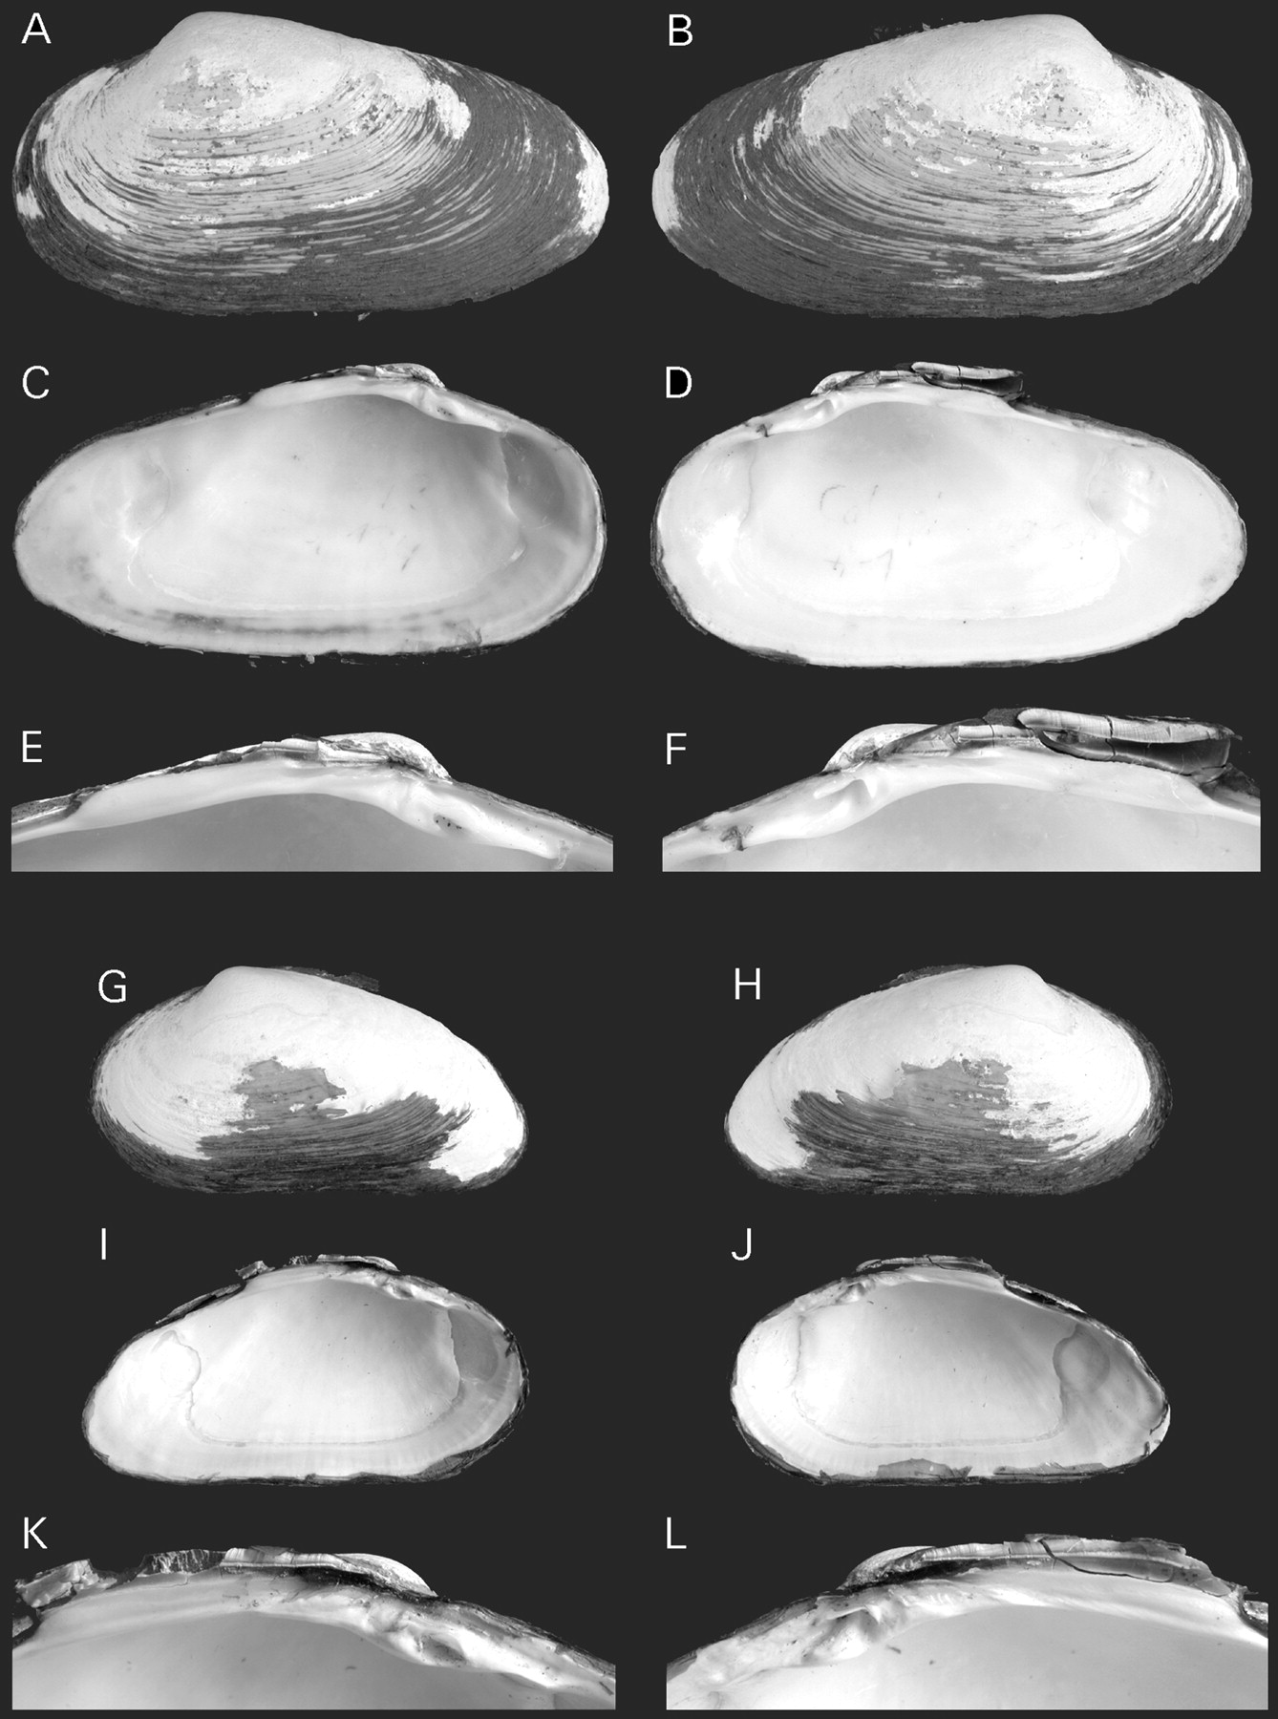
Figure 22. Calyptogena costaricana n. sp., RV Meteor, stn 134. A–F. Paratype, ZMMU Ld-3004, L=52.0 mm. A. Exterior of ...
Notes:
Figure 22. Calyptogena costaricana n. sp., RV Meteor, stn 134. A–F. Paratype, ZMMU Ld-3004, L=52.0 mm. A. Exterior of left valve. B. Exterior of right valve. C. Interior of left valve. D. Interior of right valve. E. Left hinge plate. F. Right hinge plate. G–L. Paratype, ZMMU Ld-3004, L=38.4 mm. G. Exterior of left valve. H. Exterior of right valve. I. Interior of left valve. J. Interior of right valve. K. Left hinge plate. L. Right hinge plate.
Unless provided in the caption above, the following copyright applies to the content of this slide: © The Author 2006. Published by Oxford University Press on behalf of The Malacological Society of London, all rights reserved

Slide 23
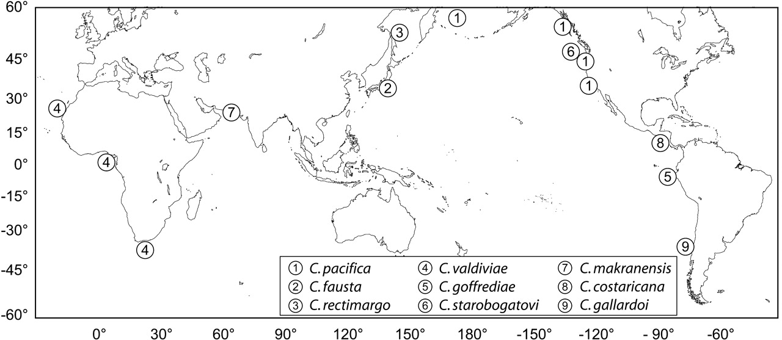
Figure 23. Distribution of Calyptogena species based on the material examined in this study.
Notes:
Figure 23. Distribution of Calyptogena species based on the material examined in this study.
Unless provided in the caption above, the following copyright applies to the content of this slide: © The Author 2006. Published by Oxford University Press on behalf of The Malacological Society of London, all rights reserved

