Slide 1
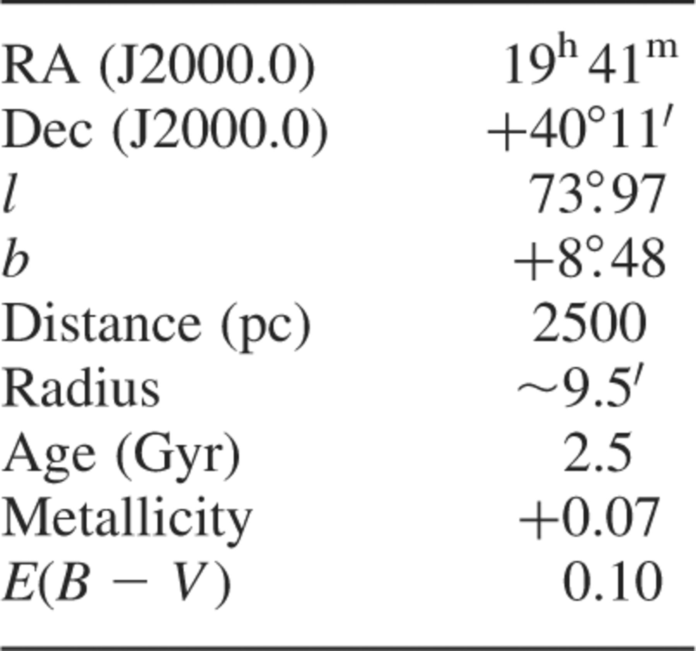
Table 1. Basic data on NGC 6819. Data taken from Kalirai et al. (2001) and the SIMBAD and WEBDA data bases.
Notes:
Table 1. Basic data on NGC 6819. Data taken from Kalirai et al. (2001) and the SIMBAD and WEBDA data bases.
Unless provided in the caption above, the following copyright applies to the content of this slide: © 2002 RAS

Slide 2
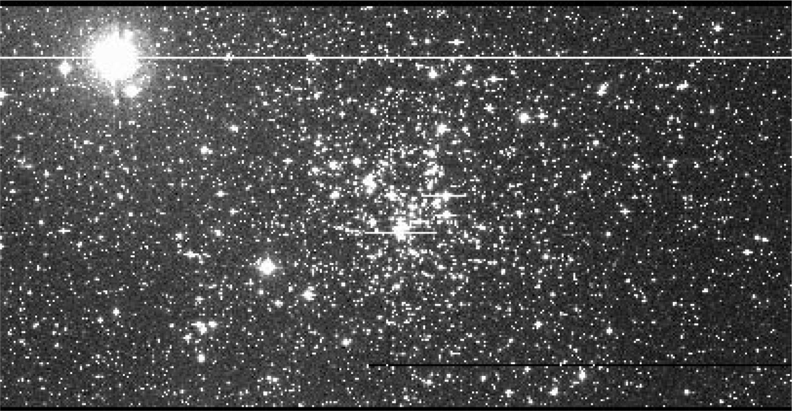
Figure 1. An example frame from the int data set showing the centre of NGC 6819. North is to the top of the image while ...
Notes:
Figure 1. An example frame from the int data set showing the centre of NGC 6819. North is to the top of the image while east to the left.
Unless provided in the caption above, the following copyright applies to the content of this slide: © 2002 RAS

Slide 3
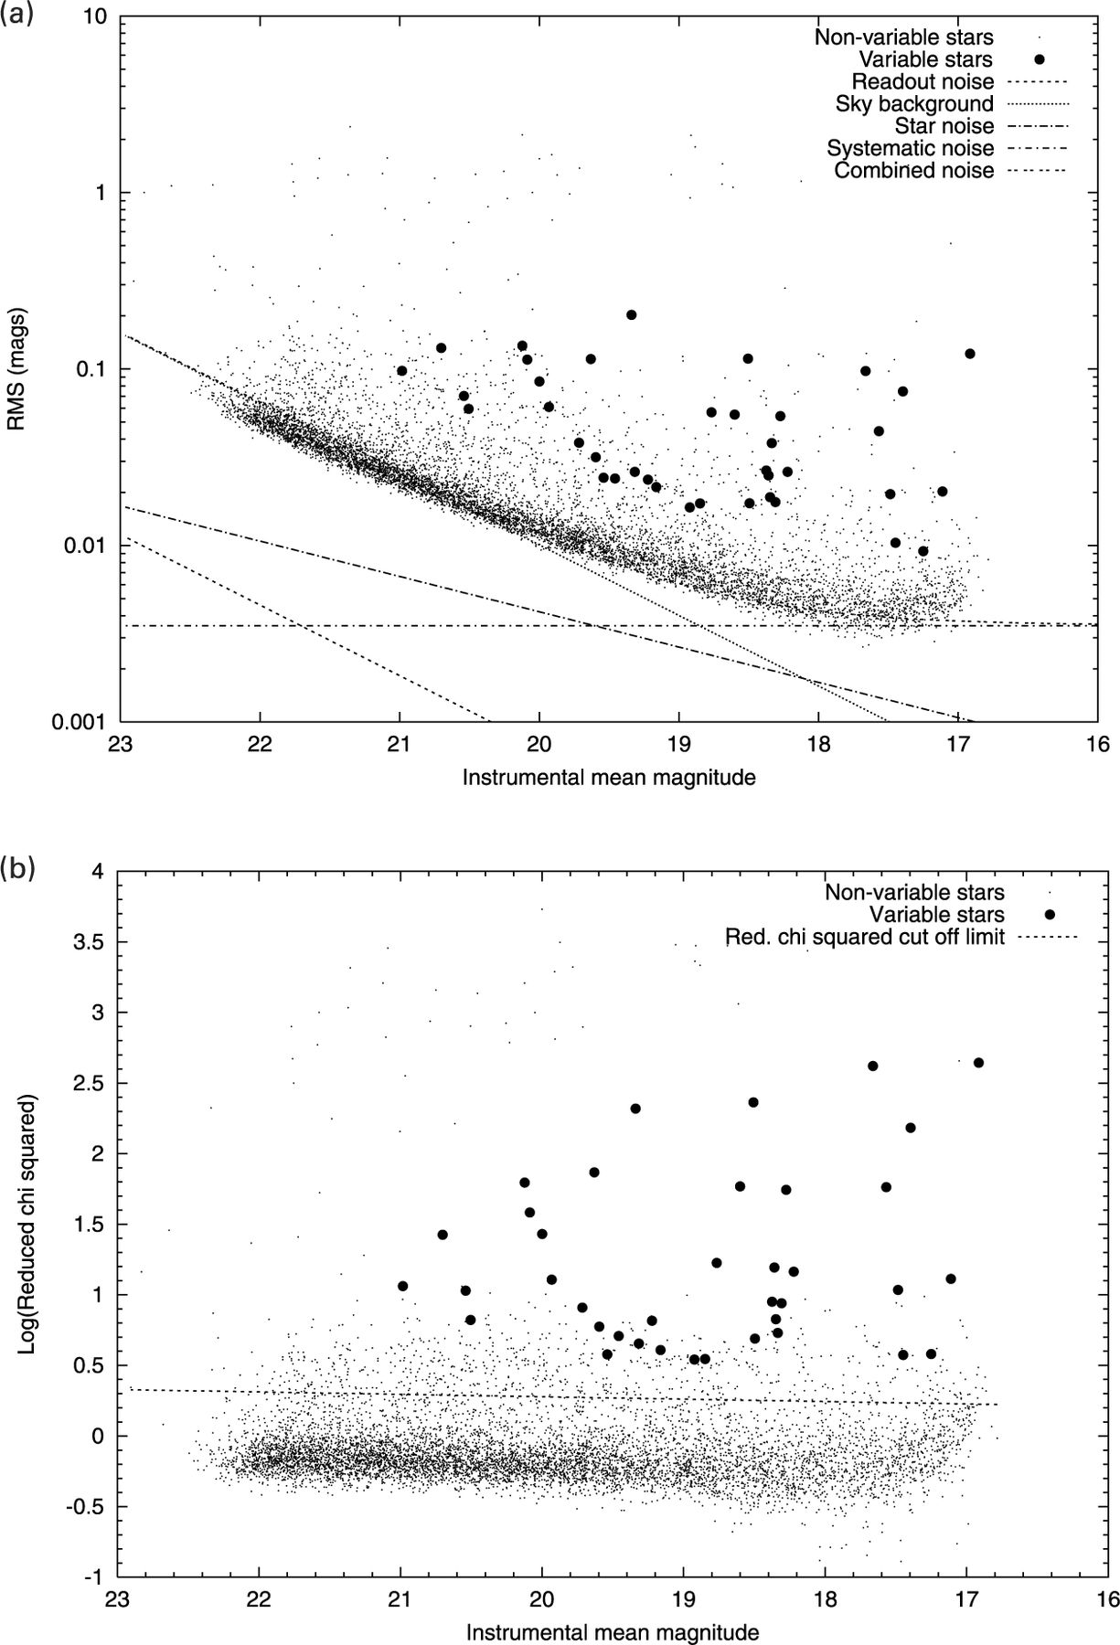
Figure 2. The variation of rms scatter and with instrumental mean magnitude.
Notes:
Figure 2. The variation of rms scatter and with instrumental mean magnitude.
Unless provided in the caption above, the following copyright applies to the content of this slide: © 2002 RAS

Slide 4
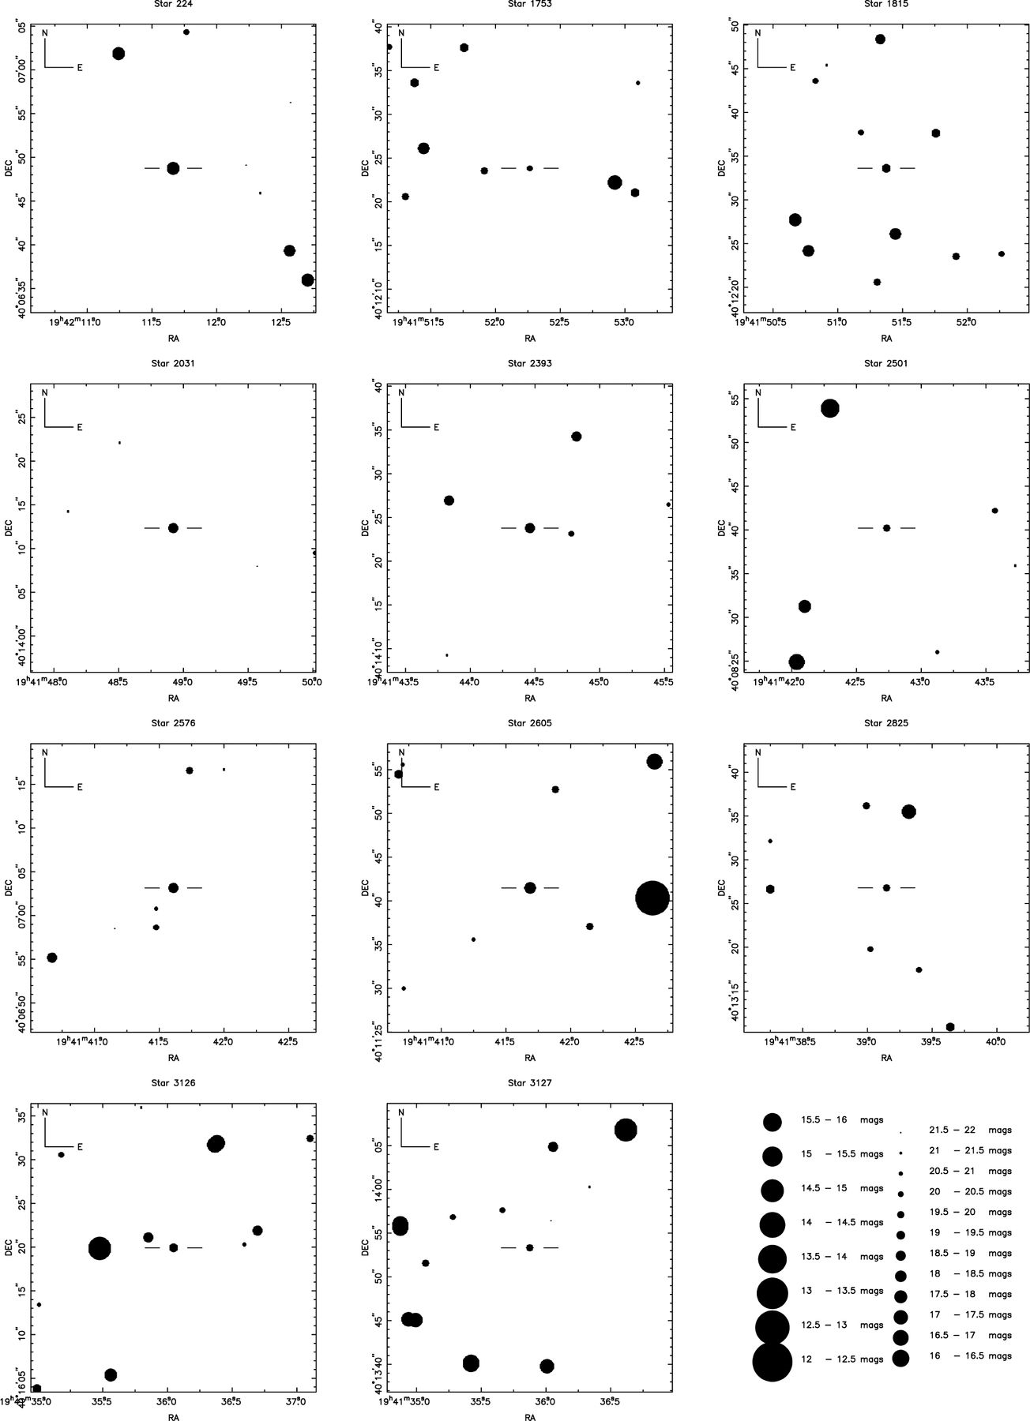
Figure 12. Finder charts for the variable stars in numerical order.
Notes:
Figure 12. Finder charts for the variable stars in numerical order.
Unless provided in the caption above, the following copyright applies to the content of this slide: © 2002 RAS

Slide 5
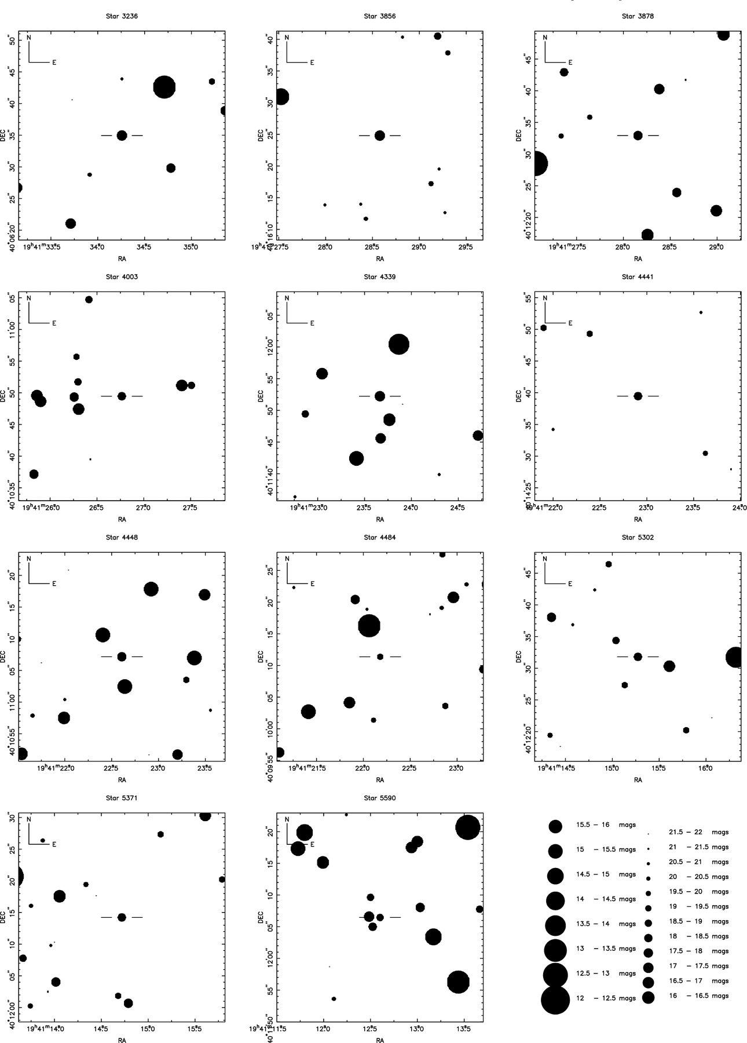
Figure 13. Finder charts for the variable stars in numerical order.
Notes:
Figure 13. Finder charts for the variable stars in numerical order.
Unless provided in the caption above, the following copyright applies to the content of this slide: © 2002 RAS

Slide 6
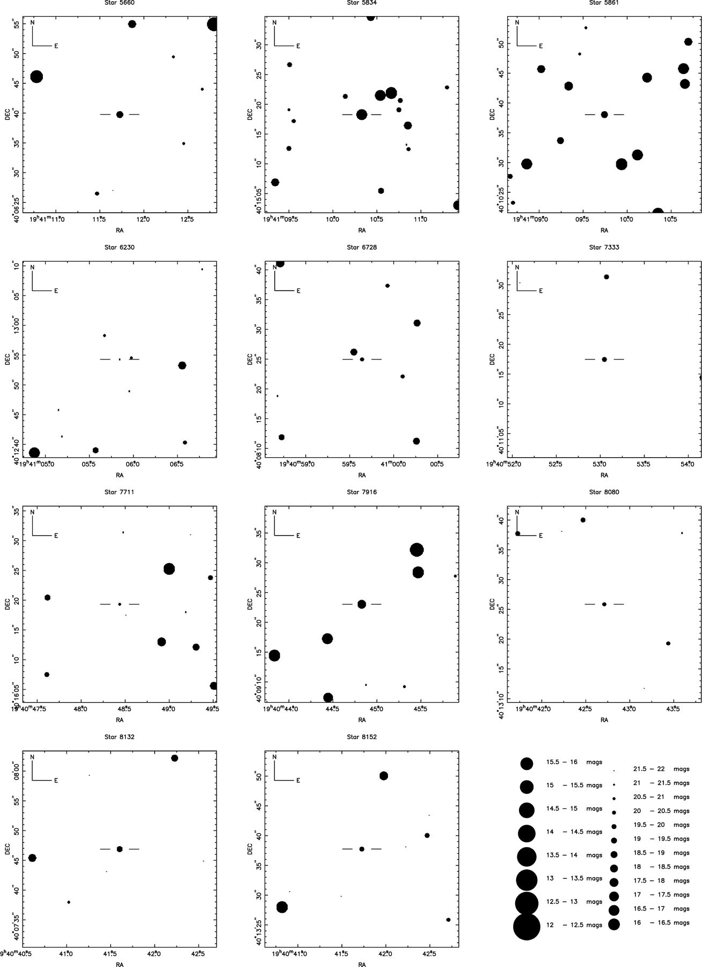
Figure 14. Finder charts for the variable stars in numerical order.
Notes:
Figure 14. Finder charts for the variable stars in numerical order.
Unless provided in the caption above, the following copyright applies to the content of this slide: © 2002 RAS

Slide 7
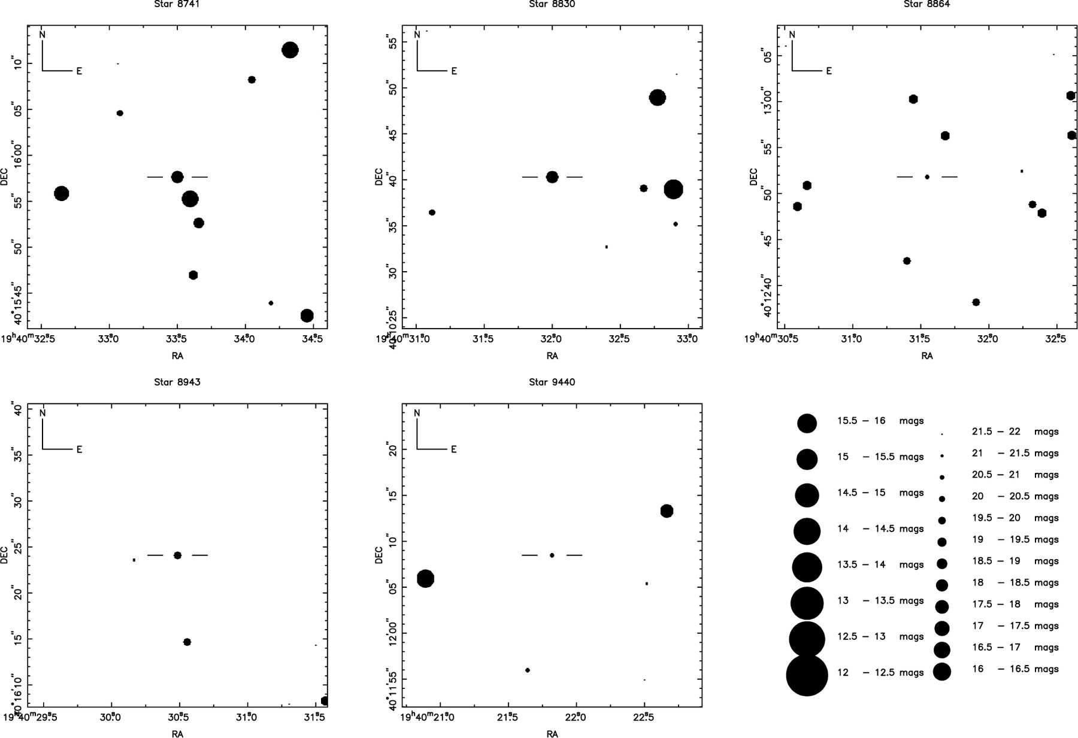
Figure 15. Finder charts for the variable stars in numerical order.
Notes:
Figure 15. Finder charts for the variable stars in numerical order.
Unless provided in the caption above, the following copyright applies to the content of this slide: © 2002 RAS

Slide 8
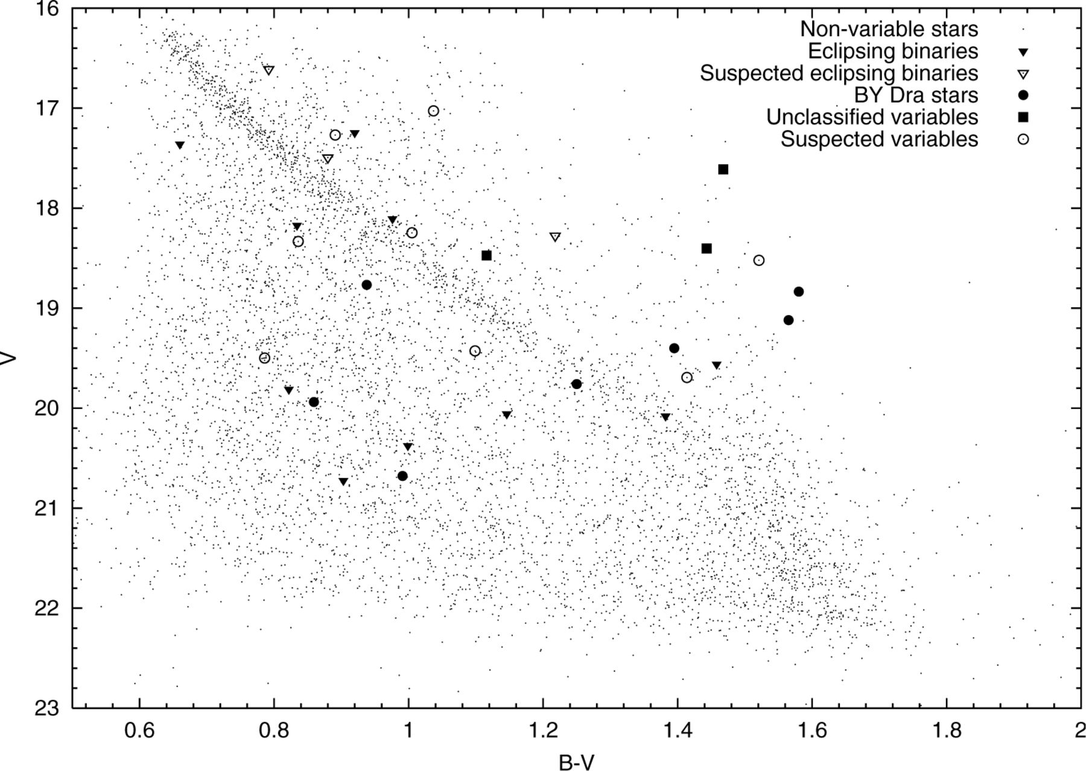
Figure 3. Colour–magnitude diagram of the field of NGC 6819 highlighting the positions of the variables.
Notes:
Figure 3. Colour–magnitude diagram of the field of NGC 6819 highlighting the positions of the variables.
Unless provided in the caption above, the following copyright applies to the content of this slide: © 2002 RAS

Slide 9
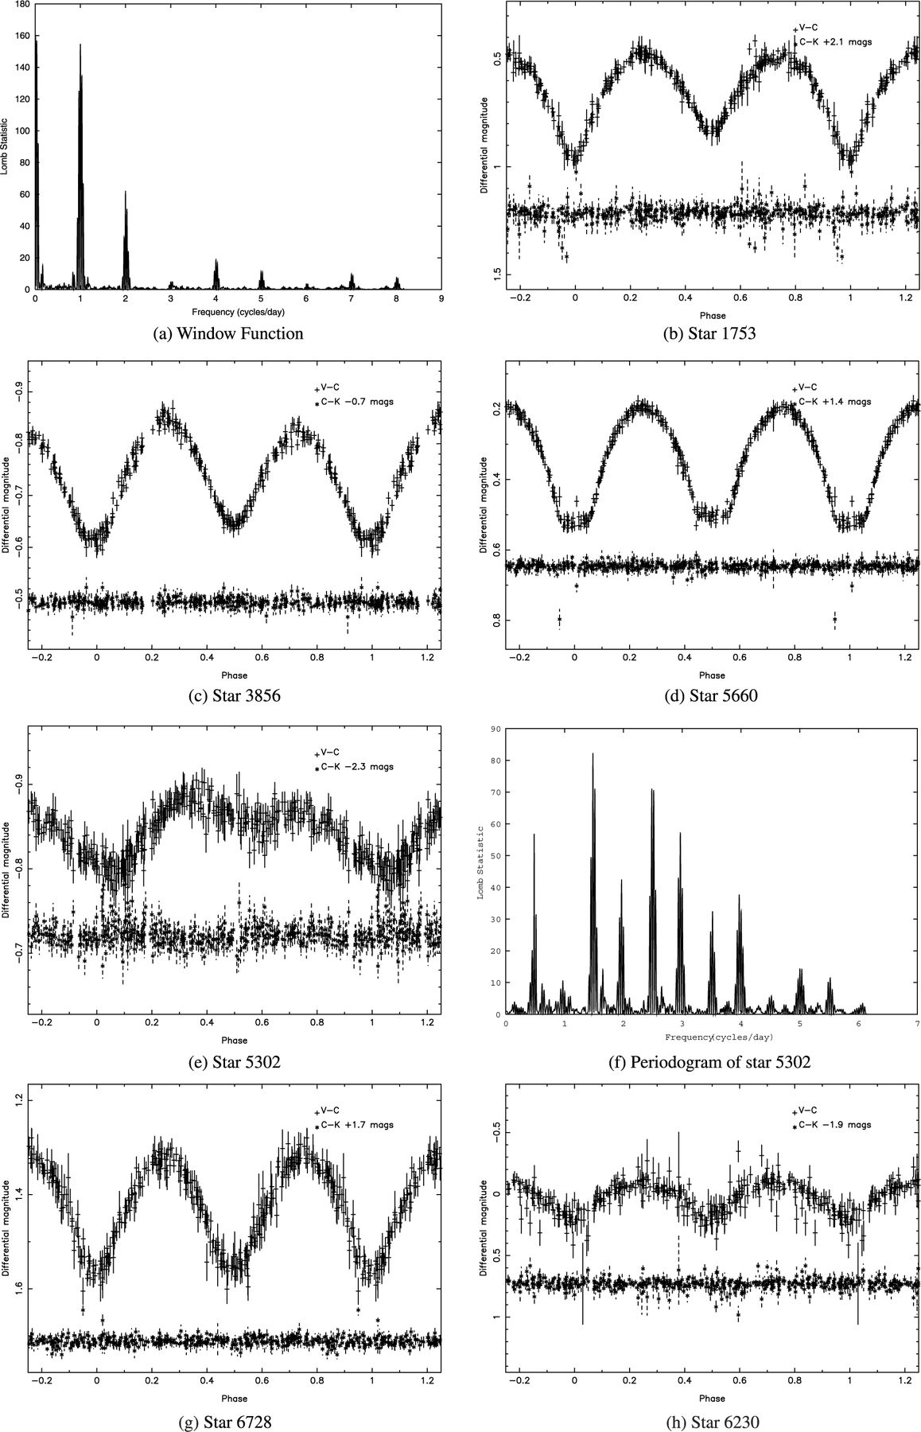
Figure 4. Phased light curves for eclipsing binary systems and the window function for the INT observations.
Notes:
Figure 4. Phased light curves for eclipsing binary systems and the window function for the INT observations.
Unless provided in the caption above, the following copyright applies to the content of this slide: © 2002 RAS

Slide 10
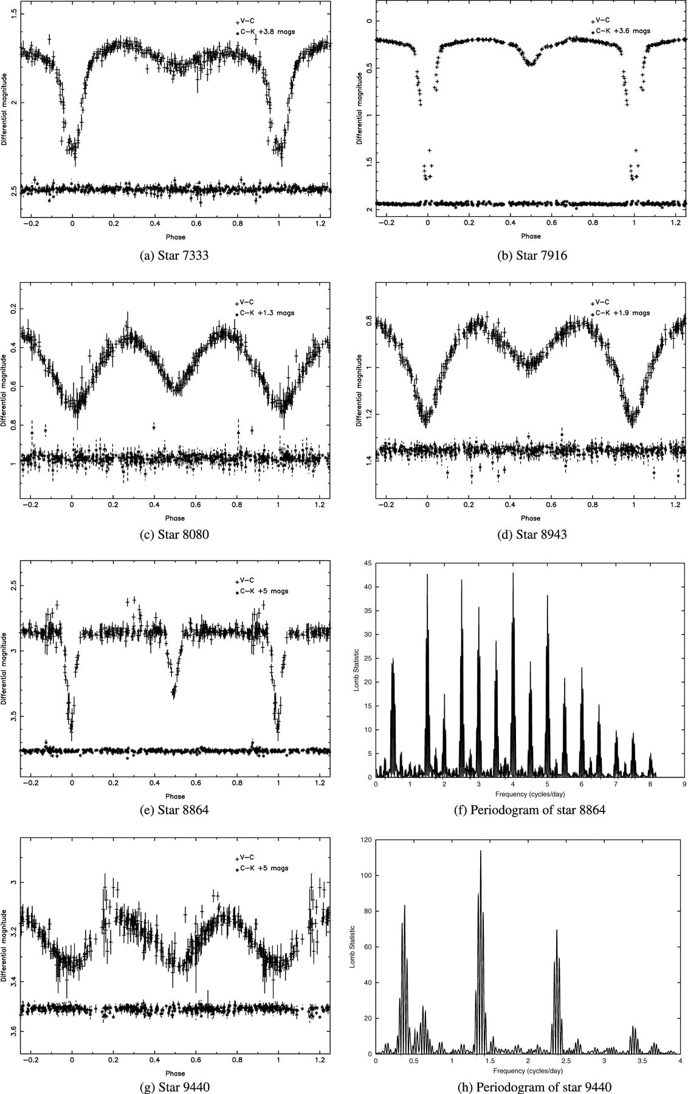
Figure 5. Phased light curves for eclipsing binary systems.
Notes:
Figure 5. Phased light curves for eclipsing binary systems.
Unless provided in the caption above, the following copyright applies to the content of this slide: © 2002 RAS

Slide 11
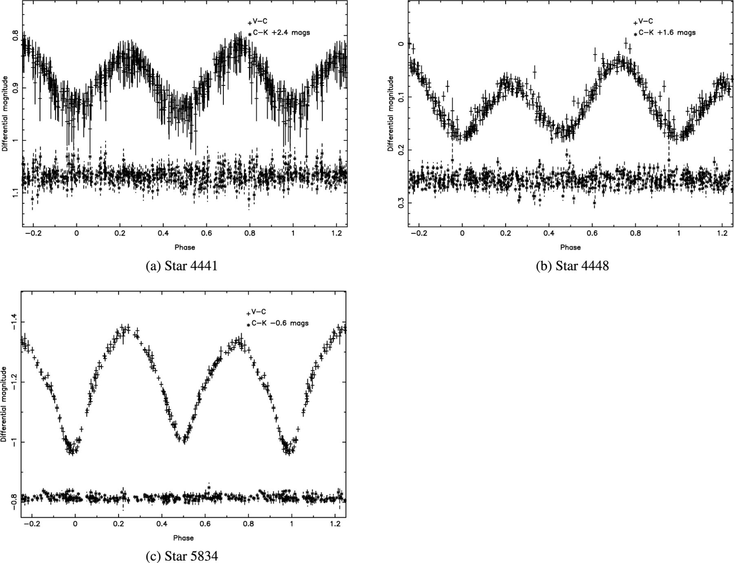
Figure 6. Suspected eclipsing binary systems.
Notes:
Figure 6. Suspected eclipsing binary systems.
Unless provided in the caption above, the following copyright applies to the content of this slide: © 2002 RAS

Slide 12
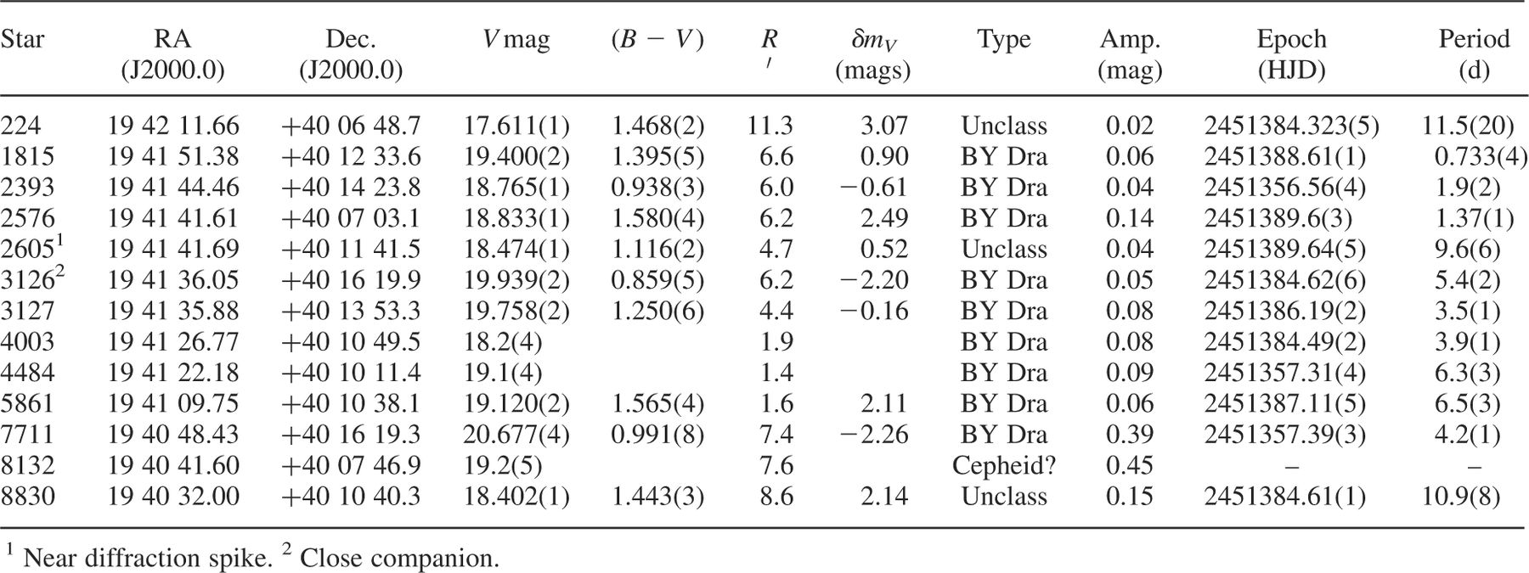
Table 3. Details of BY Dra and unclassified systems. The error on the last decimal place is given in brackets.
Notes:
Table 3. Details of BY Dra and unclassified systems. The error on the last decimal place is given in brackets.
Unless provided in the caption above, the following copyright applies to the content of this slide: © 2002 RAS

Slide 13
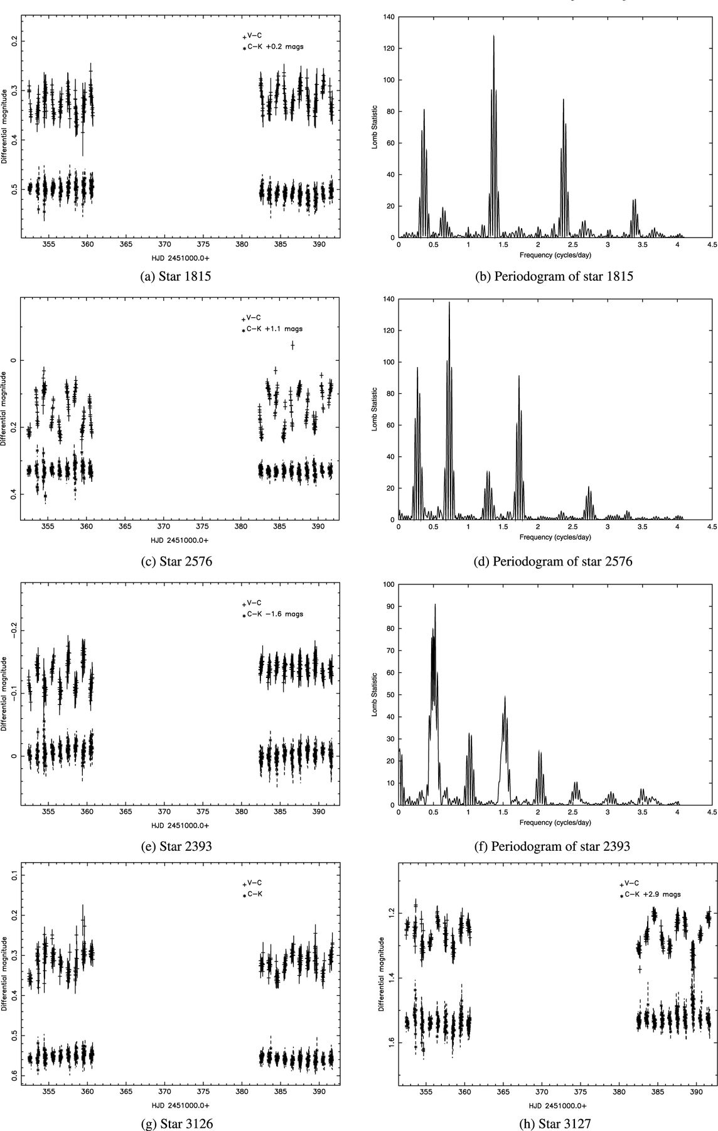
Figure 7. Light curves of the BY Dra systems.
Notes:
Figure 7. Light curves of the BY Dra systems.
Unless provided in the caption above, the following copyright applies to the content of this slide: © 2002 RAS

Slide 14
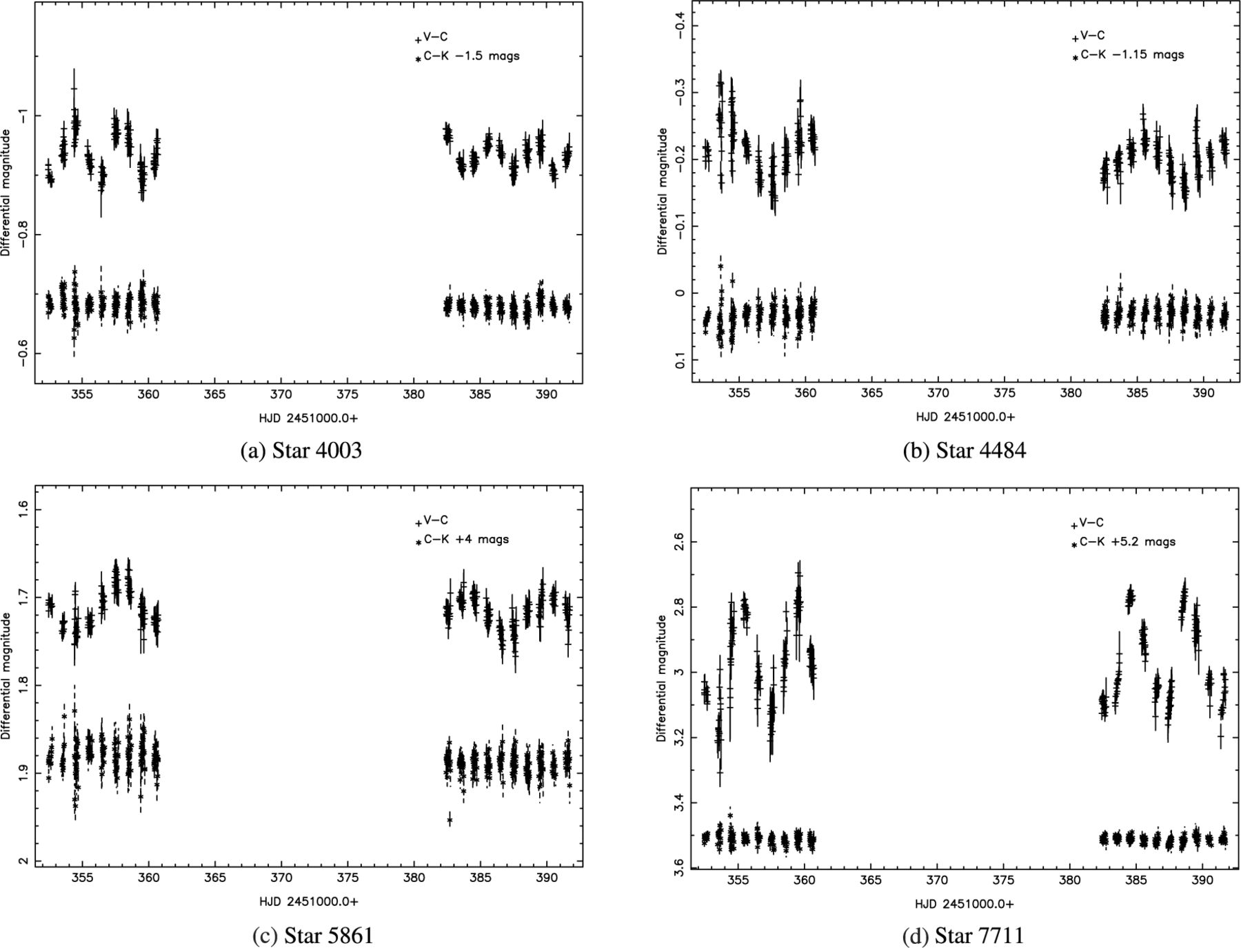
Figure 8. Light curves of the BY Dra systems.
Notes:
Figure 8. Light curves of the BY Dra systems.
Unless provided in the caption above, the following copyright applies to the content of this slide: © 2002 RAS

Slide 15
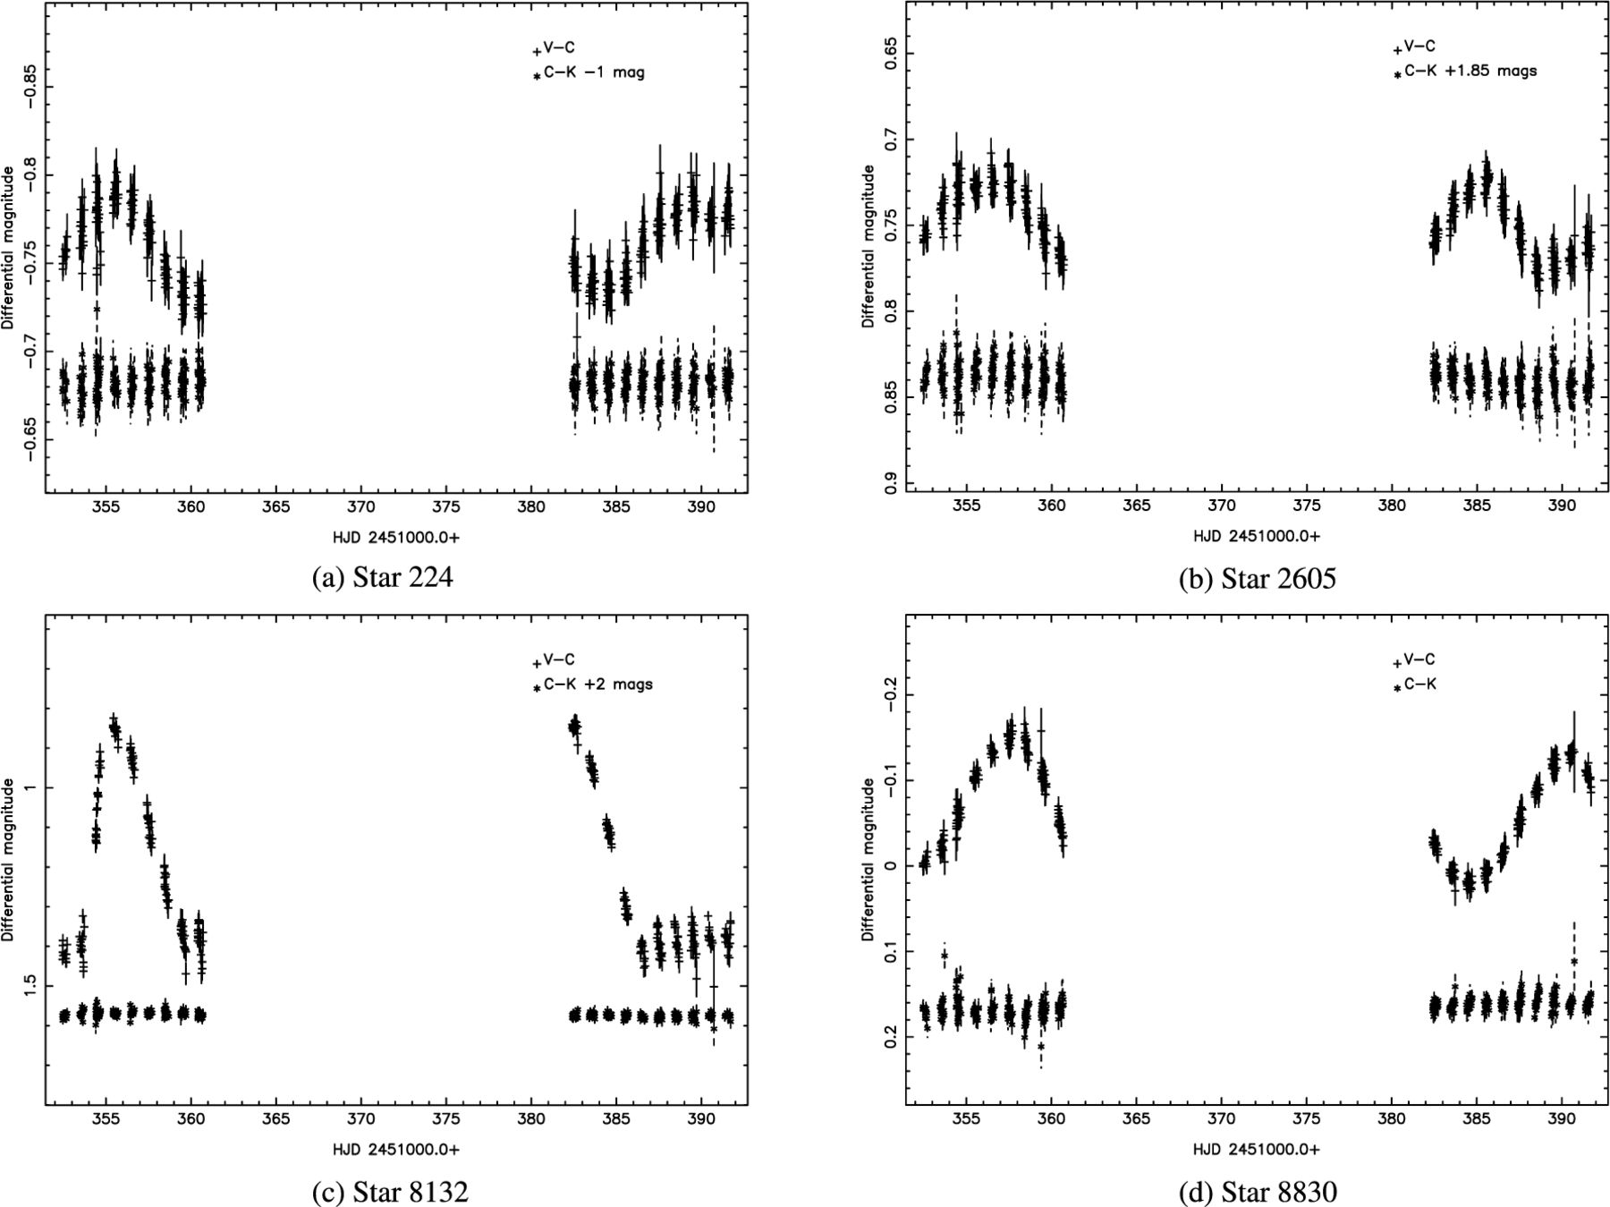
Figure 9. Light curves of the unclassified variable stars.
Notes:
Figure 9. Light curves of the unclassified variable stars.
Unless provided in the caption above, the following copyright applies to the content of this slide: © 2002 RAS

Slide 16
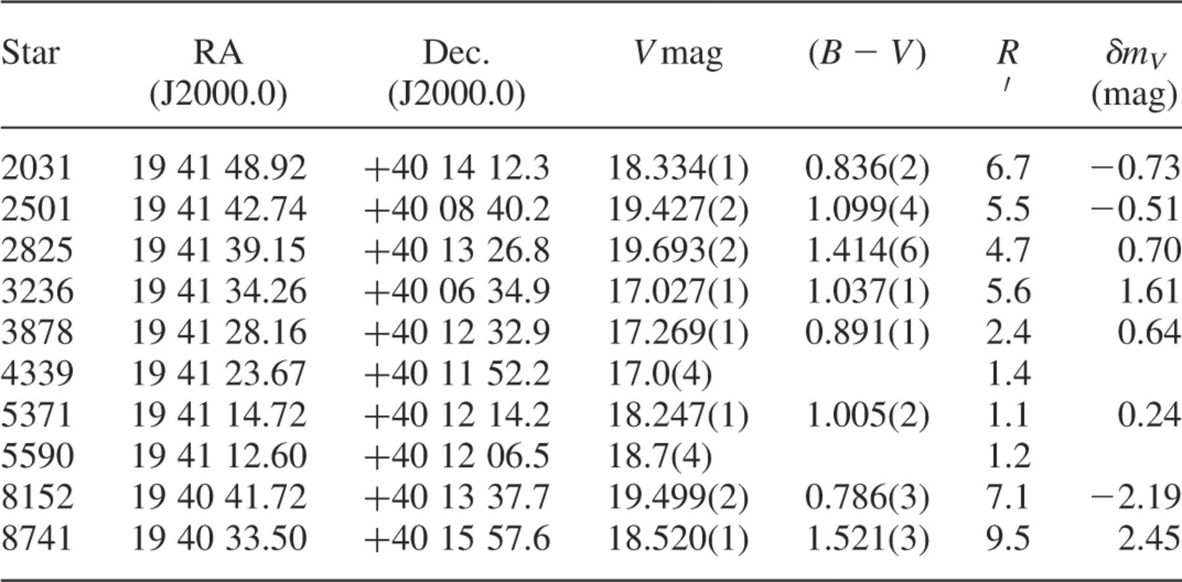
Table 4. Details of suspected variable stars. The error on the last decimal place is given in brackets.
Notes:
Table 4. Details of suspected variable stars. The error on the last decimal place is given in brackets.
Unless provided in the caption above, the following copyright applies to the content of this slide: © 2002 RAS

Slide 17
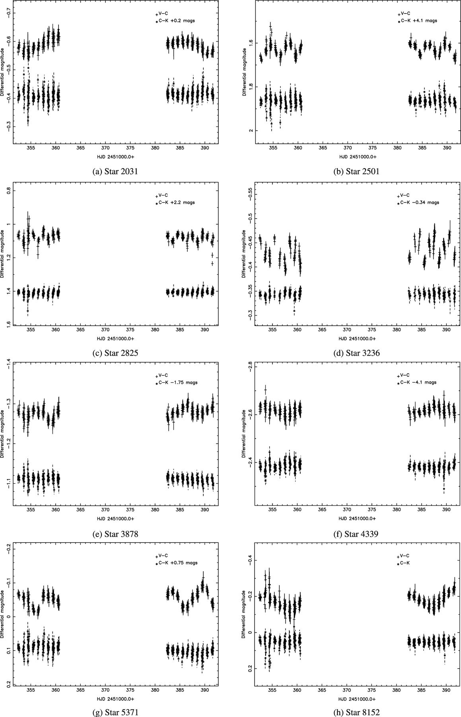
Figure 10. Light curves of the suspected variable stars.
Notes:
Figure 10. Light curves of the suspected variable stars.
Unless provided in the caption above, the following copyright applies to the content of this slide: © 2002 RAS

Slide 18
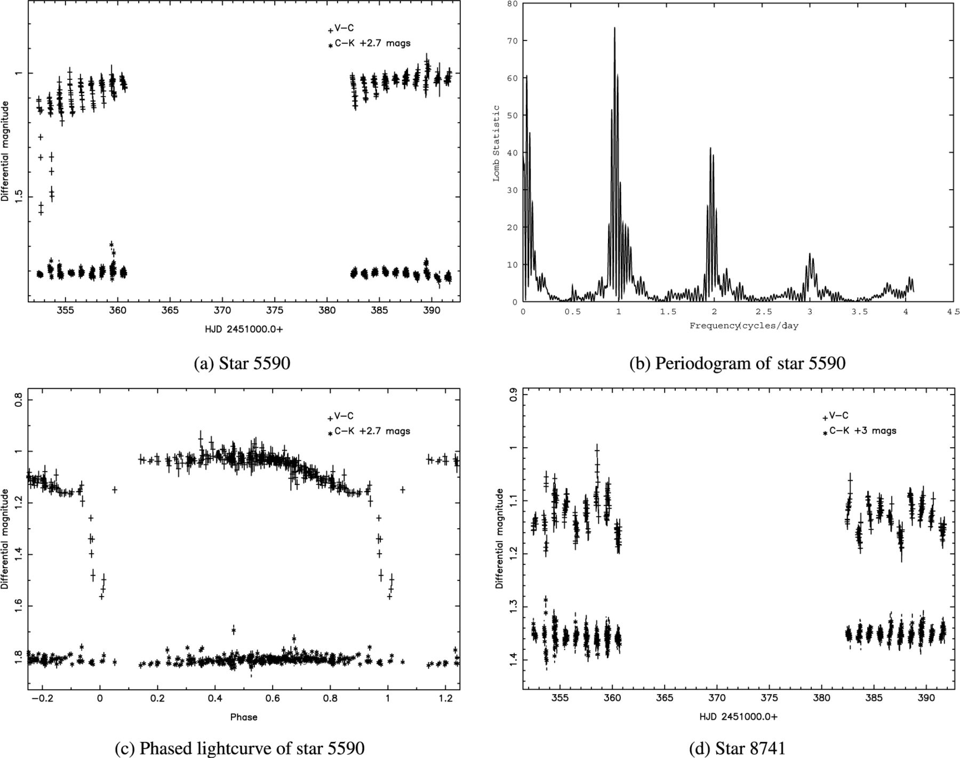
Figure 11. Light curves of the suspected variable stars.
Notes:
Figure 11. Light curves of the suspected variable stars.
Unless provided in the caption above, the following copyright applies to the content of this slide: © 2002 RAS

