Slide 1
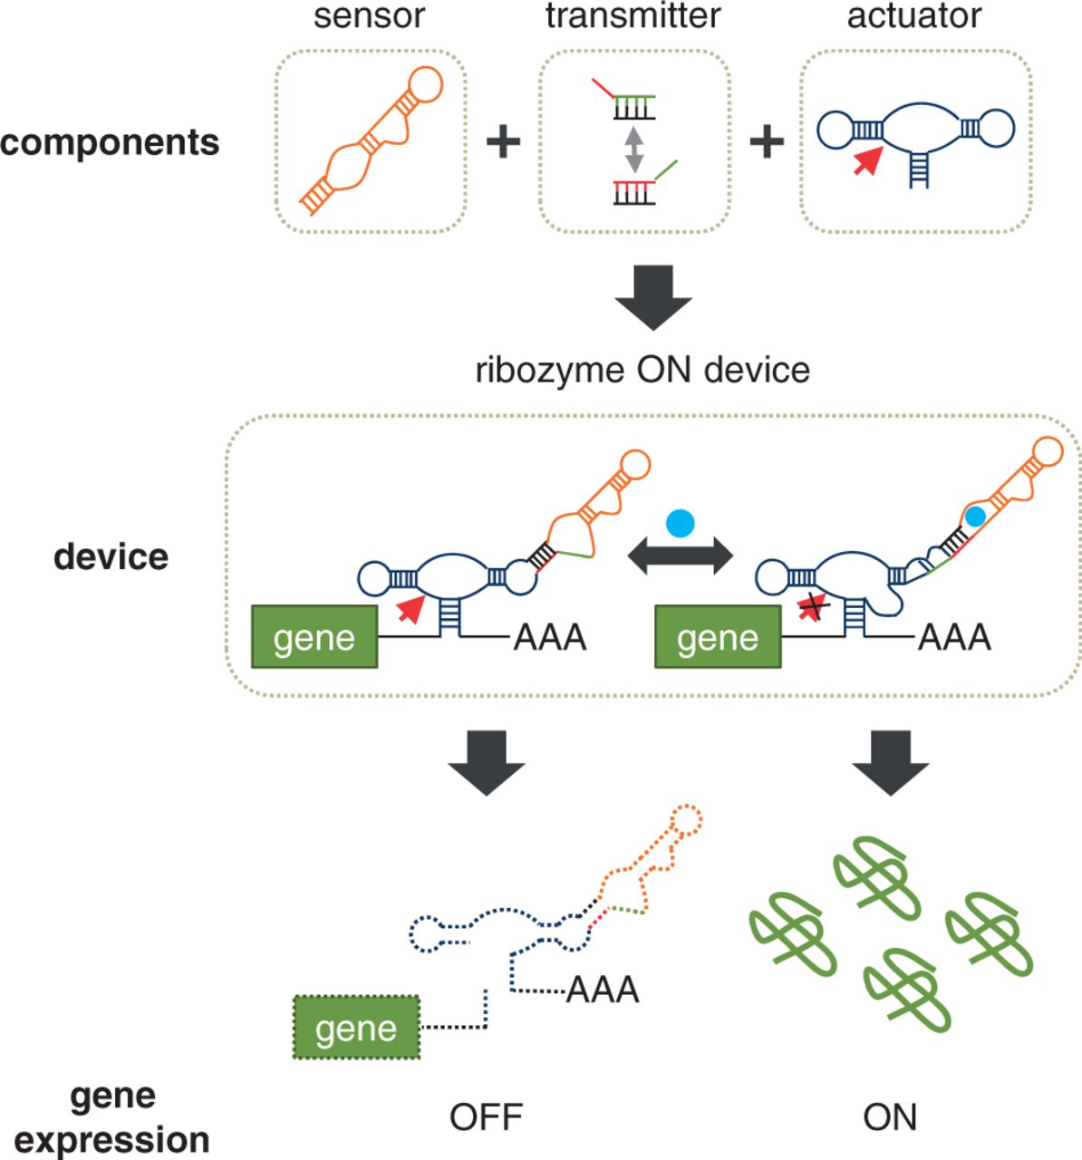
Figure 1. Schematic representation of modular assembly and mechanism of an RNA control device based on a ribozyme ...
Notes:
Figure 1. Schematic representation of modular assembly and mechanism of an RNA control device based on a ribozyme actuator. Ribozyme-based devices are constructed by modular assembly of three functional RNA components. A sensor (RNA aptamer) is linked to an actuator (hammerhead ribozyme) through a distinct information transmitter sequence (which directs a strand-displacement event and insulates the sensor and actuator components). Ribozyme-based devices are integrated into the 3′ untranslated region of the target gene and can adopt at least two functional device conformations, where each conformation is associated with different actuator and sensor activities. In the depicted example, a ribozyme ON device (upregulation of gene expression in response to increased input ligand concentration) adopts a ribozyme-active conformation associated with an aptamer ligand-unbound state, where ribozyme cleavage results in an unprotected transcript that is subject to rapid degradation by ribonucleases, thereby leading to a decrease in gene expression. The ribozyme-inactive conformation is associated with an aptamer ligand-bound state, such that ligand binding to the aptamer stabilizes the ribozyme-inactive conformation, thereby leading to an increase in gene expression in response to ligand.
Unless provided in the caption above, the following copyright applies to the content of this slide: © The Author(s) 2012. Published by Oxford University Press.This is an Open Access article distributed under the terms of the Creative Commons Attribution Non-Commercial License (http://creativecommons.org/licenses/by-nc/3.0), which permits unrestricted non-commercial use, distribution, and reproduction in any medium, provided the original work is properly cited.

Slide 2
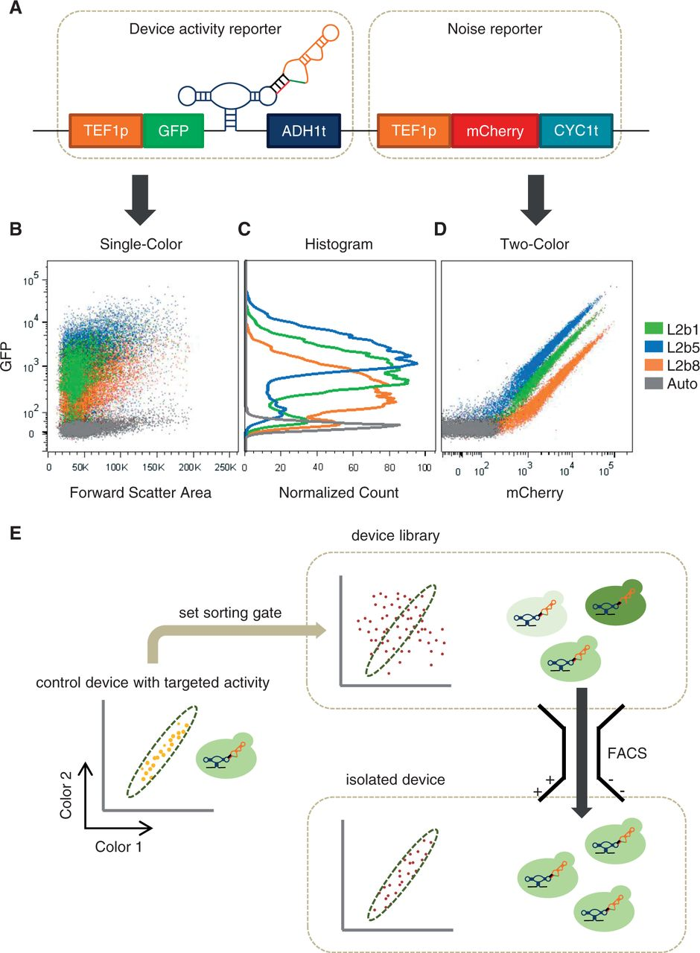
Figure 2. A high-efficiency, quantitative cell-based screening strategy for genetic devices based on a two-color ...
Notes:
Figure 2. A high-efficiency, quantitative cell-based screening strategy for genetic devices based on a two-color screening construct. ( A ) The two-color screening construct is composed of two independent activity reporters. The device activity reporter measures the gene-regulatory activity associated with the device from GFP fluorescence, whereas the noise reporter measures the variation in cellular gene expression level that is independent of the regulatory device from mCherry fluorescence. ( B ) Single-color (GFP) scatter plots of three ribozyme-based devices that span a wide range of gene-regulatory activities, as measured by their mean values, and cellular autofluorescence from a construct containing no fluorescence reporter gene exhibit significant overlap due to noise associated with gene expression. ( C ) Single-color (GFP) histograms illustrate that isolation of a device with a specific gene-regulatory activity based on a single reporter output is inefficient due to overlapping population distributions. ( D ) The gene expression levels of individual cells can be normalized by correlating the device and noise reporter outputs from the two-color screening construct. Cell populations harboring the three ribozyme-based devices in (B) can be cleanly resolved on a two-color scatter plot, where each population exhibits a tight linear relationship between the two outputs. ( E ) The two-color screening strategy is based on the output correlation between the two reporter modules. A library of control devices can be integrated in the two-color screening construct and transformed into the target cell host. The sorting gate is set by the two-color correlation (slope) associated with a control device that exhibits a target gene-regulatory activity and applied to the library to specifically isolate a cell population that exhibits similar activity (slope).
Unless provided in the caption above, the following copyright applies to the content of this slide: © The Author(s) 2012. Published by Oxford University Press.This is an Open Access article distributed under the terms of the Creative Commons Attribution Non-Commercial License (http://creativecommons.org/licenses/by-nc/3.0), which permits unrestricted non-commercial use, distribution, and reproduction in any medium, provided the original work is properly cited.

Slide 3
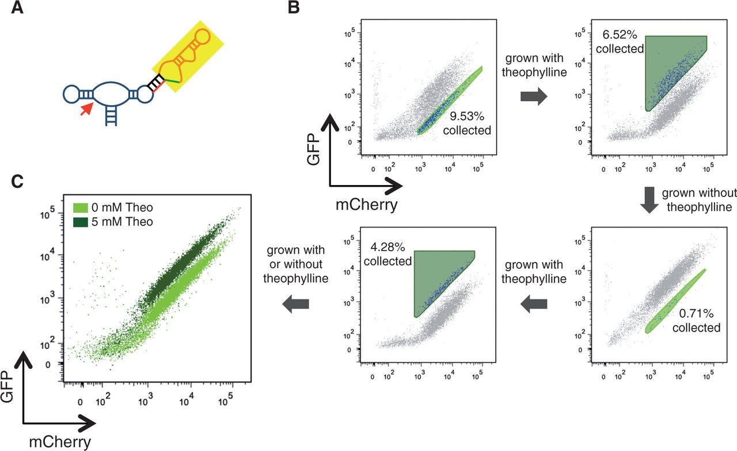
Figure 3. Screening of a sensor library within the device platform demonstrates the high enrichment efficiency of the ...
Notes:
Figure 3. Screening of a sensor library within the device platform demonstrates the high enrichment efficiency of the two-color sorting strategy. ( A ) A sensor library, sN10, is generated by randomizing 10 nucleotides at key positions within the aptamer component in a previously engineered theophylline-responsive ribozyme-based device, L2b8. ( B ) The sN10 library is subjected to two sorting rounds. Each round consists of one negative sort in the absence of theophylline (light green gate set by the activity of the parent L2b8 device in the absence of theophylline), followed by one positive sort in the presence of theophylline (dark green gate set by the activity of the parent L2b8 device in the presence of 5 mM theophylline). Percentage of cells collected in the sorting gate is indicated on each plot. ( C ) After two sorting rounds, the enriched pool was analysed by flow cytometry in the absence and presence of theophylline (theo). A gate was set by the library population in the absence of theophylline. Upon addition of theophylline, ∼98% of the population within the gate shifted, suggesting that the majority of the population exhibits switching activity.
Unless provided in the caption above, the following copyright applies to the content of this slide: © The Author(s) 2012. Published by Oxford University Press.This is an Open Access article distributed under the terms of the Creative Commons Attribution Non-Commercial License (http://creativecommons.org/licenses/by-nc/3.0), which permits unrestricted non-commercial use, distribution, and reproduction in any medium, provided the original work is properly cited.

Slide 4
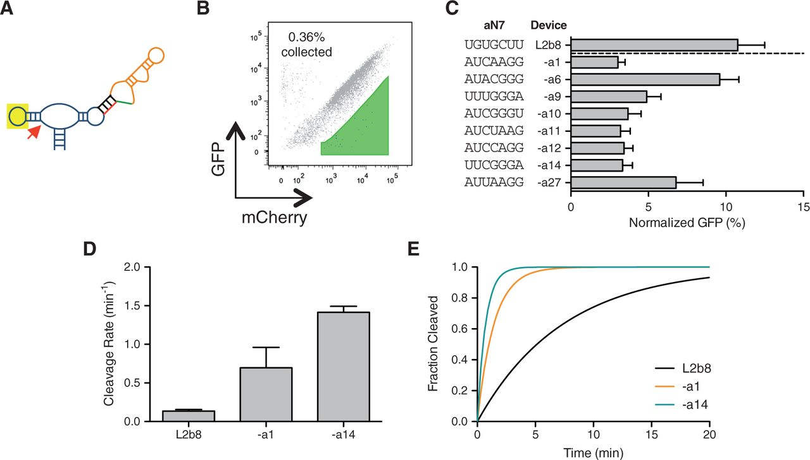
Figure 4. Screening of an actuator library within the device platform results in ribozyme variants that exhibit ...
Notes:
Figure 4. Screening of an actuator library within the device platform results in ribozyme variants that exhibit improved regulatory stringencies and cleavage rates. ( A ) An actuator library, aN7, is generated by randomizing 7 nucleotides at key positions within the loop I region of the ribozyme actuator in the L2b8 device. ( B ) The aN7 library is subjected to a single sort to enrich for devices that exhibit lower basal activities than the parent L2b8 device. The majority (∼99%) of the aN7 library exhibits a greater slope than that of the parent L2b8 device, such that one sort is sufficient to isolate members that exhibit improved regulatory stringency. ( C ) Ribozyme variants isolated from the aN7 library screen exhibit lower basal activities relative to the parent L2b8 device. Gene-regulatory activities are reported as the geometric mean of the GFP fluorescence of the indicated sample normalized to that of a positive control (sTRSV Contl, a noncleaving sTRSV ribozyme with a scrambled core) that is grown under identical ligand conditions and is set to 100%. Reported values are the mean and standard deviation of at least three independent experiments. ( D ) The recovered ribozyme variants (L2b8-al, -a14) exhibit faster in vitro cleavage rates than the parent device (L2b8). Cleavage assays were performed at 37°C with 500 µM MgCl 2 , 100 mM NaCl, 50 mM Tris-HCl (pH 7.5). Cleavage rate constants ( k ) and errors are reported as the mean and standard deviation from at least three independent assays. ( E ) In vitro cleavage kinetics of the ribozyme variants (L2b8-al, -a14) and the parent device (L2b8). The projected cleavage kinetics are generated from the single-exponential equation Ft = F0 + ( F∞ − F0 ) × (1 – e −kt ), setting the fraction cleaved before the start of the reaction ( F0 ) and at reaction endpoint ( F∞ ) to 0 and 1, respectively, and k to the experimentally determined value for each RNA device.
Unless provided in the caption above, the following copyright applies to the content of this slide: © The Author(s) 2012. Published by Oxford University Press.This is an Open Access article distributed under the terms of the Creative Commons Attribution Non-Commercial License (http://creativecommons.org/licenses/by-nc/3.0), which permits unrestricted non-commercial use, distribution, and reproduction in any medium, provided the original work is properly cited.

Slide 5
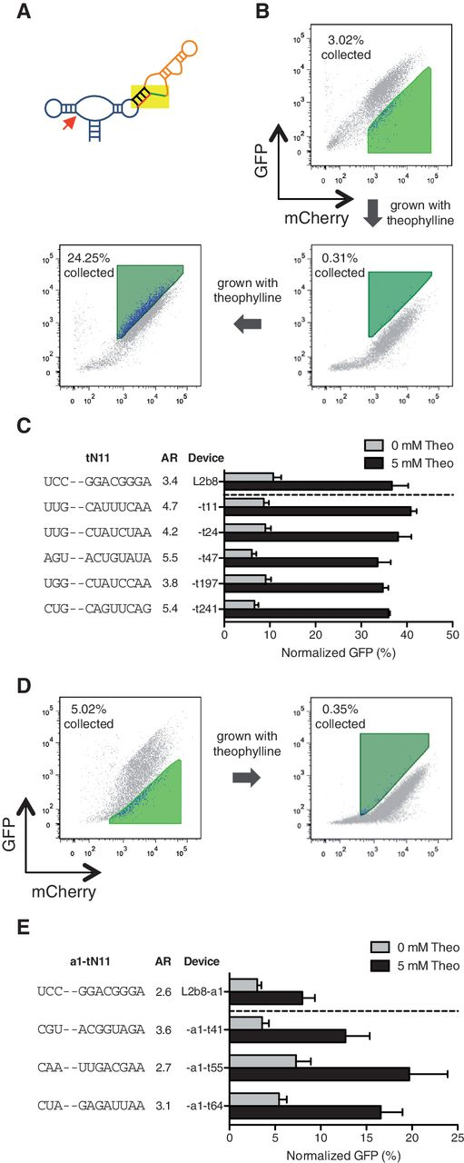
Figure 5. Screening of transmitter libraries within the device platform results in transmitter variants that exhibit ...
Notes:
Figure 5. Screening of transmitter libraries within the device platform results in transmitter variants that exhibit improved activation ratios. ( A ) Two transmitter libraries, tN11 and a1-tN11, are generated by randomizing 11 nucleotides within the transmitter components in the L2b8 (wild-type ribozyme actuator) and L2b8-a1 (enhanced ribozyme actuator) devices, respectively. ( B ) The tN11 library is subjected to one sorting round (negative and positive sort), followed by an additional positive sort to further enrich members of the library that exhibit equal or greater increases in gene-regulatory activities in response to theophylline. The negative (light green) and positive (dark green) sorting gates are set based on the activity of the parent L2b8 device in the absence and presence of 5 mM theophylline, respectively. ( C ) Transmitter variants isolated from the tN11 library screen exhibit improved activation ratios (AR), which are determined as the ratio of gene expression levels in the presence and absence of theophylline (theo). ( D ) The a1-tN11 library is subjected to one sorting round to enrich members of the library that exhibit equal or greater increases in gene-regulatory activities in response to theophylline. The negative (light green) and positive (dark green) sorting gates are set based on the activity of the parent L2b8-a1 device in the absence and presence of 5 mM theophylline, respectively. ( E ) Transmitter variants isolated from the a1-tN11 library screen exhibit improved activation ratios. Gene-regulatory activities are reported as described in Figure 4 C.
Unless provided in the caption above, the following copyright applies to the content of this slide: © The Author(s) 2012. Published by Oxford University Press.This is an Open Access article distributed under the terms of the Creative Commons Attribution Non-Commercial License (http://creativecommons.org/licenses/by-nc/3.0), which permits unrestricted non-commercial use, distribution, and reproduction in any medium, provided the original work is properly cited.

Slide 6
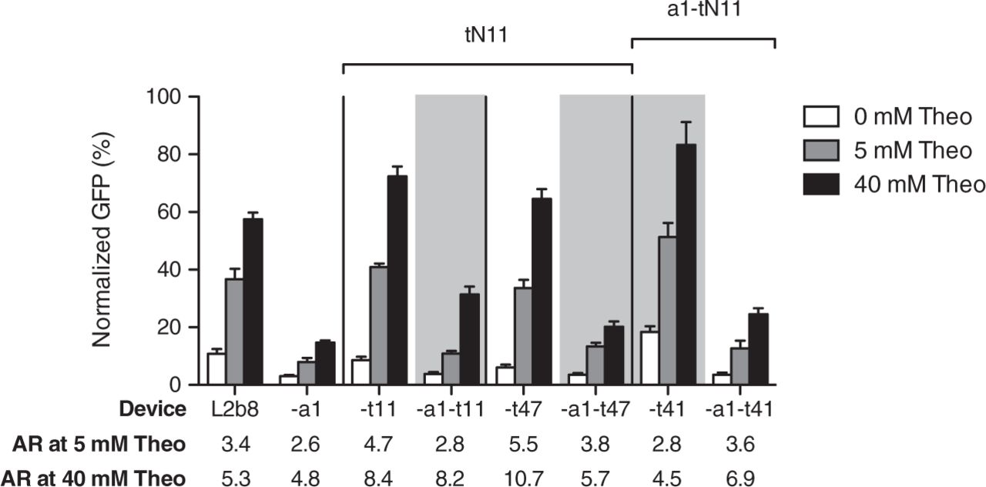
Figure 6. Component swapping demonstrates modularity of actuator components. For devices isolated from the tN11 sort ...
Notes:
Figure 6. Component swapping demonstrates modularity of actuator components. For devices isolated from the tN11 sort (L2b8-t11 and L2b8-t47), replacement of the wild-type actuator loop I sequence with the a1 sequence results in devices exhibiting lower basal activities (shaded). For L2b8-a1-t41, which was isolated from the a1-tN11 sort, replacement of the a1 sequence with the wild-type actuator loop I sequence results in a device exhibiting higher basal activity (shaded). Gene-regulatory activities and activation ratios (AR) are reported as described in Figures 4 C and 5 C, respectively.
Unless provided in the caption above, the following copyright applies to the content of this slide: © The Author(s) 2012. Published by Oxford University Press.This is an Open Access article distributed under the terms of the Creative Commons Attribution Non-Commercial License (http://creativecommons.org/licenses/by-nc/3.0), which permits unrestricted non-commercial use, distribution, and reproduction in any medium, provided the original work is properly cited.

Slide 7
Figure 7. In vitro cleavage kinetics of selected ribozyme-based devices and controls. Cleavage assays were performed at ...
Notes:
Figure 7. In vitro cleavage kinetics of selected ribozyme-based devices and controls. Cleavage assays were performed at 37°C with 500 µM MgCl 2 , 100 mM NaCl and 50 mM Tris-HCl (pH 7.5) and in the presence of 5 mM theophylline when indicated. ( A ) Ribozyme-based devices exhibit decreased cleavage rates in the presence of ligand. Cleavage assays were performed as described in Figure 4 D in the absence or presence of 5 mM theophylline. ( B ) In vitro cleavage kinetics of ribozyme-based devices in the absence and presence of ligand. Projected cleavage kinetics are generated as described in Figure 4 E. Solid lines: 0 mM theophylline; dashed lines: 5 mM theophylline. ( C ) Correlation analysis of normalized gene expression levels and cleavage rate constants indicates a strong correlation between the in vivo gene-regulatory activity and in vitro cleavage rate; Pearson correlation coefficient ( r ) of −0.9018. A semi-log line is well fit ( R2 = 0.94) for cleavage rates less than or equal to 0.16 min -1 (black data points). Devices excluded from this analysis are indicated in red.
Unless provided in the caption above, the following copyright applies to the content of this slide: © The Author(s) 2012. Published by Oxford University Press.This is an Open Access article distributed under the terms of the Creative Commons Attribution Non-Commercial License (http://creativecommons.org/licenses/by-nc/3.0), which permits unrestricted non-commercial use, distribution, and reproduction in any medium, provided the original work is properly cited.

