Slide 1
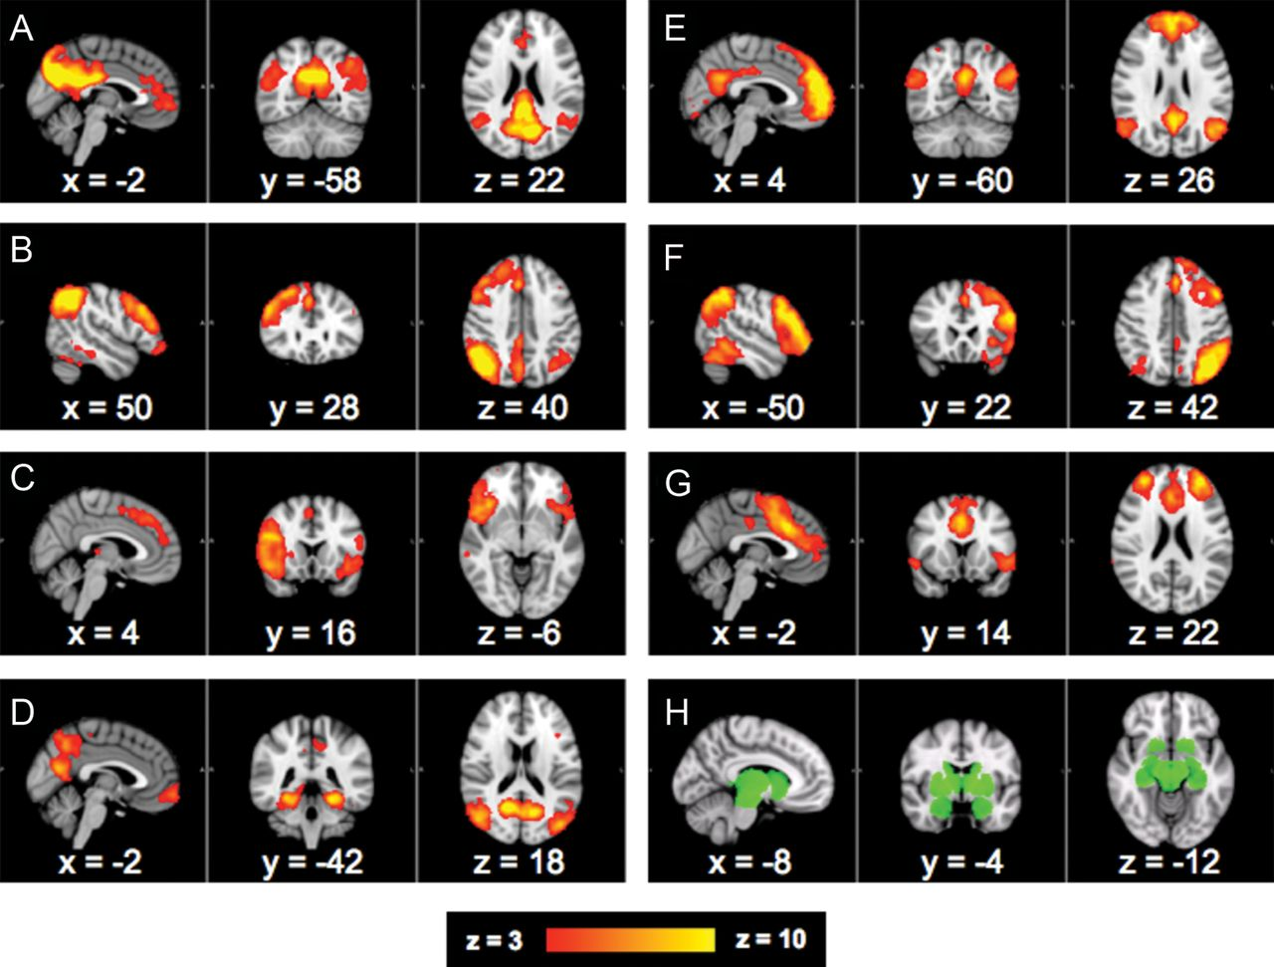
Figure 1. RSNs of interest and group subcortical seed mask. (A–G) Seven RSNs subjected to higher-level post-SBCA ...
Notes:
Figure 1. RSNs of interest and group subcortical seed mask. (A–G) Seven RSNs subjected to higher-level post-SBCA analysis of dopamine-dependent subcortical functional connectivity. (A) Posterocentric DMN, (B) right-lateralized FPN, (C) inferior fronto-insular SEN, (D) hippocampal-parietal/ventral DMN, (E) anterocentric DMN, (F) left-lateralized FPN, and (G) dorsal medial–lateral frontal SEN. (H) Subcortical mask used in higher-level analyses. Axial and coronal slices are presented in radiological orientation (left = right).
Unless provided in the caption above, the following copyright applies to the content of this slide: © The Author 2012. Published by Oxford University Press. All rights reserved. For Permissions, please e-mail: journals.permissions@oup.com

Slide 2
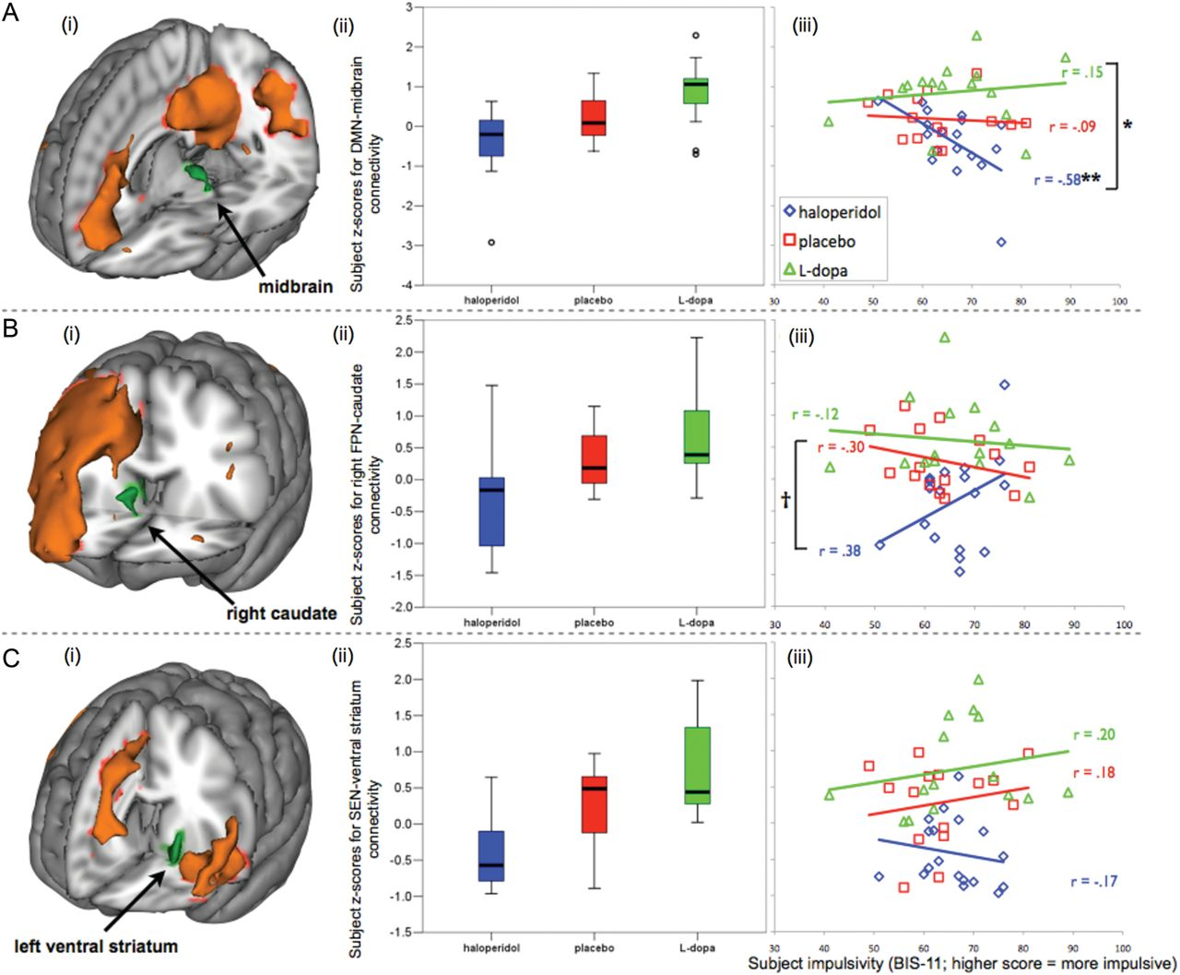
Figure 2. Significant linear effects of antagonistic (haloperidol) and agonistic (l-dopa) dopaminergic neuromodulation ...
Notes:
Figure 2. Significant linear effects of antagonistic (haloperidol) and agonistic (l-dopa) dopaminergic neuromodulation on cortico-subcortical RSN functional connectivity and correlations with subject BIS-11 impulsivity scores. (A) (i) DMN-midbrain connectivity shows (ii) a linear effect (t > 2.3, P placebo > haloperidol), which (iii) is negatively correlated with impulsivity within the haloperidol group, differentially to within the l-dopa group. (B) (i) Right FPN-caudate connectivity shows (ii) a similar linear effect and (iii) a trend toward an opposite relationship with impulsivity to the DMN-midbrain result. (C) (i) SEN-ventral striatum connectivity shows (ii) the same linear drug effect but (iii) no significant interaction with impulsivity. Left panels: RSNs presented in orange and subcortical regions in green. Centre panels: box plots represent mean connectivity scores (±95% confidence intervals) for each drug group. Right panels: **significant within-group correlation with impulsivity (P < 0.05); *significant difference between 2 correlation coefficients (P < 0.05); and †near-significant trend toward difference between coefficients (P < 0.07).
Unless provided in the caption above, the following copyright applies to the content of this slide: © The Author 2012. Published by Oxford University Press. All rights reserved. For Permissions, please e-mail: journals.permissions@oup.com

