Slide 1
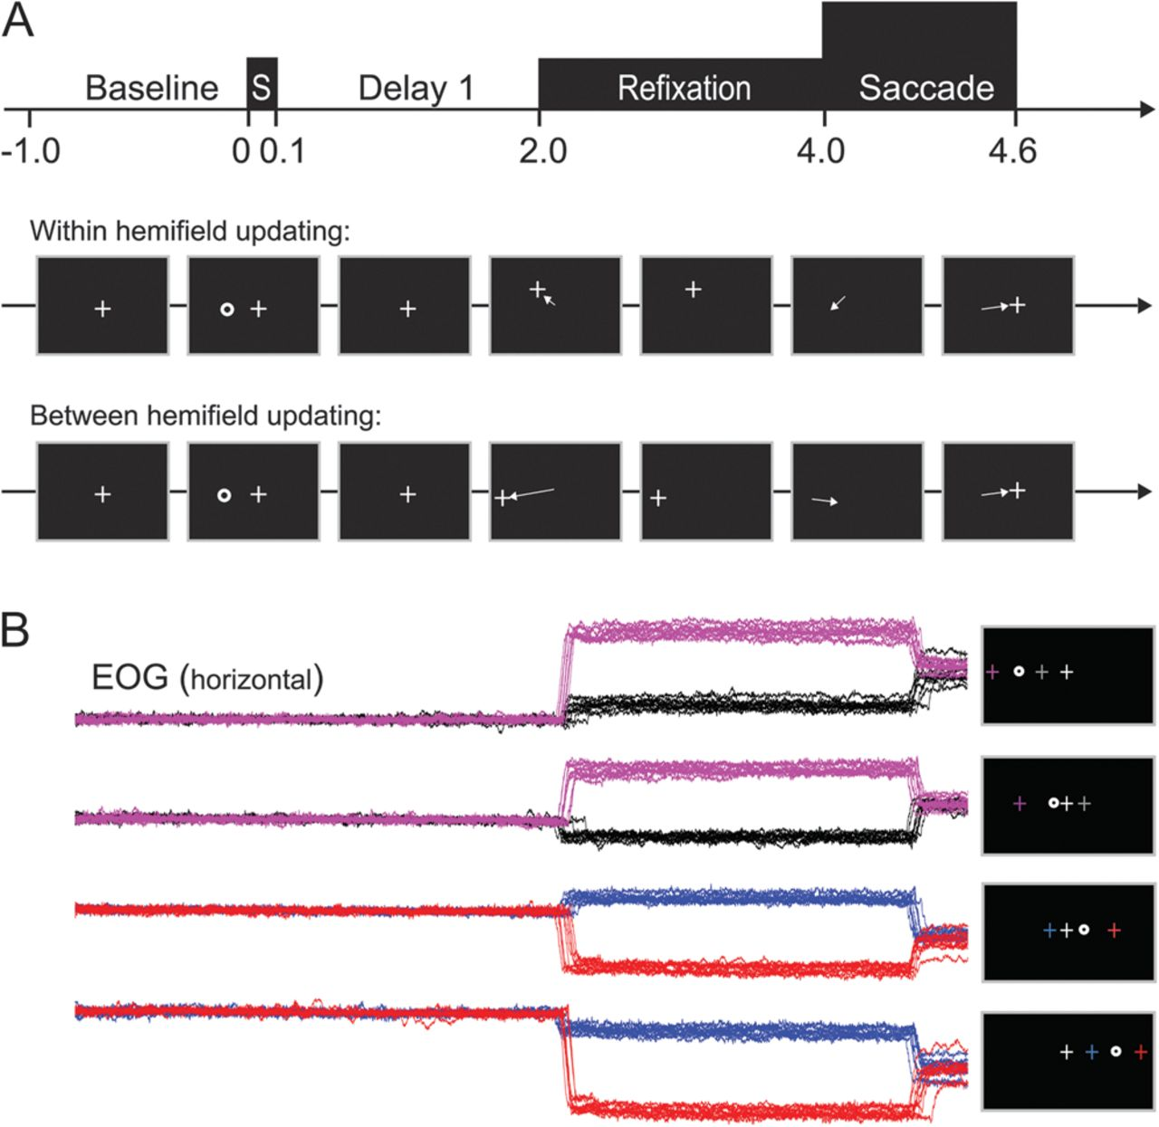
Figure 1. Experimental design. (A) Trial timing. Each trial started with a baseline period of 1 s, during which ...
Notes:
Figure 1. Experimental design. (A) Trial timing. Each trial started with a baseline period of 1 s, during which subjects were instructed to fixate a centrally presented fixation cross. Next, a stimulus was presented for 0.1 s, randomly right or left of central fixation, followed by a 2-s delay period (first delay). The second delay started with the relocation of the fixation cross unpredictably to the left or right of the remembered target location, shortly followed by the subject's gaze. Due to the intervening saccade, the remembered stimulus location remained either in the same or shifted to the opposite visual hemifield. After another 2 s delay, the new fixation cross disappeared, signaling the subject to make an eye movement to the remembered target location. Reappearance of the central fixation cross signaled the start of a new trial. (B) Four different trial types could be distinguished, depending on the remembered location of the target relative to gaze before and after the intervening saccade. Corresponding EOG traces for each trial type are presented at the bottom, grouped together based on the position of the flashed stimulus. Schematic representations of the 2 possible refixation positions (colored), the stimulus position (circle), and the central fixation cross (white cross) are presented in the right-hand panels, with the colors of the refixation crosses matching the color of the associated EOG trace.
Unless provided in the caption above, the following copyright applies to the content of this slide: © The Author 2012. Published by Oxford University Press. All rights reserved. For permissions, please e-mail: journals.permissions@oup.com

Slide 2
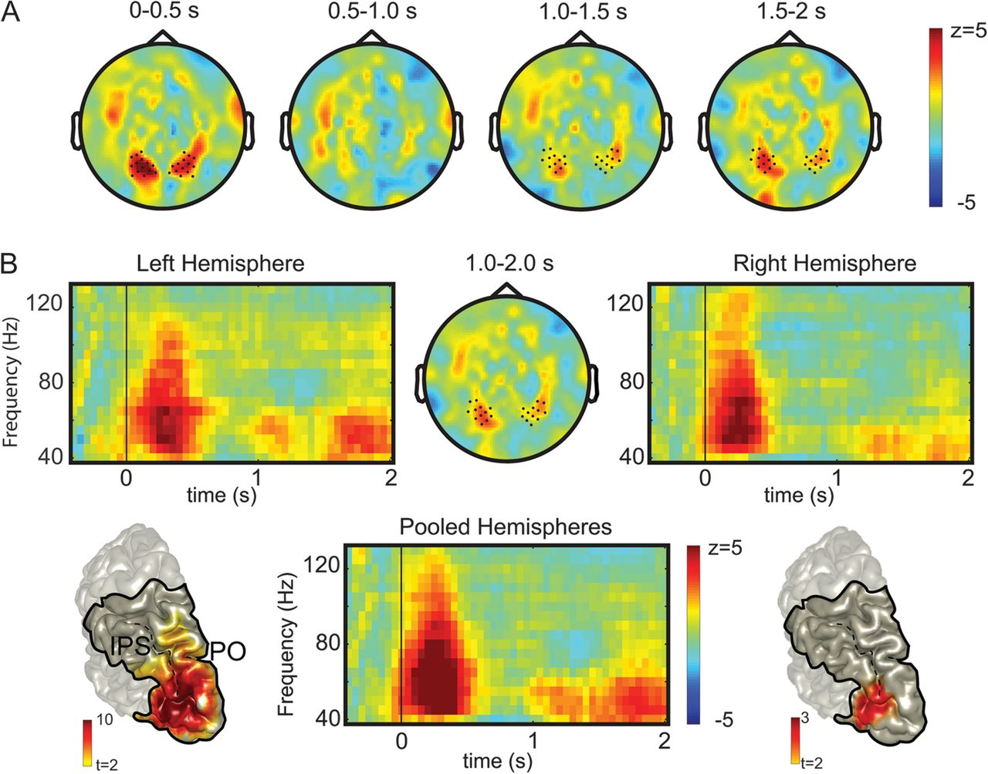
Figure 2. A 40–60 Hz gamma band encodes the working memory for the location of the flashed target during the first ...
Notes:
Figure 2. A 40–60 Hz gamma band encodes the working memory for the location of the flashed target during the first delay. (A) Topographical representation of the direction-selective 40–60 Hz gamma band over time, in consecutive 0.5 s time windows. Warmer (red) color coding represents a bias toward contralateral presented stimuli; cooler (blue) color coding represent a bias toward ipsilateral presented stimuli. Marked sensors show a significant effect (P < 0.05, see Materials and Methods). (B) Direction-selective time–frequency resolved power changes during the first delay, for the sensors marked in the top-middle panel. The top-middle panel shows the topographical representation of the 40–60 Hz gamma band pooled across subjects during the 1.0- to 2.0-s period after stimulus presentation. Top-left and -right panels show the TFRs of the selected sensors covering the left and right hemisphere, respectively. The bottom-middle panel shows the TFR in the gamma band (40–130 Hz) range pooled across hemispheres. Time t = 0 and vertical line, stimulus presentation; at t = 2.0 s the fixation cross jumps to a new position. The bottom-left and -right panels show ROI-restricted source reconstructions of the 40–80 Hz and 40–60 Hz gamma band during the first 0.5 s, and the 1.0- to 2.0-s period after stimulus presentation, respectively. Color format as in A. Only significant voxels are shown (P < 0.05, see Materials and Methods). CS, central sulcus; PO, Parietooccipital sulcus; IPS, intraparietal sulcus. The solid line demarcates the visible part of the ROI.
Unless provided in the caption above, the following copyright applies to the content of this slide: © The Author 2012. Published by Oxford University Press. All rights reserved. For permissions, please e-mail: journals.permissions@oup.com

Slide 3
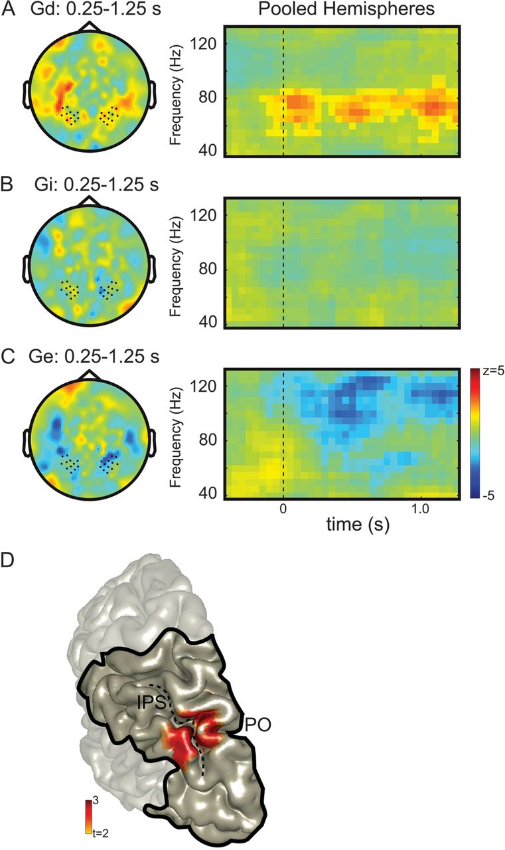
Figure 3. Gaze-centered reorganization of gamma-band activity during spatial updating. Topographical distribution ...
Notes:
Figure 3. Gaze-centered reorganization of gamma-band activity during spatial updating. Topographical distribution (times 0.25–1.25 s, left panels) and time–frequency representations (40–130 Hz, right panels) in relation to gaze-dependent updating (A), gaze-independent coding (B), and gaze-direction (eye position) effects (C). Nonsignificant time–frequency tiles are masked with opacity of 0.5. (A) Gaze-dependent (Gd) updating. Topography plot of the 60–80 Hz gamma band. Significant gamma band sustained from refixation onward (P < 0.05). Warmer (red) color coding, a preference for contralateral target directions relative to gaze. T = 0 marks the end of the intervening eye movement. (B) No evidence for a gaze-independent representation in gamma-band oscillatory activity. Topography plot as in A. (C) Gaze-direction effects. Topography plot of 100–130 Hz band. Significant gamma-band activity from refixation onward. Cooler (blue) color coding, relative decrease of power for contralateral gaze direction. (D) ROI-restricted source reconstruction of the gaze-dependent (Gd) gamma band (60–80 Hz). Only significant voxels are shown (P < 0.05). The solid line demarcates the visible part of the ROI.
Unless provided in the caption above, the following copyright applies to the content of this slide: © The Author 2012. Published by Oxford University Press. All rights reserved. For permissions, please e-mail: journals.permissions@oup.com

Slide 4
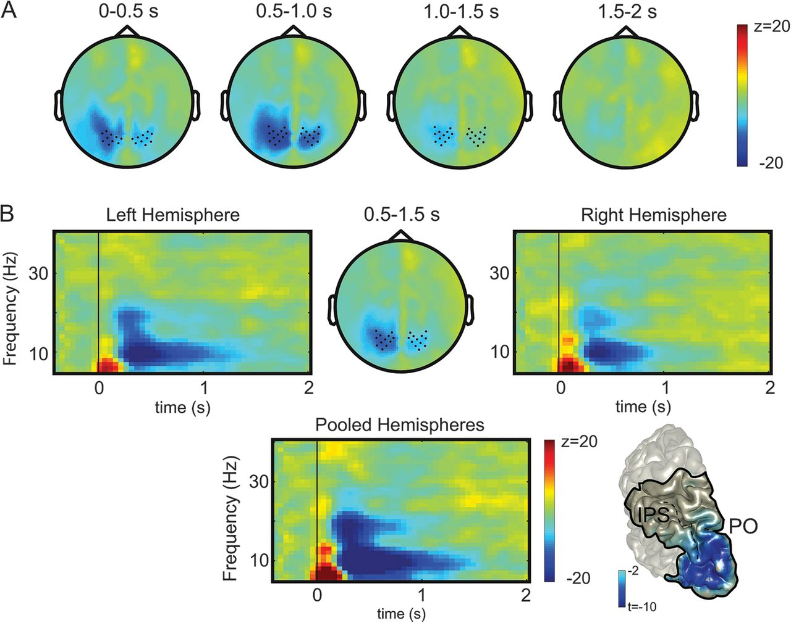
Figure 4. Alpha-band modulations during the first delay interval. Format as in Figure 2; blue color coding indicating ...
Notes:
Figure 4. Alpha-band modulations during the first delay interval. Format as in Figure 2; blue color coding indicating lower power for contralateral than ipsilateral targets. (A) Temporal evolution of the alpha-band topography (8–12 Hz). Significant sensors are marked (P < 0.05). (B) Time–frequency resolved power modulations for the sensors marked in the top-middle panel (8–12 Hz, 0.5–1.5 s). Right bottom panel shows the ROI-restricted source reconstruction of the alpha band during the 0.5- to 1.5-s time period. Only significant voxels are shown (P < 0.05). The solid line demarcates the visible part of the ROI.
Unless provided in the caption above, the following copyright applies to the content of this slide: © The Author 2012. Published by Oxford University Press. All rights reserved. For permissions, please e-mail: journals.permissions@oup.com

Slide 5
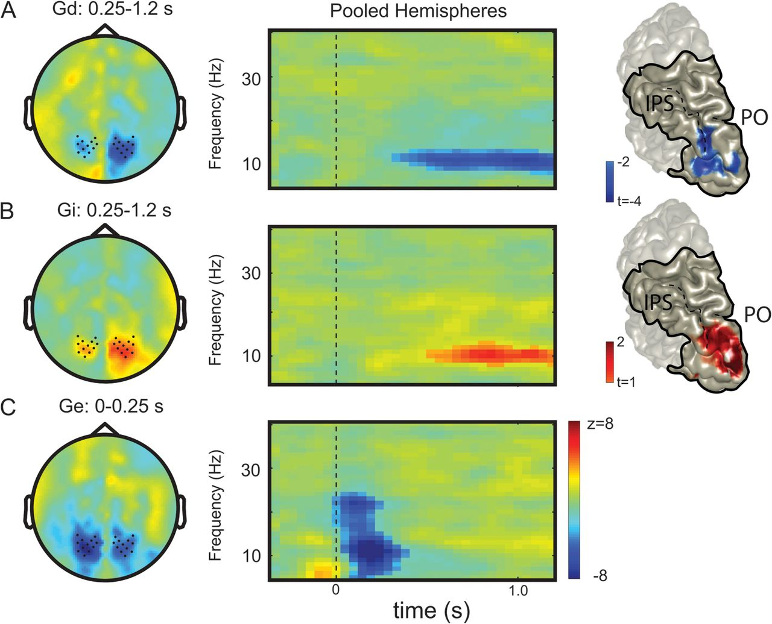
Figure 5. The alpha band (8–12 Hz) facilitates the gaze-dependent representation while inhibiting the gaze-independent ...
Notes:
Figure 5. The alpha band (8–12 Hz) facilitates the gaze-dependent representation while inhibiting the gaze-independent target representation. Format as in Figure 3. Nonsignificant time–frequency tiles are masked with opacity of 0.5. (A) Reorganization of alpha-band desynchronization during spatial updating in a gaze-dependent reference frame. Cooler (blue) color coding represents a decrease of alpha-band power for targets contralateral relative to gaze. (B) Alpha-band synchronization in a gaze-independent reference frame. Warmer (red) color coding represents an increase of power for contralateral presented stimuli, independent of the current gaze position. (C) Gaze position does not modulate alpha-band power. Cooler (blue) color coding, a relative alpha decrease for contralateral gaze direction.
Unless provided in the caption above, the following copyright applies to the content of this slide: © The Author 2012. Published by Oxford University Press. All rights reserved. For permissions, please e-mail: journals.permissions@oup.com

Slide 6
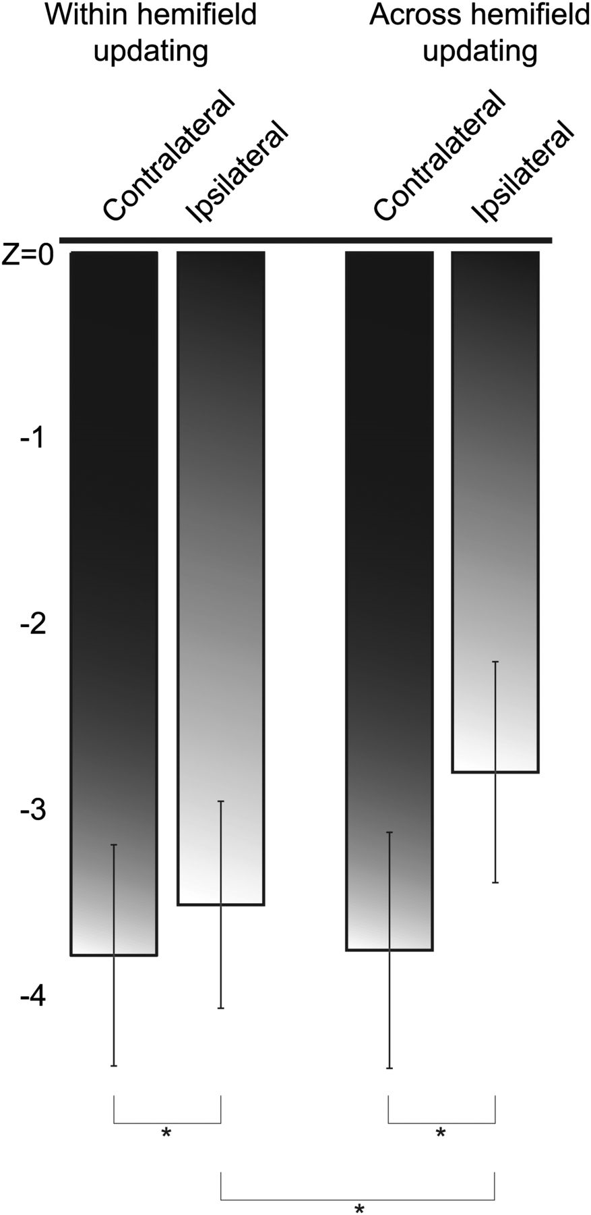
Figure 6. After spatial updating, the alpha band reflects inhibition of the gaze-independent stimulus position. The bar ...
Notes:
Figure 6. After spatial updating, the alpha band reflects inhibition of the gaze-independent stimulus position. The bar plots (with standard error of the mean across subjects) represent the alpha power relative to baseline, for contralateral and ipsilateral sensors relative to the upcoming saccade direction, in relation to within and across hemifield updating. Asterisks indicate significant differences (P < 0.05; paired t-test).
Unless provided in the caption above, the following copyright applies to the content of this slide: © The Author 2012. Published by Oxford University Press. All rights reserved. For permissions, please e-mail: journals.permissions@oup.com

