Slide 1
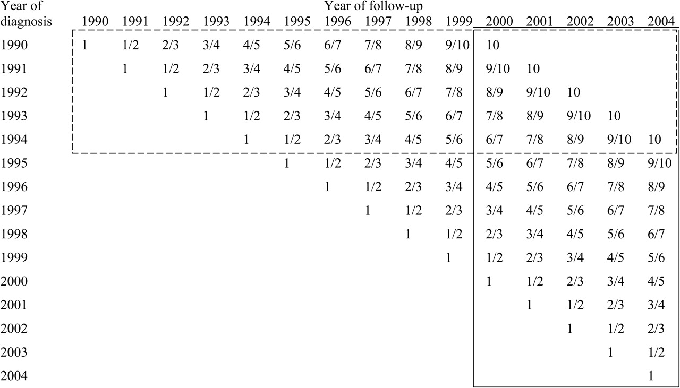
Figure 1 Comparison of the principle of period analysis vs traditional cohort analysis. The solid frame shows the ...
Notes:
Figure 1 Comparison of the principle of period analysis vs traditional cohort analysis. The solid frame shows the data used to estimate 10-year survival for the 2000–2004 period using period analysis. The dashed frame shows the data used to derive the most up-to-date estimate of 10-year survival from the same database (pertaining to the 1990–1994 cohort) using traditional cohort analysis. The numbers within the cells indicate the number of years of follow-up since diagnosis. For example, for patients diagnosed in 1991, the first year of follow-up is spread over the years 1991 and 1992, the second year of follow-up is spread over the years 1992 and 1993, and so on.
Unless provided in the caption above, the following copyright applies to the content of this slide: © The Author 2008. Published by Oxford University Press.

Slide 2
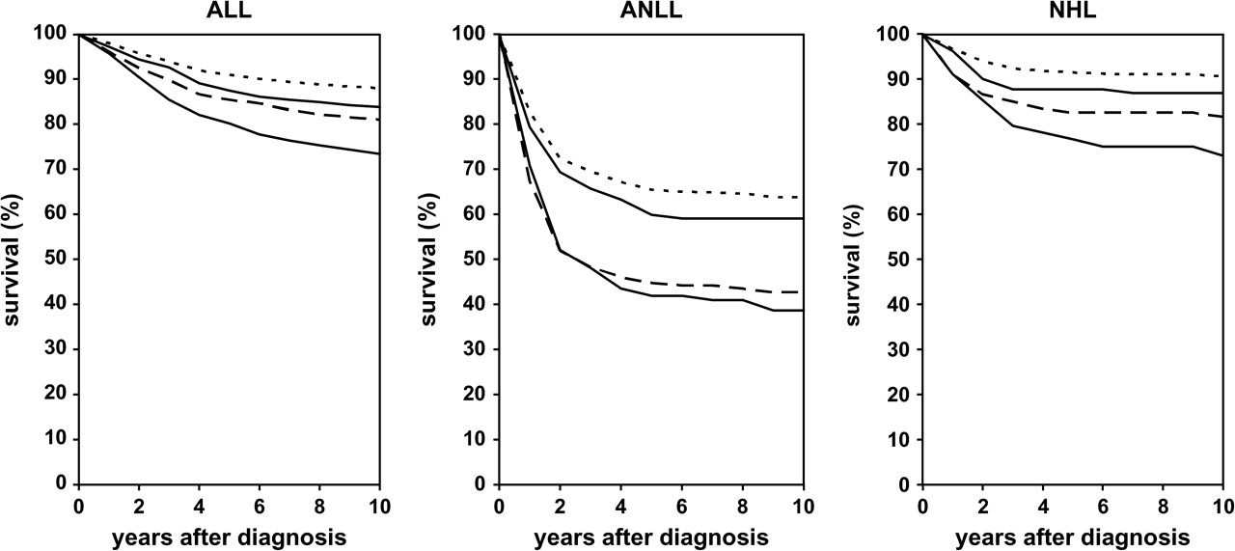
Figure 2 Ten-year survival curves for children with common hematologic malignancies. Period estimates for calendar ...
Notes:
Figure 2 Ten-year survival curves for children with common hematologic malignancies. Period estimates for calendar periods 1990–1994 (lower solid curve) , 1995–1999 (long-dashed curve) , and 2000–2004 (upper solid curve) and projected survival for calendar period 2005–2009 (short-dashed curve) . The 95% confidence intervals are given in Tables 2 and 3 . ALL = acute lymphoblastic leukemia; ANLL = acute non-lymphoblastic leukemia; NHL = non-Hodgkin lymphoma.
Unless provided in the caption above, the following copyright applies to the content of this slide: © The Author 2008. Published by Oxford University Press.

Slide 3
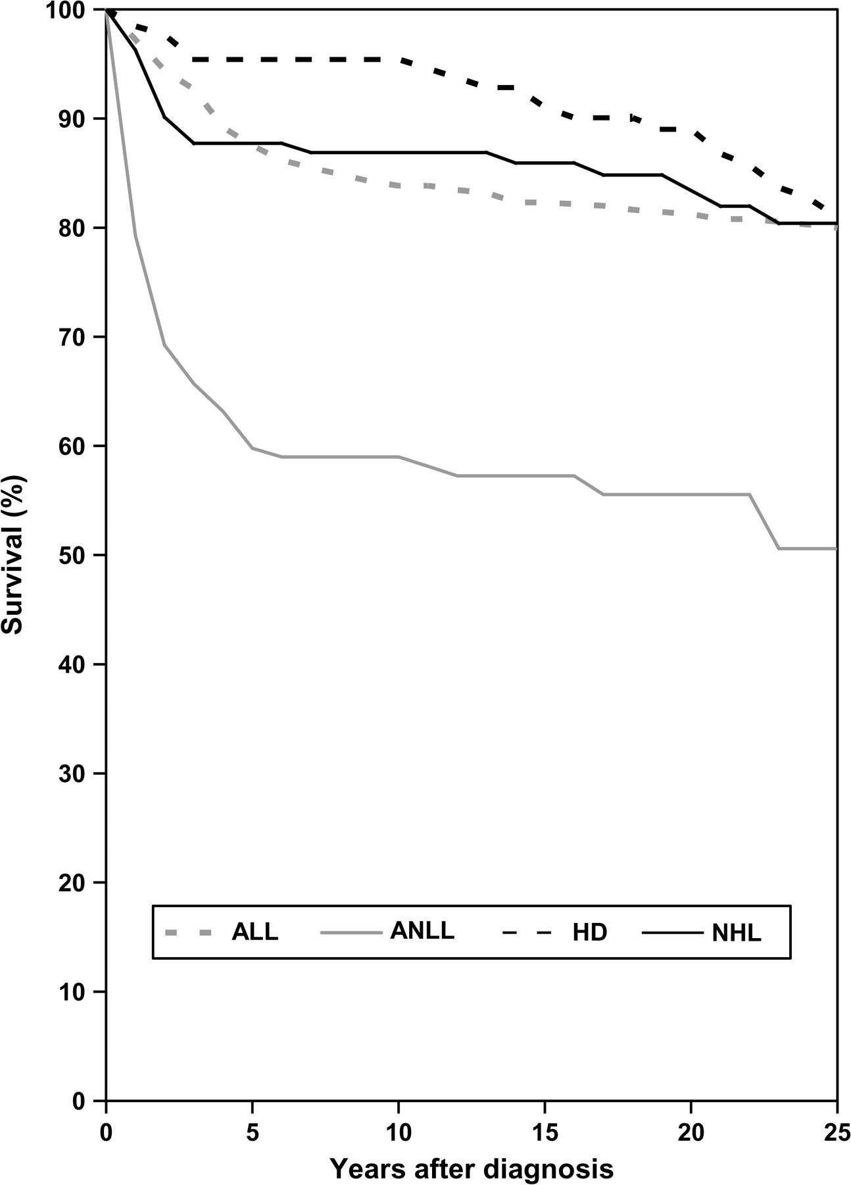
Figure 3 Twenty-five–year survival curves for children with common hematologic malignancies. Period estimates for the ...
Notes:
Figure 3 Twenty-five–year survival curves for children with common hematologic malignancies. Period estimates for the 2000–2004 calendar period. Point estimates for 25-year survival (95% confidence intervals): ALL, 80.0% (77.1% to 82.7%); ANLL, 50.6% (40.9% to 60.3%); HD, 80.9% (73.0% to 87.8%); NHL, 80.4% (72.7% to 87.1%). ALL = acute lymphoblastic leukemia; ANLL = acute non-lymphoblastic leukemia; HL = Hodgkin lymphoma; NHL = non-Hodgkin lymphoma.
Unless provided in the caption above, the following copyright applies to the content of this slide: © The Author 2008. Published by Oxford University Press.

