Slide 1
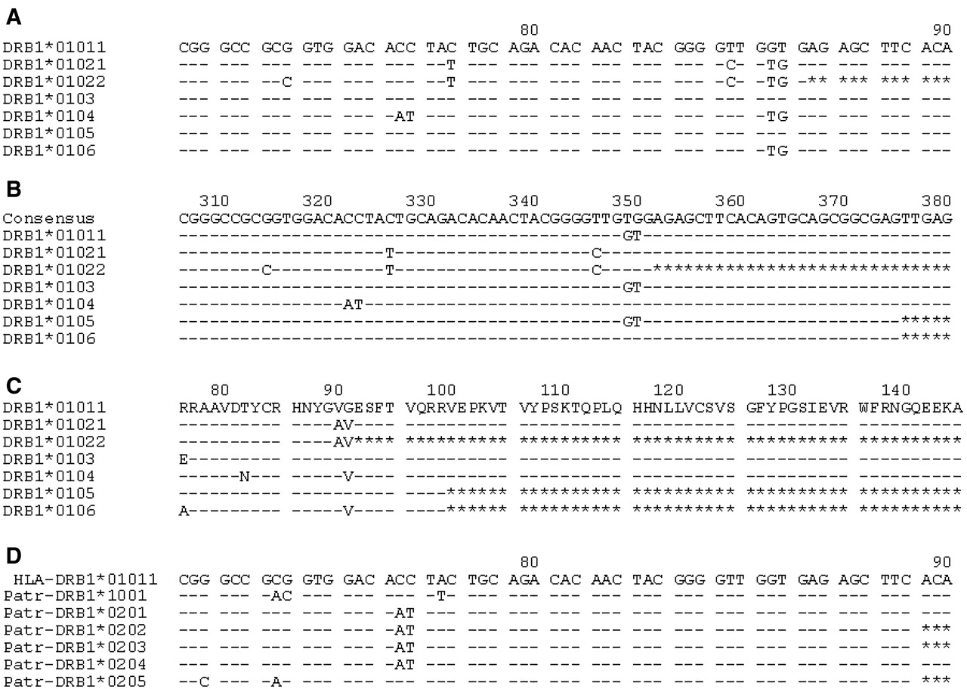
Figure 1. Alignment formats available from the IMGT/HLA and IMGT/MHC Database. The examples shown are based ...
Notes:
Figure 1. Alignment formats available from the IMGT/HLA and IMGT/MHC Database. The examples shown are based on alignment (A) which shows seven DRB1*01 alleles. In these alignments a dash (−) indicates identity to the reference sequence and an asterisk (*) denotes an unsequenced base. Alignment (B) shows how an alternative reference sequence can be used, here for example we have used a DRB1 consensus sequence. Alignment (C) represents a translation of the nucleotide sequence to produce a protein sequence alignment. Alignment (D) shows the same HLA-DBR1*010 reference sequence been used for the alignment of Chimpanzee ( Pan troglodytes ) DRB1 alleles.
Unless provided in the caption above, the following copyright applies to the content of this slide:

