Slide 1
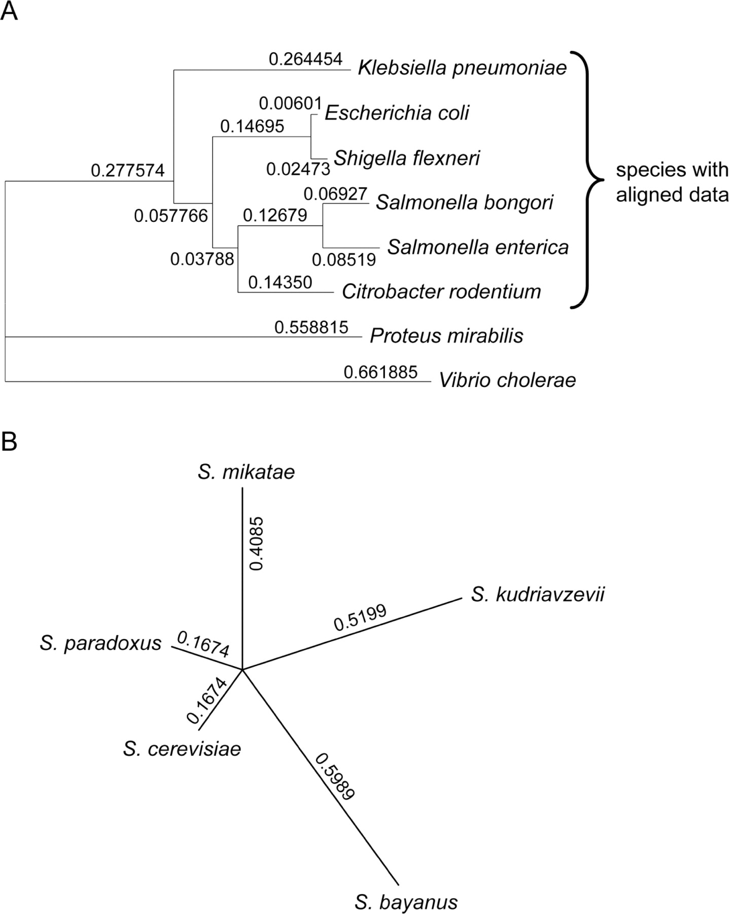
Fig. 1. Phylogenetic trees for (A) the eight bacterial species, where the distances shown are the branch lengths ...
Notes:
Fig. 1. Phylogenetic trees for (A) the eight bacterial species, where the distances shown are the branch lengths generated by DNAML (Felsenstein, 2002) and the values for Proteus mirabilis and Vibrio cholerae were ‘stretched’ as described in Supplementary Material and (B) the five Saccharomyces species, where the distances shown are calculated from proximities, as described in Supplementary Material.
Unless provided in the caption above, the following copyright applies to the content of this slide: © 2007 The Author(s)This is an Open Access article distributed under the terms of the Creative Commons Attribution Non-Commercial License (http://creativecommons.org/licenses/by-nc/2.0/rcial use, distribution, and reproduction in any medium, provided the original work is properly cited.

Slide 2
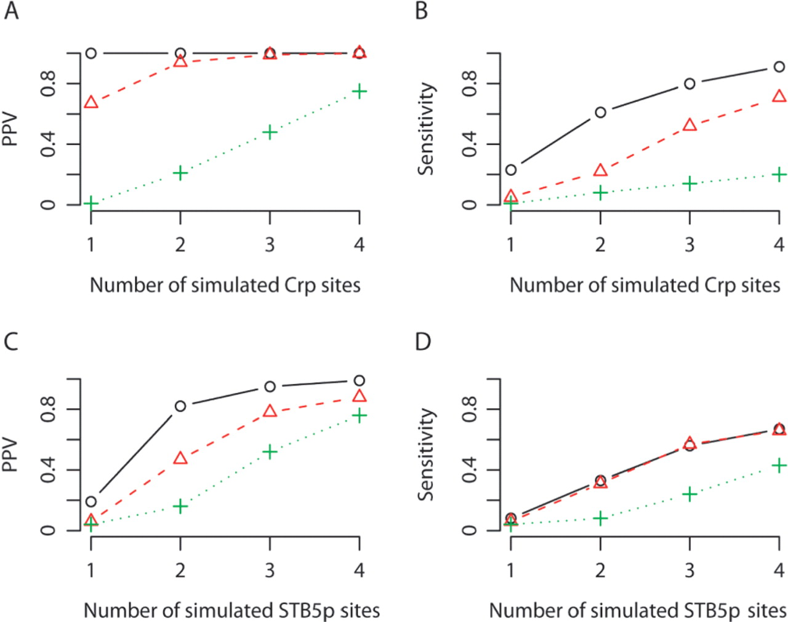
Fig. 2. (A) PPV and (B) sensitivity as a function of the number of planted simulated Crp sites in each simulated ...
Notes:
Fig. 2. (A) PPV and (B) sensitivity as a function of the number of planted simulated Crp sites in each simulated γ-proteobacterial sequence; (C) PPV and (D) sensitivity as a function of the number of planted simulated STB5p sites in each simulated yeast sequence. Open circle, results for the Centroid+Phylogeny; open triangle, results for MAP+Phylogeny; plus symbol, results for PhyloGibbs.
Unless provided in the caption above, the following copyright applies to the content of this slide: © 2007 The Author(s)This is an Open Access article distributed under the terms of the Creative Commons Attribution Non-Commercial License (http://creativecommons.org/licenses/by-nc/2.0/rcial use, distribution, and reproduction in any medium, provided the original work is properly cited.

