Slide 1
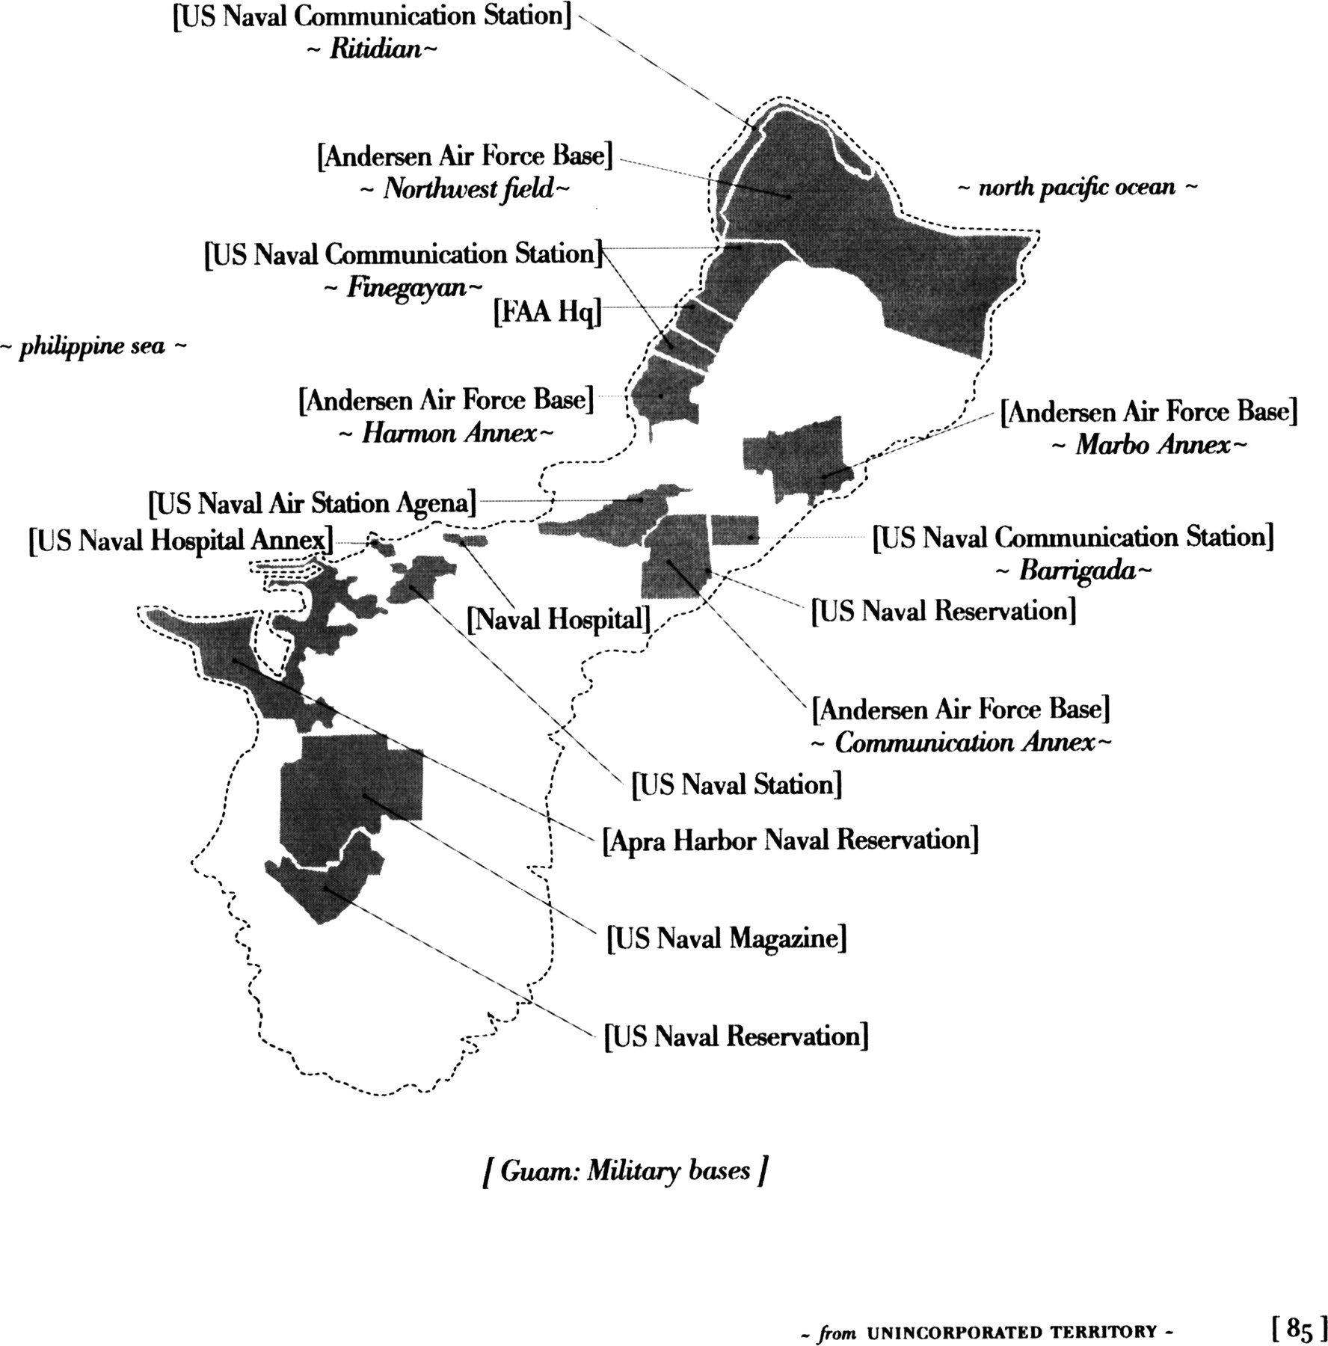
Fig. 1. Sumet (Ben) Viwatmanitsakul [Guam: Military bases] ([hacha] 85). Used with permission from the author.
Notes:
Fig. 1. Sumet (Ben) Viwatmanitsakul [Guam: Military bases] ([hacha] 85). Used with permission from the author.
Unless provided in the caption above, the following copyright applies to the content of this slide: © The Author 2012. Published by Oxford University Press. All rights reserved. For permissions, please e-mail: journals.permissions@oup.com

Slide 2
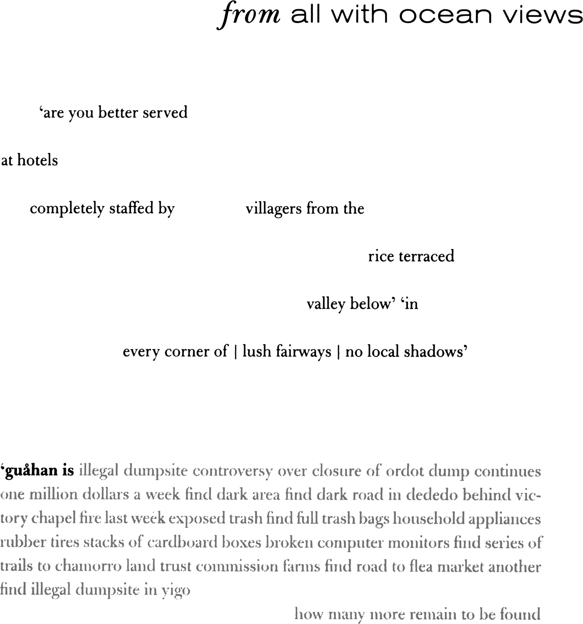
Fig. 2. from unincorporated territory [hacha] (19). Used with permission from the author.
Notes:
Fig. 2. from unincorporated territory [hacha] (19). Used with permission from the author.
Unless provided in the caption above, the following copyright applies to the content of this slide: © The Author 2012. Published by Oxford University Press. All rights reserved. For permissions, please e-mail: journals.permissions@oup.com

