Slide 1
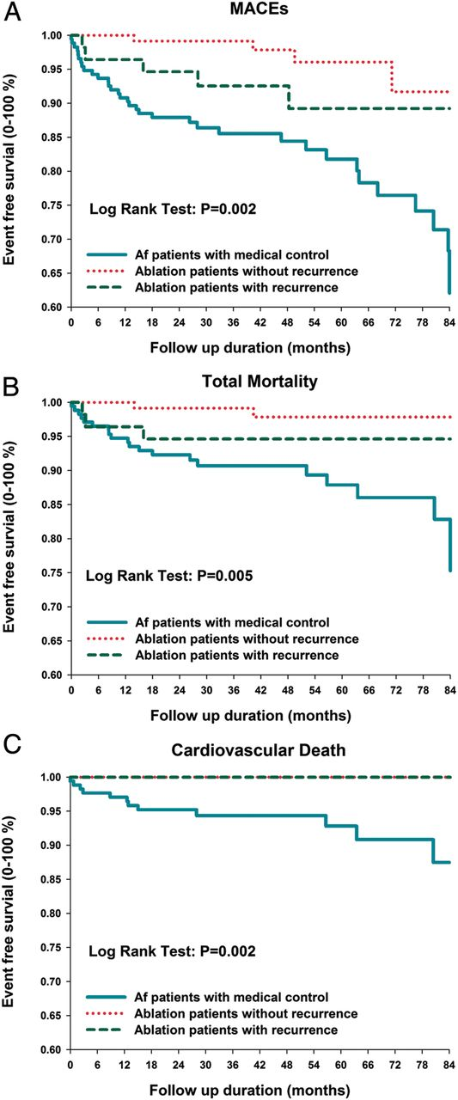
Figure 1 Event-free survival from major adverse cardiovascular events (A), total mortality (B), and cardiovascular ...
Notes:
Figure 1 Event-free survival from major adverse cardiovascular events (A), total mortality (B), and cardiovascular death (C).
Unless provided in the caption above, the following copyright applies to the content of this slide: Published on behalf of the European Society of Cardiology. All rights reserved. © The Author 2012. For permissions please email: journals.permissions@oup.com.

Slide 2
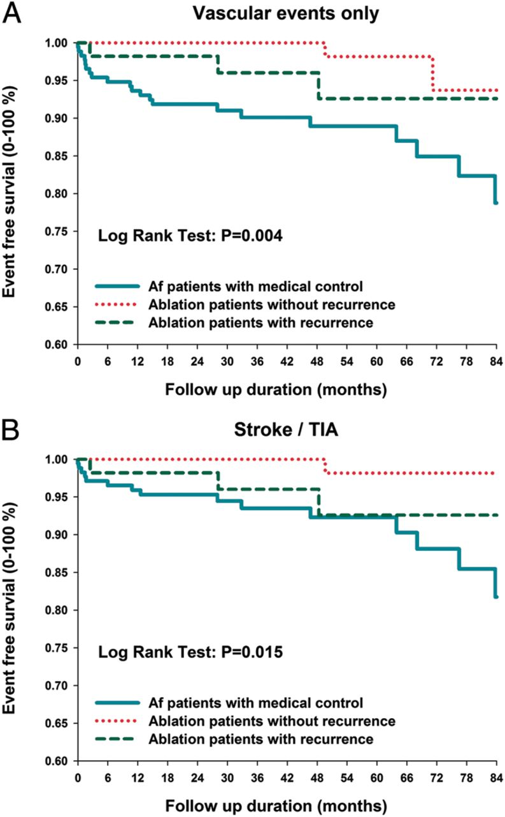
Figure 2 Event-free survival from vascular events (A) and stroke/transient ischemic attack (B).
Notes:
Figure 2 Event-free survival from vascular events (A) and stroke/transient ischemic attack (B).
Unless provided in the caption above, the following copyright applies to the content of this slide: Published on behalf of the European Society of Cardiology. All rights reserved. © The Author 2012. For permissions please email: journals.permissions@oup.com.

Slide 3
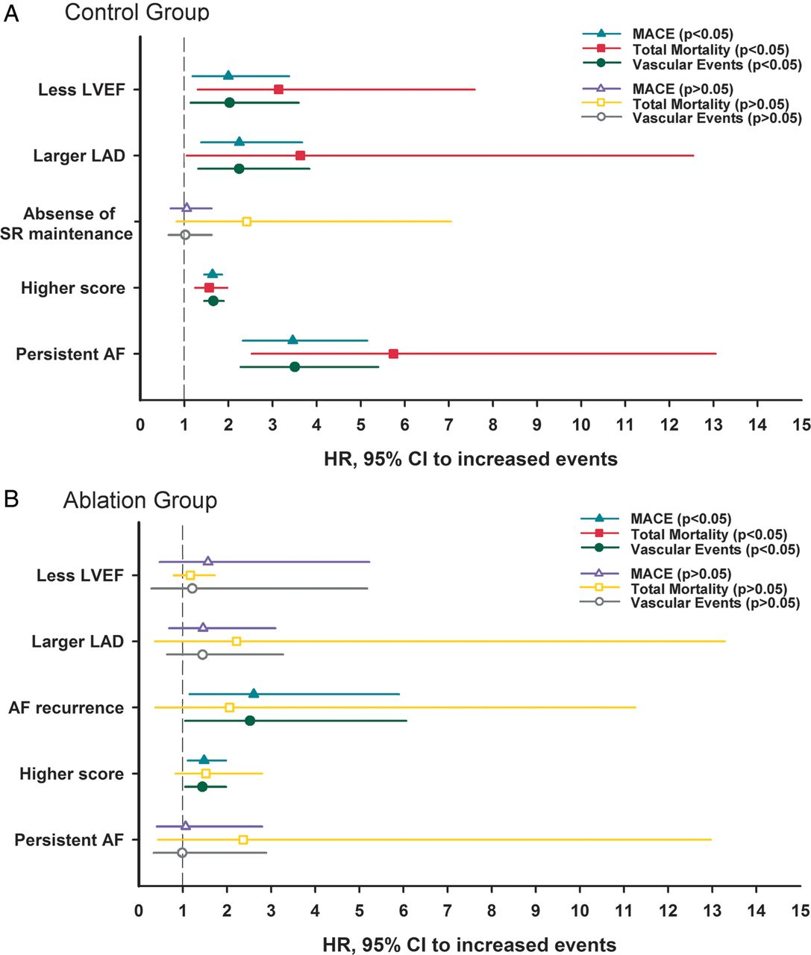
Figure 3 Total mortality and total vascular events in patients with medical treatment (A) and catheter ablation (B) ...
Notes:
Figure 3 Total mortality and total vascular events in patients with medical treatment (A) and catheter ablation (B) according to the multivariate Cox regression analysis, using the following categorical variables: the left ventricular ejection fraction (>45% or ≤45%), left atrial diameter (>40 or ≤40 mm), sinus maintenance, atrial fibrillation types (persistent atrial fibrillation or paroxysmal atrial fibrillation), and ordinal variable of the CHA2DS2-VASc score (score 1–9).
Unless provided in the caption above, the following copyright applies to the content of this slide: Published on behalf of the European Society of Cardiology. All rights reserved. © The Author 2012. For permissions please email: journals.permissions@oup.com.

